Slide 1


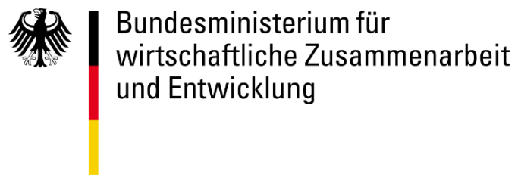

Empowering societies to chart their digital futures
Notes:
ITU

Slide 2
GovStack: Who we are
GovStack Overview
Design Thinking Principles
Leveraging DT to Design Service Blueprints
Architecture
govstack.global/partnership

Slide 3
GovStack: Who we are
GovStack is a multistakeholder, community-driven initiative, focused on accelerating national digital transformation worldwide, and drawing on expertise from contributors across the private sector, civil society, and governments all over the world.
The initiative was founded by the International Telecommunication Union (ITU), Estonia, Germany, and the Digital Impact Alliance at the United Nations Foundation in 2020.
govstack.global/partnership

Slide 4
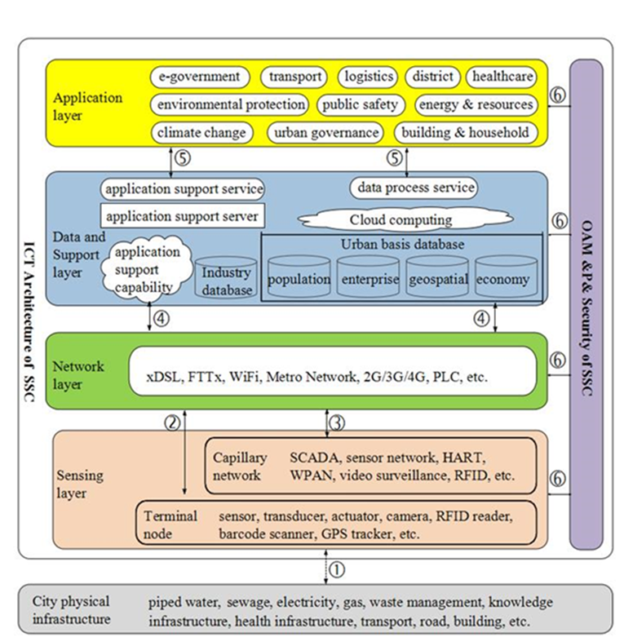
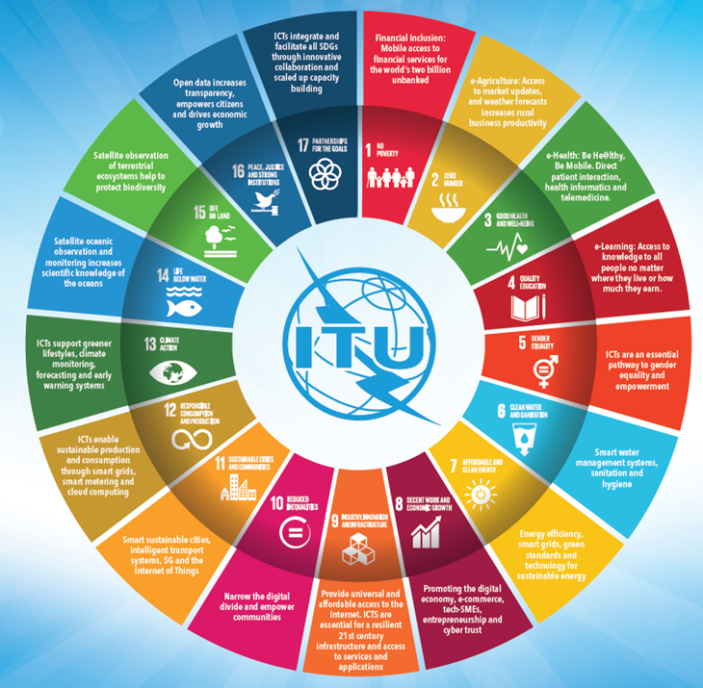
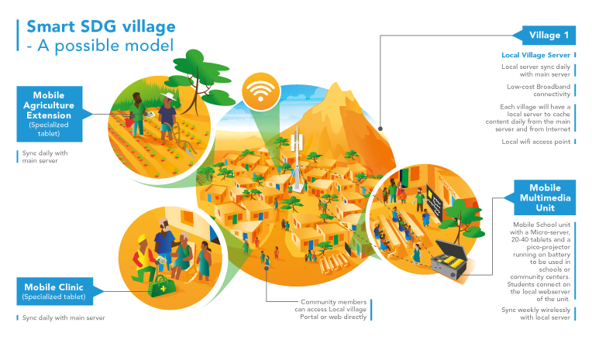
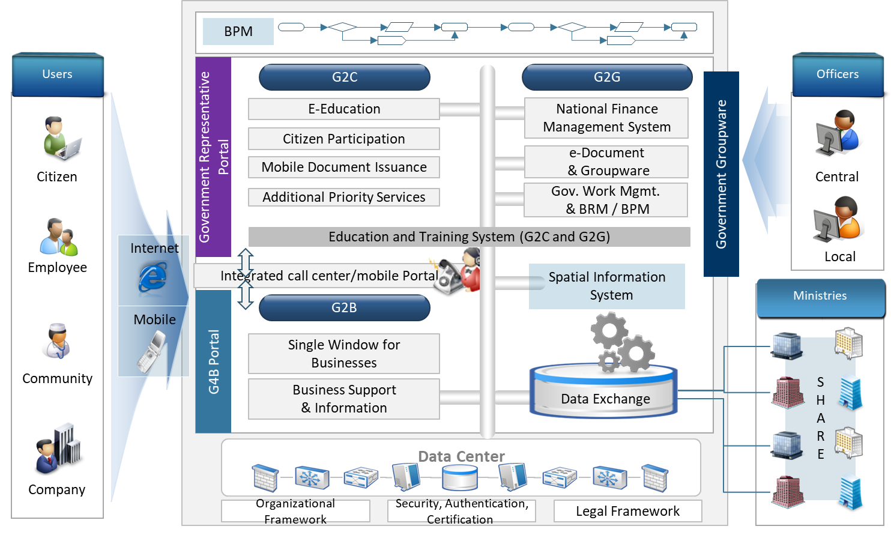
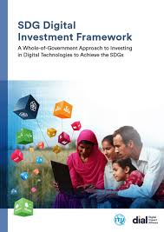
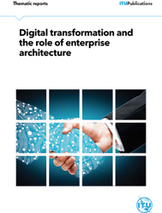

Whole-of-government approach for digital development
Smart city
National Vision and SDG implementation plan
Whole of Government (National) Policy / Strategy / Plan
Digital agriculture policy / strategy / plan
Digital health policy/ strategy / plan
Digital education policy/ strategy / plan
Digital financial inclusion policy/ strategy / plan
E-Commerce Strategy; Other sectoral policy/ strategy / plan
Legislations Regulations
Customized planning
SDG
Smart village
Smart Islands
Enterprise architecture
International level
National level
Local level

Slide 5
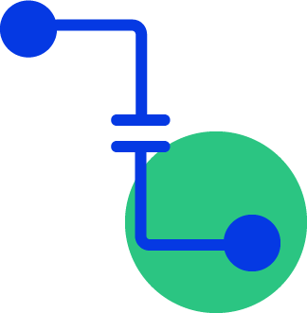
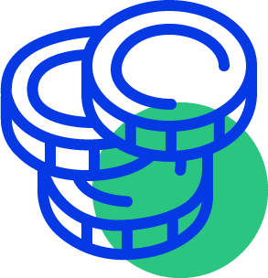

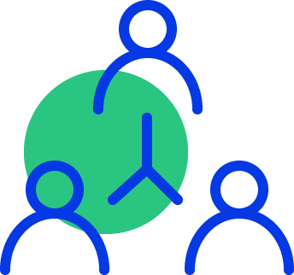
Country governments struggle with the digitization of their public services for several reasons
SILOES
FUNDING FOR PROCUREMENT
SCALING
COORDINATION
Siloed investments and duplicative efforts by development partners promote fragmented digital governance and silos in partner countries.
Challenges in procuring and implementing affordable IT solutions persist, as do challenges in creating the necessary capital to invest in ICT infrastructure projects.
Huge challenges exist in adapting and investing in projects at scale, particularly around the rollout of physical ICT infrastructure, the deployment and use of common data platforms.
Problems in coordination commonly occur in aligning ICT ministry work with that of other agencies.
Notes:
ITU

Slide 6
Analogy: Building applications like houses…
Specifications
Interoperability
….
Exchange
Consent
Demo houses
(Reference implementation)
Registries
Payments
Dig ID
Public Administration
Agriculture
Health
How bricks can be
Assembled to build
Houses (services)
Architecture
E-signature
….
….
….
Building Blocks
(bricks)
Traditional solutions oriented approach | Platform/infrastructure oriented approach
Siloed, frangmented, duplicative solutions | Solutions built on top of a shared infrastructure and by re-using shared services
Be spoke, non-interoperable applications | Solutions built using Standardized, reusable, interoperable Building Blocks
Pain points focused | Consider User journeys
Privacy, data protection are not enforced nor standardized | Privacy and data protection are « encoded » in the Builing Blocks
High risks of vendor lock-in | Standardized components can be replaced, ensure sovereignity
High costs of development and Maintenance | Develop once and use for all, possibly lower cost if open source
Notes:
Hani

Slide 7
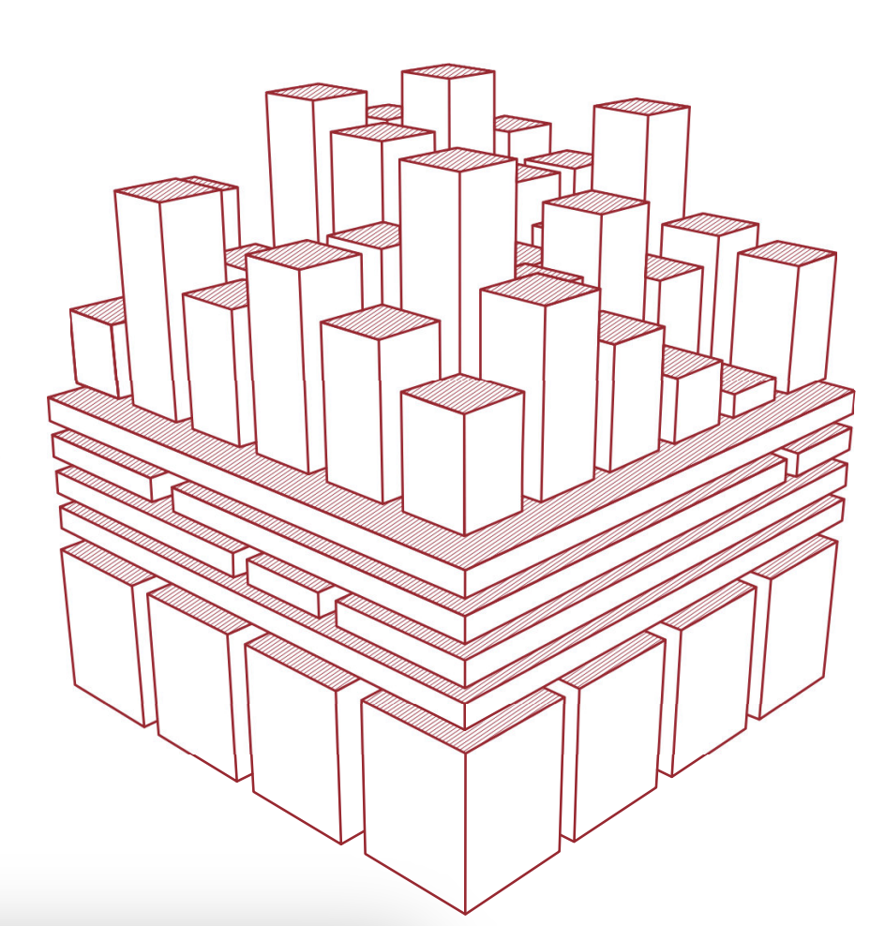
From silo ICT investments to reusable software components to digitize governments services at scale
Infrastructure
Buy property
Silo investments, duplication of functionalities
Digital gov services
Pay taxes
Find a job
Dep
Tax
Education
Health
Authentication
Reusable components/Building blocks
(GovStack)
App
Sign On
Sign On
Sign On
Exchange / IM
Payments
Payments
Payments
Payments
DB
Data
Data
Data
Other shared services
Data registritries
Unique id
Vehicle registry
GIS data
Health record
Data
Source: David Eves, UCL 2023
Notes:
Digital Public Goods
Refers to open-source software, open data, open AI models, open standards, and open content that adhere to privacy and other applicable laws and best practices, do no harm by design, and help attain the Sustainable Development Goals (SDGs).
DPGs may be implemented as a part of a country’s digital public infrastructure.
When they provide a generic service at scale, DPGs may be considered building blocks.
DPGs may also advance the SDGs but not contribute to public service delivery or be customisable across multiple use cases. Therefore, DPGs are not always building blocks and may not be implementable as digital public infrastructure.
Building Blocks
Refers to software code, platforms, and applications that are interoperable, provide a basic digital service at scale, and can be reused for multiple use cases and contexts.
Serves as a component of a larger system or stack.
They can be used to facilitate the delivery of digital public services via functions, which may include registration, scheduling, ID authentication, payment, data administration, and messaging.
Building blocks can be combined and adapted to be included as part of a stack of technologies to form a country’s DPI.
Building blocks may be open source or proprietary and therefore are not always DPGs.
“Building blocks can be as simple as a common set of rules or protocols (for example email programs like Simple Mail Transfer Protocol – SMTP), or complex (for example an open-source health information system like the DPG, District Health Information Software – DHIS2)“
Digital Public Infrastructure (DPI)
Refers to solutions and systems that enable the effective provision of essential society-wide functions and services in the public and private sectors.
This includes but is not limited to digital forms of ID and verification, civil registration, payment (digital transactions and money transfers), data exchange, and information systems (including sector-specific, i.e. health or education).
A country’s digital public infrastructure may include implementations of multiple proprietary and/or open-source solutions (including digital public goods).

Slide 8
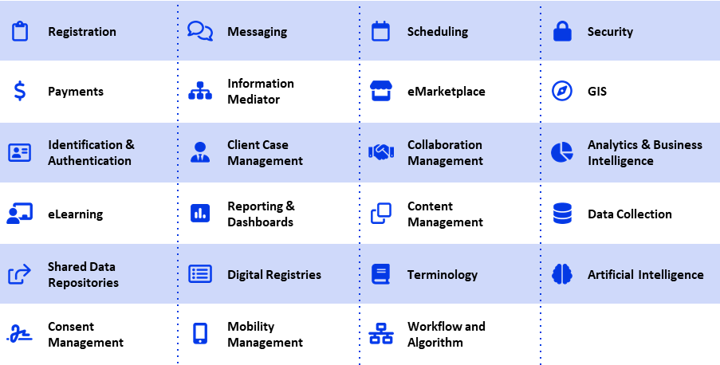
Designing e-government services with generic Building Blocks
What are Building Blocks?
    Generically-defined software components that in combination provide key functionalities to facilitate generic workflows common across multiple sectors.
What are their characteristics?
    Reusable software components​
    Open-source, commercial off-the-shelf (COTS), or freely available with open access to data​
    Facilitate one or more generic op. workflows​
    Applicable to use cases across multiple sectors​
    Interoperable with other Building Blocks
    Secure by design, standards-based and interoperable
Source: SDG Digital Investment FW, 2019
[refer to: Building Blocks section of Govstack.global]
Notes:
•The building block approach involves unbundling the components of the solution to a set of problems and identifying a minimal common core.
•This modular approach fosters innovation, allowing solutions to be built to multiple problems based on the common core.
•A building block approach provides those closer to the problem with the basic tools to create tailored solutions. A focus on supporting a vibrant ecosystem implies the need for interoperability between the different DPIs.
•Interoperability should be supported through open standards, allowing anyone to utilize the functionality provided by the GovStack
•The architecture is designed to be modular, allowing components to be independently developed while still ensuring that they can be seamlessly integrated into the rest of the ecosystem. This enables them to be upgraded independently of the rest of the infrastructure when required.

Slide 9
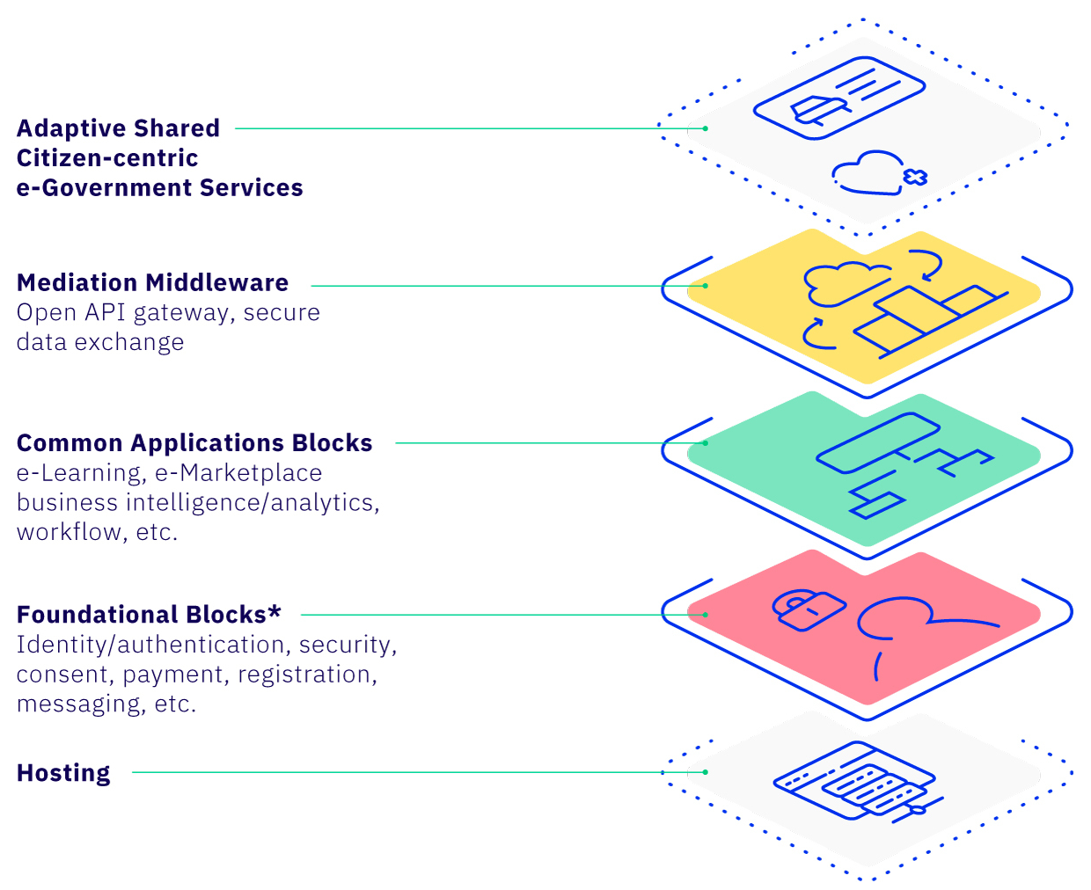

GovStack's Whole-of-Government approach
  There is growing evidence that a whole-of-government approach to digital infrastructure investment can deliver reusable digital services at scale with a greater return on investment.
  The approach takes advantage of economies of scale that are not available when taking a piece-meal approach.
Instead of creating unique and disparate solutions, use a common reusable stack of Building Blocks to form the core platform engine and contextualize various e-government services on top.
A “platform of platforms” that can be used by any government agency, department across different sectors to build new government digital services without having to design, test and operate the underlying systems and infrastructure themselves

Slide 10

Adapt to existing, to means, to objectives and to context
GovStack on the shelves UC
Existing siloed system
DPG/DPI
Private sector system
NGOs
Start-up
Pay
ID
OpenCRVS
Pay
WF
OpenSPP
OpenG2P
Portal
Portal
OpenEDU
OpenAGRI
mGov
WF
WF
Registry
G2PConnect
Portal
Registry
Pay
MSG
Registry
ID
WF
Portal
mGov

Slide 11
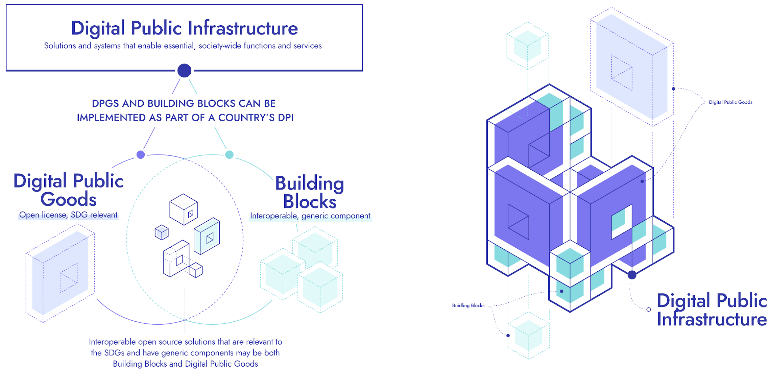
Together, Digital Public Goods and Building Blocks enable Digital Public Infrastructure (DPI)
Source: https://digitalpublicgoods.net/blog/unpacking-concepts-definitions-digital-public-infrastructure-building-blocks-and-their-relation-to-digital-public-goods/
Notes:
Digital Public Goods
Refers to open-source software, open data, open AI models, open standards, and open content that adhere to privacy and other applicable laws and best practices, do no harm by design, and help attain the Sustainable Development Goals (SDGs).
DPGs may be implemented as a part of a country’s digital public infrastructure.
When they provide a generic service at scale, DPGs may be considered building blocks.
DPGs may also advance the SDGs but not contribute to public service delivery or be customisable across multiple use cases. Therefore, DPGs are not always building blocks and may not be implementable as digital public infrastructure.
Building Blocks
Refers to software code, platforms, and applications that are interoperable, provide a basic digital service at scale, and can be reused for multiple use cases and contexts.
Serves as a component of a larger system or stack.
They can be used to facilitate the delivery of digital public services via functions, which may include registration, scheduling, ID authentication, payment, data administration, and messaging.
Building blocks can be combined and adapted to be included as part of a stack of technologies to form a country’s DPI.
Building blocks may be open source or proprietary and therefore are not always DPGs.
“Building blocks can be as simple as a common set of rules or protocols (for example email programs like Simple Mail Transfer Protocol – SMTP), or complex (for example an open-source health information system like the DPG, District Health Information Software – DHIS2)“
Digital Public Infrastructure (DPI)
Refers to solutions and systems that enable the effective provision of essential society-wide functions and services in the public and private sectors.
This includes but is not limited to digital forms of ID and verification, civil registration, payment (digital transactions and money transfers), data exchange, and information systems (including sector-specific, i.e. health or education).
A country’s digital public infrastructure may include implementations of multiple proprietary and/or open-source solutions (including digital public goods).

Slide 12
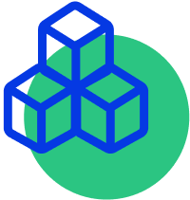



GovStack offerings
GovSpecs
GovTest
GovLearn
GovExchange
A digital testing environment to learn, experiment, and prototype services​
Sandbox for building
blocks and create prototypes for eGovernment
services​
Supporting countries in using building blocks
through the GovStack Implementation Playbook, workshops and Communities of Practices.
A platform to explore and compare products, view use cases, post or find RFPs.
Building Blocks build the basis for scalable, interoperable digital services​
​Functional specifications for
foundational building
blocks
Country Engagement
Countries build their services based on Building Block specifications
Countries may contribute to their development in working groups.
Countries identify and prioritize use cases which can then be demonstrated, tested and explored in sandboxes.
Countries benefit from capacity building (e-learning, implementation playbook, workshops) and exchange knowledge through Communities of Practice.

Slide 13
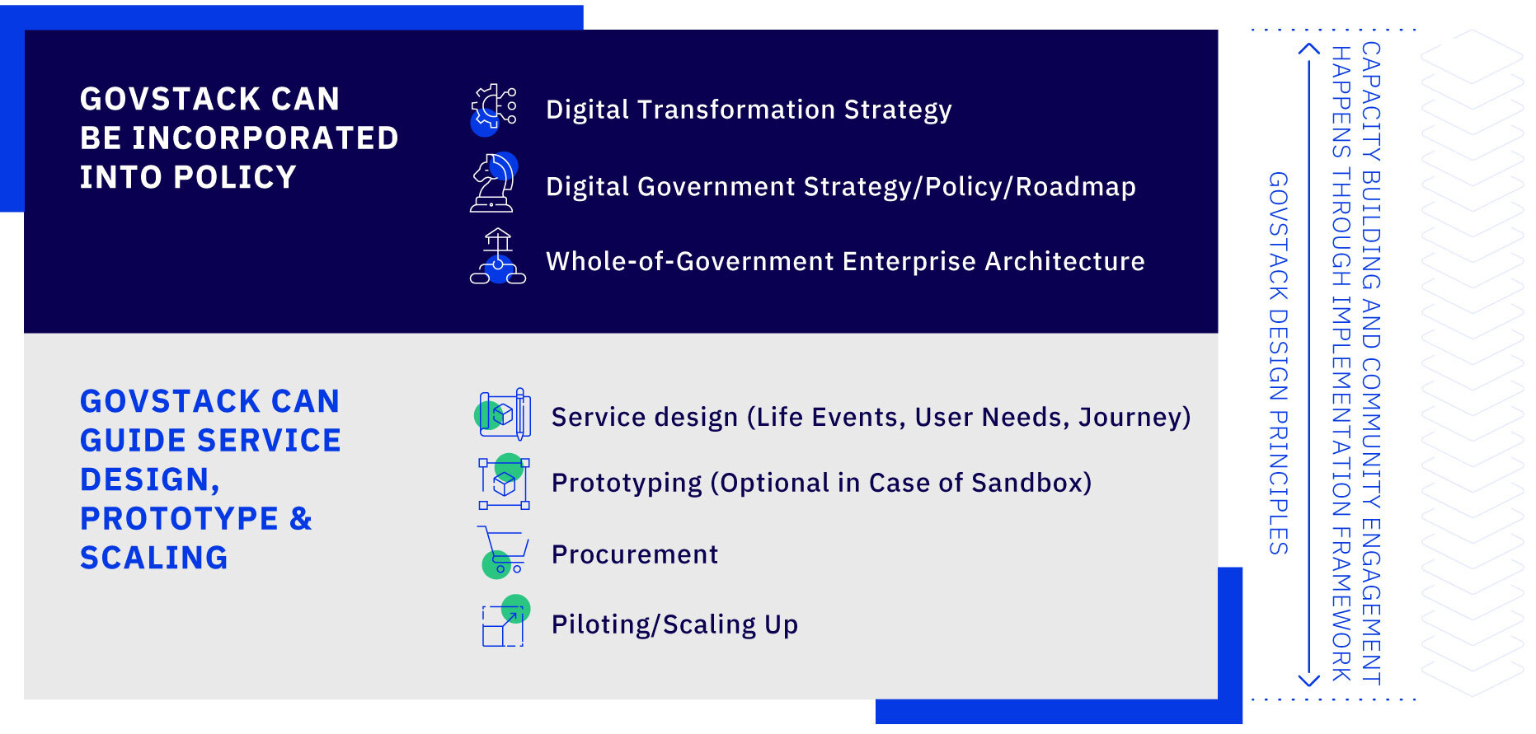
GovStack implementation framework strengthens institutional mandate, service design and delivery using a BB approach

Slide 14
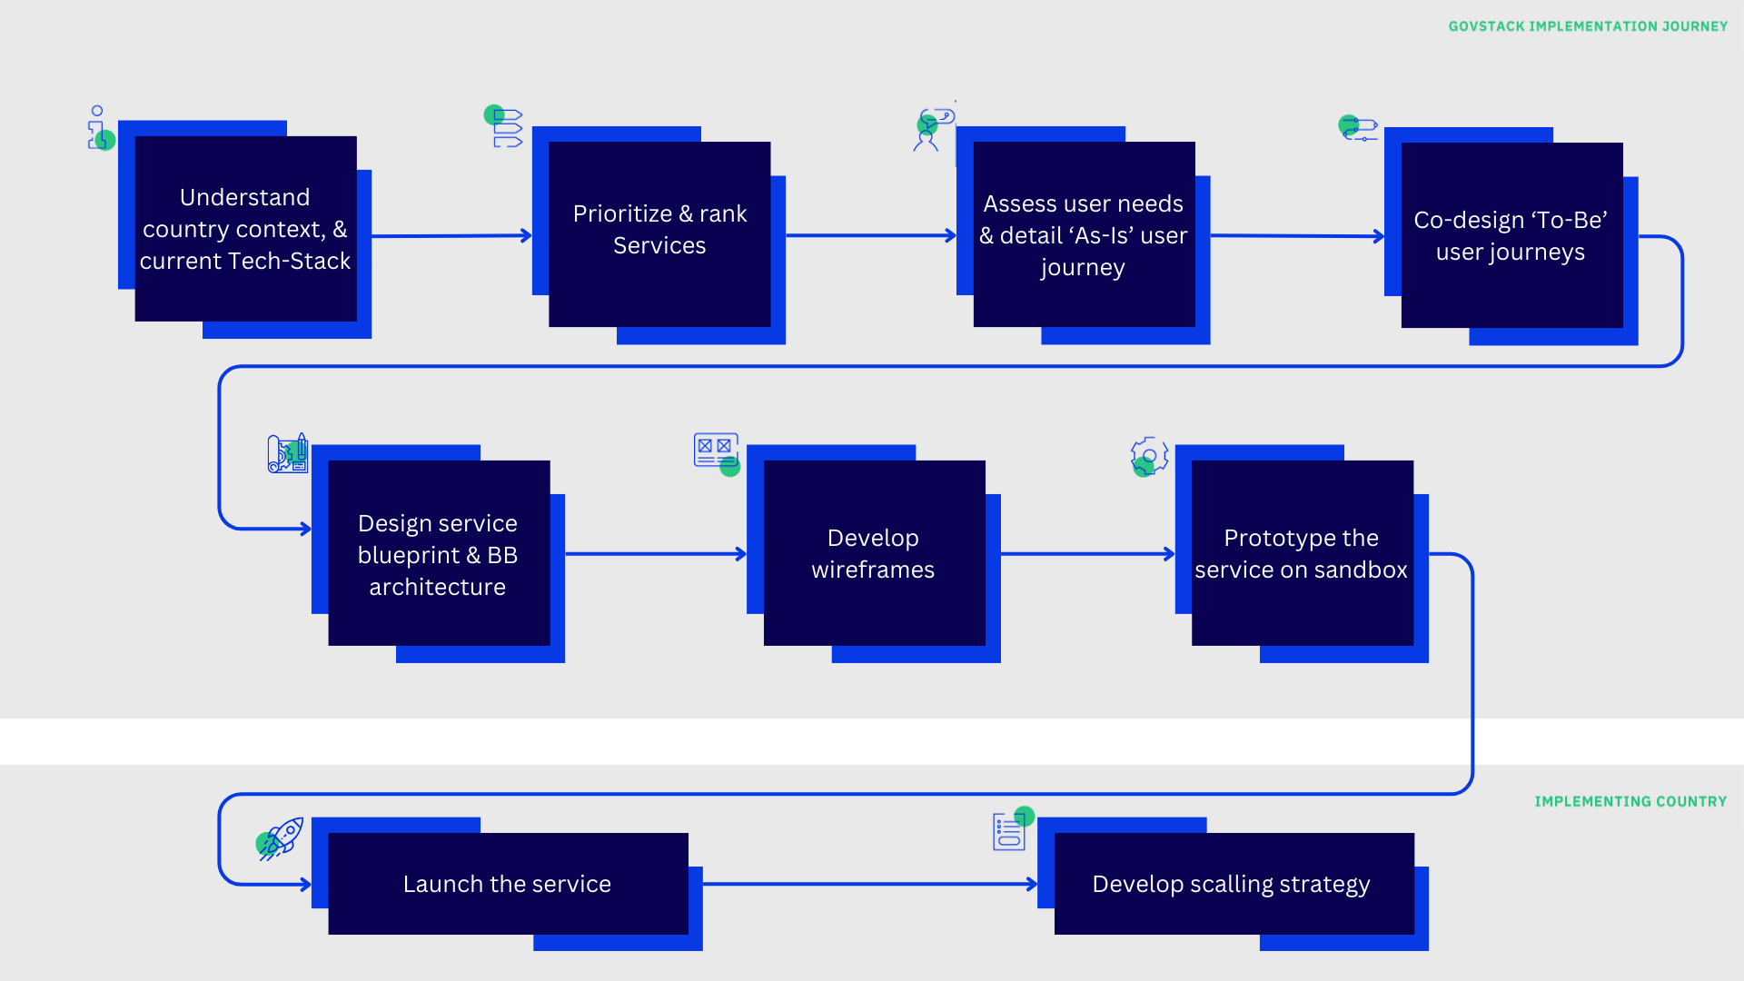
High-level GovStack digital service design and delivery journey

Slide 15
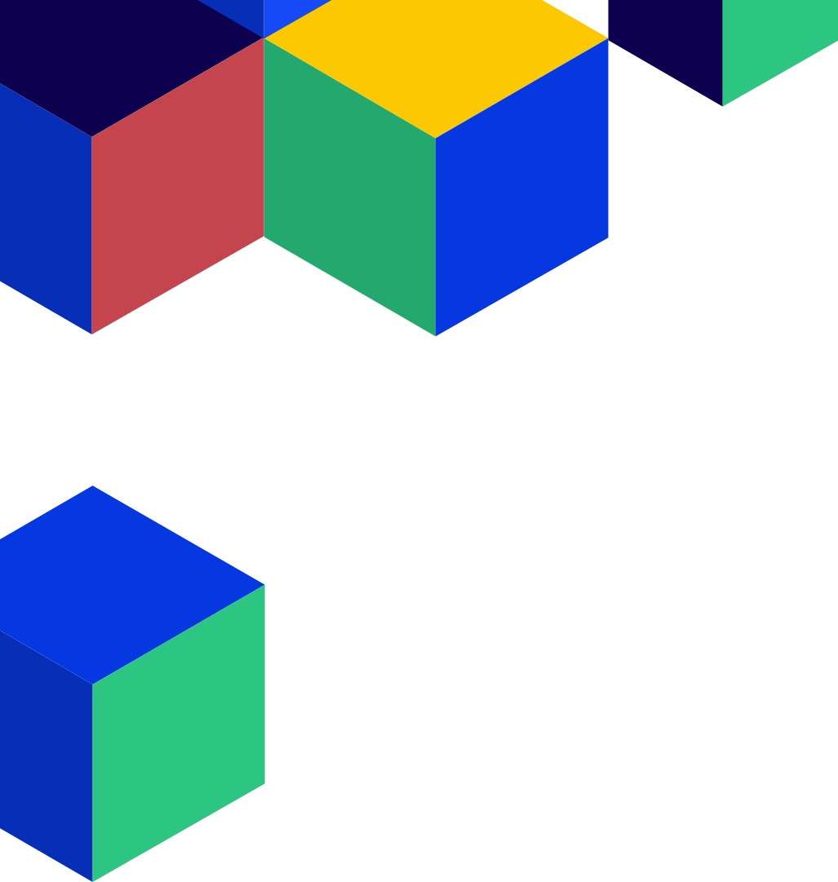
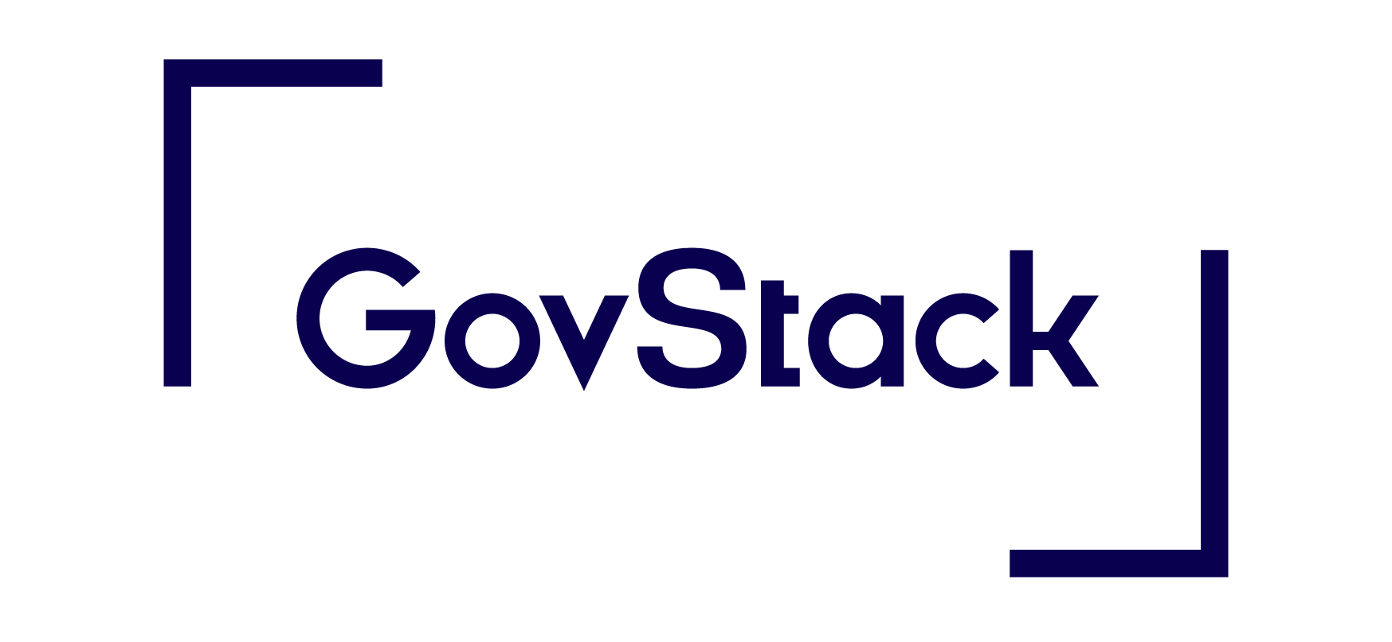
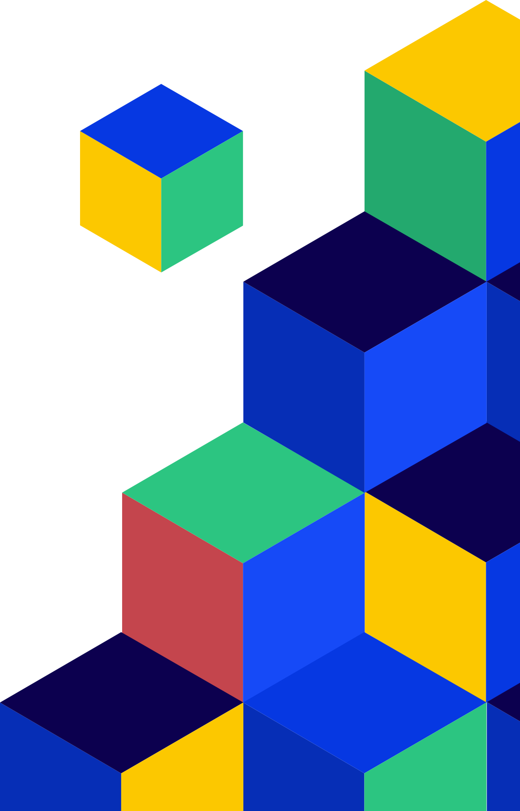

Approach to
Service Blueprint
Workshops
For Country Engagements

Slide 16
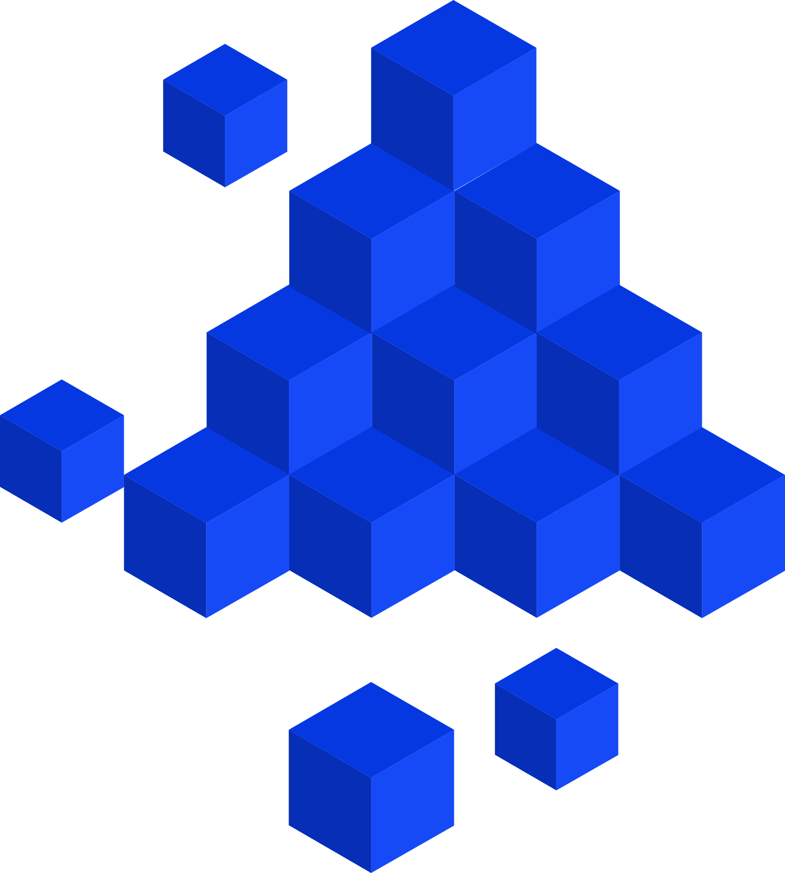
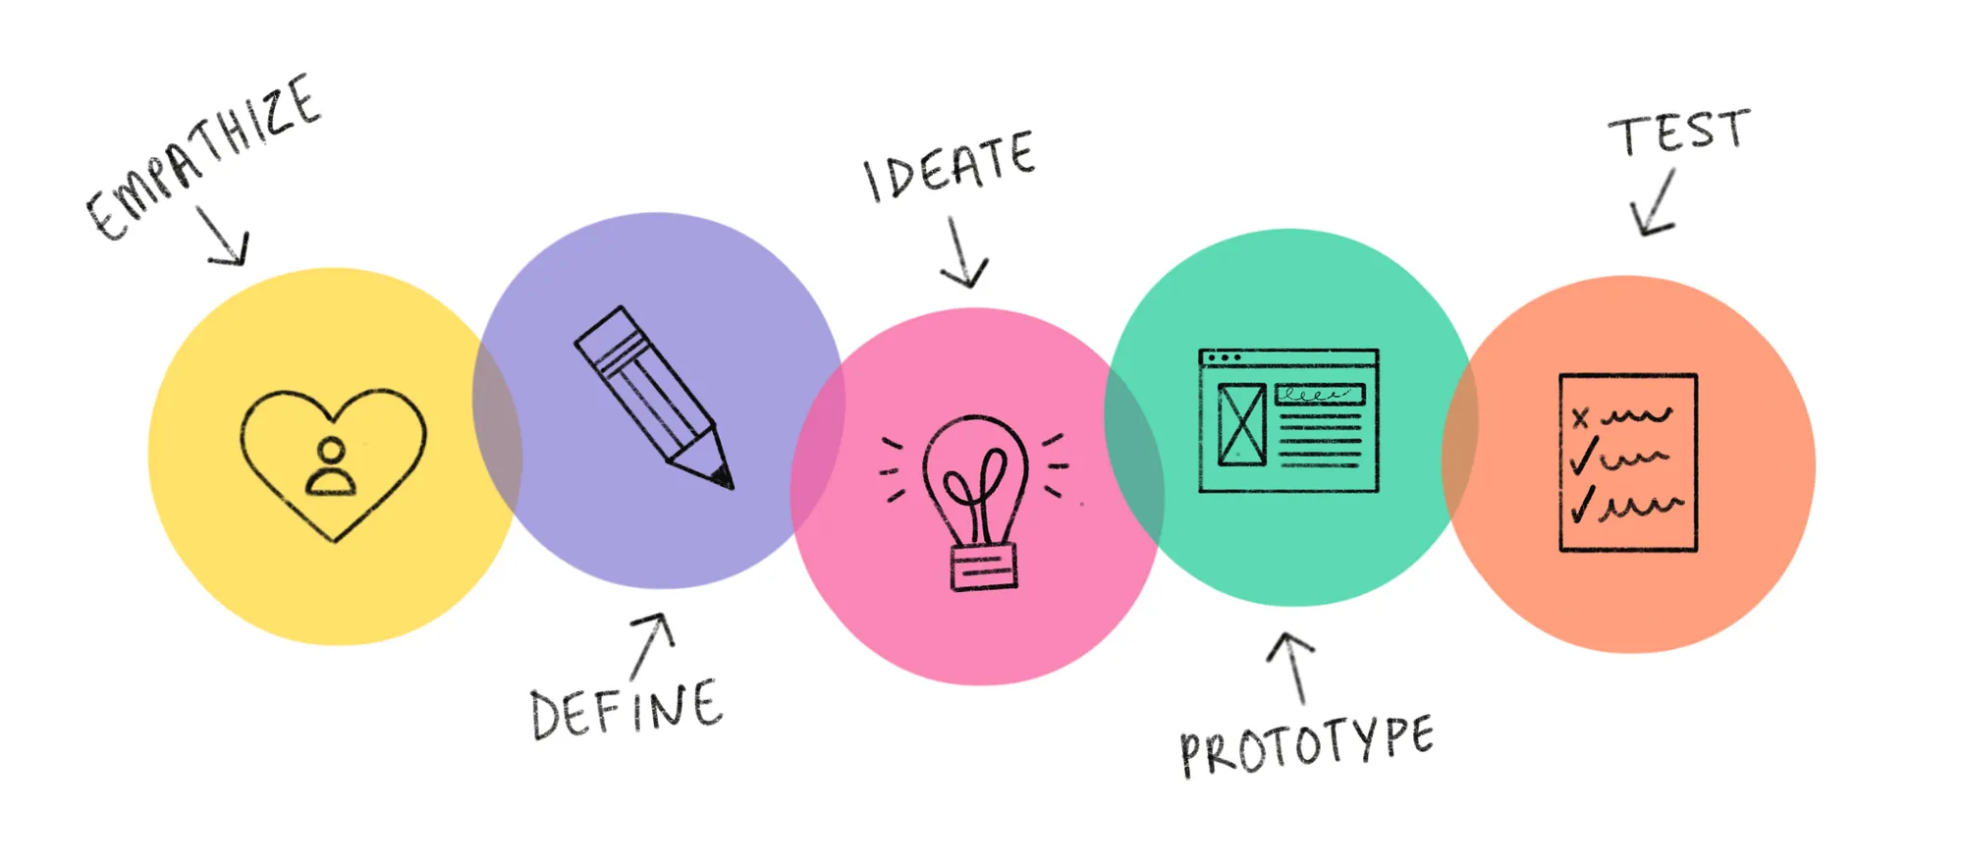
Design Thinking
#GovStack
Notes:
1. Empathize: Understand the needs, challenges, and experiences of the users. This stage involves deep research, interviews, and observations to gain insights into user behavior and emotions.
2. Define: Synthesize the findings from the empathize phase to clearly articulate the problem that needs to be solved. A well-defined problem statement provides focus and direction for the team.
3. Ideate: Brainstorm and generate creative solutions to the problem. In this phase, a wide range of ideas are explored without judgment, encouraging creativity and out-of-the-box thinking.
4. Prototype: Build low-fidelity models or mockups of the potential solutions. These prototypes allow teams to experiment, visualize ideas, and gather feedback before investing in full-scale development.
5. Test: Evaluate the prototypes by testing them with real users. Feedback from this stage helps refine the solutions and can lead to further iterations of ideation and prototyping.

Slide 17

Preparation for Identifying the
problem

Slide 18
Identifying the Target Use Case
Understand the Organization’s Objectives
Start by having a conversation with key stakeholders to understand the department’s primary goals and mandates.
What are your department’s main responsibilities?
What are the key objectives of your digitization efforts (e.g., efficiency, citizen satisfaction, compliance)?
List the Potential Use Cases
List the target use cases and rank them as per Impact to Stakeholders, Feasibility, Urgency and Alignment to core objectives of the department.
Prioritize based on Quick Wins Vs Long-Term Impact
Quick Wins: Identify use cases that can be implemented with high impact & low effort
Long term Projects: Identify larger, more complex use cases that require more investments
Identify Focus Areas
Are they more concerned with service delivery, internal operations, data management, public engagement, or regulatory compliance?
This should help you identify which use case you want to target first.

Slide 19
Understanding the AS IS Process
of the Selected Use Case

Slide 20
Preparation
1. Research
Familiarize yourself with the business context, industry standards, and terminology by studying similar systems, ideally within the same region. This will enable more meaningful discussions with the SME appointed by the Government.
Prepare Questions
Formulate specific questions to clarify how the process works, such as:
What is the problem that you want to solve?
What is your goal?
Who are the key stakeholders?
What triggers the start of the process?
What are the key steps involved?
What systems/tools are used at each step?
How do the stakeholders interact?
Is the process different for different type of applicants in the flow?
What are the pain points or inefficiencies?
Any legal or political implications?
Do you see any scope of improvement?
#GovStack
2. Identify key objectives
Focus on processes that can be improved using GovStack building blocks. While aiming for overall improvement, prioritize areas where GovStack’s components can deliver the most impact for efficient and scalable enhancements.

Slide 21


Understanding the current state – “As-Is”
Ask the SME to provide a high-level overview of the entire process from beginning to end
Use the User Journey Template the document the AS IS user journey flow
Conduct
In depth
Interviews
01
02
#GovStack
Workshops to understand and document the AS IS process flow for the use case.
Ask Open Ended Question to encourage the SME to elaborate each stage, including inputs, outputs, stakeholders, and exceptions
Get clarity on who is responsible for each step, what tools are used, where the process occurs and what information is passed between roles.
05
03
04
Pay attention to areas where the process may use an existing building block or can be improved by using a GovStack Building block

Slide 22
Understanding the current state – “As-Is”
#1
Identify the Goal
Once the use case is identified, identify the primary purpose or objective of the User Journey that you want to focus on.
Birth Registration Process
Provide Benefits to Citizens affected by a Natural Calamity
Improve the Current VISA or Immigration Process
User Experience for Going for Higher Education
01
02
#GovStack
05
04
#2
Identify the Key Stakeholders
Identify all internal and external stakeholders involved in the user journey. When enhancing a process, it’s important to recognize that bottlenecks may arise from multiple sources, including stakeholders, systems, or workflows.

Slide 23
Understanding the current state – “As-Is”
#3
Divide the Journey into 3 Stages
01
02
Pre-Contact Stage
This stage occurs before users engage with the service. It includes their discovery and exploration of your service, contact channels. This stage sets the first impression of the quality of service offered.
05
#GovStack
Contact Phase of User Service
This phase occurs when users make their first (or repeated) contact with an entity (involved in provision of the service), usually with service providers or support teams. This is the most critical service phase, as it heavily influences Users experience and impacts the use of the service in future.
04
Post-contact Phase of User Service
This phase occurs after users have contacted your service. It can happen immediately, in the form of a response form (“Was our team helpful in resolving your issue?”) or after several weeks or months have passed.

Slide 24
Understanding the current state – “As-Is”
#4
Identify the
Procedures
Pre-Contact Phase
Process Identification
Site Visit - Visit the Passport Office
Contact Phase
Data Collection
Payment
Verification
Quality Check
Printing & Dispatch
Post Contact Phase
Feedback
#GovStack
A procedure is a series of steps, taken together, to achieve a desired result.

Slide 25
Understanding the current state – “As-Is”
Under each procedure list the granular steps.
a
Document
the detailed steps
#5
For each step identify the stakeholder performing the step
b
Identify what inputs are needed in the steps
(documents or Information, etc.)
#GovStack
c
A step is defined as an action taken by the user to progress in completing a procedure.
Steps are in-detail and singular actions
Identify the core output of the steps (if any)
d
Identify where this particular action is being performed (point of contact)
e
Importance of this steps due to any legal justification
f

Slide 26
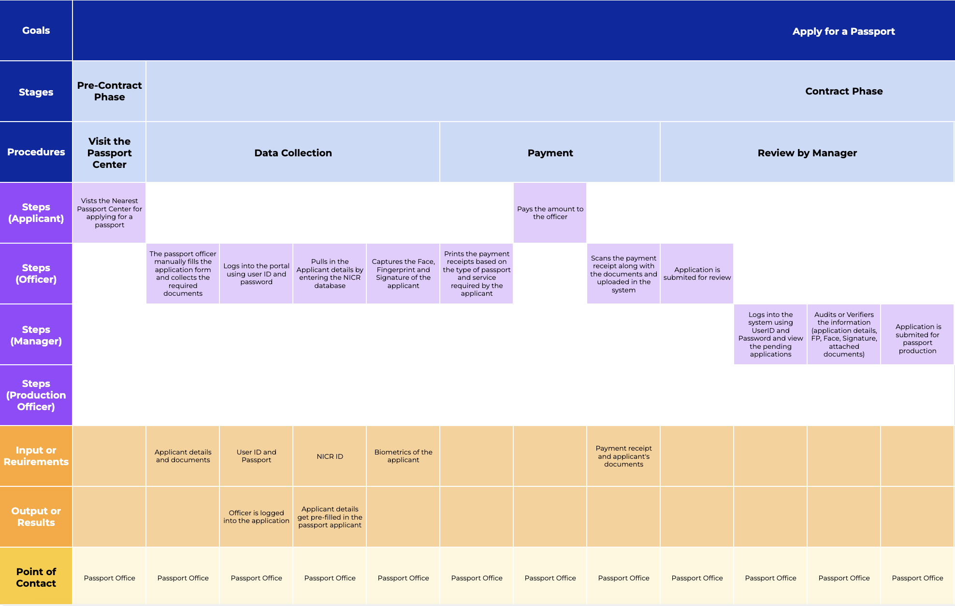
Understanding the current state – “As-Is”
#6
AS IS
Template
#GovStack
Fill the AS IS Template based on the inputs received from the stakeholders.
Link to Template

Slide 27

Gender
Male
Female
Age Group
Minor
Adult
Senior Citizen
Persona
Specific Flows
Nationality
National
Foreigner
Sometime there are different process flow based on the type of persona involved.
Hence, based on the persona profile if there is a major change in steps, it’s recommended to create a new User Journey
Residence
Village
City
Abroad
#GovStack
Economic Status
Low Income
Middle Income
Upper Income
Higher Income
Occupation
Farmer
Self Employed
Employed, etc.

Slide 28
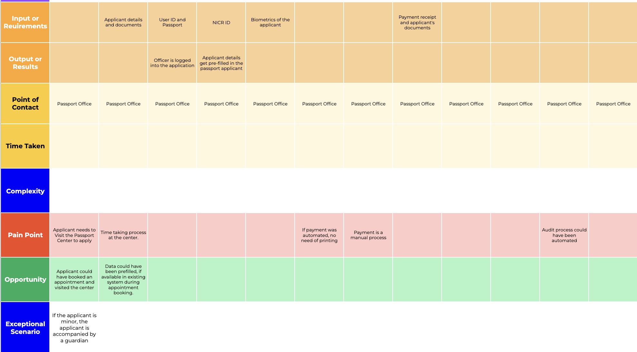
Document the Pain Points & Opportunities in the “As-Is” User Journey
#7
Document the pain points and opportunities identified at each step after discussions with multiple stakeholders.
In cases where improvements are restricted due to the country’s legal framework, these limitations should also be recorded.
#GovStack

Slide 29
Next Steps
Observe (optional)
If possible, observe the process in action. Watching the SME or other stakeholders perform the tasks, this gives a firsthand insight into the workflow, tools, and challenges the SME faces.
Clarify and iterate
After the initial interview, synthesize the information and draft the User Journey process flow.
Conduct follow-up sessions if needed, to clarify gaps, resolve misunderstandings and understand the legal justification for the processes.
#GovStack
Request for supporting documents
Collect any forms, process documentation, standard operating procedures (SOPs), or reports that can help you understand the process better. These documents often provide the finer details the SME may not cover verbally.
Understand current DPI infrastructure
Understand what are the DPIs that are available in the country to leverage them while defining the TO BE User Journey.

Slide 30
Defining the TO BE Process

Slide 31
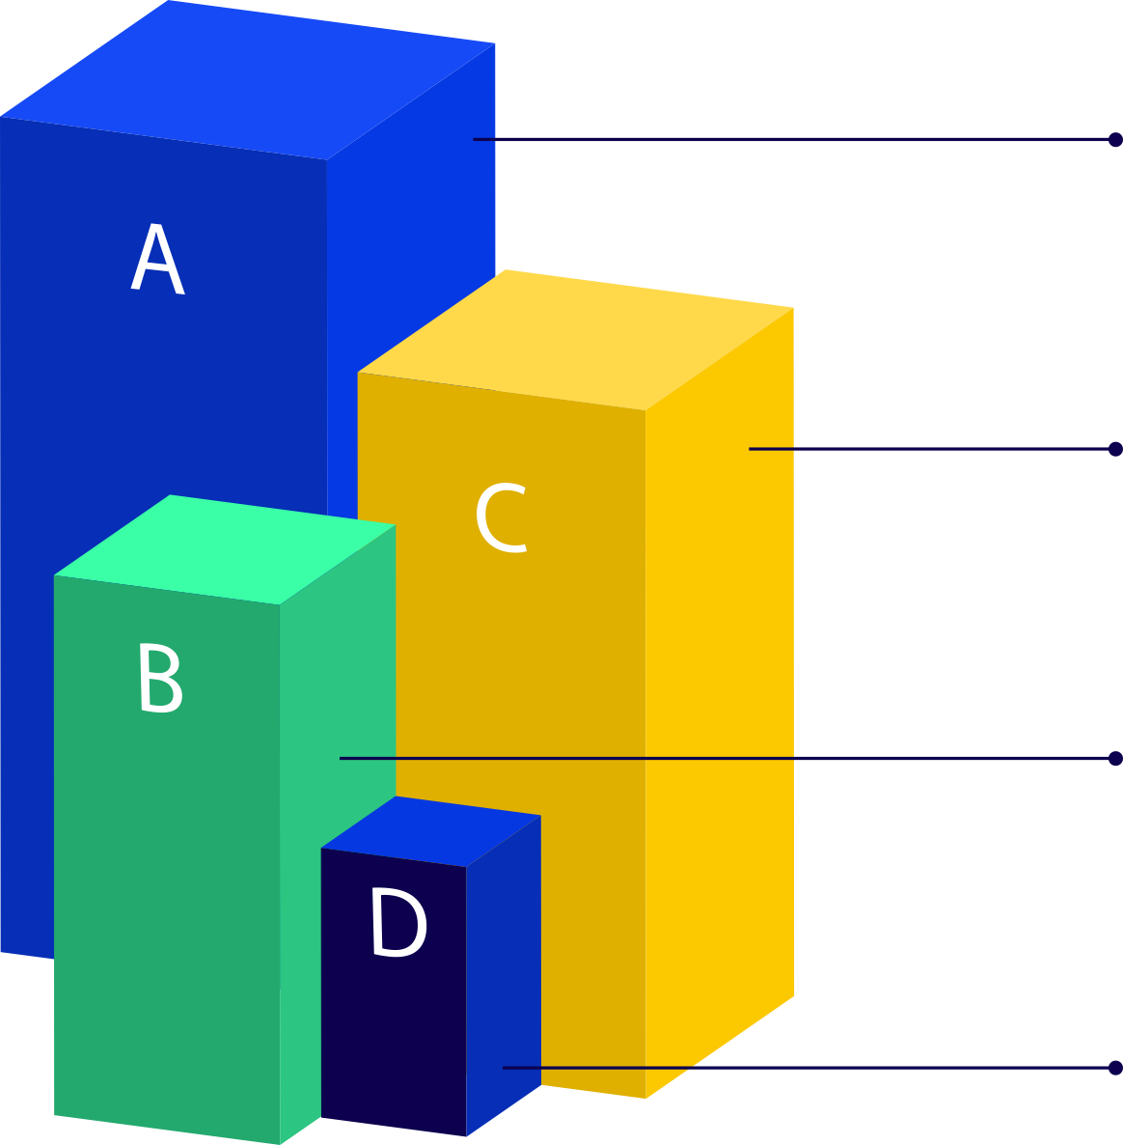

Analyze the AS IS Process
Review the AS IS process documentation to pinpoint bottlenecks, delays, redundant tasks, and manual work that could be automated.
Look for areas where the process is failing to meet objectives or where there’s potential for improvement (e.g., quality, speed, cost, user satisfaction).
Gather feedback from end users and stakeholders to identify their needs and expectations that are not met by the current process.
Document the inputs from the stakeholders and prioritize the expectations and pain points.

Slide 32
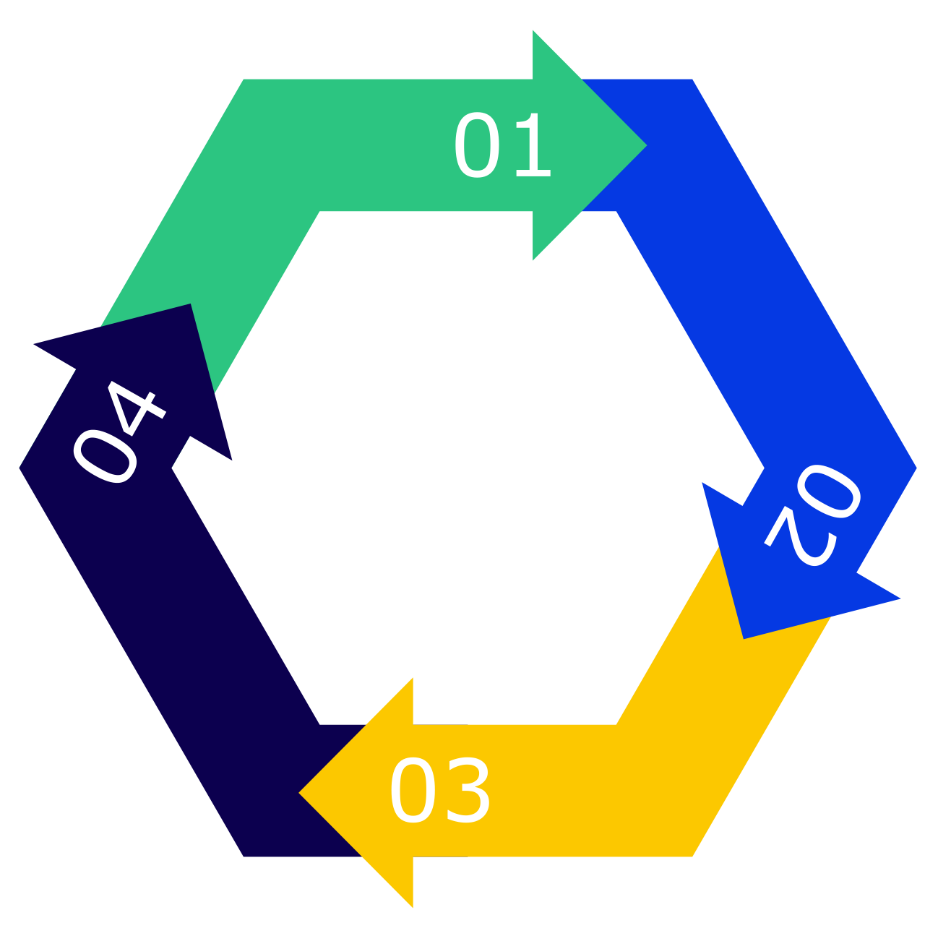


Define Goals for TO BE User Journey
Increase efficiency
Improve user experience and satisfaction
Clearly articulate what the new process should achieve.
Better compliance with regulations
Scalability and flexibility to adapt to future changes

Slide 33
What kind of user-experience you want to deliver?
Brainstorm & ideate
Model the TO BE
Collaborate with stakeholders
Bring together SMEs, process owners, and relevant stakeholders like Building Block Owners to brainstorm potential improvements. Encourage out-of-the-box thinking and solutions.
Service Design Blueprint
Document each step using a Service Design Blueprint template with the input and expected output. Ensure that all activities are clearly segregated by user roles, with each user’s actions, interactions, and touchpoints outlined.
#GovStack
Use Design Thinking principles
Employ a human-centered approach to ensure the redesigned process meets the needs of end users.
Building Blocks
Map the building blocks required in step of the process flow and map the UX designs patterns in the Service Blueprint Template.

Slide 34
Templates for TO BE Journey
User Journey Template
Use the same user journey template which was used to document the AS IS flow with the new process for each and every stakeholder. The steps documented should be detailed with all new improvements.
#GovStack
Service Blueprint Template
Once, the TO BE Journey is defined, create the Service Blueprint. The Service Blueprint is to implements the To-Be state of the User Journey by providing the detailed steps related to the building blocks that are used.

Slide 35
Service Blueprint Template
The sections related to Application Stages, Application Procedures, Application Steps with User Profiles remains same with Input and Output documented
For each User Profile, we documents the Goals and the Actions.
Once detailed, we map the actions with the Building Blocks involved.
Document the UI/UX Design Patterns for each steps.
Sample Service Blueprint

Slide 36
Next Steps
Gather Feedback
Share the TO BE process with stakeholders and gather their feedback. Validate whether the proposed process meets their needs and addresses the identified issues.
Prototyping
Share the finalized TO BE User Journey with the GovStack architect for prototyping.
Prototyping can be done using any Low Code No Code tool
Or
UX design tool like Figma to visualize th TO BE.
#GovStack
Ideate and Refine
Based on feedback and simulations, refine the TO BE process as needed.
Ensure all stakeholders are aligned and that any changes address both the pain points from the AS IS process and the desired future outcomes.

Slide 37
Driving long term sustainable and scalable transformation through architecture

Slide 38
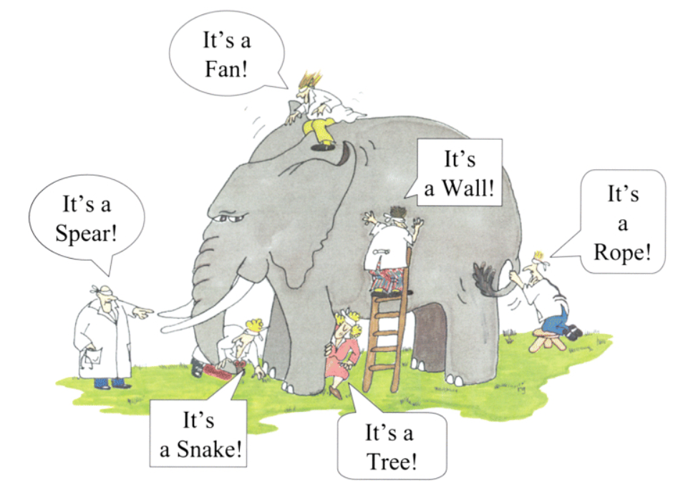
Why Architecture?
Architecture
  Is an abstract description of entities of a system and the relationship between those entities
Source: System Architecture: Strategy and Product Development for Complex Systems, Global Edition, Person Education Limited 2016
Handling complexity
The real cost drivers are the following:
  Complexity
  Dependency
  Integration
  People change management
  Cost of application functionality change
Source: McComb, Dave. Software Wasteland: How the Application-Centric Mindset is Hobbling our Enterprises . Technics Publications. 2018.
38
38

Slide 39

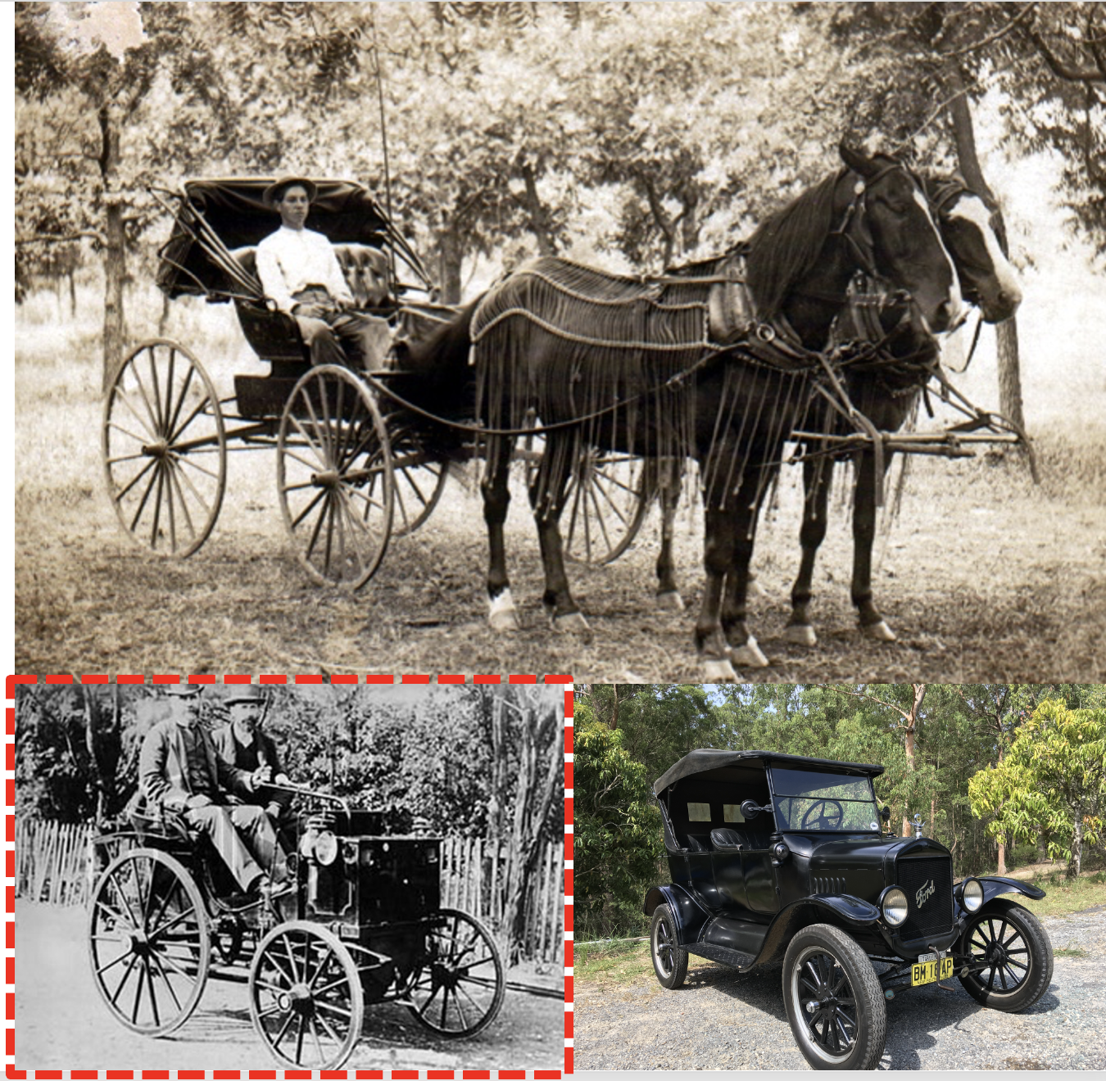
How do we industrialise a country's digital transformation and ensure that it does not repeat the long learning curve of pioneer countries?
In 1860, Belgian inventor Lenoir created the first commercially successful internal combustion engine. The first Ford Model T was created in 1908. Properly implementing the engine invention took almost 50 years. How can we integrate digital into government faster?
The GovStack initiative proposes a solution by creating reusable building block specifications based on global best practices. These blocks are intended to simplify the implementation and management of digital systems, minimise risks, and enhance sustainability.
The PAERA brings the context of the public sector and architectural practice as a methodology to ensure immediate impact from properly implemented BBs.

Slide 40
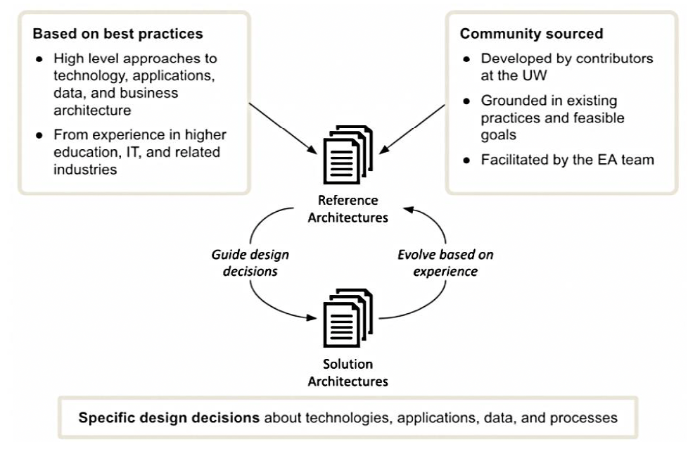
What is Reference Architecture?
Reference Architecture refers to the consolidation of previous experience in the domain of digitalization in public administration.
It involves creating templates that structure components of applications and technology to support specific business models presented in the public sector.
These templates should be used to speed up the development of solutions for public sector organizations and to decrease the risk of design decisions.

Slide 41
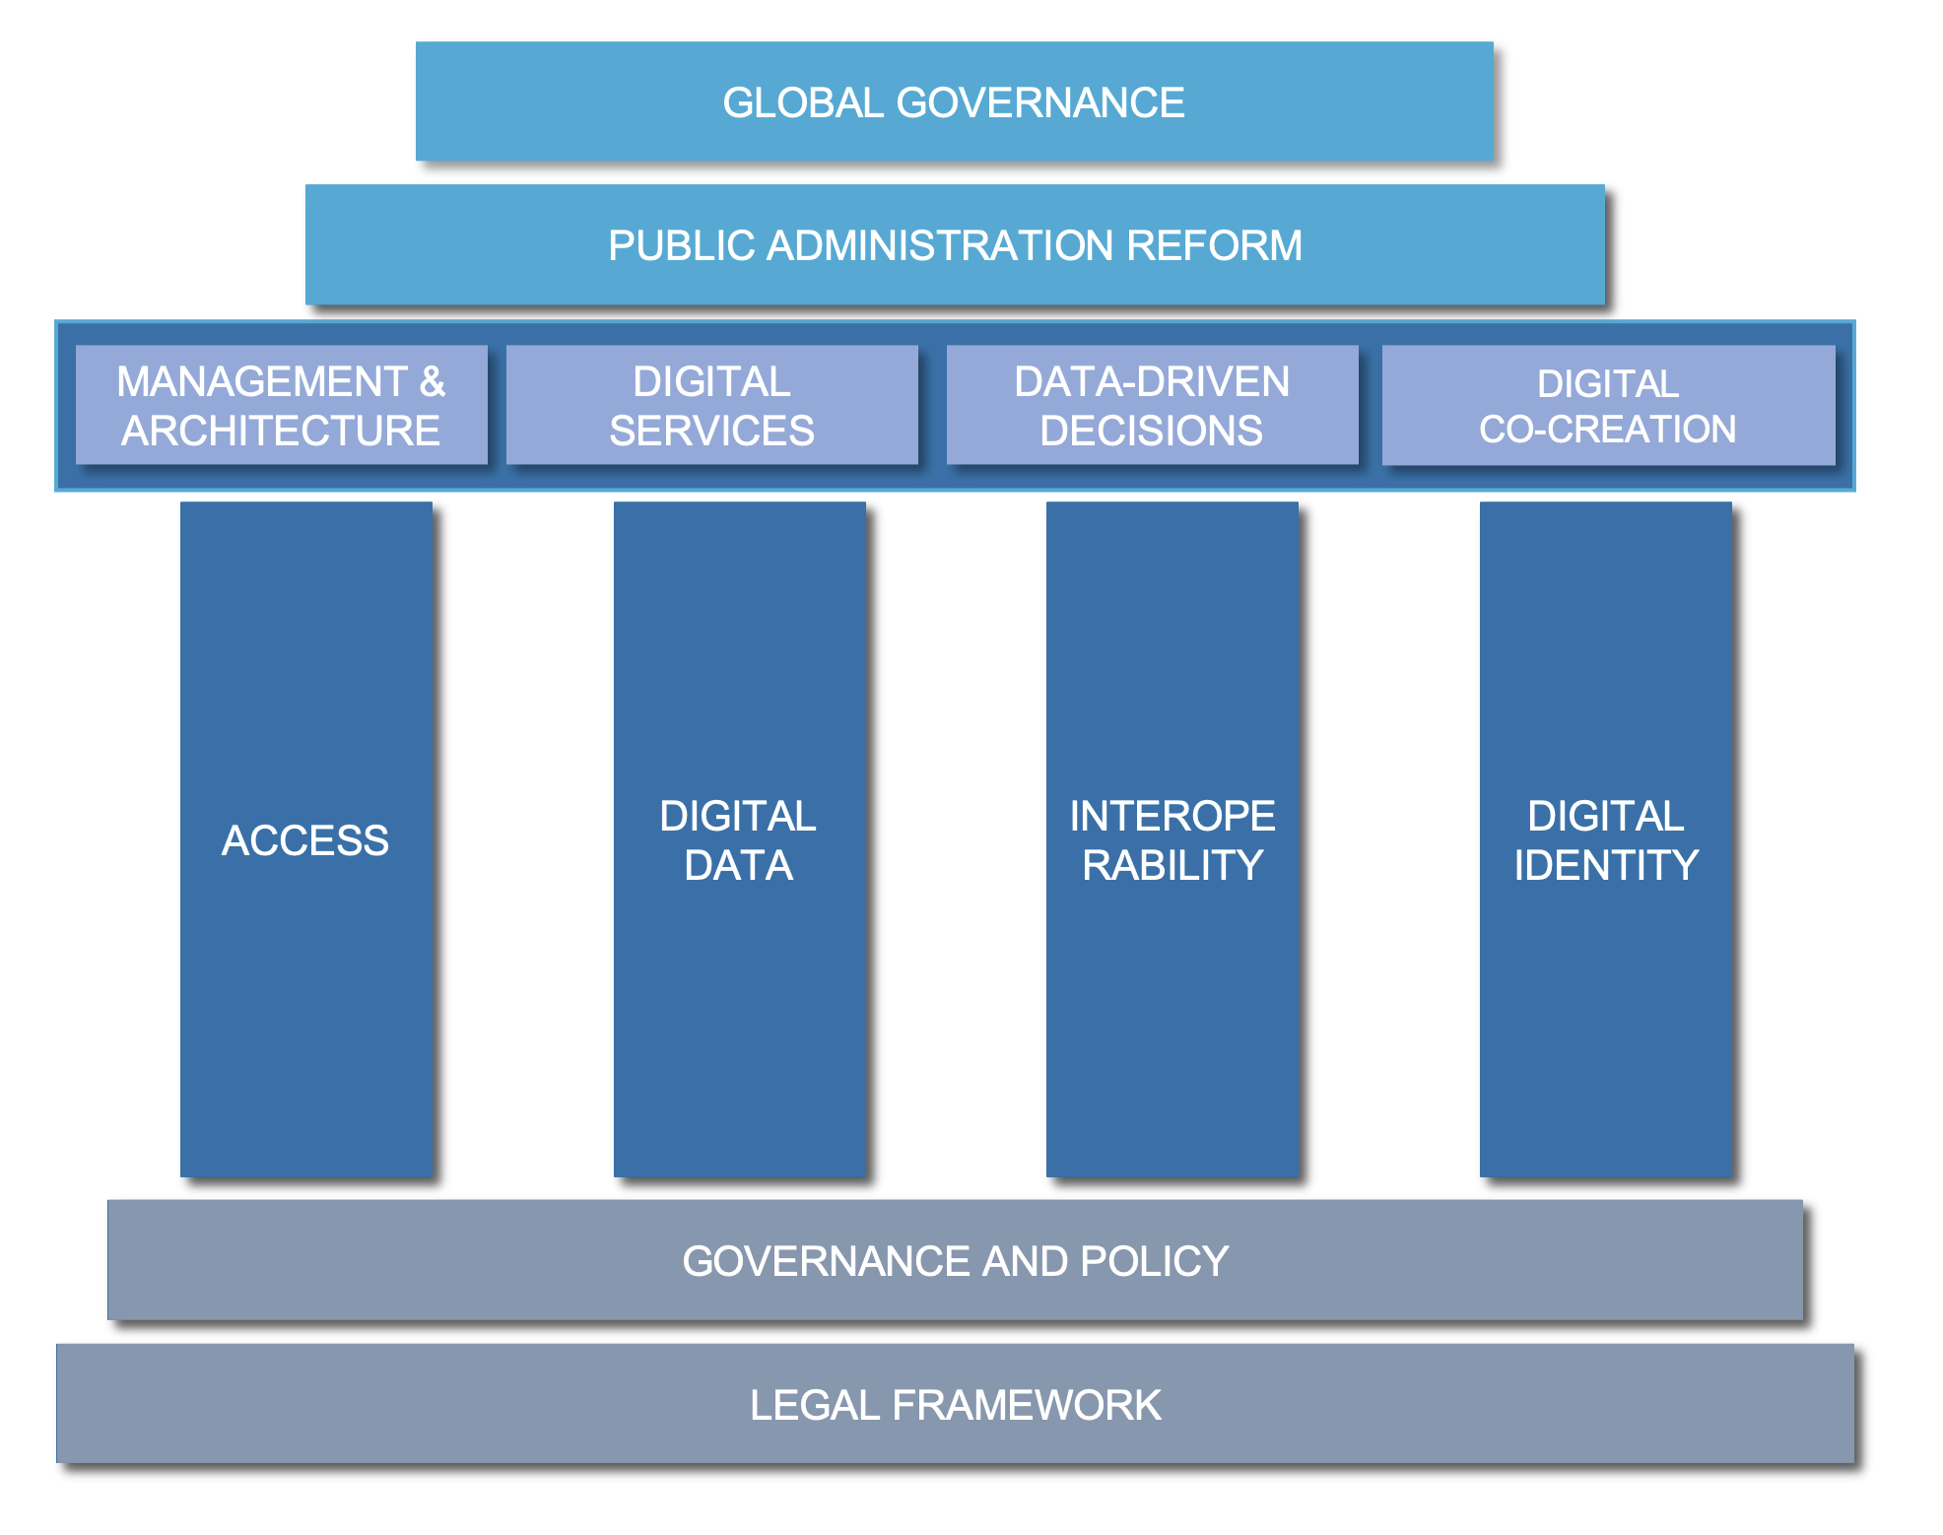
Digital Government Infrastructure
  A certain level of digital government infrastructure availability should be necessary for secure and resilient delivery of public digital services. This will enable
      quality user experience,
      reliability of legal transactions, and
      sustainability of investments.
  The framework follows a causal sequence where one input triggers the success of other Digital Governance aspects. These 'inputs' are the underlying conditions that set the stage for effective Digital Governance.
  Digital Governance Infrastructure contains Policy, Governance, Legal, and National Framework with the following major components:
  The Foundation has four Digital Infrastructure Pillars: Access, Data, Identity, Interoperability
  The Organisation component defines management, architecture and decision-making policies and procedures.

Slide 42
Building Digital Government
Governance and Policy
Effective governance and policy frameworks are crucial for digital transformation at the national level.
More than adopting technologies is required. A well-defined governance framework must integrate digital tools into daily administrative processes and decision-making.
A digital culture is vital among civil servants, and fostering this requires practical engagement with digital systems, not just high-level strategic plans.
Transformation Strategy
There is a need for a phased approach to digital transformation, starting with building a solid digital foundation through strengthening laws, improving IT infrastructure, establishing interoperability standards, and enhancing cybersecurity.
Interoperability
Emphasizing a distributed model for public sector architecture, we advocate for decentralization to empower government agencies while maintaining centralized governance and standards.
This approach ensures flexibility, security, and efficiency while enabling seamless information exchange across systems.
Legal Framework
A robust legal framework is essential for digital governance. There is the need for laws and regulations that promote digital data flows across public and private sectors while ensuring secure e-government and e-business transactions.
Adapting legal frameworks to support digital transformation and align with human rights in the digital era is a paramount.

Slide 43
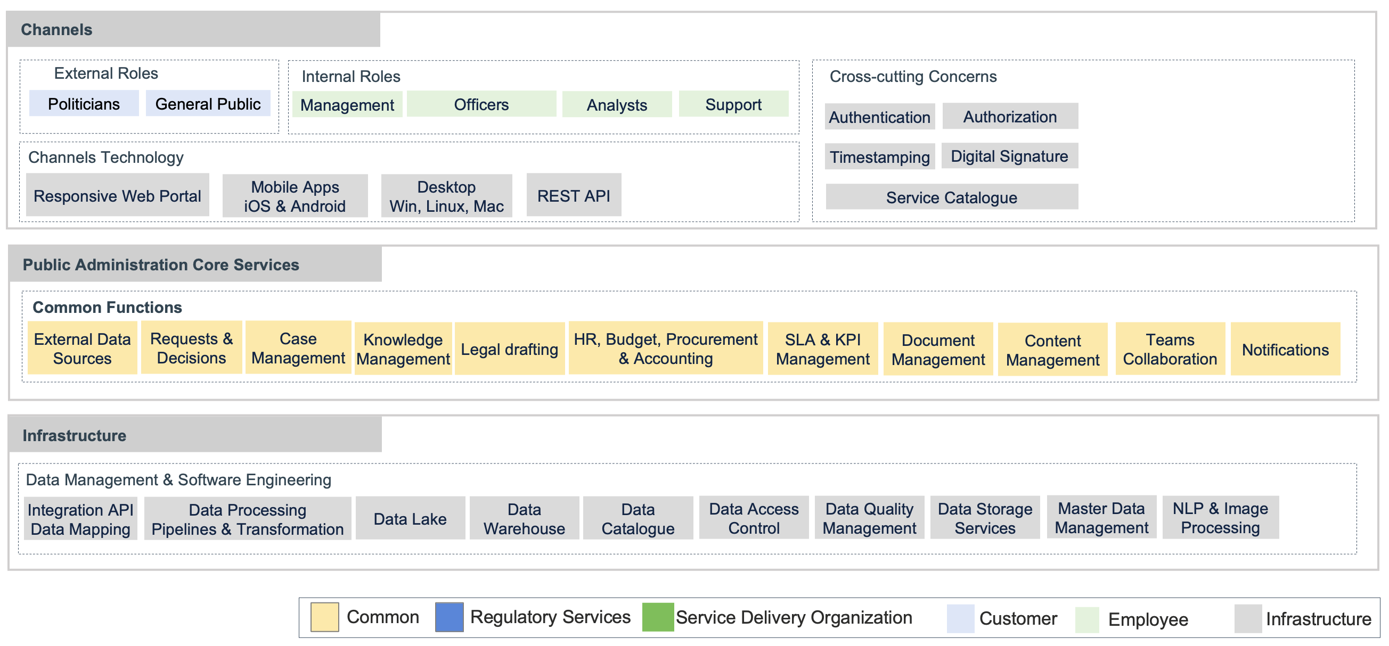
Policy Development Unit Reference Architecture
  Typical example: ministries

Slide 44
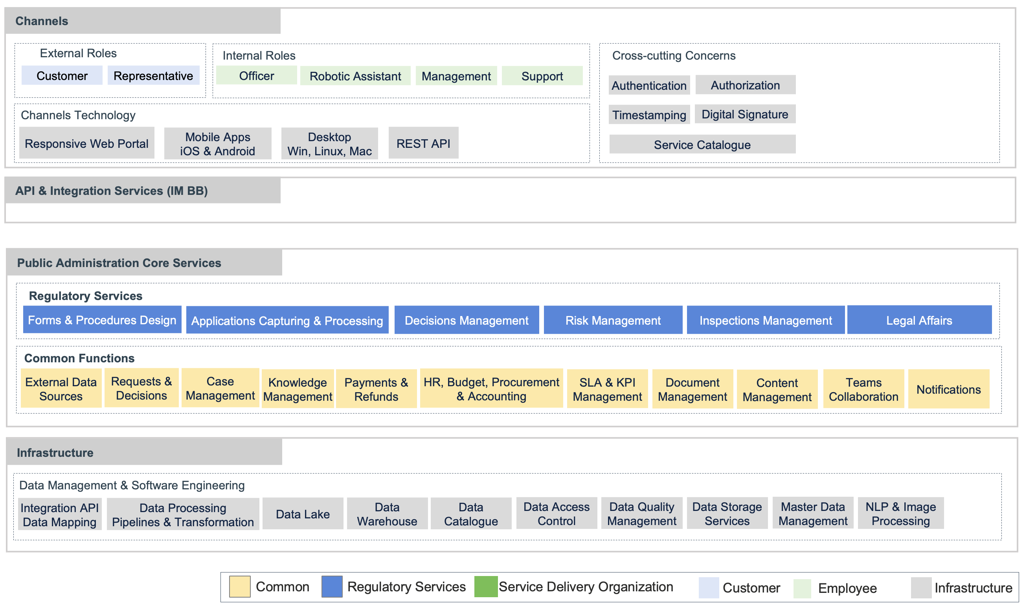
Regulatory Agency Reference Architecture
  Typical examples: Business Registration, Licensing, etc.

Slide 45
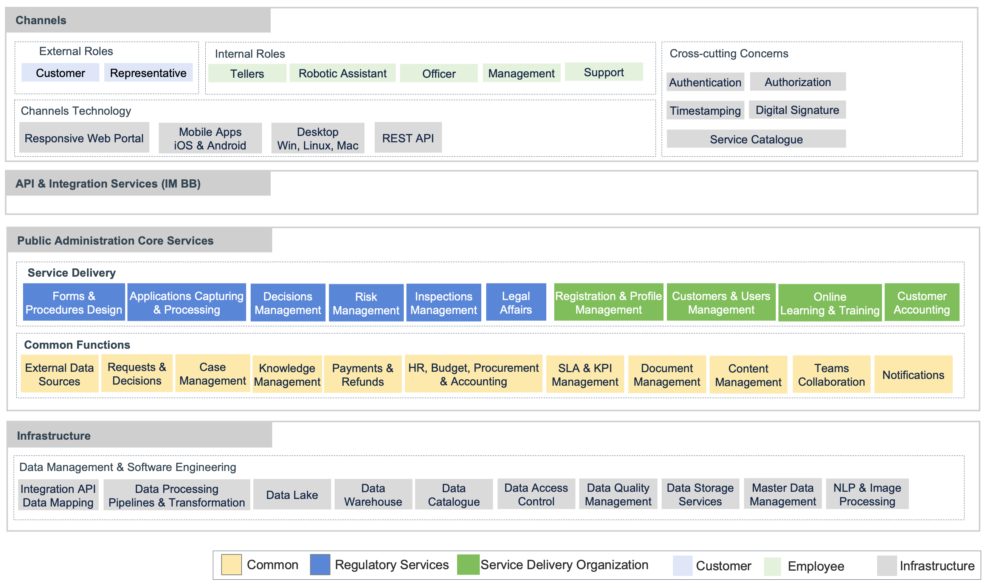
Service Delivery Agency Reference Architecture
  Typical examples: Tax Administration,
  Customs,
  Police,
  Social Care, etc.

Slide 46
Thank You !

