Slide 1


Integrated Electronic Case Management System
(IECMS)
Mr. Robert Tonny – Manager/System Administrator IECMS – PNG Judiciary
DICT Transformation Summit 2024 – Wednesday, 2nd September 2024

Slide 2

DIGITALIZING
PNG COURTS
Easy access to justice via e-Filing
Efficient court operations through automated case management
Collaboration on cases and notification management
Advanced document management
Electronic signature and stamping
Embedded OCR and automated hearing transcription
Virtual court and e-Summoning
Advanced security and role-based access

Slide 3
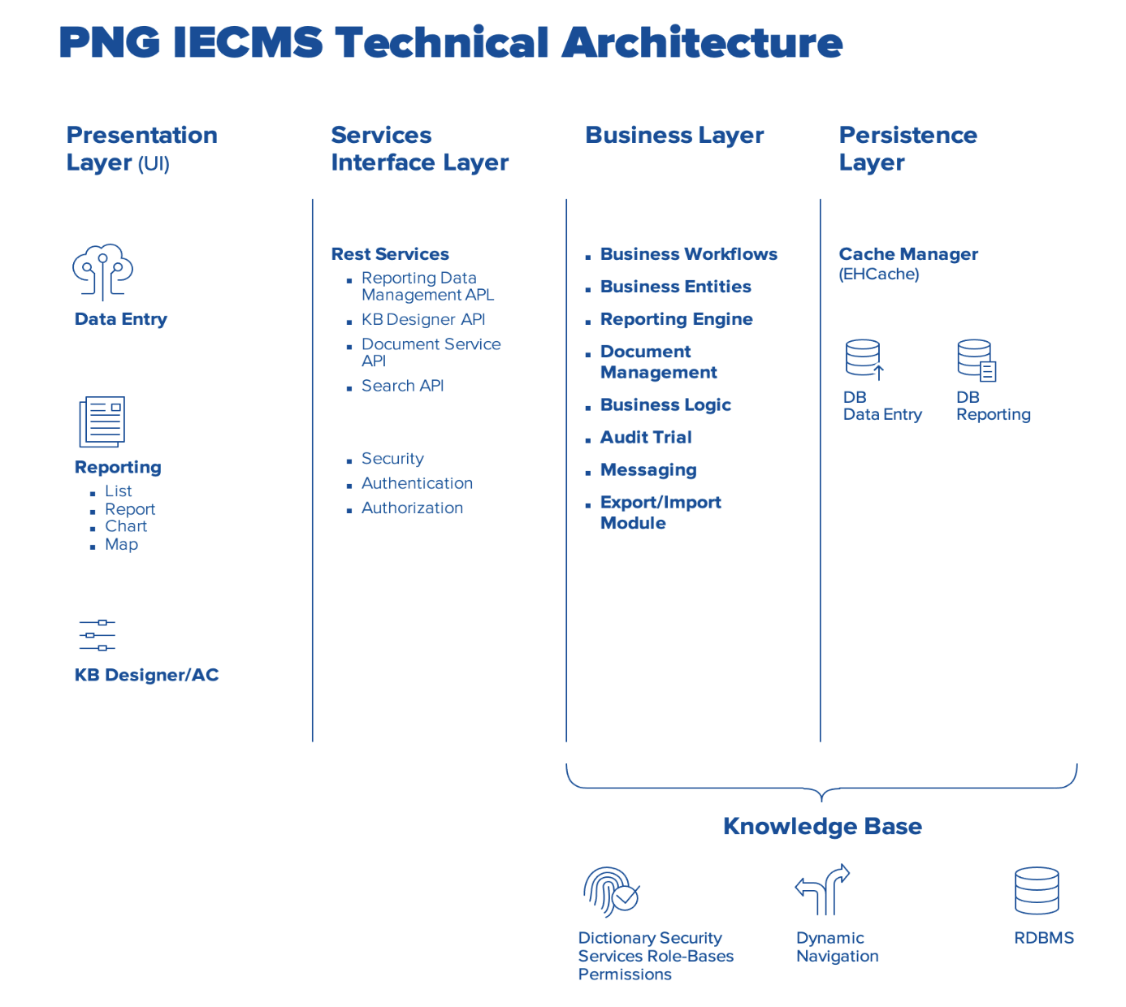
ARCHITECHTURE OVERVIEW
PRESENTATION LAYER (UI)
Data entry, reporting (lists, charts, maps)
Knowledge Based (KB) Designer and access control tools
SERVICE INTERFACE LAYER
REST API’s for reporting, KB, documents and search
Security (Authentication and Authorisation)
BUSINESS LAYER
Business workflows, document management, business logic
Audit trail, messaging, export/import module
PERSISTENCE LAYER
EHCache (cache manager) for performance
RDBMS for structured data storage (Data Entry, Reporting)

Slide 4



MAIN FEATURES
ADVANCED DOCUMENT MANAGEMENT
FIELD AND FORM GENERATION
ONLINE CASE DATA ENTRY
ADVANCED ANALYTICAL REPORTING
IECMS
FORM GENERATION
CALENDAR AND TASK MANAGEMENT
ROLE BASED ACCESS
AUTOMATED WORKFLOW PROCESSING
COLLABORATION, MESSAGING
AND NOTIFICATIONS
INTEGRATION

Slide 5

IECMS
IN PAPUA NEW GUINEA
8000+
REGISTERED CASES IN WAIGANI
More than 8000+ cases registered since March 23, 2020
For National and Supreme Court cases in Waigani
The Integrated Electronic Case Management System (IECMS) in Waigani is a state-of-the-art digital platform designed to streamline the management of legal cases. It supports the efficient handling of court cases from initiation to resolution, replacing traditional paper-based processes with automated workflows.
The IECMS enhances transparency, accountability, and efficiency by allowing users to file documents, track case progress, and manage case data securely online.
4400+
DISPOSED CASES
3765 National cases disposed
701 Supreme cases disposed
3500+
USERS ON IECMS
A combined total of 3500+ users inclusive of the public, lawyers, internal users and law firms
IECMS is hosted on a Kubernetes cluster on a Microservices architecture and the databases are PostgreSQL
250+
DAILY USERS ON IECMS

Slide 6

PNGIECMS JOURNEY
APPROVAL OF SYSTEM DELIVERY
IECMS PILOT PHASE LAUNCHED - WAIGANI
DEPLOY IECMS INFRASTRUCTURE ON PREMISE
ROLL-OUT TO THE PROVINCES
UPGRADE TO IDM8 & INTEGRATE CRIMES AND SECTOR
2018
2020
2024-2025
2025-2027
2025-2027

Slide 7


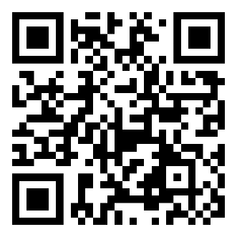
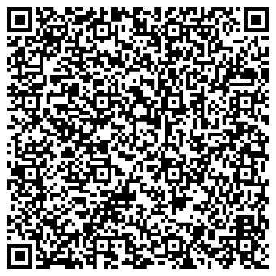
THANK YOU
Link to PNGIECMS
Manager/System Admin Contact Details
www.iecms.pngjudiciary.gov.pg

