Slide 1

PNG Judicial SERVICE – DIGITAL INITIATIVES
Alison Holt – e-Judiciary Adviser to the CHIEF JUSTICE

Slide 2
Agenda
Introduction
Digital Initiatives:
  Getting Connected
  Building Digital Services and Solutions
  Planning the Future

Slide 3
INTRODUCTION

Slide 4






PNG Judicial service DIGITAL JOURNEY
First Steps
Productivity Services
Digital Innovation
Case Docketing System (CDS)
For The Record ( FTR)
Sentencing Database
Office 365
File Storage
Voice & Video
JSIMS HR and Finance System
Portal Apps
Digital Bail & Digital Twin
AI, Sensors and Surveillance
WNCC Infrastructure
PNGLIN
2012
2026
Integrated Criminal Case System Database (ICCSD)
Integrated Case Management System – (IECMS)
Connectivity for PNG Judiciary
Training for PNG & Pacific Islands (PNGCJE)
Virtual Hearings
Intelligent Case Management
Cross Sector Services
WNCC Fully Functional
Agile Information Management
Case Management
Connectivity
Intelligent Case Management

Slide 5
DIGITAL initiatives
E-judiciary adviser to the Chief Justice
Notes:
Building Awareness of Emerging Technologies
Understanding Utility for the Judiciary
Developing Prototypes and Pilots
Preparing for Off-the-Shelf Capabilities
Researching the non-Tech Elements of Digital Transformation
Today we will cover:
Information Portals & Digital Bench Books
Satellites, Sensors, Surveillance
Digital Bail
Digital Twin Development & Artificial Intelligence

Slide 6
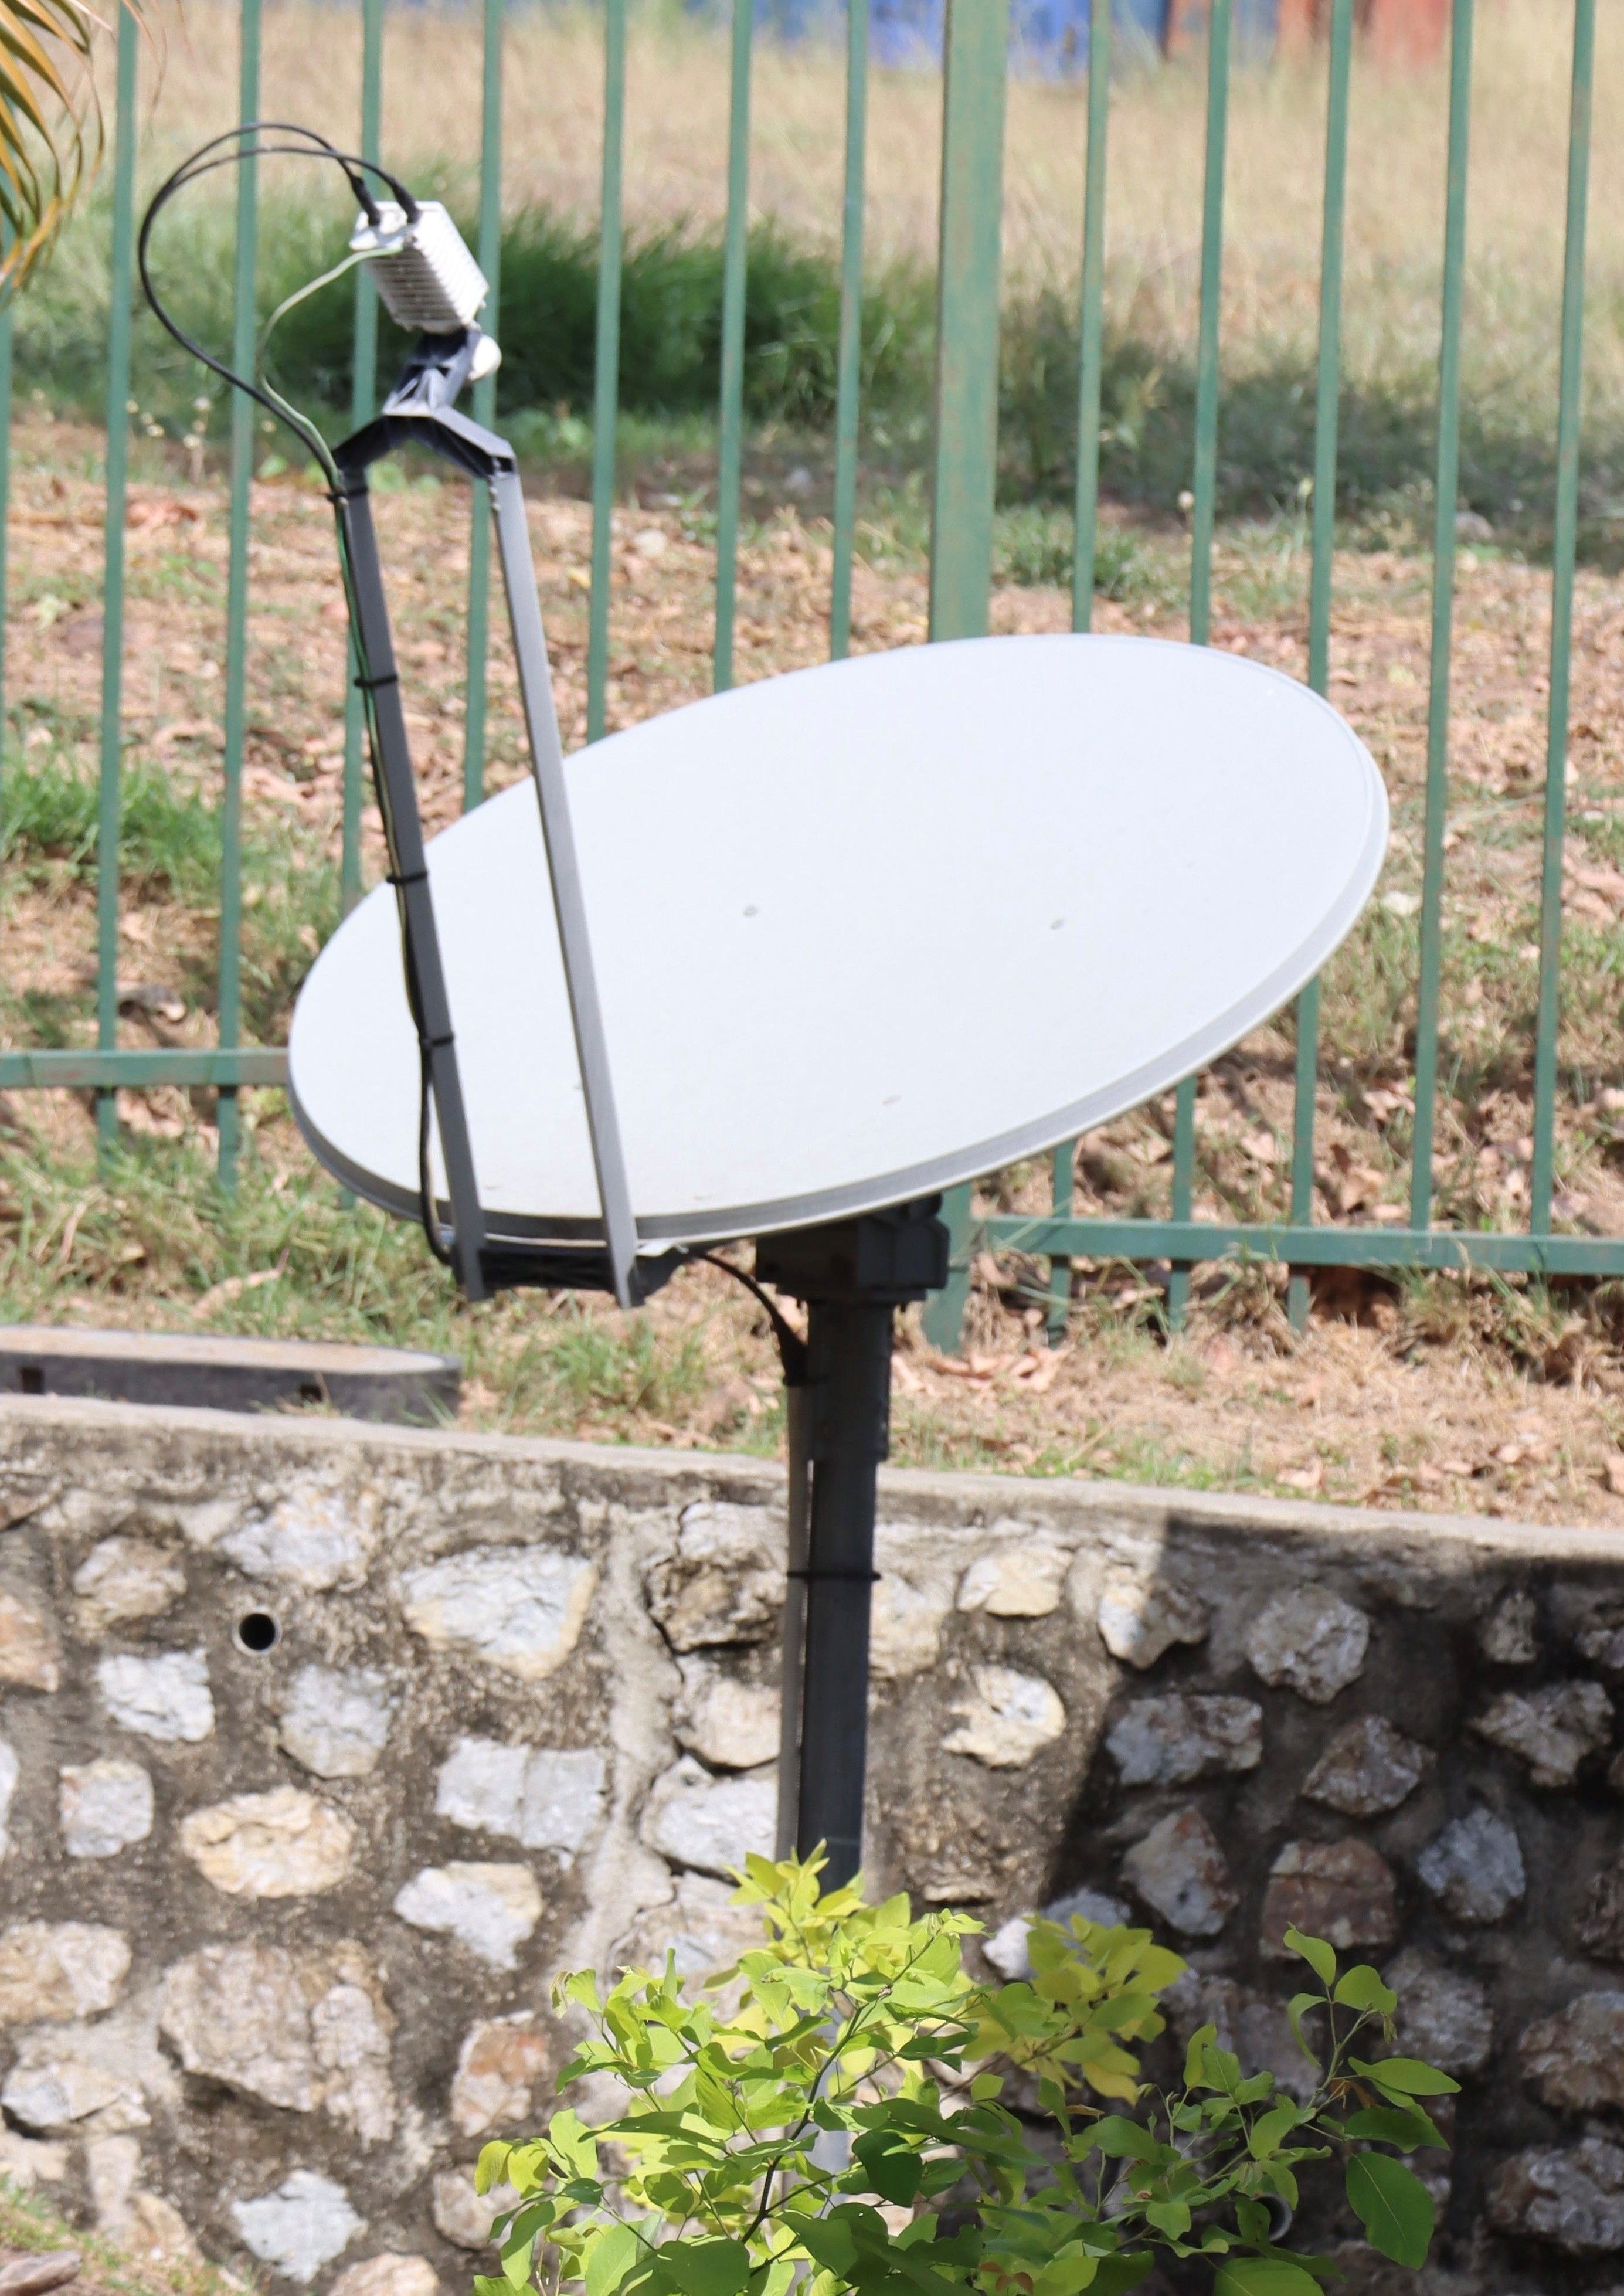
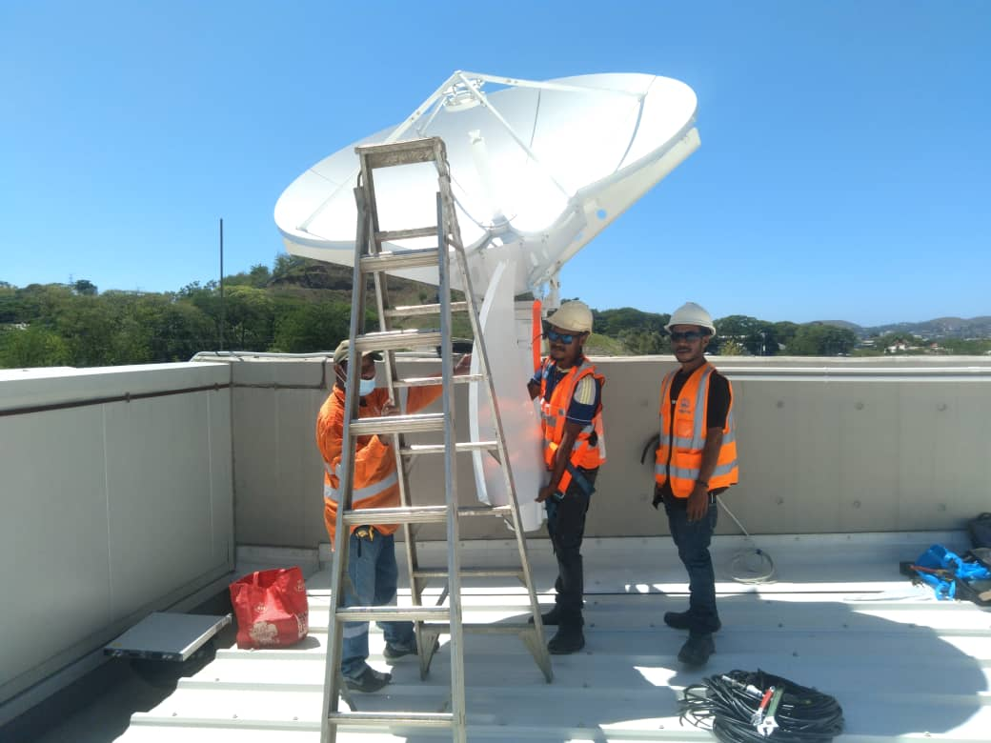
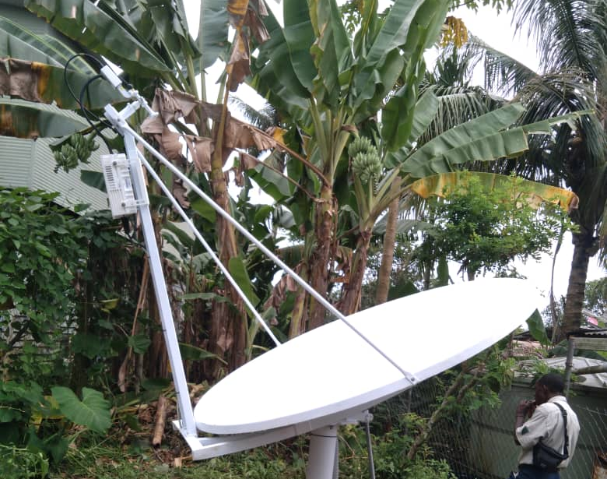
SATELLITES, SENSORS & SURVEILLANCE

Slide 7
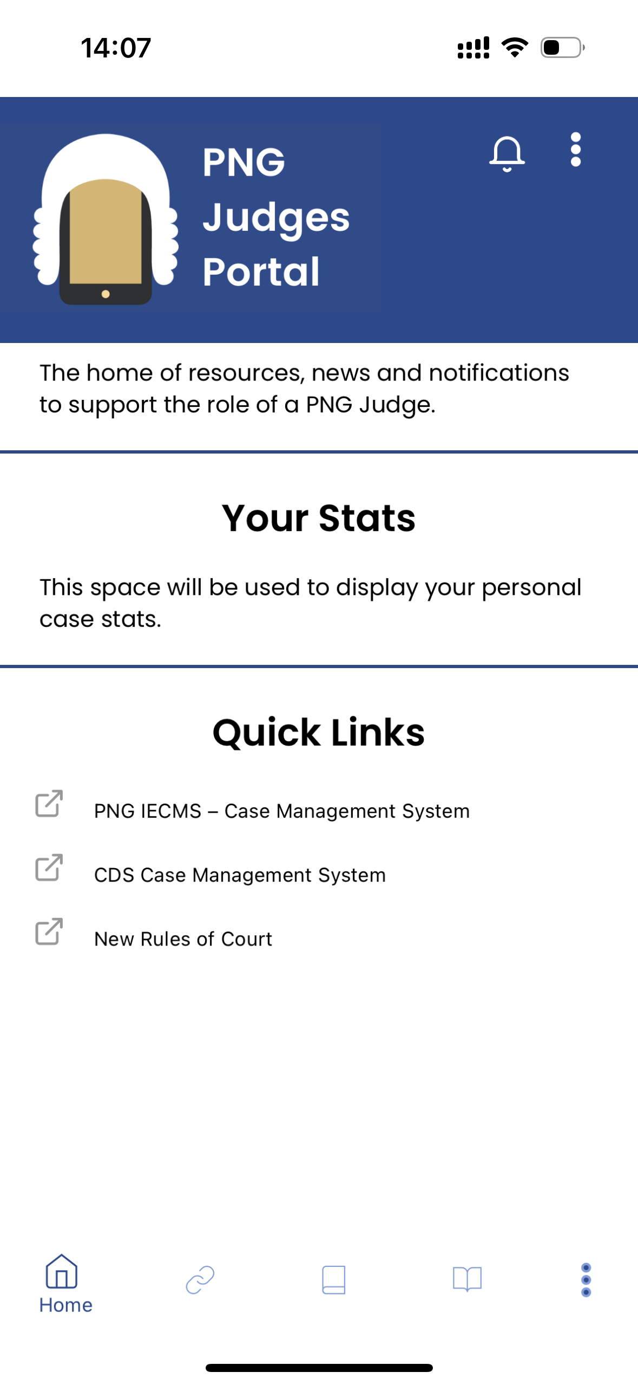



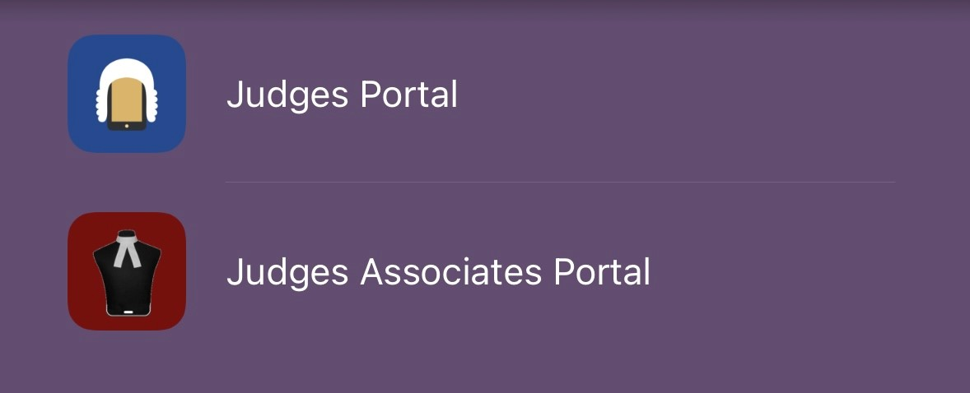
INFORMATION PORTAls
Notes:
A range of portal apps with different functions for different audiences:
Built discrete functional modules that can be served up in different combinations – Links, Training, Notifications, Secure Messaging, Calculator, News, Notebook, Video Clips, Monthly Reports.
Built for Android and Apple and moved to single code base.
Configured for different audiences – Judges, Judges Associates, Village Court Officials, Lawyers etc.
Digitised Bench Books for quick reference:
Redesigned format and alphabeticised by task.

Slide 8
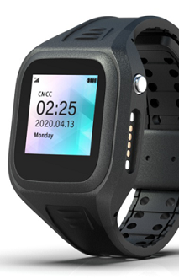
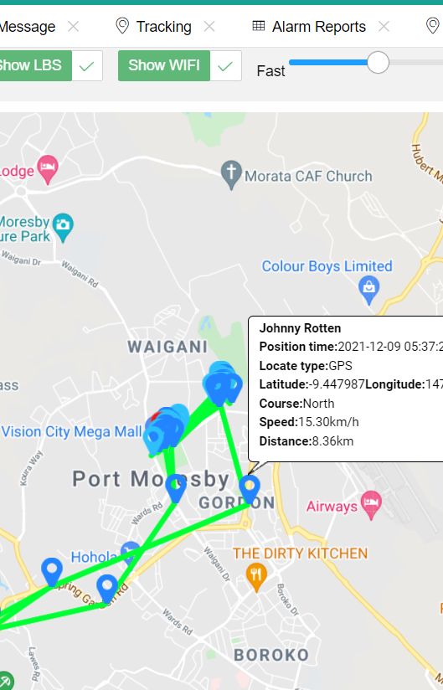
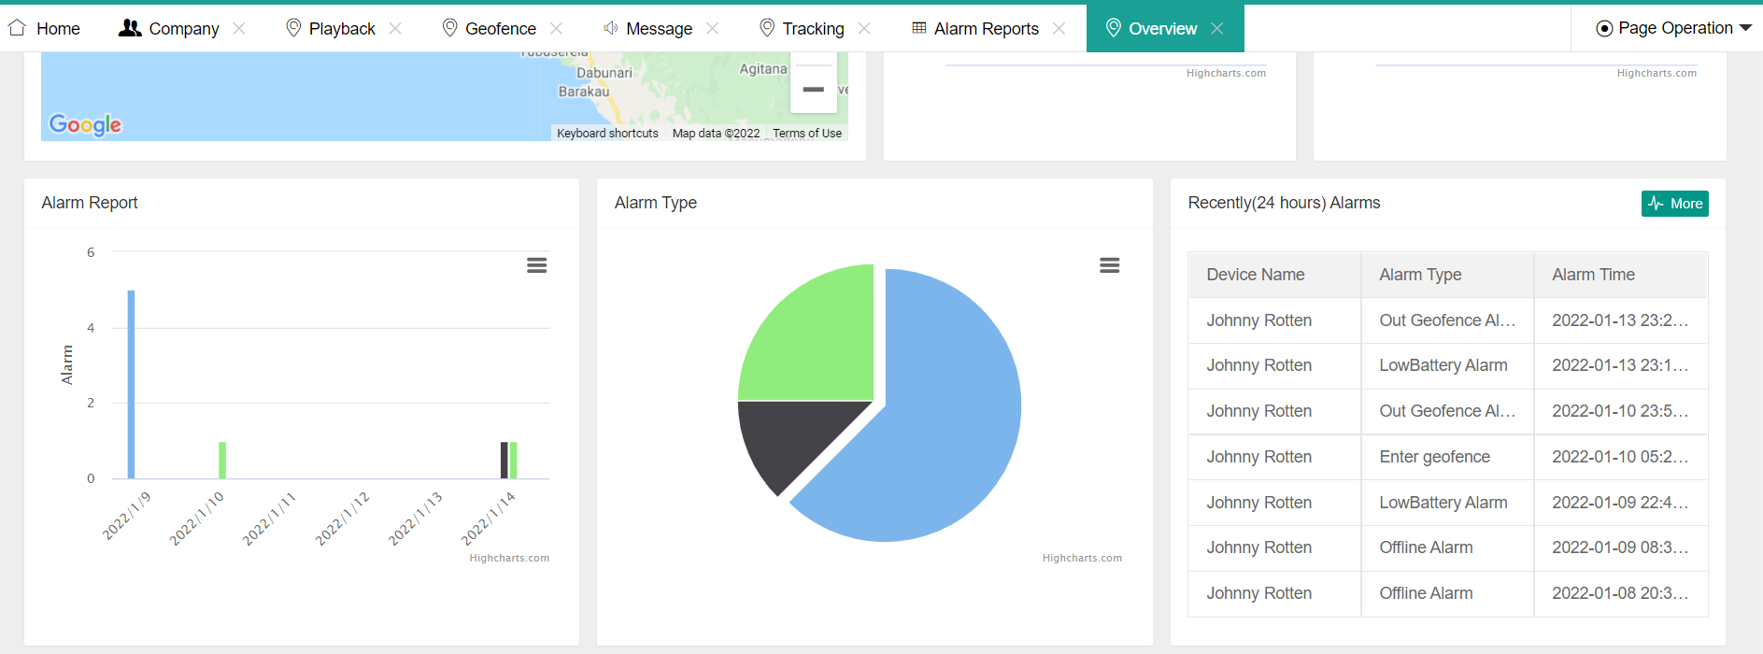
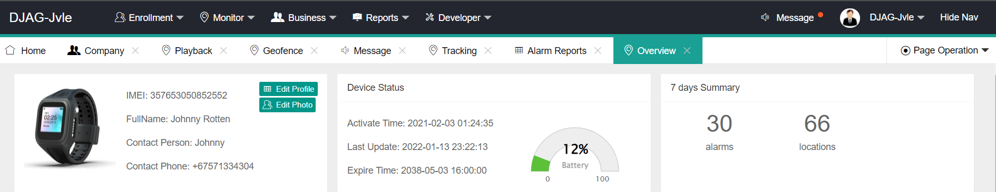
Digital bail
Notes:
What is digital bail?
What benefits does it bring?
Where can it be deployed?
What are the pre-requisites for deployment?
Project progress so far...

Slide 9
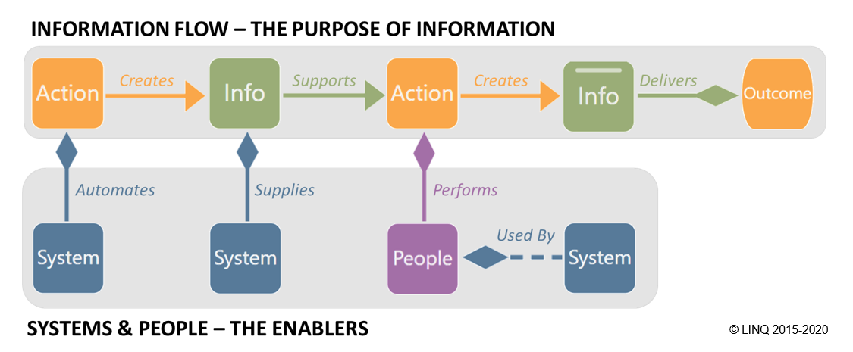
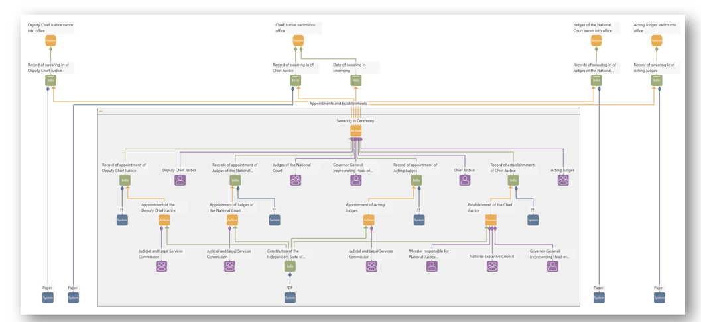
Digital Twin and AI
Notes:
What is a digital twin?
What does a digital twin provide?
What are we building and why?
What role does AI play?
Project progress so far…
An action ‘creates’ content
Content ‘supports’ an action
Content ‘enables’ an outcome
People ‘perform’ an action
A System ‘is used by’ people
A System ‘automates’ an action
A System ‘supplies’ content
Enable ‘Conversational Capture’
Capture the model based on documentation or discussion, not hands on modelling
Provide natural language access to insights
“Tell me about the role of the Chief Justice”
Identify opportunities
If we add 10 Judges, how does our national case disposal rate change?
If we add 10 new Courthouses, how does our national case disposal rate change?

Slide 10
Questions?

