Slide 1
The Value of Partnership and Collaboration in relation to the Memorandum of Understanding between the National Research Institute and the Department of Information Communications Technology
Digital Transformation Summit2024
DR. OLUGBENgA IGE
Senior Research Fellow & PROGRAM LEADER, NSIRRP
3 October 2024

Slide 2
Outline of Presentation
The NRI-DICT Memorandum of Understanding (MoU)
The Objectives of NRI-DICT Memorandum of Understanding (MoU)
Cooperative Activities of the Memorandum of Understanding (MoU)
Emerging Research Projects
Conclusion

Slide 3
The Objectives of NRI-DICT Memorandum of Understanding (MoU)
  The NRI-DICT MoU was signed on 28 February 2024. Under the MoU, NRI and DICT intend to:
  Establish a framework for mutual collaboration to support the extension and strengthening of research exchange and teaching co-operation for their institutions, and for the general benefit of Papua New Guinea (PNG).
  Express their future intention to create a relationship between the institutions for academic and research purposes.
  Cost share resources, expertise and information during the tenure of the program.

Slide 4
Cooperative Activities of the Memorandum of Understanding (MoU)
The participants will collaborate through specific activities mutually determined in writing between them, including on information and communication technologies, research, developing policy papers on fourth industrial revolution (4IR) and other areas of mutual benefit and agreement.
Details of collaborations under this MoU, including the terms of cooperation for each specific activity, will be negotiated and mutually determined in writing by the participants under separate implementation agreements and included as appendices to the MoU.

Slide 5
Cooperative Activities of the Memorandum of Understanding (MoU)
Participants may share Information with each other on a reciprocal basis for research undertaken for the activities under the MoU or any of its appendices, including on ICT and Cybersecurity with the emphasis on influencing policy outcomes on good governance.
The Participants may facilitate future activities in areas of mutual interest including joint academic research projects and organizing conferences, symposia, workshops and lectures.

Slide 6
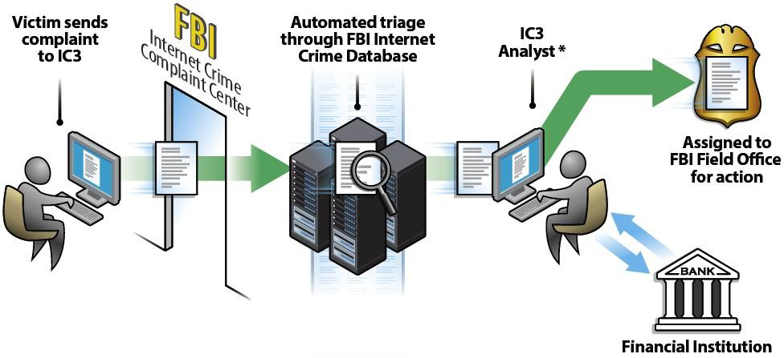
Emerging Areas of Collaboration between NRI and DICT
The Adapted Recovery Asset Model Team for Papua New Guinea
* If these criteria are met, transaction details are forwarded to the identified point of contact at the recipient bank to notify of fraudulent activity and request freezing of the account. Once response is received from the recipient bank, PNGRAT contacts the appropriate RPNGC field office(s).

Slide 7

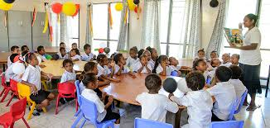

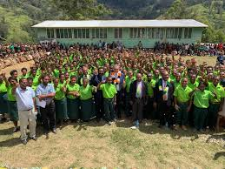

Emerging Areas of Collaboration between NRI and DICT
The PNG Schools Cybersecurity Program
NRI-DICT Cybersecurity Clubs

Slide 8
Conclusion
The Fourth Industrial Revolution (4IR)
The Fourth Industrial Revolution represents a fundamental change in the way we live, work, and relate to one another. It is a new chapter in human development, enabled by extraordinary technological advances comparable to those of the first, second, and third industrial revolutions. These advances are merging the physical, digital, and biological worlds in ways that create both huge promise and potential peril. The speed, breadth, and depth of this revolution are forcing us to rethink how countries develop, how organizations create value, and even what it means to be human (https://www.weforum.org/focus/fourth-industrial-revolution/)

Slide 9
Conclusion
The Fourth Industrial Revolution is about more than just technology-driven change; it is an opportunity to help everyone, including leaders, policymakers, and people from all income groups and nations, harness converging technologies to create an inclusive, human-centered future. The real opportunity is to look beyond technology and find ways to give the greatest number of people the ability to positively impact their families, organizations, and communities.
(https://www.weforum.org/focus/fourth-industrial-revolution/)

Slide 10

Questions

Slide 11


