Slide 1
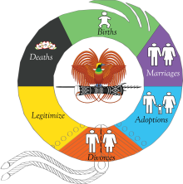

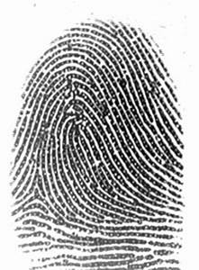
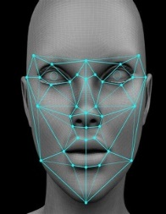
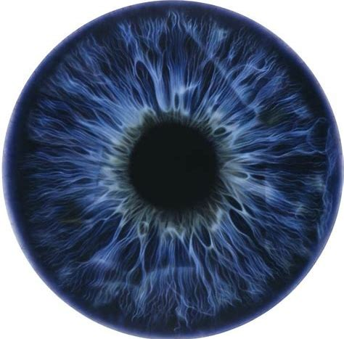

DIGITAL TRANSFORMATION SUMMIT 2024
NAVIGATING DIGITAL TRANSFORMATION TOWARDS 50 YEARS AND BEYOND
COLLABORATIVE GOVERNANCE & INNOVATION
BUILDING BLOCKS – DIGITAL ID
Presentation by:
A/Deputy Registrar General
SALOME BOGOSIA-KEARI

Slide 2
PNGCIR is empowered by its Act, the Civil Registration Act 1963 (Amendment) 2014, to facilitate Identity along with civil registration and vital statistics.
1963 – 2014
(Paper Based )
PNG Civil Registry recorded and maintained registers for births, marriages, adoptions, divorces, deaths, and legitimization
(47 Yrs )
2014
Act was amended to cover Identity as an implementation of SDG 16.9 hence the National Identity Document (NID) Project in 2015.
2015 - Current
NID Project was launched and is managed under PNG Civil and Identity Registry
(9 Yrs)
CRVS
CIRVS

Slide 3
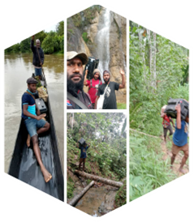
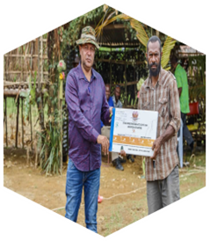
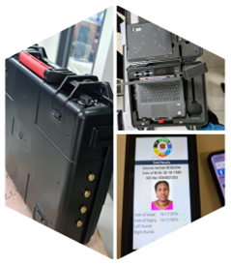
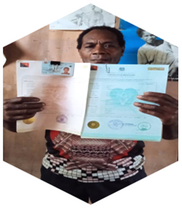
PNG NID : Why it is crucial as a building block.
Legislated: Data collection, transmission, storage, and application are allowed by PNG Laws, which ensures the security of the data stored.
Largest Biometric Database: Over 6TB of data. Good source of statistics.
Reliability: Civil registration data is typically accurate and reliable. It’s collected at birth or other significant life events, making it a trustworthy source.
Completeness: Civil registration covers the entire population, ensuring inclusivity. Everyone, regardless of socio-economic status, should be part of this system. Increase the registration of the unbankable population.
Consistency: The data remains consistent over time. It’s not subject to frequent changes or updates unless permitted by a legal process.
Uniqueness: Each individual has a unique identifier (e.g., birth certificate number) linked to civil registration.
Longitudinal Tracking: Civil registration data spans an individual’s entire life, from birth to death. This continuity is crucial for digital identity systems.

Slide 4
CRVS Ecosystem
Where does the PNG Civil and Identity Registry get its data from?
Civil Identification
Health Sector
Civil Registration
Vital Statistics
The link between Civil Registration, Vital Statistics and Identity Management
As Is, all systems operate in SILOS. Identity Management systems must be sustainable. Systems need to feed each other, and human dependency must be minimized as much as possible.
The Data Flow process from the point of origination to the Civil and Identity Registry for civil registration as a holistic approach to CRVS is non-existent.
Legislative reforms will address these gaps. CIR Bill 2020 table on the floor of parliament with first reading. Once passed it will trigger consequential amendments to the Health, NSO, DPLLGA, Judiciary and Electoral Commission Legislations enabling data sharing and integration of systems.
Papua_New_Guinea_CRVS_Action_Plan_2023_2025.pdf (unescap.org)

Slide 5
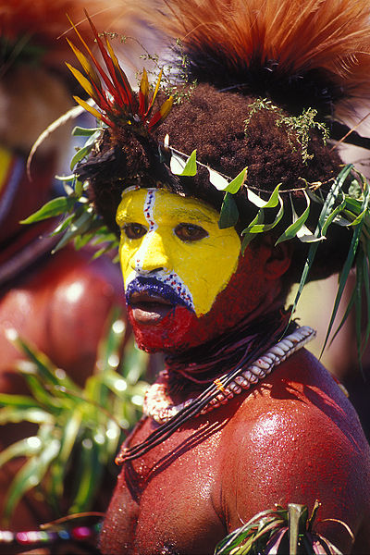
1. WHERE ARE WE NOW?
(30 SEP 2024)

Slide 6
COUNTRY OVERVIEW
Nationwide coverage
  Office Presence: 17/22 Provinces.
  District Office : 3/96 FOC, 3/6 FOD
  Mobile Enrolment: 22/22 Provinces
National Average Cost : K50.00
Cost per registration : K25.00
Processing Cost per file: K25.00
Staffing
440 staff with an average age of 27 years, half with first degrees, GPA of 2.6.

Slide 7
COUNTRY OVERVIEW
A. Civil Registrations:
3,550,982 Million Registrations:
  Birth registration (under 18 years of age) – 27%;
  Births & NID Card (adults) registrations: – 73%;
Processed so far:
  Printed birth certificates: 2.2 million
  Printed NID cards: 1.2 million.
  Backlog
  800,000 Birth certficates
  600,000 NID cards
      B. Vital Statistics:
  Less than 5% for deaths, marriages, adoptions, divorce.

Slide 8
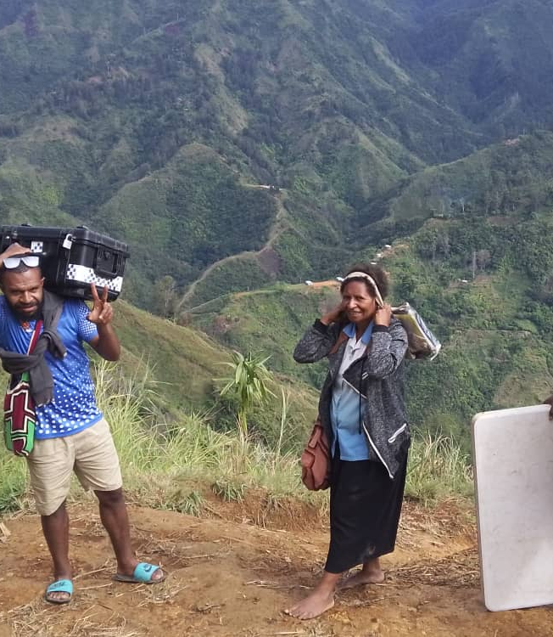
Cost of Registration is High
Simbu Provincial Registrar Nancy Dilu and her MRO team deployed to Gumine Kumai Bomai LLG, M204 at ward 9 and M219 at walked to Ward 5.
Team dropped down for an hour to the river and walked up the mountain again to Kuabala primary school. After registering school moved further up to the mountain to register Diane community. This track is worse than Kokoda track. The registration continue and will be completed tomorrow. We will drop down and its 3- 4hours walk to reach the road for the vehicle to pick us up.

Slide 9
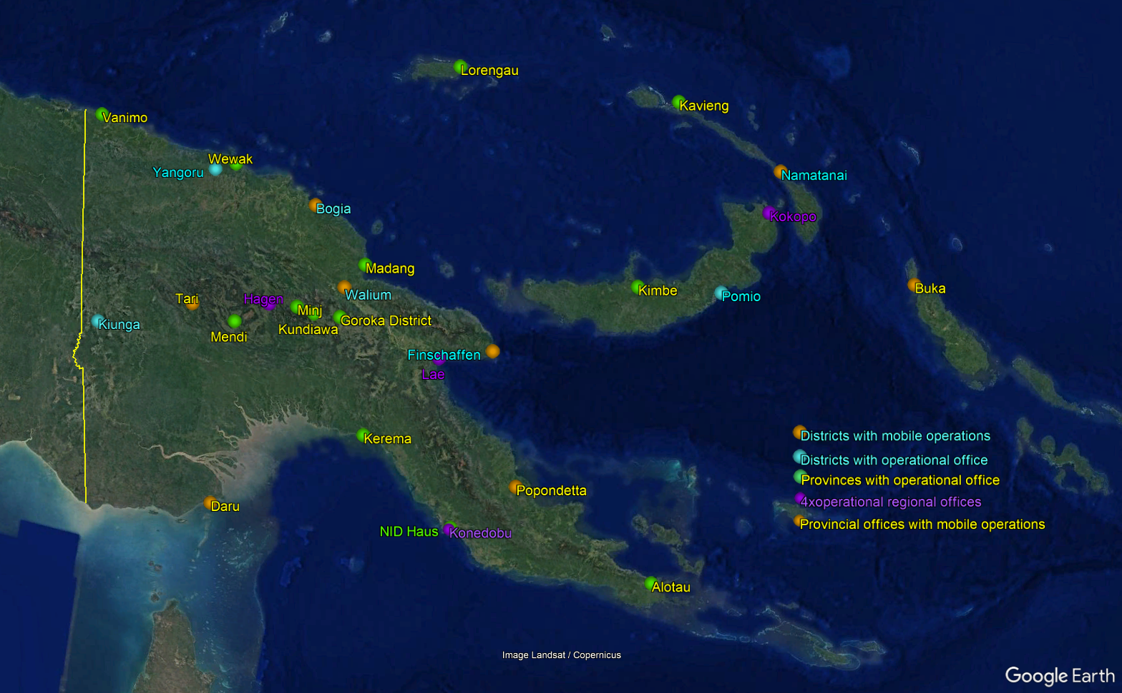
Country Overview
Our Footprint

Slide 10
DATA COLLECTION AND PROCESSING
Data Transportation
NID Registration
Data Transportation
NID Registration
Data Entry
Approval
Printing
Issuance
Data Entry
Forms and biometrics, as well as photos captured for citizens
Data collected at fixed sites and mobile enrolment counters after thorough vetting.
Data is compressed when uploaded onto live system.
CS submitted with each upload.
The National Data Coordination team manages all files through the system
Internal process team works on backlogs daily
Data qualified and stored.
NID number is generated.
Security sensitive.
Compliance watches staff and process
Vital Events Certificates as well as NID Card printing.
Manual QC applies
Manual signing for official certification.
Archives follows immediately after issuance and is another entirely major documentation mobilization exercise by law
Speed is a f(t) .
Veracity of data crucial at this point
Most expensive and time-consuming part.
Opportunity for AI to improve process
Legislation and policy interventions needed to enable system integration.
Internal process team works on backlogs daily
Data qualified and stored.
NID number is generated.
Security sensitive.
The National Data Coordination team manages all files through the system
Opportunity for system upgrade and use of AI to streamline processes while improving security.
Outcome is a f(processing) dependent on staffing, space, and machines.
Legislation and policy will enable further systems upgrades to capitalize on a one-source verified formal legal identity database in its microservices application.

Slide 11

2. CAN WE PULL THIS OFF
I think we can. The future is ours to take.

Slide 12
Experience
Culture
Youth
System Upgrade – process drives technology
Priorities
Mobile Registration Kits
Manpower
KPI Based Work
Systems must feed systems – Our focus is on building the CRVS ecosystem.

Slide 13
National Identity Data is the Genesis of all Data.
~` Hon. MP Tsiamalili Junior, RM AROB and Minister of Police`~
TENK YU TRU!

