Slide 1

Fixed Asset Management System for Government Agencies
A Unified Solution to Optimize Fixed Asset Management Across All Government Agencies
Presenter: Paul Muingnepe
Co-founder & CEO

Slide 2
Outline
Introduction
Kumulsoft FAMS – A Digital Solution
Challenges in Fixed Assets
Solution
Agency Concern
Implementation Strategy
Hosting 39 Government Agencies
DICT FAMS

Slide 3
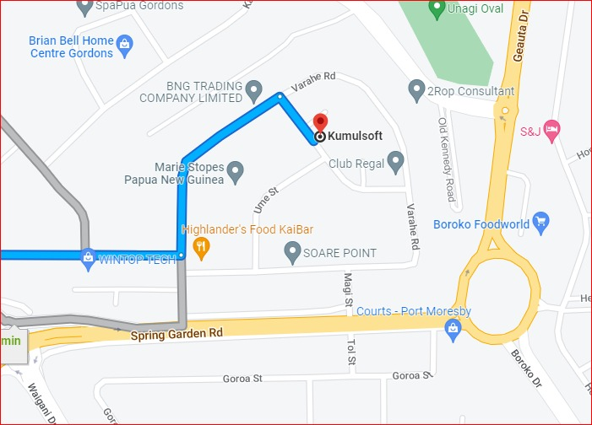
1. INTRODUCTION
Kumulsoft Brief
  Established in 2007
  100 % Locally Owned Software Company
  Owns two Software Products
    Fixed Asset Management System and ( Government)
    Legal Billing System – servicing the Law Firms (SME)
Achievements
  2018 MSME Digital Award for the Best Innovative Micro Enterprise
Physical Location
Unit 11, HT Haus, Ago Street, Gordons Industrial NCD

Slide 4

2. Kumulsoft FAMS – A Digital Solution
Government Shared Service
Mission: Digitalize PNG SMEs’ and Government Sector
This mission drive Kumulsoft to developed two products:
  Fixed Assets Management System (Government)
  Legal Billing Management System (SMEs’)
2020
Digital Transformation Policy
Fixed Assets Management System

Slide 5
What is Fixed Asset management?
Fixed Asset Management is the process of tracking, managing, and maintaining an organization’s physical assets, such as buildings, machinery, and equipment, throughout their lifecycle. The goal is to ensure assets are efficiently utilized, properly maintained, and accurately accounted for, while optimizing performance and reducing costs.

Slide 6
Challenges in Fixed Assets
Core Issues for all government agencies:
  Insufficient and inaccurate fixed assets register Records
  Inaccurate Financial Statement of Fixed Assets
  No proper inventory and stock take
  Lack of maintenance and update
  No proper acquisition and registration
Unaccounted asset value – from 2015 – 2019 : K3.7 Billion
Note: Based on Desktop Research of Auditor Generals 2015-2019 Report

Slide 7

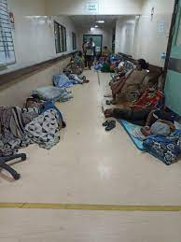
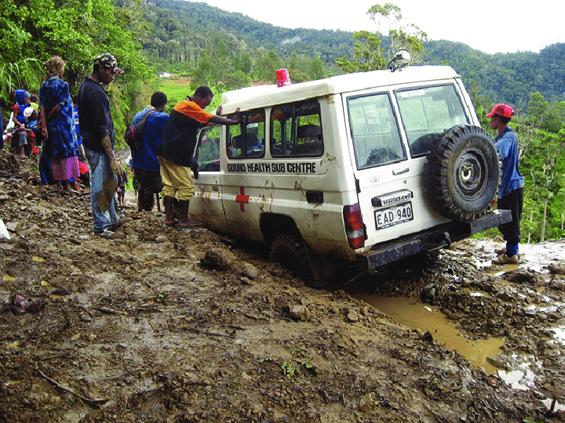

Control & Issue of Firearms
Hospital No Bed
Rural Health Ambulance
Classroom no Desks

Slide 8

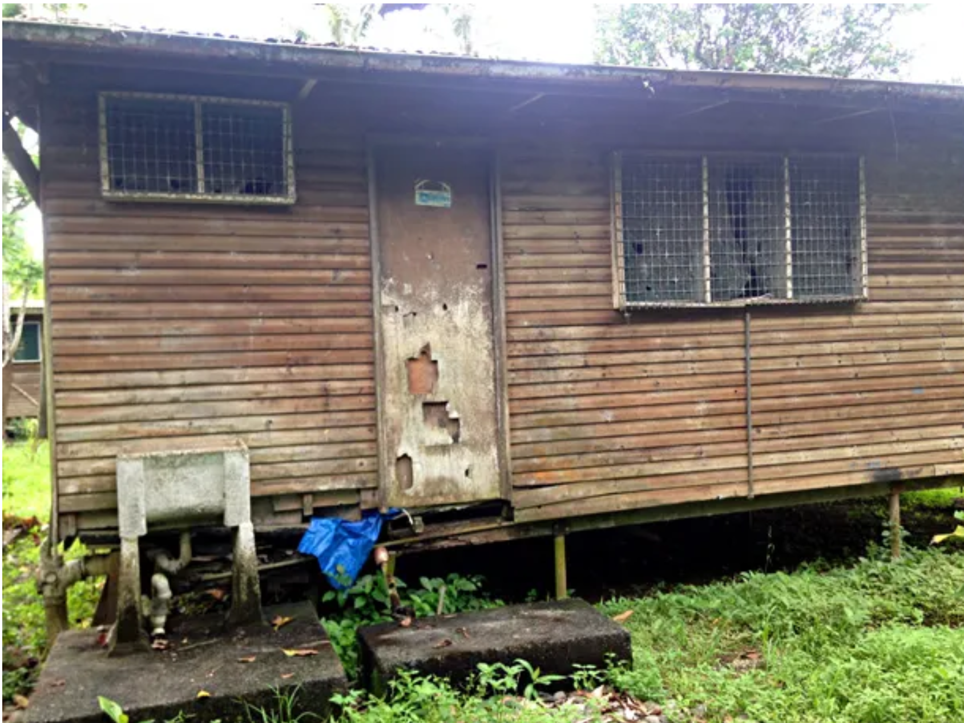
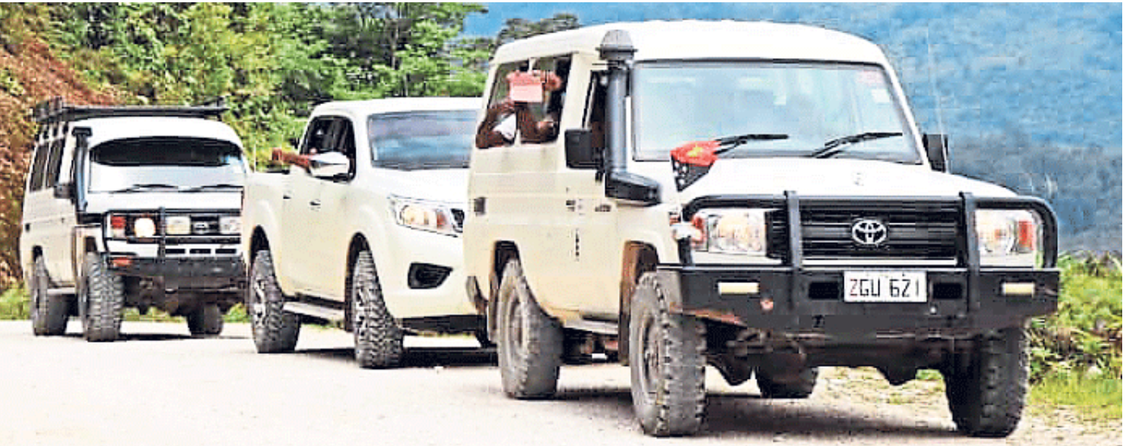
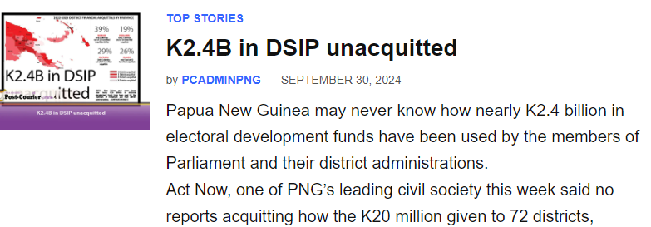
Bomana Prison
Run Down Police House
Police house in Poor Condition
DSIP Funded District Vehicles

Slide 9

Solution
Acquisition
Inventory
Allocation
Maintenance
Reports
Depreciation
Disposal
Kumulsoft Integrated Fixed Asset Management System. (General Asset, Fleet & Property Modules)
The software addresses Public Finance Management Manual Part 32
Control of asset theft and misuse
Save cost
Track and control asset movement
Prudent asset reporting

Slide 10
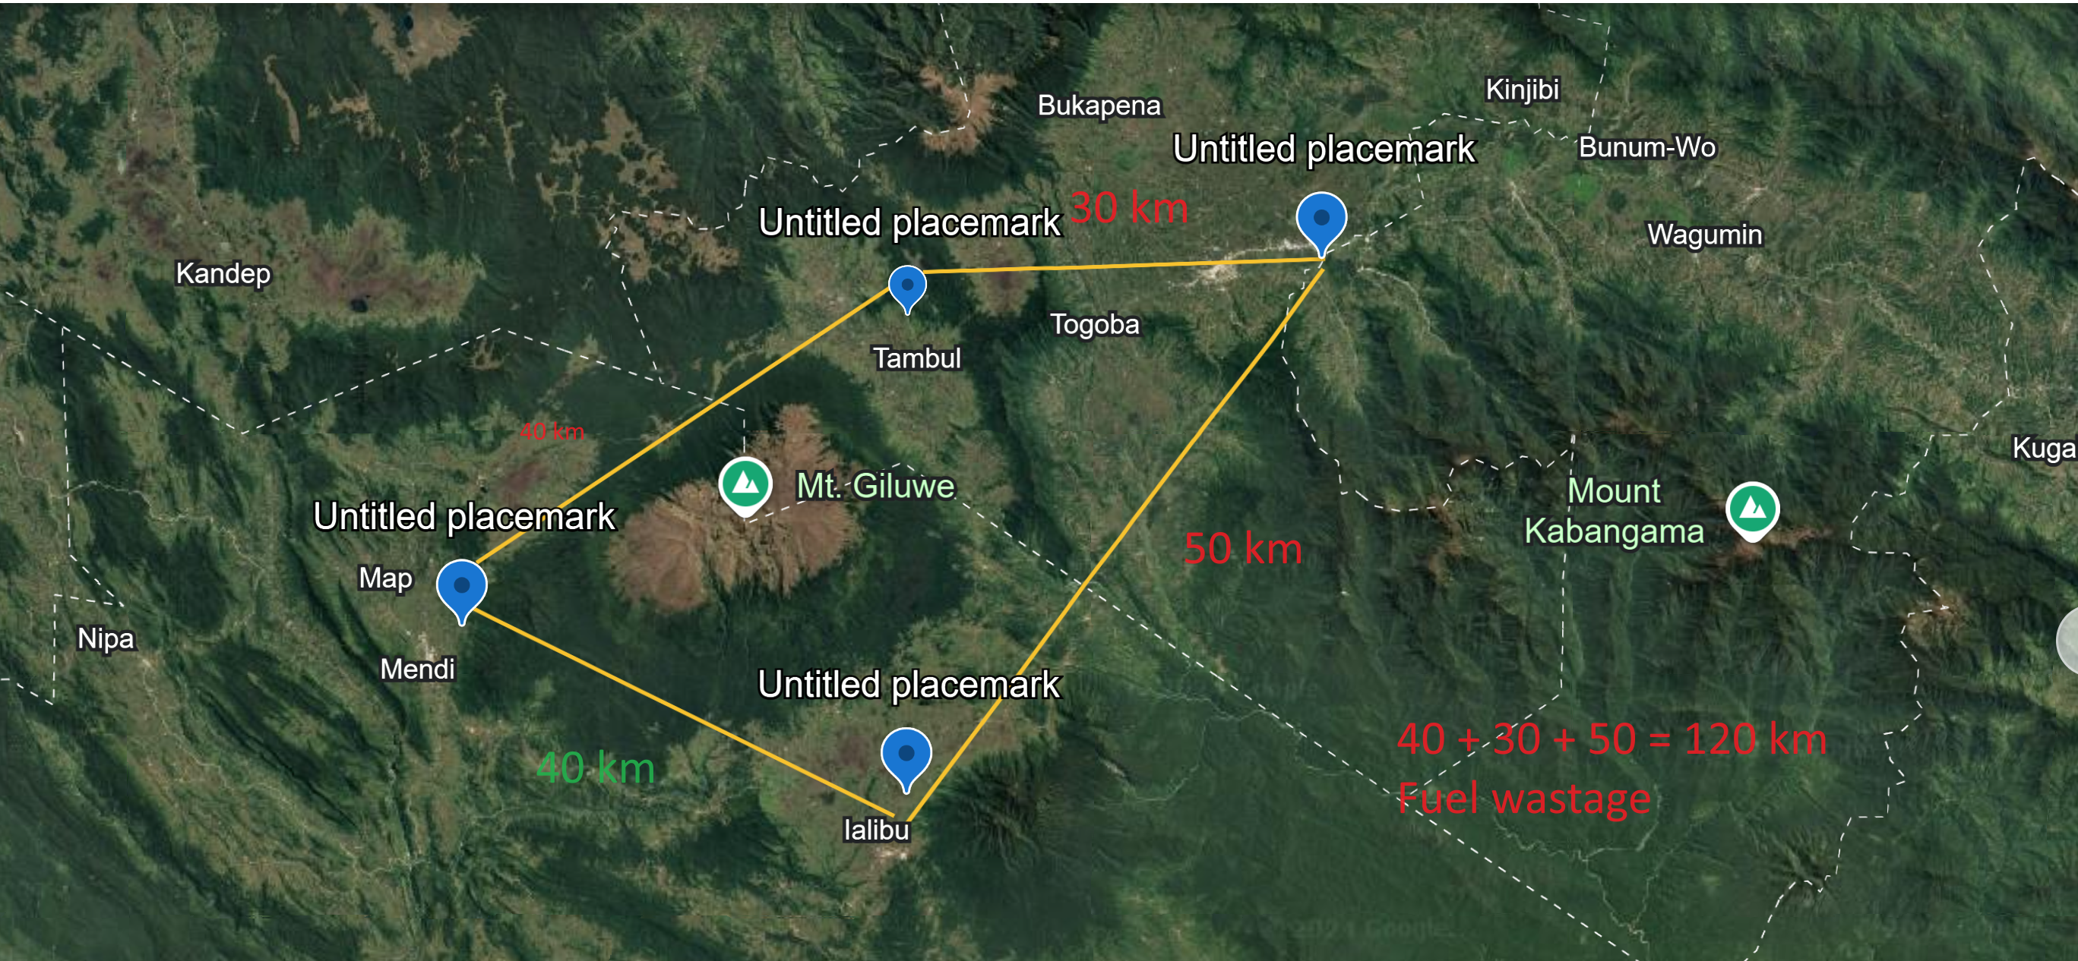
User Case: Southern Highlands PHA
50 % Fuel saved after introduction of Kumulsoft FAMS
Ialibu to Mendi PHA = 40 km to collect medical supplies

Slide 11


Agency Concern
Data Security and Hosting
Subscription
Transfer
Kumulsoft Cloud Infrastructure
Government Leased Cloud Infrastructure

Slide 12
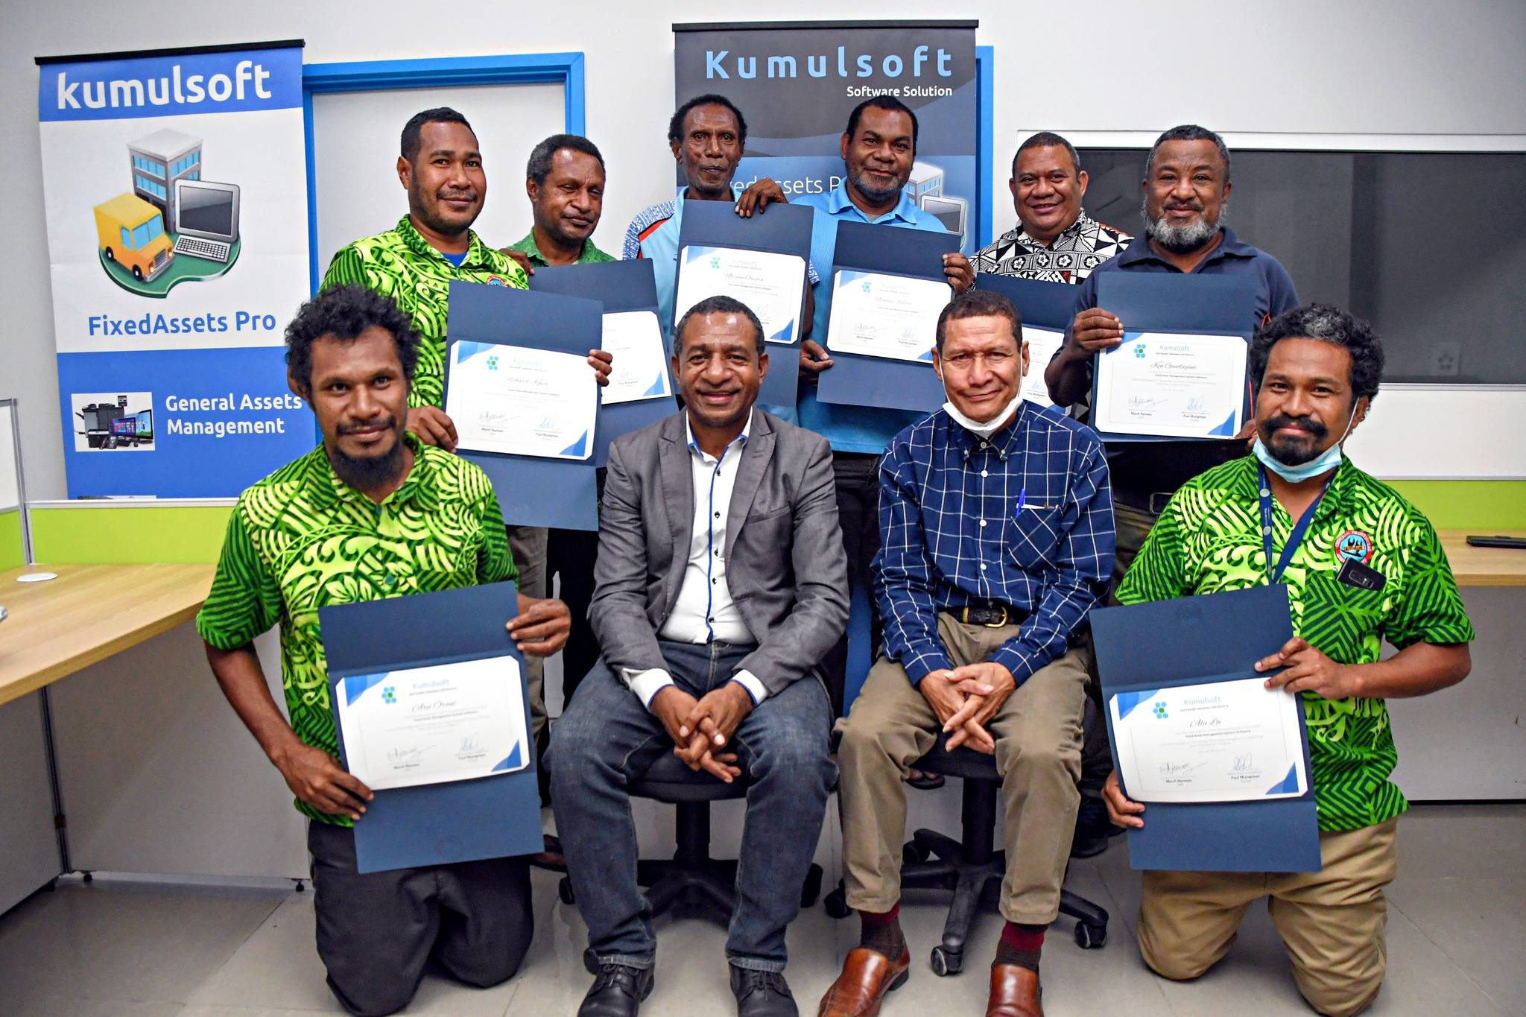
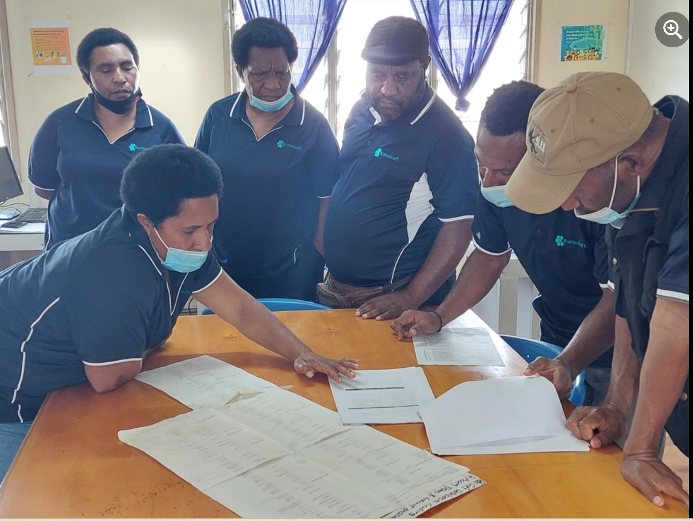
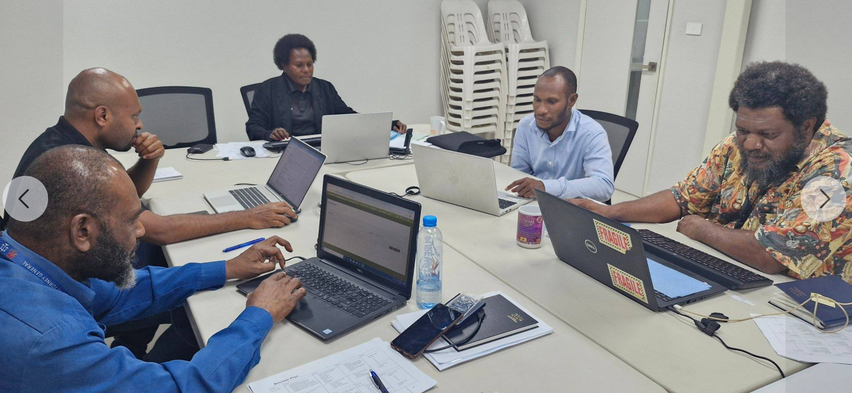

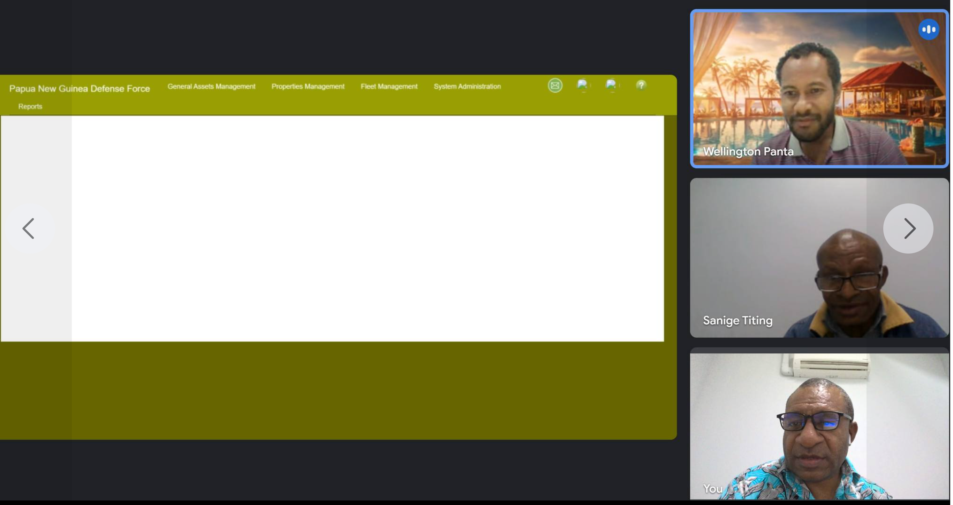
Implementation Strategy
Training and Support
Research and Development (RND)

Slide 13







































Hosting 39 Government Agencies

Slide 14
DICT FAMS
DICT Fixed Assets Account: Link
https://dict.fixedassetspro.com/login.html
Thank you

