Slide 1


Digital Transformation Summit 2024
1st – 3rd October
Department of Education
DIGITAL INTERVENTIONS
TPODARUA - ICTD
Department of Education
Digital Transformation Summit 2024 Department of Education 2024

Slide 2
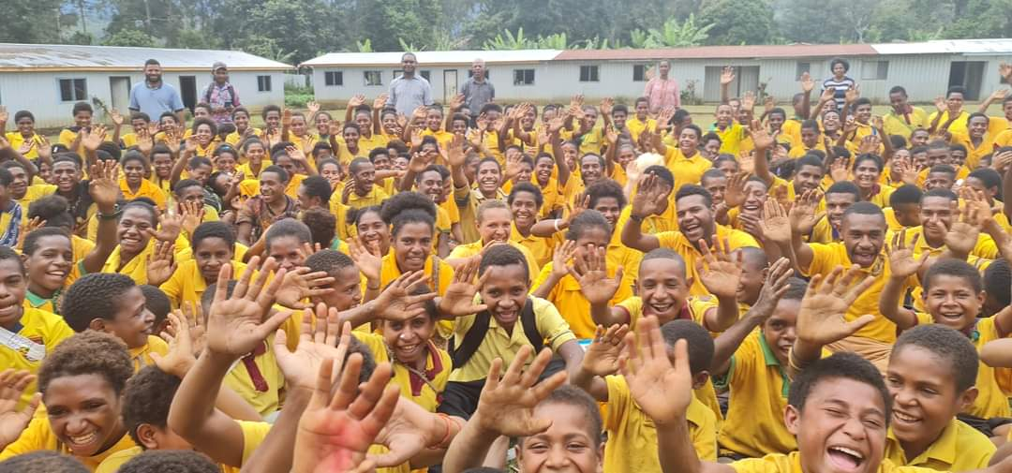
Department of Education
14,000 schools
75,000 teachers
2.6 million students
Student Population
  472,000 (1975 -1990)
  19% increase
Digital Transformation Summit 2024 Department of Education 2024

Slide 3


Department of Education
PNGETV 2075
  FA4 – Digitization
NEP – 2020 – 2029
  FA1 getting children ready to learn – Unique ID
  FA3 getting school ready for teachers and students
    Enhancing Teaching & Learning through Digital transformation
    Internet & eLibraries for all schools
  FA5 Modernization Education Sector
    Unified system for teachers, students and school
    Digitization of systems and processes
Digital Transformation Summit 2024 Department of Education 2024

Slide 4
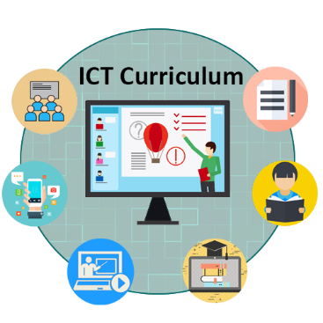
Department of Education
K – 12
STEM
AI & Machine Learning
Digital Transformation Summit 2024 Department of Education 2024

Slide 5
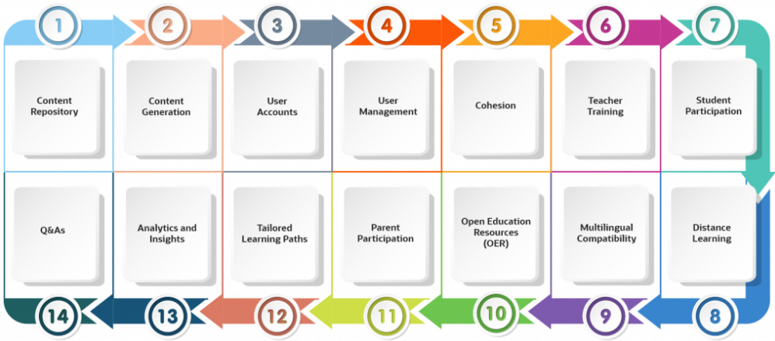
Department of Education
MyPNGLMS
  Open Source
  Oracle/ Dataco/ DICT/ Ekstep/DoE
Digital Transformation Summit 2024 Department of Education 2024

Slide 6
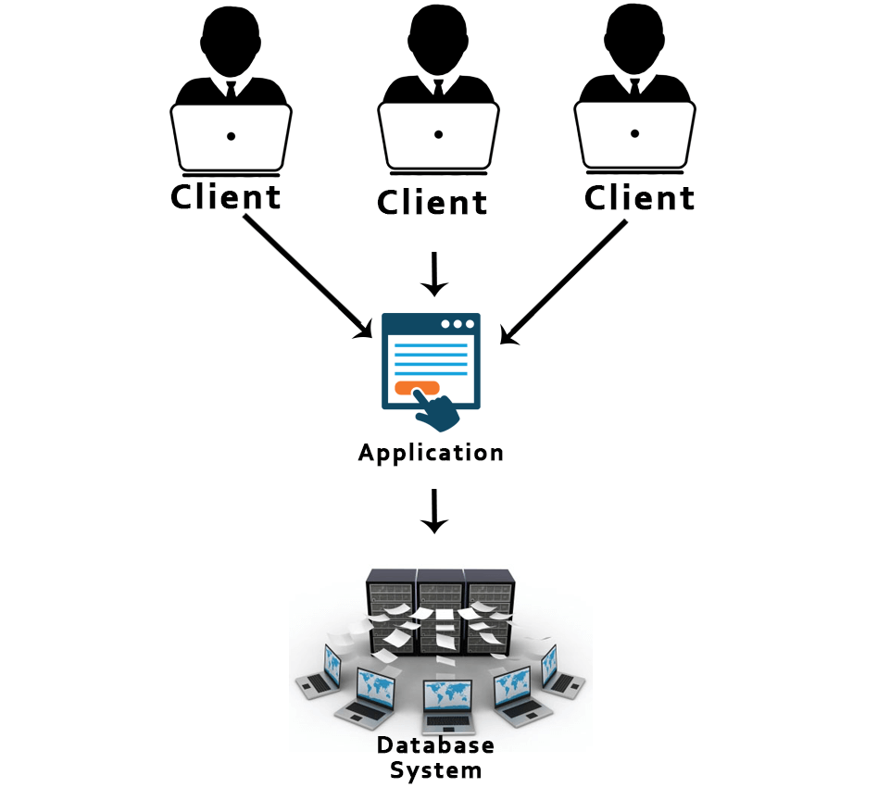
Department of Education
MyITIMS
  A Unified Teacher Information System
  Integrate All DBs holding Teacher Information
  One Data Warehouse for
  the Ministry
  Automate Business processes
Digital Transformation Summit 2024 Department of Education 2024

Slide 7
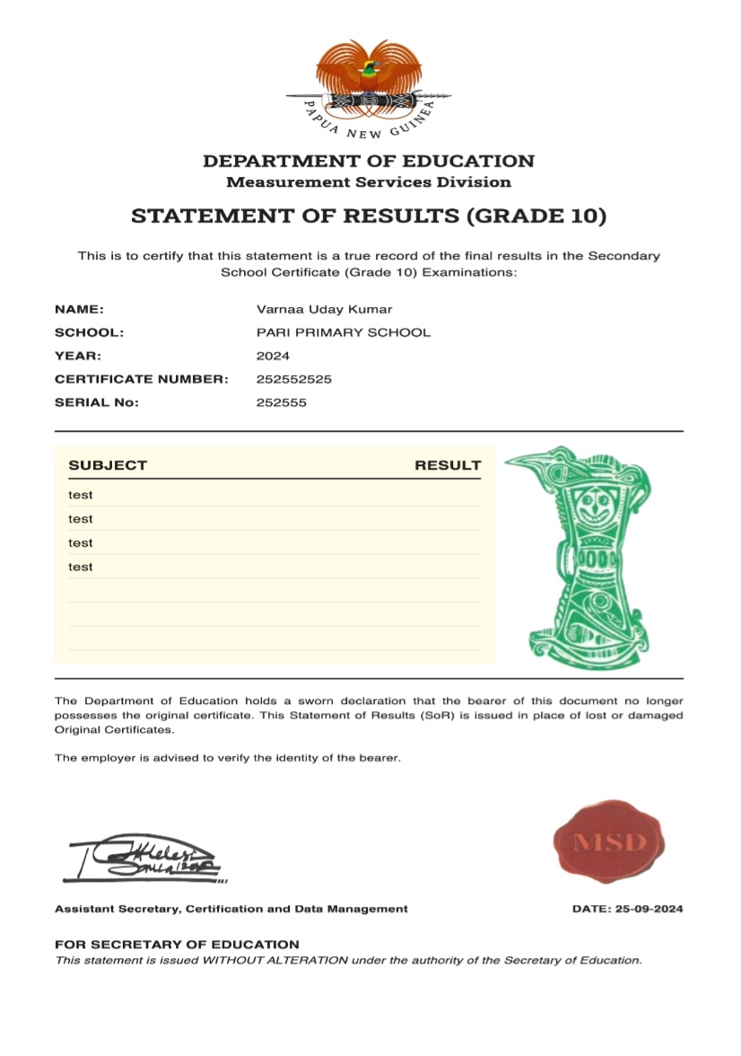
Department of Education
G2C
  Statement of Results
  School Fee payments
Digital Transformation Summit 2024 Department of Education 2024

Slide 8
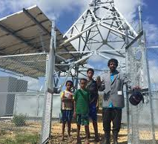
Department of Education
A whole of Government Approach
  Infrastructure
  Pricing for Education/Teachers/students
  Minimize Digital Gap
Digital Transformation Summit 2024 Department of Education 2024

Slide 9
Department of Education
Thank you
Digital Transformation Summit 2024 Department of Education 2024

