Slide 1


Slide 2
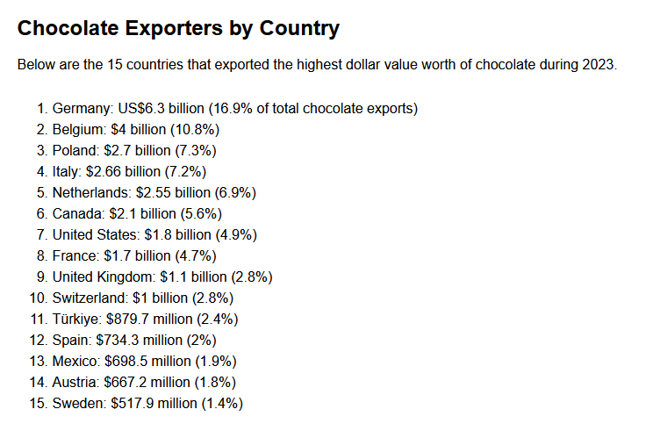
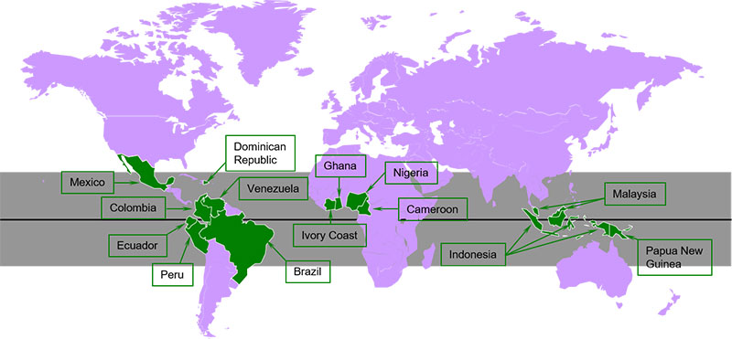
https://www.worldstopexports.com/chocolate-exporters/

Slide 3
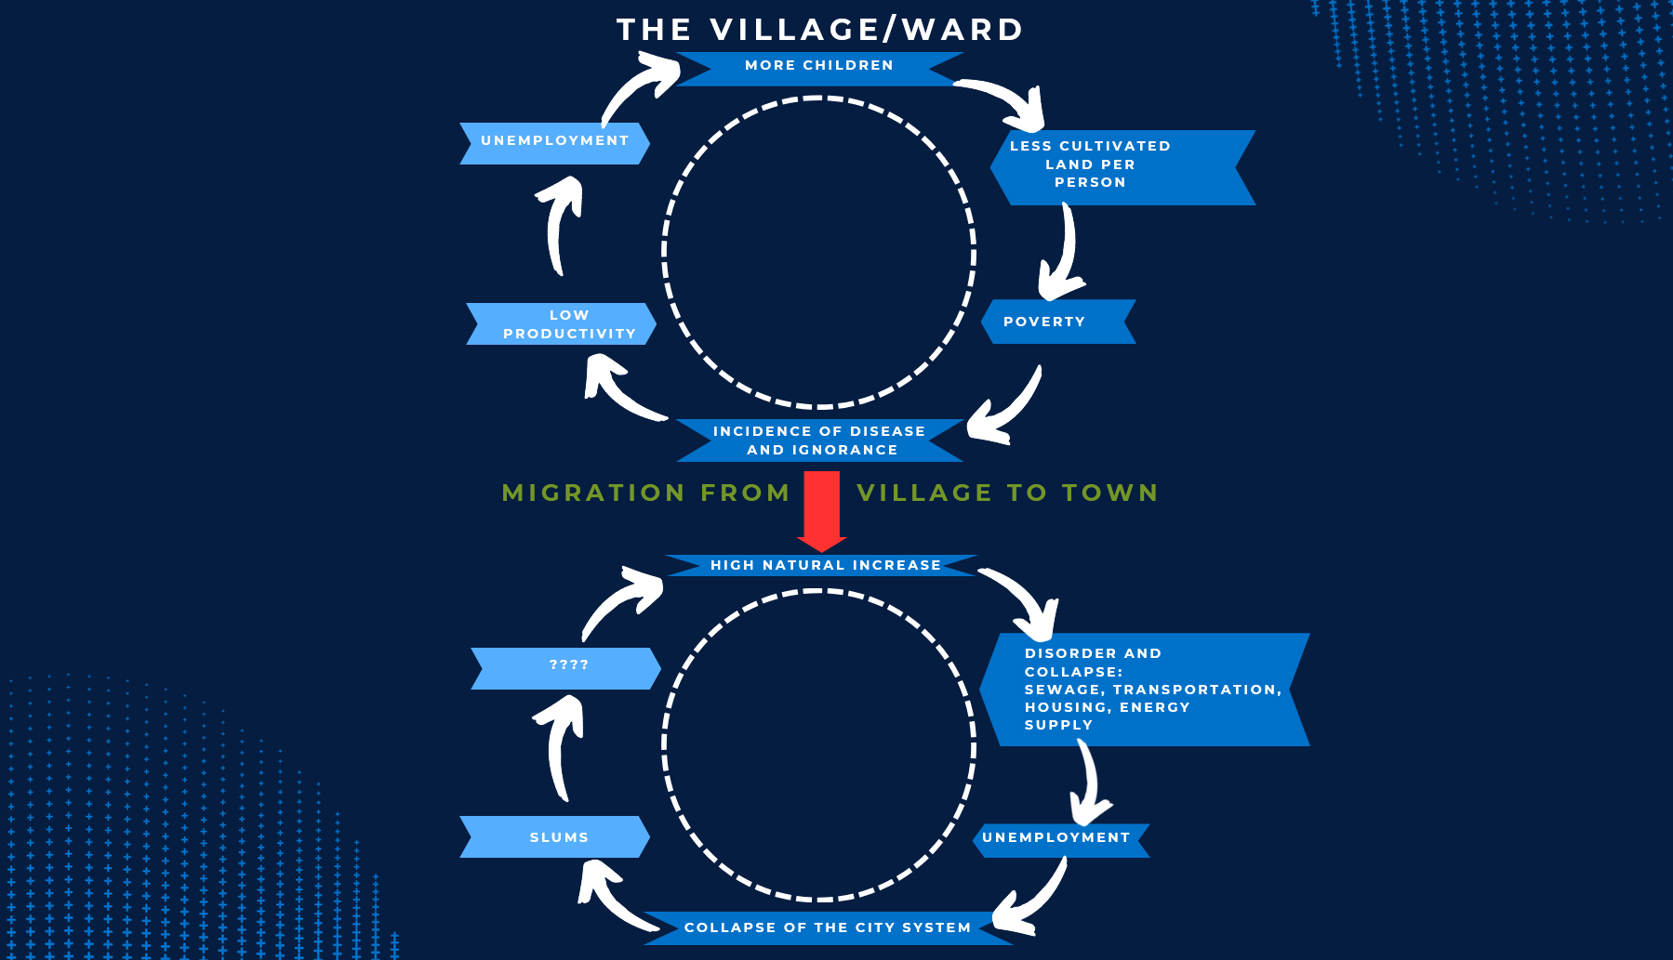

Slide 4

DPLGA
Central Coordinating Agency to all Sub-National Entities while providing the essential link between the three tiers of Government.
Mandated under the Organic Law on Provincial and Local Level Government (OLPLLG) and other enabling Legislations
One of the few Departments that implements an Organic Law as its PRIMARY LEGISLATION

Slide 5
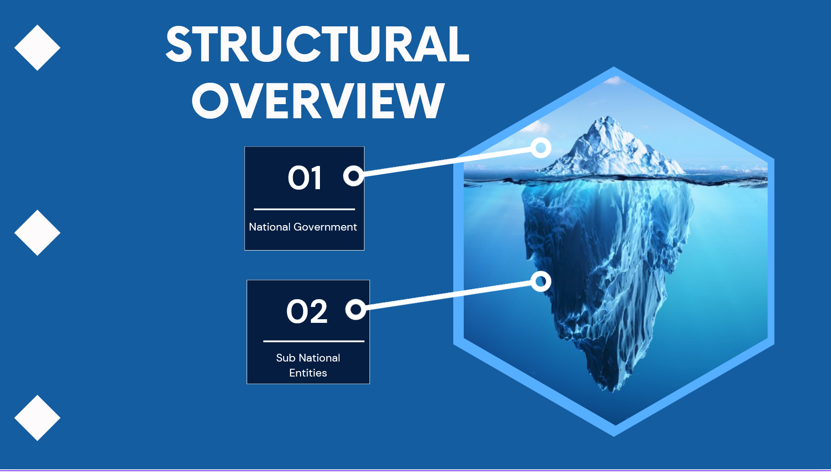

Slide 6
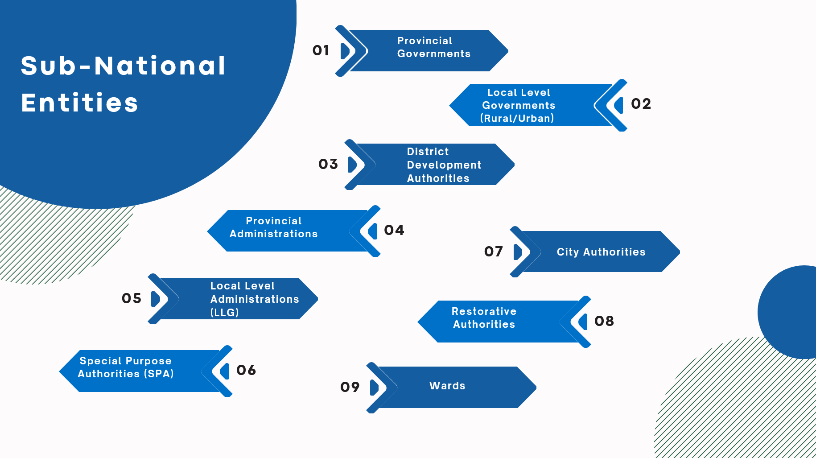

Slide 7
PM and NEC Act 2002
8. NATIONAL SECURITY COUNCIL.
(1) The National Security Council established Section 3 of the National Intelligence Organization Act 1984 continues in establishment.
(2) The Council shall consist of –
(a) the Prime Minister, who shall be Chairman; and
(b) the Deputy Prime Minister; and
(c) the Minister responsible for defence matters; and
(d) the Minister responsible for foreign affairs matters; and
(e) the Minister responsible for provincial affairs matters; and
(f) the Minister responsible for police matters; and
(g) the Minister responsible for treasury matters.
(3) The Chairman may co-opt such other Ministers to be members of the
Council from time to time as he considers necessary.
(4) Where the Council is considering an application for a warrant under Part
VI of the National Intelligence Organization Act 1984, the Minister responsible for
justice matters shall be deemed to be a member of the Council.

Slide 8
9. FUNCTIONS OF THE COUNCIL.
The functions of the Council are –
(a) to determine and direct the action to be taken in respect of matters affecting the sovereign integrity and security of Papua New Guinea and the security of its people; and
(b) to provide guidance and direction to those elements of Government which are responsible for –
(i) matters affecting the maintenance of good order in Papua New Guinea; and

Slide 9
11. NATIONAL SECURITY ADVISORY COMMITTEE.
(1) The National Security Advisory Committee is hereby established.
(2) The Committee shall consist of –
(a) the Chief Secretary to Government, who shall be Chairman; and
(b) the Departmental Head of the Department responsible for personnel management matters, who shall be Deputy Chairman; and
(c) the Department Head of the Department responsible for treasury and finance matters; and
(d) the Departmental Head of the Department responsible for national planning and monitoring; and
(e) the Departmental Head of the Department of the Attorney-General; and
(f) the Departmental Head of the Department responsible for provincial and local-level government affairs; and
(g) the Departmental Head of the Department responsible for defence matters; and

Slide 10
“National Security” refers to everything a state does, both in order to ensure its continued existence as a sovereign entity in a given territory, and to defend its essential interests. Survival is the motivating force behind national security considerations and is a basic, objective value common to all nations. Therefore, by definition, the quest for national security requires no justification.
In contrast; essential national interests may differ significantly from one country or government to another, as they depend, to a large extent, upon political culture, dominant ideology, tradition, physical conditions, national aspirations and other subjective factors. In addition, every basic interest is subject to periodic review by the society that upholds it, to examine if it is still one in the defence of which the leadership may rally the people and if the struggle to achieve it justifies recourse to arms.

Slide 11
National Security is a composite concept, the following being a few of its salient aspects:
• The population – its size, pattern of dispersal and birth and death rates
• The territorial configuration of the state – size, climate, topography and borders
• National assets – natural resources, infrastructure and industrial capability
• The society – its cohesion, moral strength, morale and degree of stability
• The government – its character, legitimacy, style of leadership and formal pattern of rule
• The economy – capital, financial returns, rate of growth and potential for development
• International standing – power of deterrence, foreign relations (overt and covert) and military and/or political treaties
• The military force – its capability, state of readiness and relations with the political rank

Slide 12
A nation’s strength is measured in terms of its ability to mobilise the physical and human resources at its disposal. Strength is, of course, a central component of a nation’s security and dictates to what extent an attack can be withstood or effectively delivered. Whereas the ability to withstand attack depends on a country’s overall assets, the ability to give battle depends on military strength.
The balance between defensive and offensive capabilities derives, to a large extent, from the way in which national resources are divided. An unbalanced allocation of resources will be detrimental to a country’s overall strength. For example, a government that decides to enlarge the military budget at the expense of the education budget may well find itself with a strong military dependent on a weak or undeveloped society. Therefore, the most demanding task for national security policymakers is to determine the correct balance in allocation of the resources at their disposal.

Slide 13
When we speak of national defence, we refer to the military, an entity quite distinct from the system that upholds national security. The danger of confusing the two is very real, especially in countries that hold the military in disproportionately high esteem. Notwithstanding that systems charged with upholding national security exist in every modern state and the motivating force behind them is the basic wish to survive, definitions of the essence of national security vary. It is universally the case, however, that national security considerations and interpretation of these interests deeply influence the life of a nation – the standard of living, the extent of civic freedom, the allocation of resources and the decision as to who will monopolise the management and legitimate perpetration of violence on the nation’s behalf.

Slide 14
PLLSMA Mandate - Sect 110, OLPLLG
(4) The principal functions of the Authority are–
(a) to co-ordinate and monitor the implementation of the national policies at the provincial and local-level; and
(b) to establish minimum development standards and to monitor maintenance of those standards in the overall development of the rural and urban communities; and
(c) to assist the Auditor-General carry out the performance audit of the Provincial Government and Local-level Government affairs; and
(d) to develop, co-ordinate and monitor the training and professional needs of the officers of the National Public Service assigned to the provinces and districts; and
(e) to assess the effectiveness and efficiency of the Provincial Governments and the Local-level Governments; and
(f) to execute powers and functions that are delegated to it by law; and
(g) to make recommendations to the Minister responsible for provincial government and local-level government matters in the strengthening of the decentralisation of government; and
(h) to ensure that all appointments to offices in a Provincial Government and a Local level Government are based on merit.

Slide 15
Subdivision L.155 – Planning and Data System.
106. PROVINCIAL PLANNING AND DATA SYSTEM.
156(1) There shall be established in each province an extended service of the Department responsible for planning matters and of the National Statistical Office.
(2) The functions of these services are to establish and maintain an effective and efficient provincial and local-level planning and data system.
(3)157 158 There shall be a census or the count of all natural persons in each province in the year proceeding a general election, other than–
(a) the general election held next after certification of this Organic Law; and
(b) a general election following a dissolution of Parliament under Section 105(1)(b) or
(c) (General Elections) of the Constitution.
(4) An Act of the Parliament shall prescribe the types of records or data to be kept and details of the planning and data control system for the Provincial governments and Local-level Governments.

Slide 16
LLGAA 1997
S.57. VILLAGE BOOKS.
(1) A Local-level Government shall establish and maintain for each ward within the Local-level Government area a register to be known as the Village Book.
(2) A Village Book shall contain information as to–
(a) the names, clans, ethnic groups and, where applicable, addresses of all persons within the ward; and
(b) the particulars of village officials; and
(c) such information on assets, facilities and other matters relating to the ward as the Minister directs.
(3) A person to whom Subsection (2)(a) applies shall provide information relevant to the compilation and maintenance of the Village Book.
(4) A Village Book shall be in a format directed by the Minister.
(5) The Village Book–
(a) is a public document; and
(b) shall be kept within the ward; and
(c) shall be available for inspection at reasonable times.
(6) The Regulations may prescribe other matters relating to the format,
contents, manner of maintaining and access to the Village Book.

Slide 17
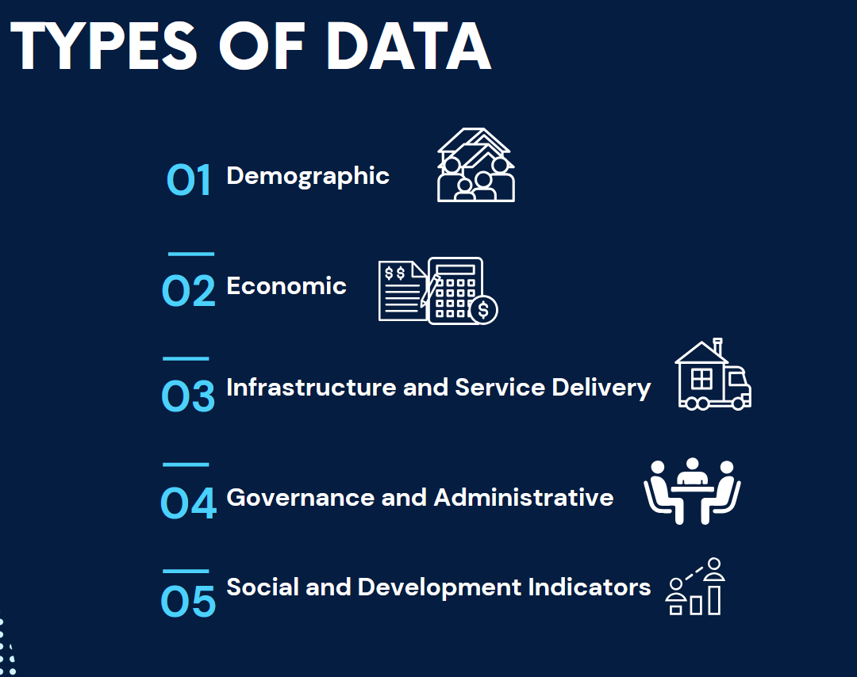
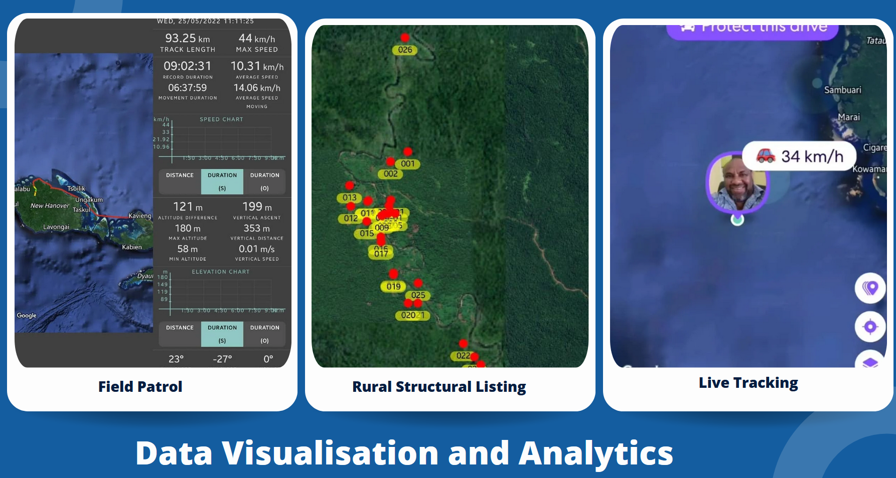
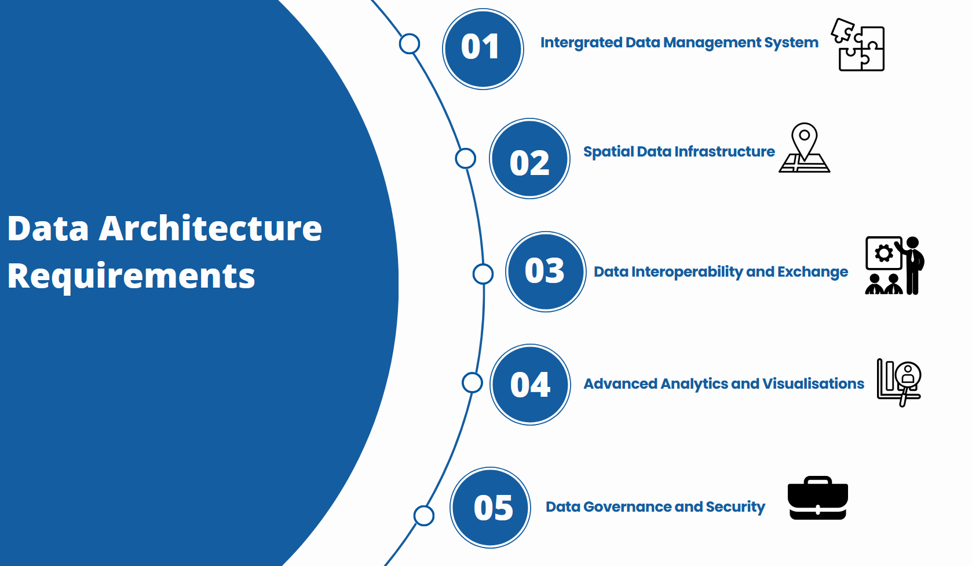
Now working on Digital Integration and Online Hosting

Slide 18
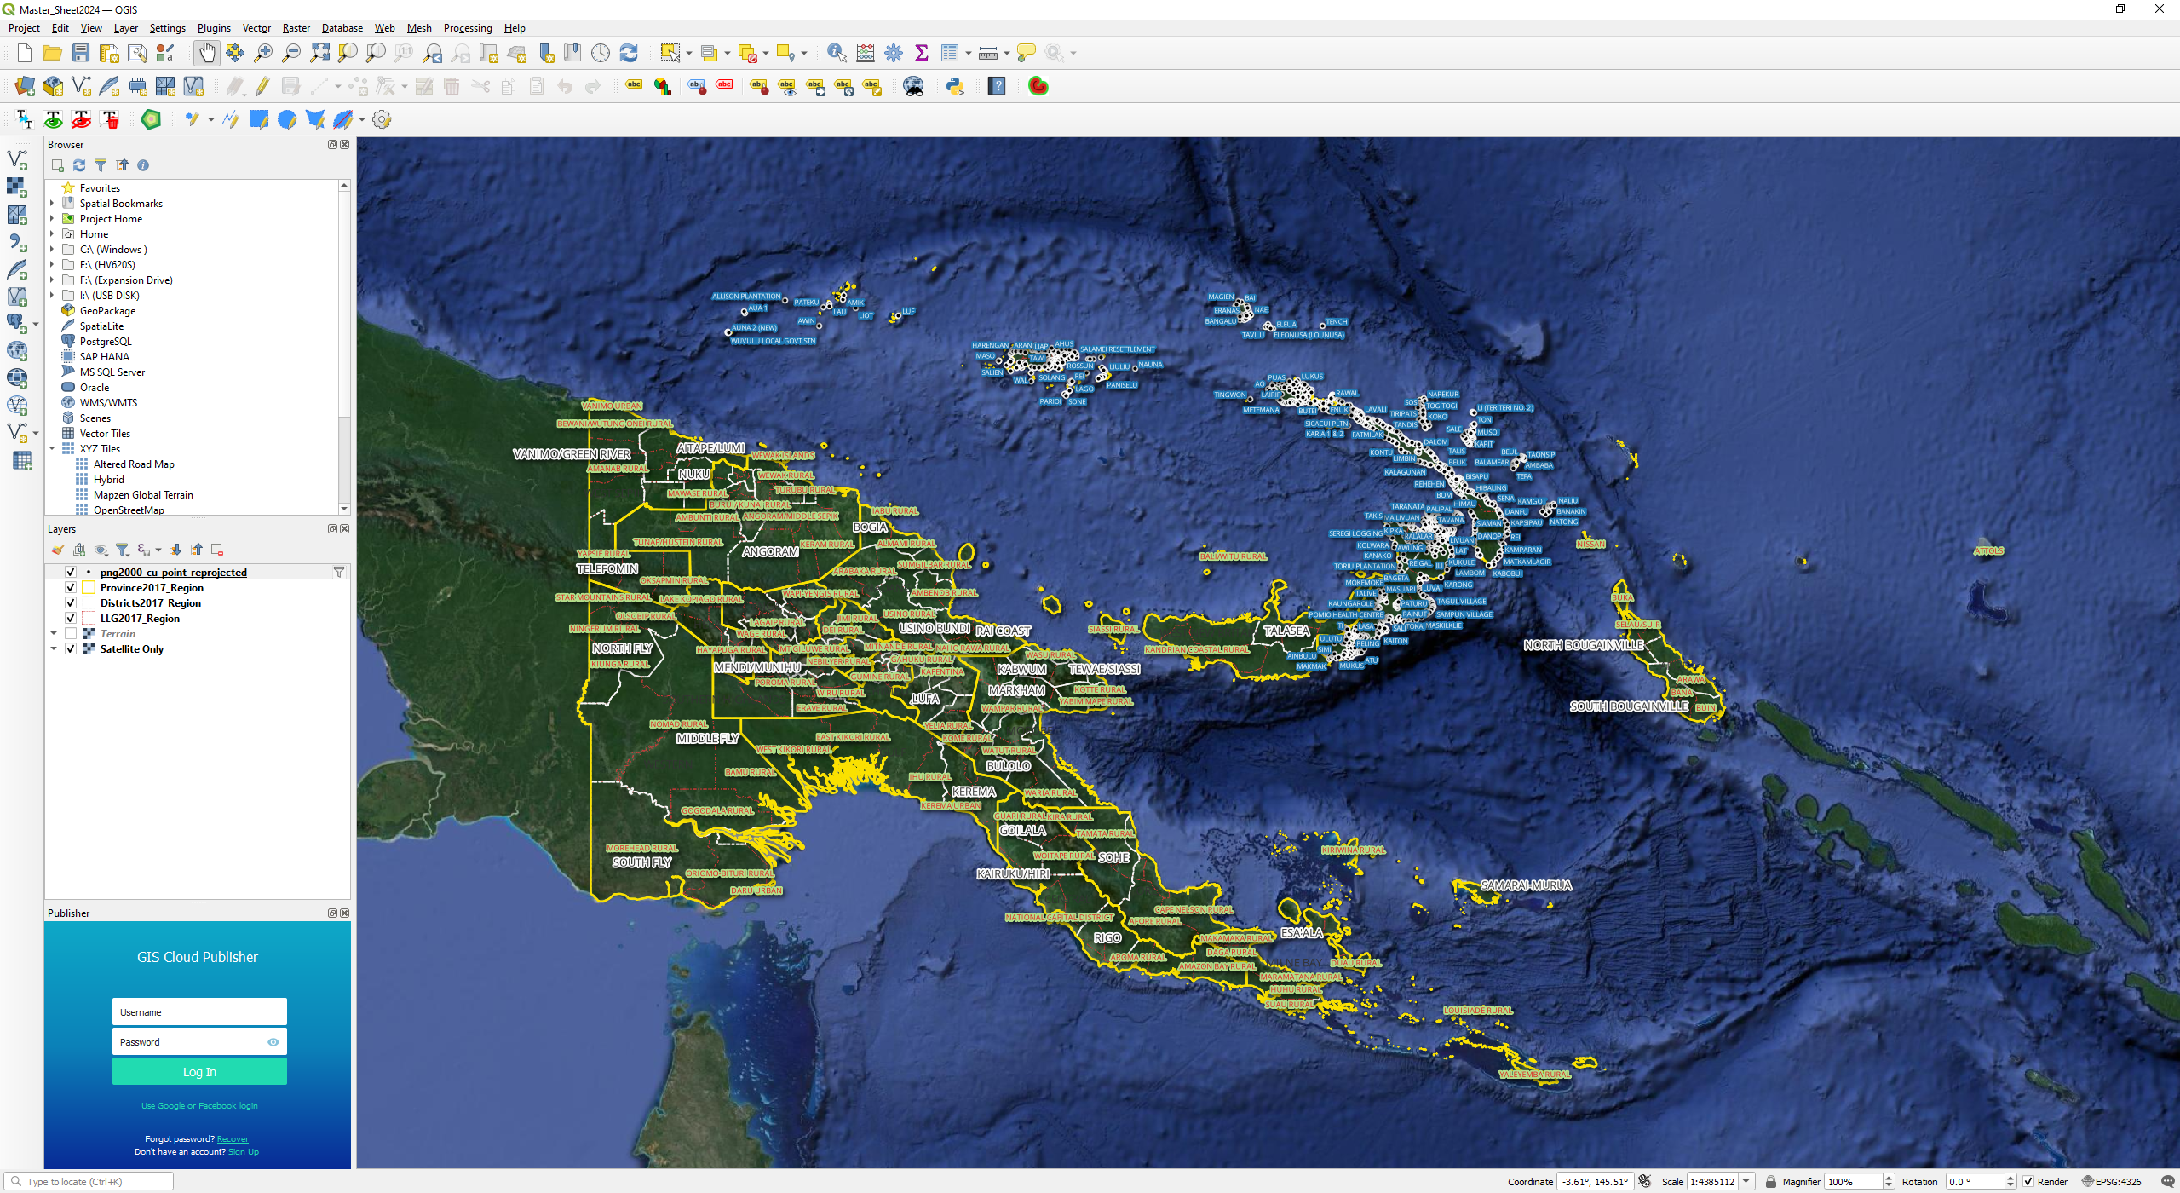

Slide 19
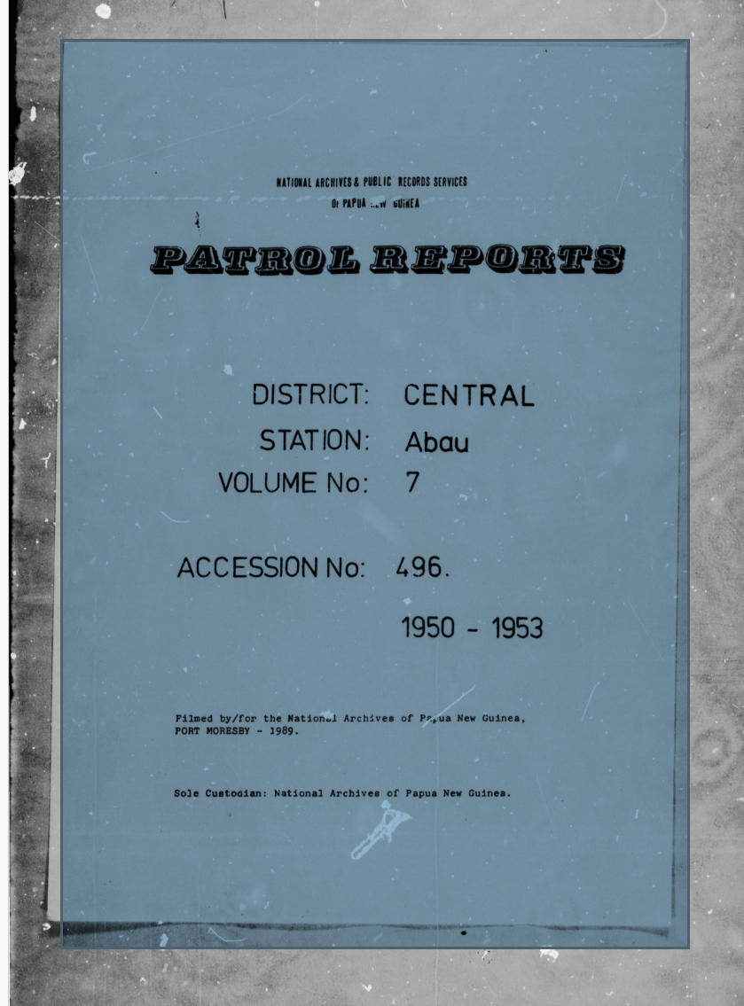
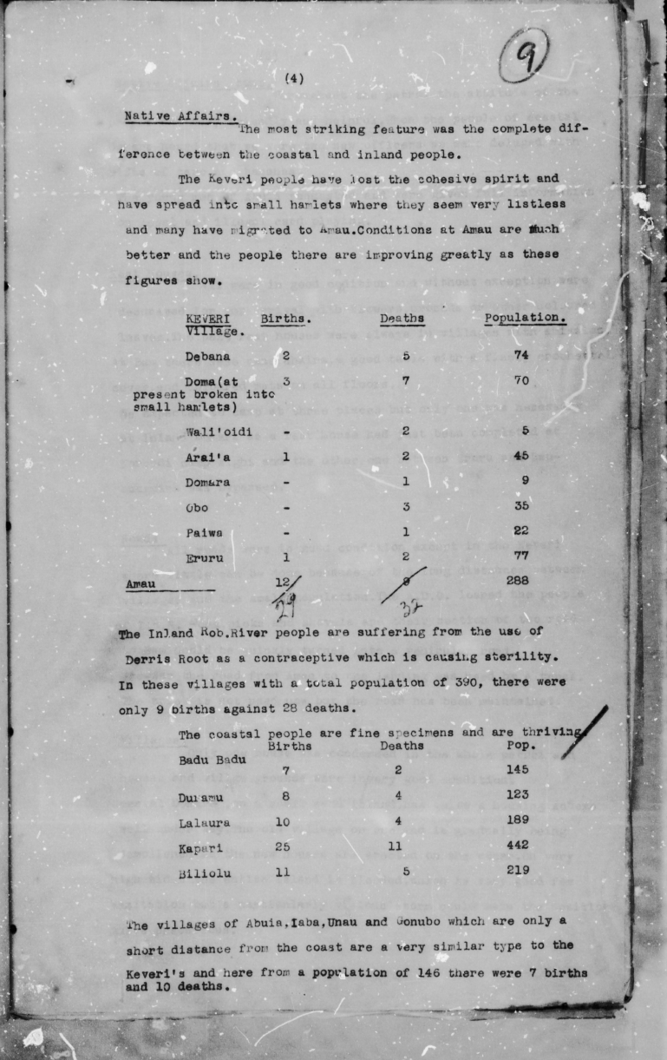
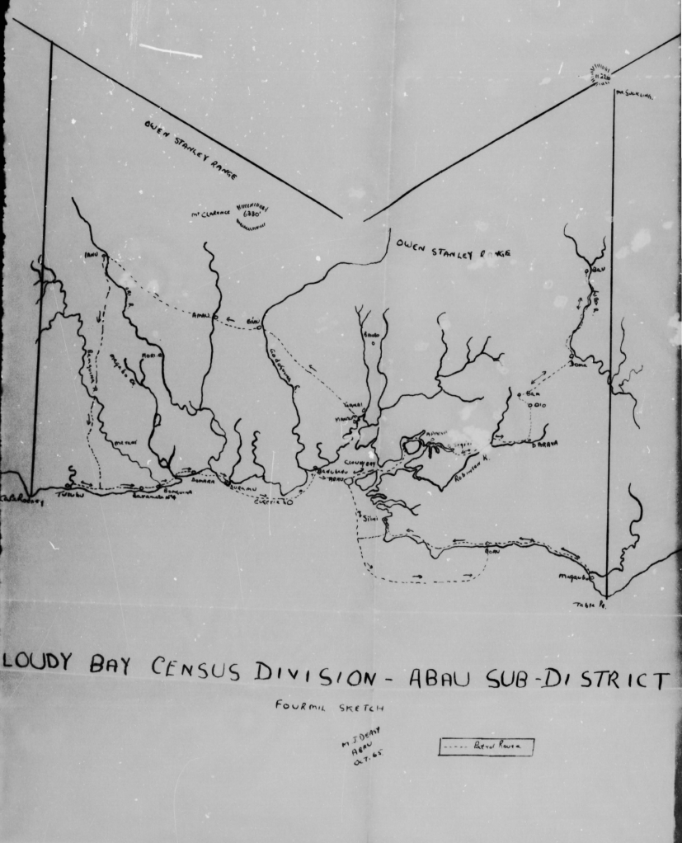
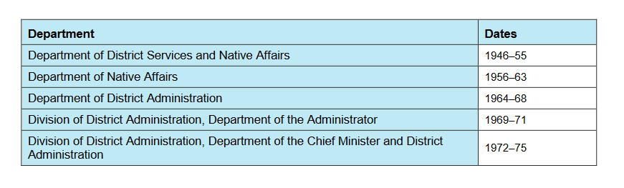

Slide 20
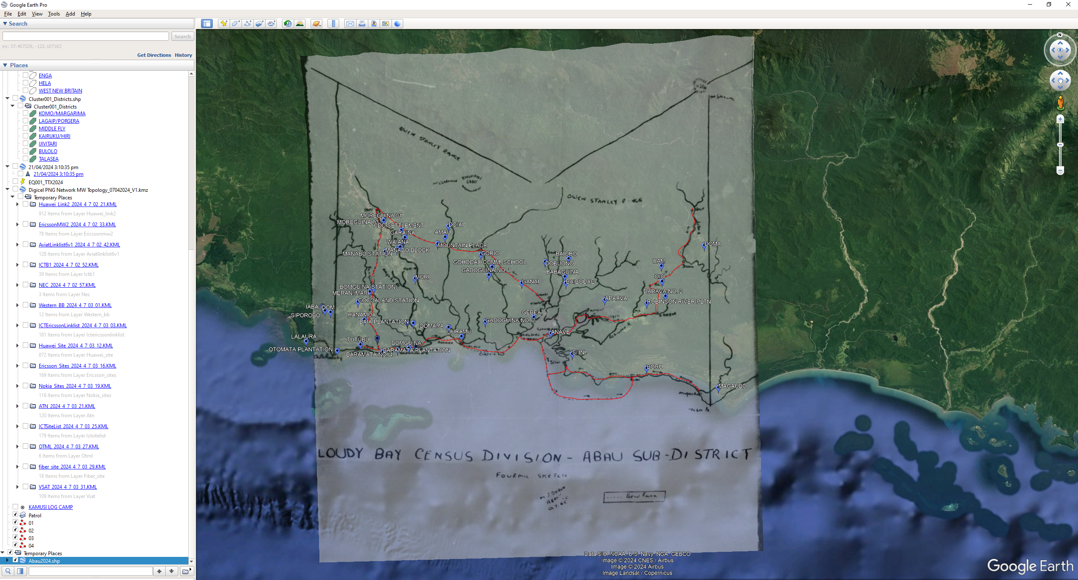

Slide 21
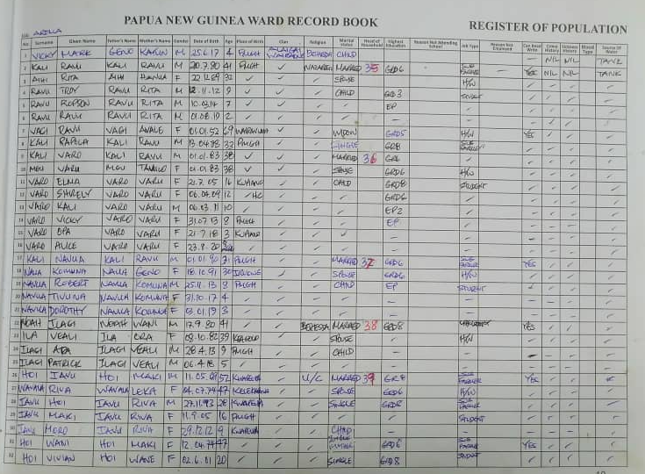
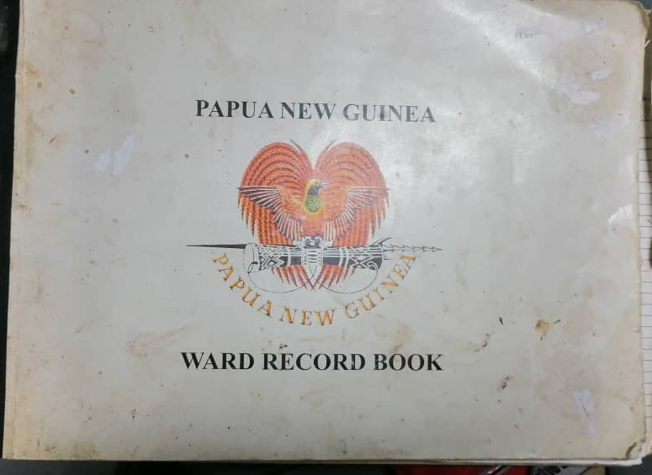

Slide 22
Key Updates
Standardization of Formats
All ward record books have been standardized to ensure uniformity across all regions. This includes specific sections for demographic data, service delivery records, and community engagement initiatives. Currently being rolled out.
Digital Transition
A pilot project for digitizing ward record books has been initiated. Selected wards will implement electronic record-keeping to improve data management and reduce reliance on paper records. Training sessions for local officials are scheduled.
Data Accuracy and Validation
A comprehensive review process has been established to validate the information recorded in the ward books. Regular audits will be conducted to ensure data integrity and address discrepancies promptly.
Training and Capacity Building
Workshops are being organized to train local officials in effective record-keeping practices and the use of new digital tools. Emphasis will be placed on data entry, maintenance, and reporting.
Community Involvement
Mechanisms for community feedback have been integrated into the record-keeping process. This allows residents to verify information and report any inaccuracies, promoting transparency and accountability.
Reporting and Analysis
New reporting templates have been developed to facilitate better analysis of ward-level data. This will assist in informed decision-making and resource allocation.
Next Steps
Implementation Timeline: The digital transition is expected to be fully operational by 2nd Qtr 2025.
Feedback Mechanism: Stakeholders are encouraged to provide feedback on the new formats and processes by December 2024 to ensure continuous improvement.

Slide 23


