Slide 1




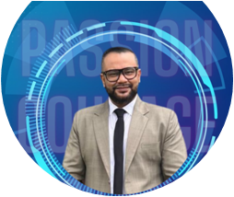

DIGITAL TRANSFORMATION
SUMMIT 2024
Presented by:
Preetam Tallukdar
General Manager – Corporate
Digitec ICT Limited
(2ⁿᵈ October 2024)

Slide 2















OUR
JOURNEY
    With over 15+ years of ICT experience, Digitec ICT is proud to of one of the preferred ICT solutions providers in Papua New Guinea.
    We specialize in Retail, Kiosks, and Corporate solutions.
    As a key player within the esteemed USD 7 billion Vodafone Group, we operate out of the Pacific Islands, bringing our expertise and services to the region.
    Serving a diverse clientele of over 2,000+ we are delighted to welcome new clients every month!
    As one of only two local data center providers in PNG approved by the PNG DICT, we are authorized to offer cloud infrastructure services to the government and state-owned enterprises.
    Headquartered in Port Moresby, with branch/spoke offices in Lae, Mt. Hagen and Kimbe.
    With a dedicated team of over 125 employees and continually growing, we are committed to excellence.
    Achieving an impressive year-over-year growth

Slide 3



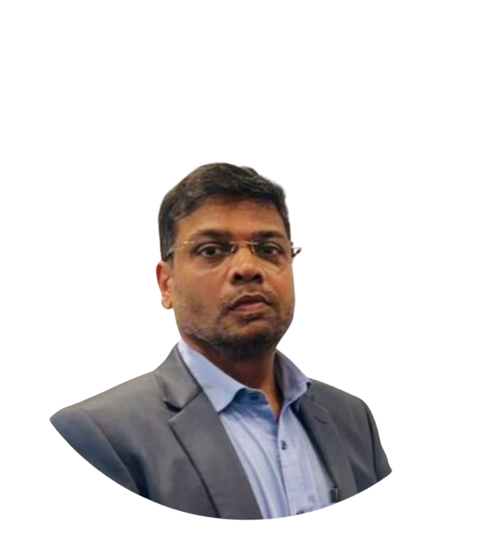

BEING
CUSTOMER OBSESSED & CUSTOMER CENTRIC!
“WE PUT OUR CUSTOMERS AT THE HEART OF EVERYTHING WE DO! - OUR CORE COMMITMENT TO EXCELLENCE WE ARE DRIVEN BY CUSTOMER SUCCESS - OUR COMMITMENT TO EXCEPTIONAL SERVICE”
Mr. Satyen Singh
CEO, Digitec ICT

Slide 4


Global ICT revolution and how Papua New Guinea (PNG) can position itself to benefit from these developments:
The Role of AI and Automation in the Future of Work:
Global Trend: Artificial intelligence (AI) and automation are revolutionizing industries worldwide. In the next two years, AI-driven solutions are expected to streamline operations, reduce costs, and improve productivity.
PNG Focus: Papua New Guinea should prioritize building digital infrastructure and upskilling its workforce to adapt to AI advancements. The country can explore AI-driven solutions in sectors like agriculture, healthcare, and energy, leading to better service delivery and economic growth.

Slide 5
Digital Inclusion and Bridging the Digital Divide:
Global Trend: As more economies digitize, ensuring digital access for all will become a major global focus. The challenge is making sure that marginalized communities are not left behind.
PNG Focus: Papua New Guinea faces significant geographical and economic barriers to digital access. The government and private sector must collaborate to build affordable internet access, especially in rural areas, to bridge the digital divide. This will empower citizens with education, healthcare, and e-commerce opportunities.

Slide 6
Cybersecurity in the Age of Digital Transformation:
Global Trend: With the rapid increase in digital transformation, cybersecurity risks are also rising. Countries worldwide are tightening cybersecurity measures to protect critical infrastructure and data.
PNG Focus: As PNG embraces digital transformation, it is crucial to strengthen its cybersecurity frameworks to protect national assets, businesses, and citizens. PNG can develop strong cybersecurity policies and frameworks, train professionals, and collaborate with global cybersecurity agencies.

Slide 7
E-Government and Digital Public Services:
Global Trend: E-government platforms and digital public services are transforming how governments interact with citizens. In the next two years, countries will increasingly adopt e-governance to enhance transparency, reduce bureaucracy, and improve service delivery.
PNG Focus: Papua New Guinea can leverage digital transformation to provide better public services, from healthcare and education to taxes and civic engagement. By embracing e-government, PNG can improve transparency, enhance the citizen experience, and strengthen the overall governance structure.

Slide 8

Digital Workplace
Power Solutions
Print Management
Managed SLA
SERVICES/
PRODUCTS - CORPORATE
Internet Services
Cybersecurity,
Networking &
Infrastructure Services
Datacenter Cloud
Infrastructure Services
Solutions
Professional Services

Slide 9





SERVICES/
OUR KEY TECHNOLOGY VENDORS

Slide 10





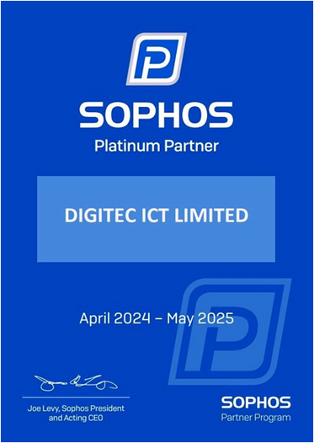

RESELLER ACCREDITATIONS
Digitec ICT Ltd
PAPUA NEW GUINEA
has met the program prerequisites and business requirements to qualify
as a Dell Technologies Partner Program Titanium Tier Partner
February 3, 2024 –January 31, 2025

Slide 11







DICT’S REGISTER OF CLOUD INFRASTRUCTURE VENDORS
DICT’s Register of Cloud Infrastructure Vendors
Consistent with section 25(9) of the Digital Government Act 2022, and NEC Decision No. 40/2024, the Departmental Head for the Department of Information and communications Technology Mr. Steven Matainaho announces the establishment of the register of Cloud Infrastructure Vendors.
The list of Cloud Infrastructure Vendors approved by the National Executive Council (NEC) on 1 March 2024 are:
Digitec ICT

Slide 12
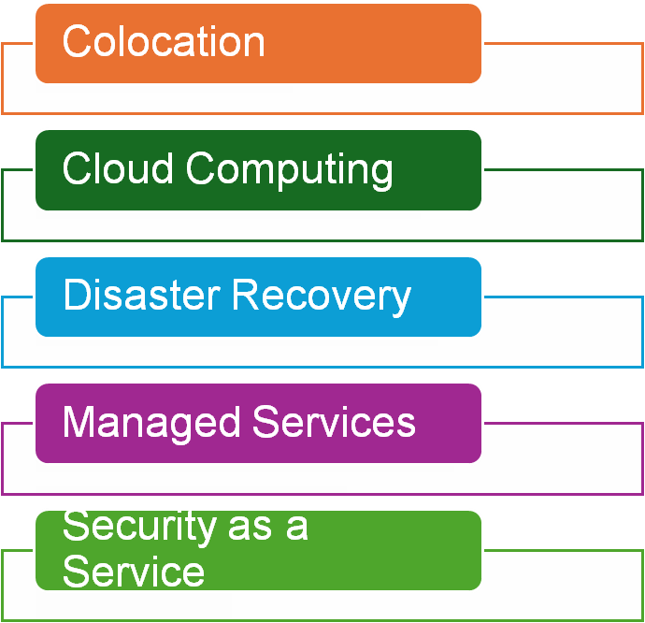
DIGITEC DATA CENTER SERVICES

Slide 13
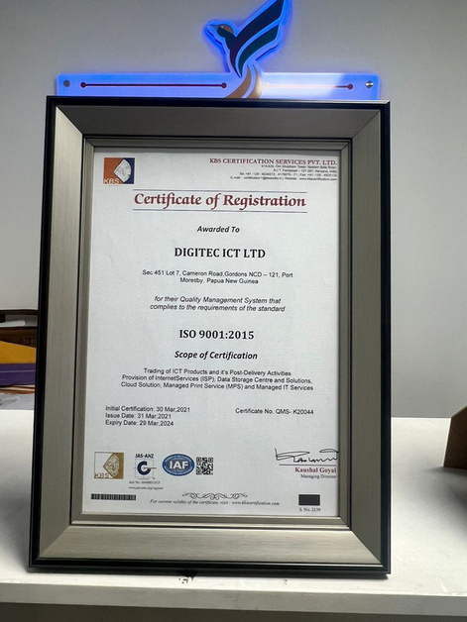
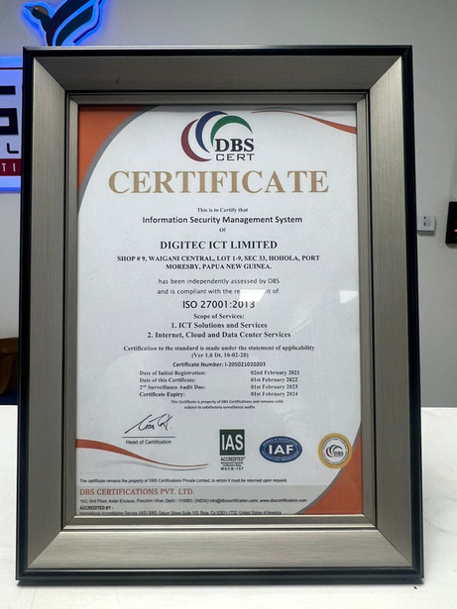
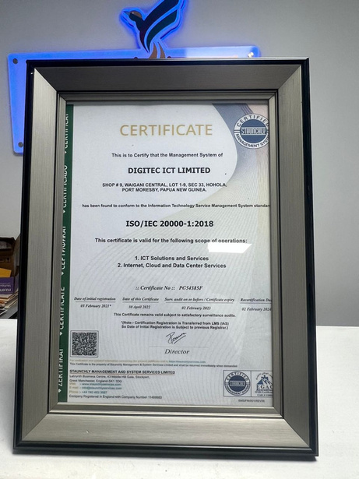
ISO CERTIFICATIONS

Slide 14
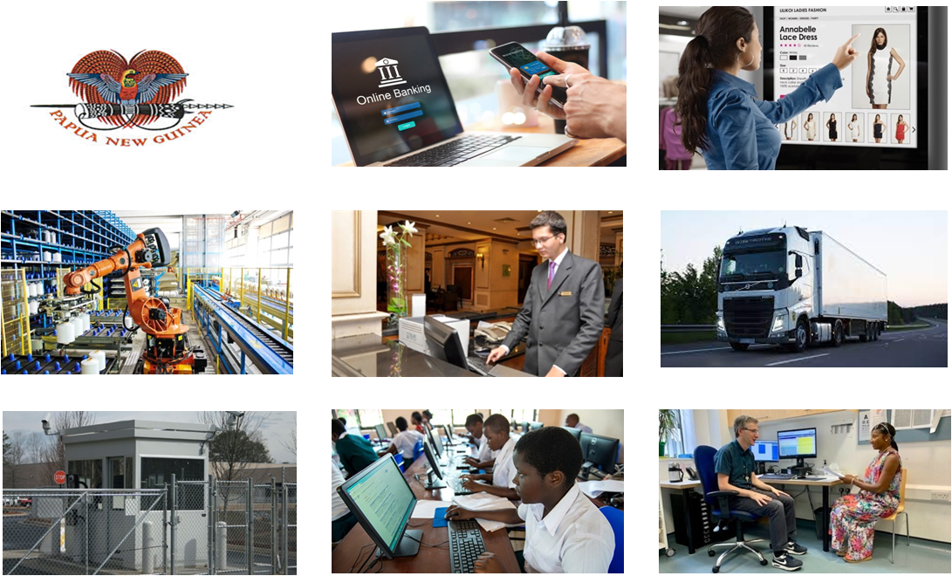

MARKET
PRESENCE
Government/SoEs
Banking/Financial
Retail/Supermarkets
Manufacturing/FMCG
Hospitality
Transportation
Logistics
Education
Healthcare

Slide 15

DIVING INTO THE FUTURE :
    Setting up of new Digitec ICT Retail & Kiosk centers, increasing our overall footprints (roadmap FY 24-25)
    Invest in continuous training and development programs for our team, making Digitec ICT as one of the best employers of choice in PNG! Hiring of resources will continue to be seen over next 12 months to fuel our needs.
    Onboarding new cutting-age technologies & services. Collaboration with various global technology vendors and get them offer services in PNG.
    Rolling out of our SOC/ MSP/MSSP model to customers in PNG.
    Setting up of the 1st of its kind “Cybersecurity Center of Excellence” in Port Moresby in collaboration with leading Cybersecurity vendors
    More of Roadshows/Events planned over the next 12 months.
    Rolling out of DC services in Lae (announcements soon!)
    Learning Centers for students, professionals
    PNG’s largest ICT Roadshow planned in 1st week of November at APEC HAUS.

Slide 16
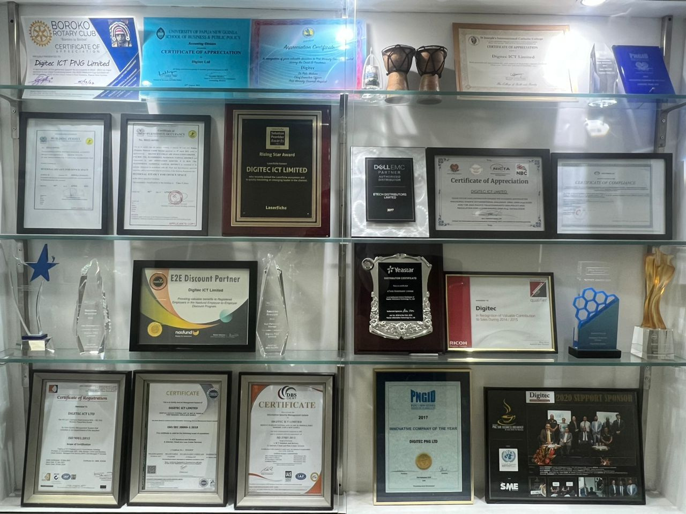
AWARDS & RECOGNITIONS

Slide 17
Conclusion:
“UNITY IN DIVERSITY”
E-Government and Digital Public Services:
Encourage PNG to seize the opportunity in this era of global digital transformation by investing in infrastructure, building digital skills, and fostering public-private partnerships.
Emphasize how strategic planning now can position PNG as a future-ready nation with inclusive growth.

Slide 18



TENK YU TRU!
Preetam Tallukdar
General Manager - Corporate
Digitec ICT Limited
Email: preetam@digitec.com.pg
Mobile: +675 786 39 204

