Slide 1

Department of Lands and Physical Planning
Digital-first land management

Slide 2
Our integrated ecosystem
eLands
GoLands
DLPP’s digital front counter. Anything you can do at a counter you should be able to do online!
DLPP’s single source of truth ‘engine’ for land, property, titles, revenue, and more!
Signiflow
Microsoft 365
Geospatial GIS
Internationally compliant eSignature workflows and digital document signing
Centralised Identity Provider (IdP) / Single Sign On (SSO), Email, Productivity Suite, Licensing and Endpoint Management
Geographic Information System for open and standardised geospatial data

Slide 3

eLands.
Putting the power in their hands.
Over 9,000 registered users
Over 4.1 million user activities logged
Launched
50,000 unique visitors the last 12 months
2020
Average user interaction time of 10 minutes
Continual improvements to citizen self-service
~1,500 businesses / ~8,500 individuals active

Slide 4

Our flexible core
Securely storing nearly 20 million files
Processed over 8,000 digital client support cases
Automatically reconciled over 57,000 payments
GoLands is DLPP’s extensible back-office platform developed specifically for PNG land management. Designed to save substantial man-hours associated with manual tasks through automation and workflow management.
Manages over 140,000 properties
Processing over 300GB of data a month
Nearly 200 officers onboarded
GoLands is all about re-thinking what ‘building for the future’ means. Modular building blocks, leveraging cutting-edge cloud technologies.
Managing over 540,000 State Lease bills
Over 15,000 back-office tasks managed digitally

Slide 5
DLPP is moving fast
Pre 2020
2020 - 2024
2025
Paper-based processes
No automation
Manual billing
No data oversight
No self-service tools
Antiquated payment process
Debt recovery tools
Digital valuations
Data cleansing
Automated billing
Digital front counter
Online payments
Automatic reconciliation
Digital audit chains
Digital case management
eTitles & Strata Titles
Self-service Title transfers
Introduction of AI (Artificial Intelligence)/ML (Machine Learning) tools
Fully deployed MS365
Digital signature workflows
External G2G integrations
Title searches
Self-service kiosk rollout
DLPP 0.1
DLPP 1.0
DLPP 2.0
Digital vision put in place
Digital building blocks developed and in place
100% digital-first workflows & client services

Slide 6
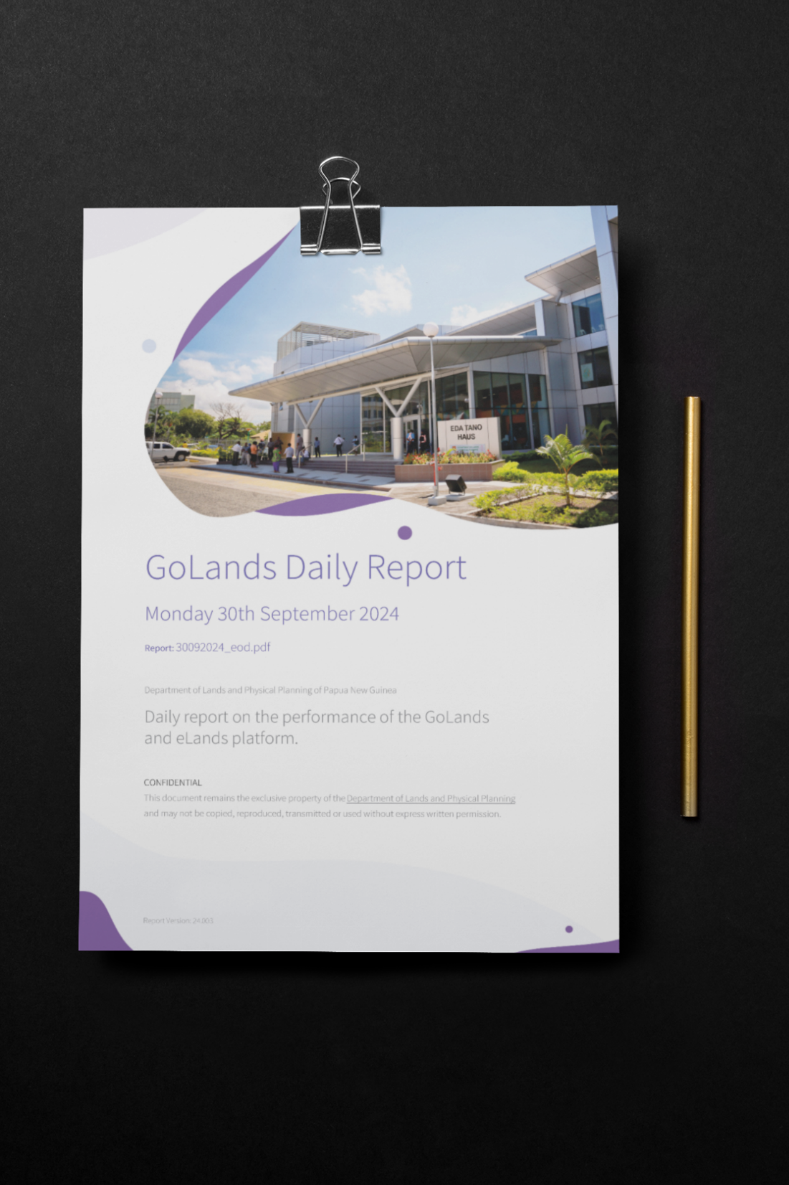
Data is gold
Moving to real-time systems has allowed DLPP to automate reporting processes which often took days, weeks or months.
DLPP has put its officers in the driving seat – those who need to know are provided with automated, point-in-time reports on the performance of its data platforms.
Data-driven decisions are only as good as the quality and speed at which the data is made available. Starting each day with the latest performance metrics makes for informed decision making.

Slide 7
Data integration and sharing
DLPP is waiting to integrate…
Our digital platforms are eagerly waiting on other Government entities to develop system-to-system integration capabilities
Come chat to DLPP!
Gov. Data Warehouse
IPA
IRC
ICSA
OpenAPI
Standard
GovID / Citizen SSO
Others

Slide 8
Lessons for others.
1.
Digital tools are only a part of the solution
Even the most advanced technology is ineffective without equal attention to human resources. Significant investment in upskilling and change management is essential—humans naturally resist change.
3.
Challenge your partners to provide better value
Digital change is not straightforward. Work with partners that are willing to adapt to evolving requirements. Continually challenge them to provide value.
2.
Change management isn’t just for Government
If your services face the public, substantial investment in public training is crucial. After decades of relying on paper-based processes, citizens are as resistant to change as Government entities. Simply making processes "easier" often isn’t enough to drive digital adoption.

Slide 9
MISSION: Promote the best use of land in PNG in the interests of all citizens, individually and collectively, by ensuring that an orderly process exists or land to be made available for sustainable economic and social development and that land rights are guaranteed.
Thank you.

