Slide 1

REGULATION FOR DIGITAL TRANSFORMATION - SPECTRUM AND ACCESS FOR ALL
Kila Gulo-Vui
CEO, NICTA
2nd OCTOBER 2024

Slide 2

Agenda
Regulation for digital transformation
Universal Broadband Connectivity
Spectrum Reforms – Market based spectrum assignment
PNG Universal Connectivity and Spectrum Policy
Conclusions & Q/A

Slide 3
Along the digital transformation road: Connectivity, Regulatory, Technology, Market and Societal changes –
Digital impacts all sectors and aspects of life
1980s – The dawn of email and mobile
1990s – Data and the global network society
2000’s – Phones turn “smart”
2010 – Digitization of new parts of society
2020 – ICTs help mitigate global pandemic
2030 – Full digital economy and society

Slide 4
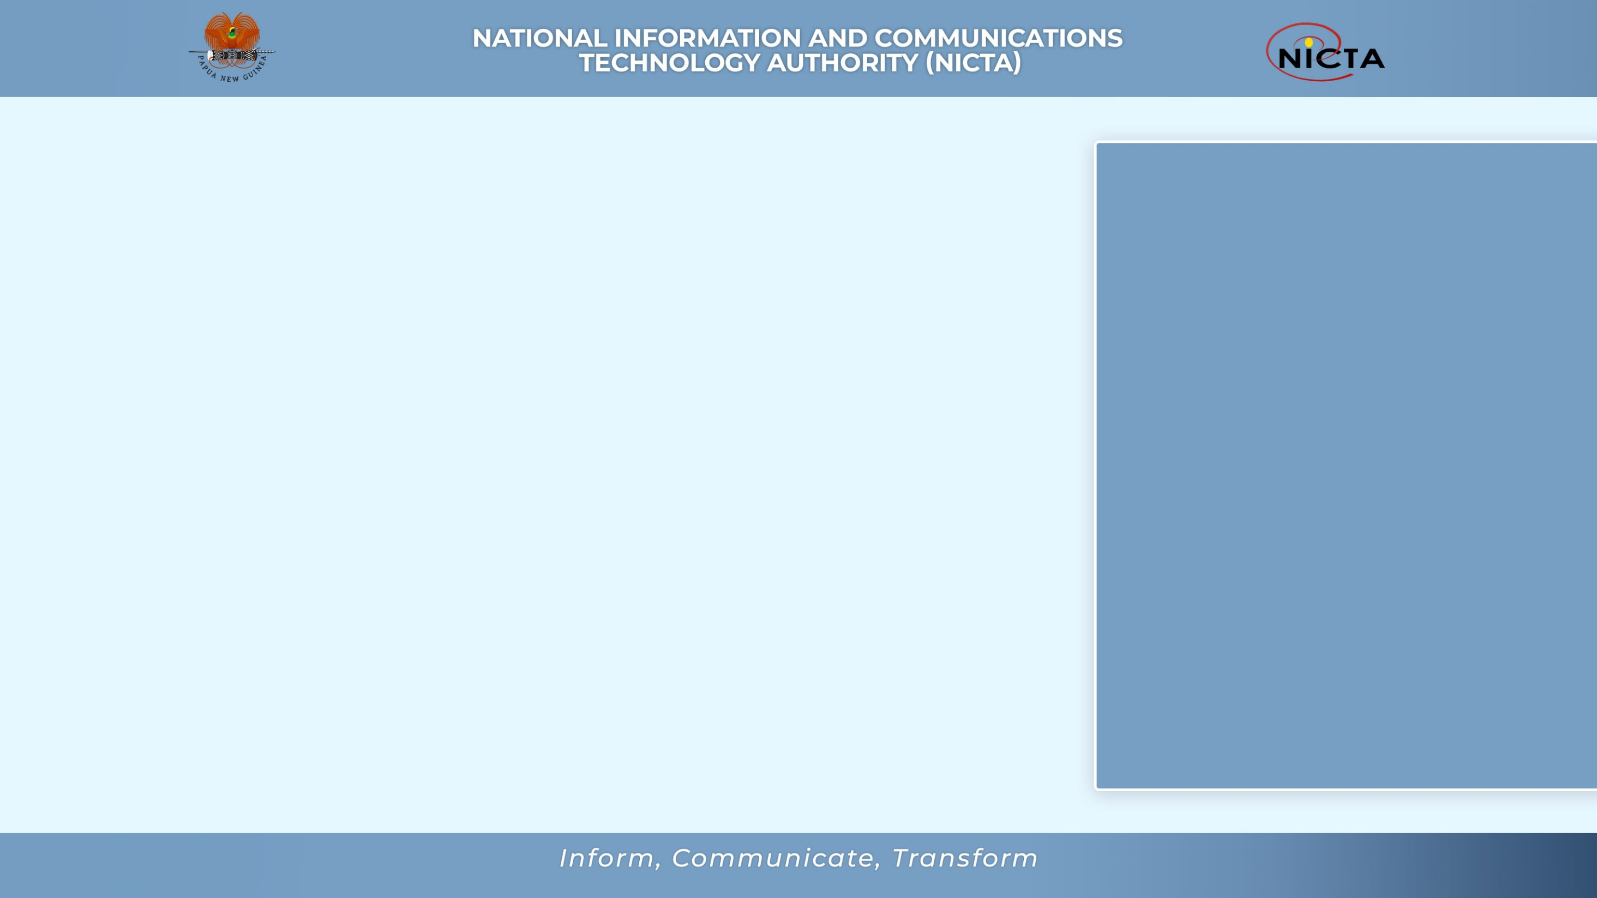

Why is regulation important?
Regulatory and institutional frameworks are essential in driving ecosystem and the effect build up over time
The connectivity of digital services is significantly and positively correlated with the level of advancements of ICT policies and regulations, and competition frameworks in particular
Investment and development of infrastructure in the digital ecosystem are directly and influenced by the maturity of the ICT regulatory frameworks and by competition in the ICT markets
Level playing field in the market place is a challenge to achieve
New policies and regulations have to be built in and onto to existing ones in order to increase their relevance and impact on the development of the digital ecosystem

Slide 5

Regulatory tools and approaches for sustainable digital transformation
Pro-competition frameworks - longer value chains, more diverse market players, services, devices and infrastructure
Stakeholder engagements - public consultations / hearings. workshops
Robust and enforceable mechanisms for consumer protection – rules on data privacy, data protection and data portability
Market based and dynamic mechanisms for spectrum management – allow for flexible, transparent use of scare radio spectrum resources and promote technology neutrality
Regulatory expertise needs to be developed continuously – to integrate new technologies, competence, and skills and allow for data and evidence based decision making
Regional and international cooperation in defining regulatory rules on cross border issues

Slide 6

BROADBAND CONNECTIVITY – IS NOT JUST THE BACKBONE BUT A CRITICAL ENABLER OF DIGITAL TRANSFORMATION

Slide 7
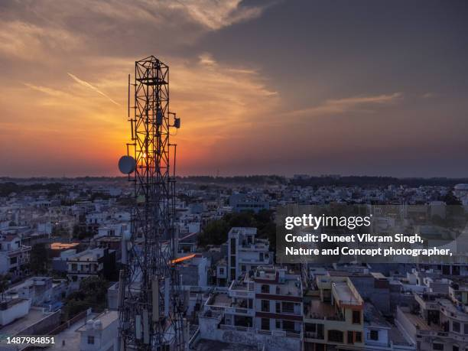
MOBILE SERVICE COVERAGE
PNG – DEC 2023

Slide 8
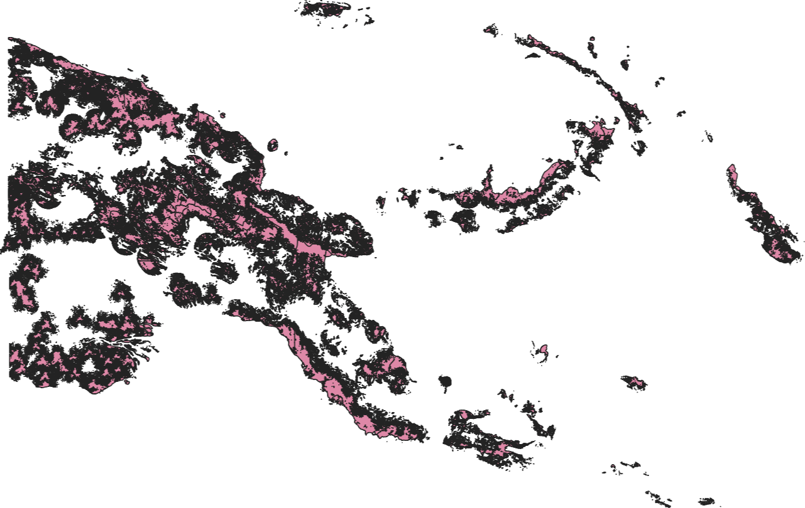
2G OVERALL COVERAGE
TOTAL POPULATION NSO_2021:
11,781,559
79% Population Covered
9,335,434

Slide 9
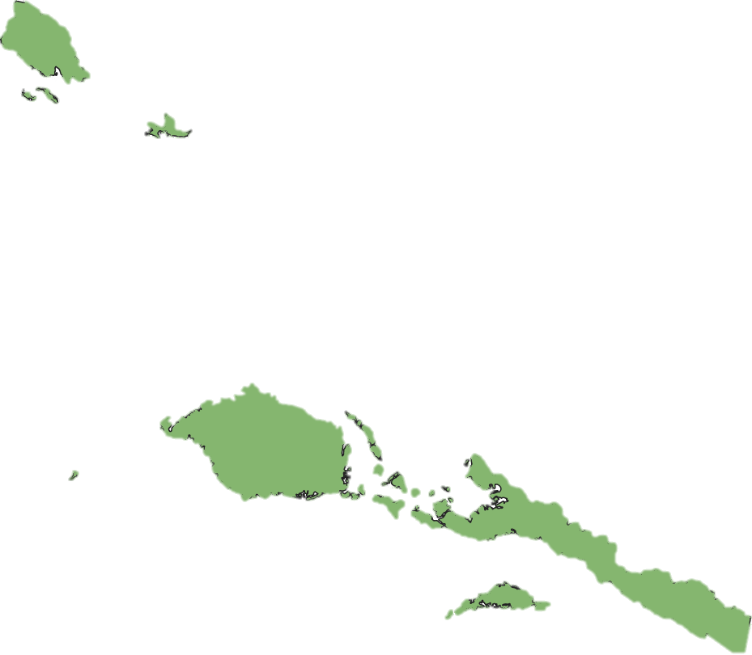
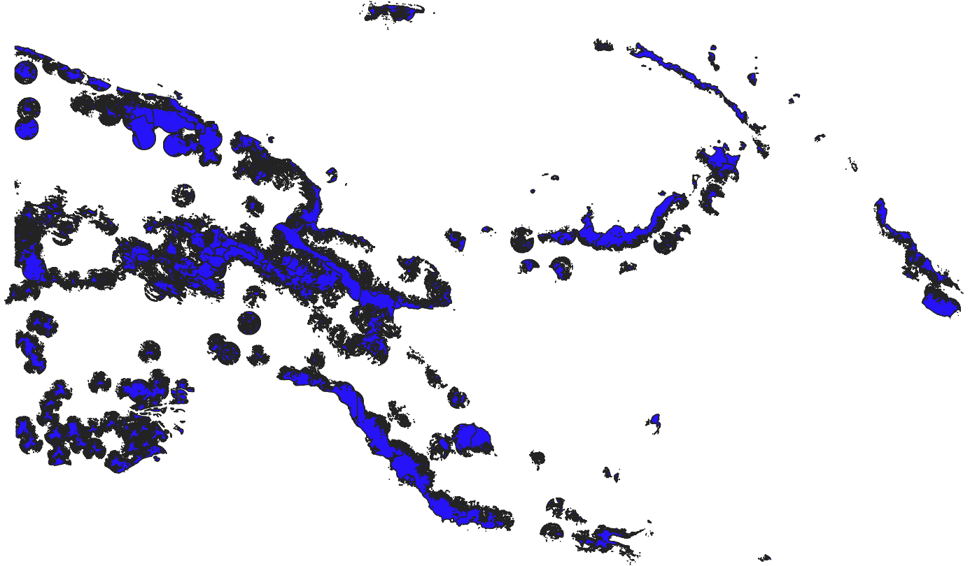

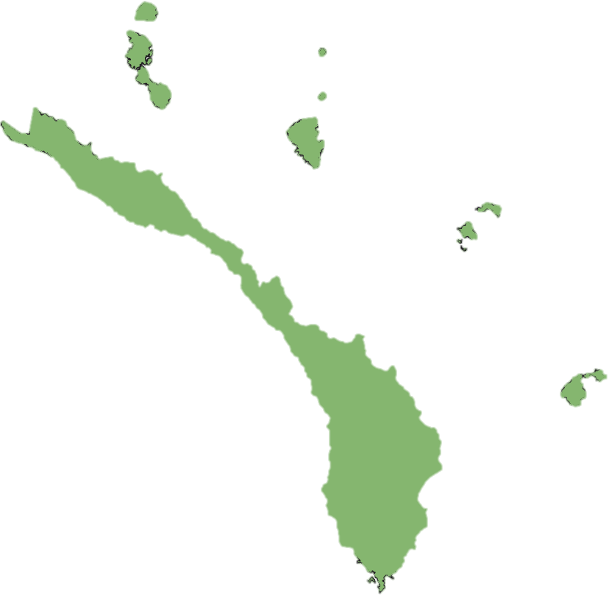




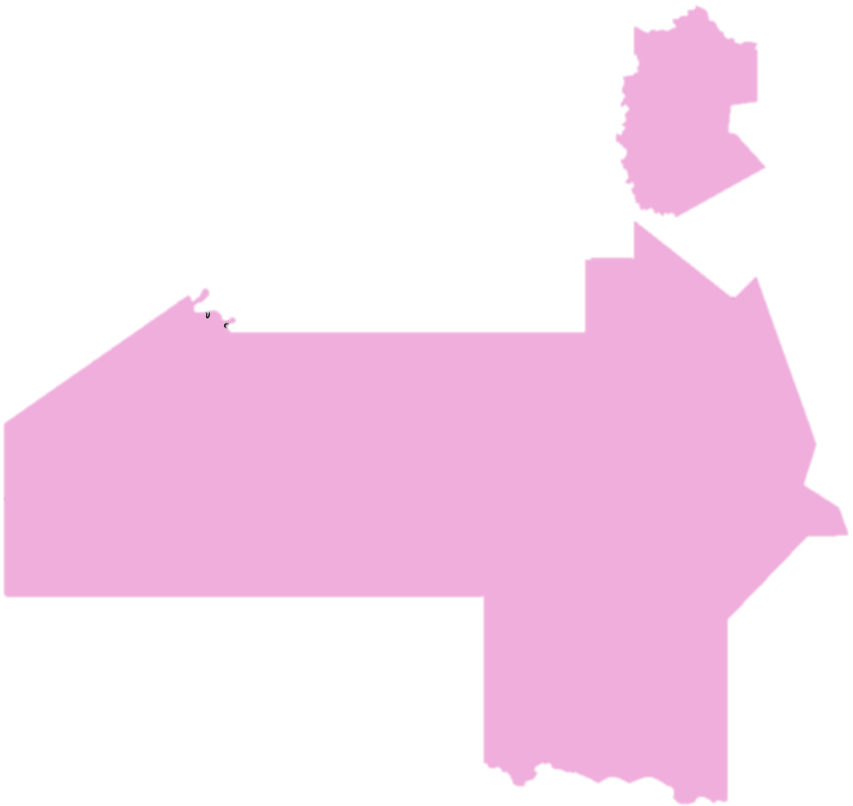




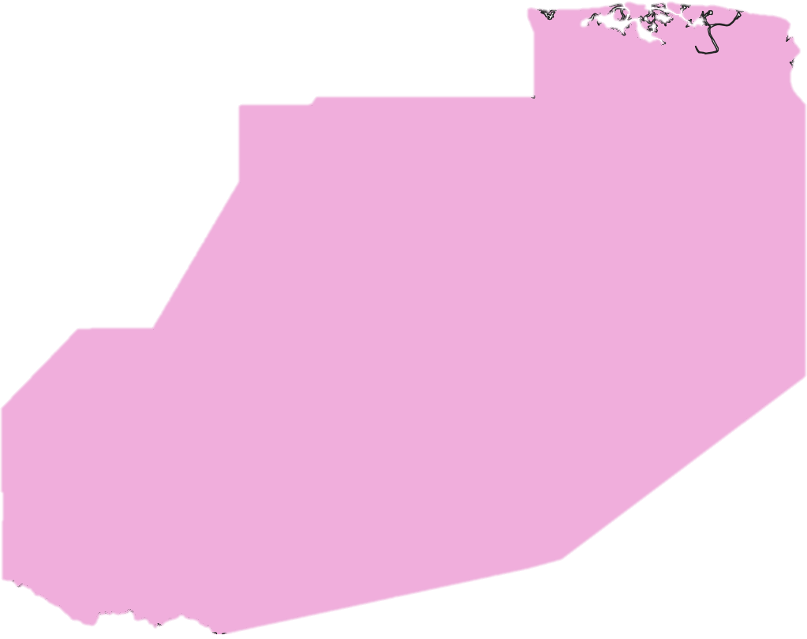
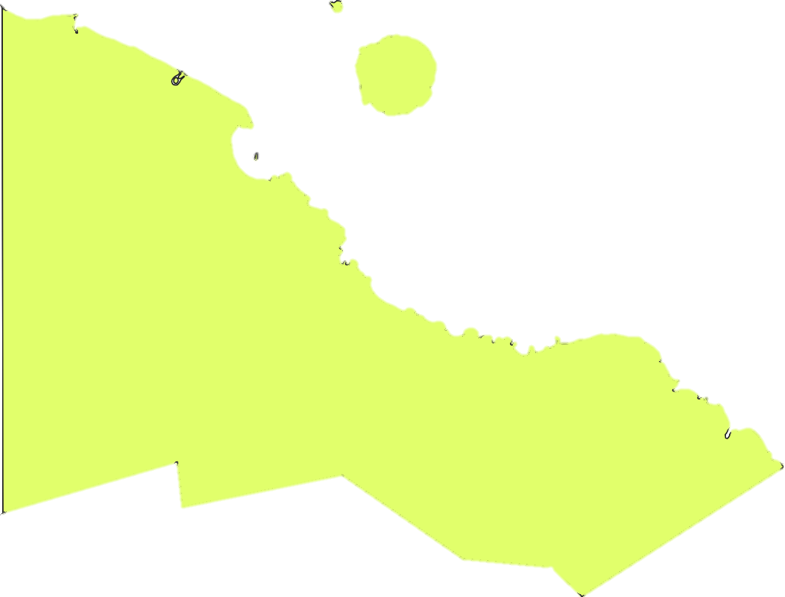


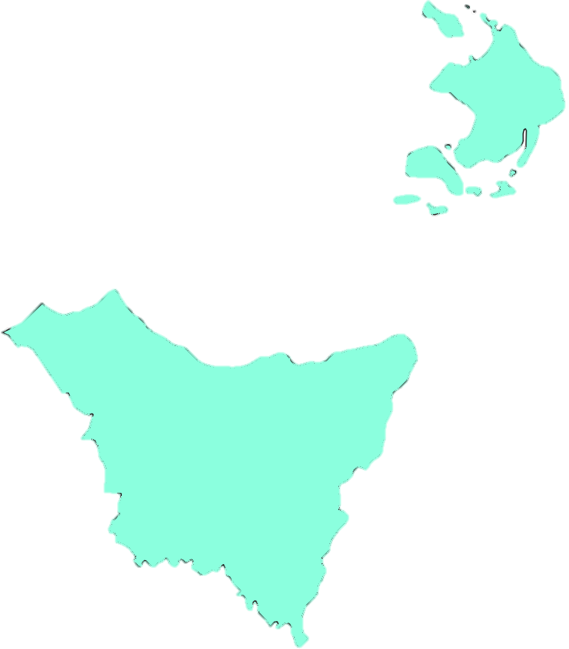
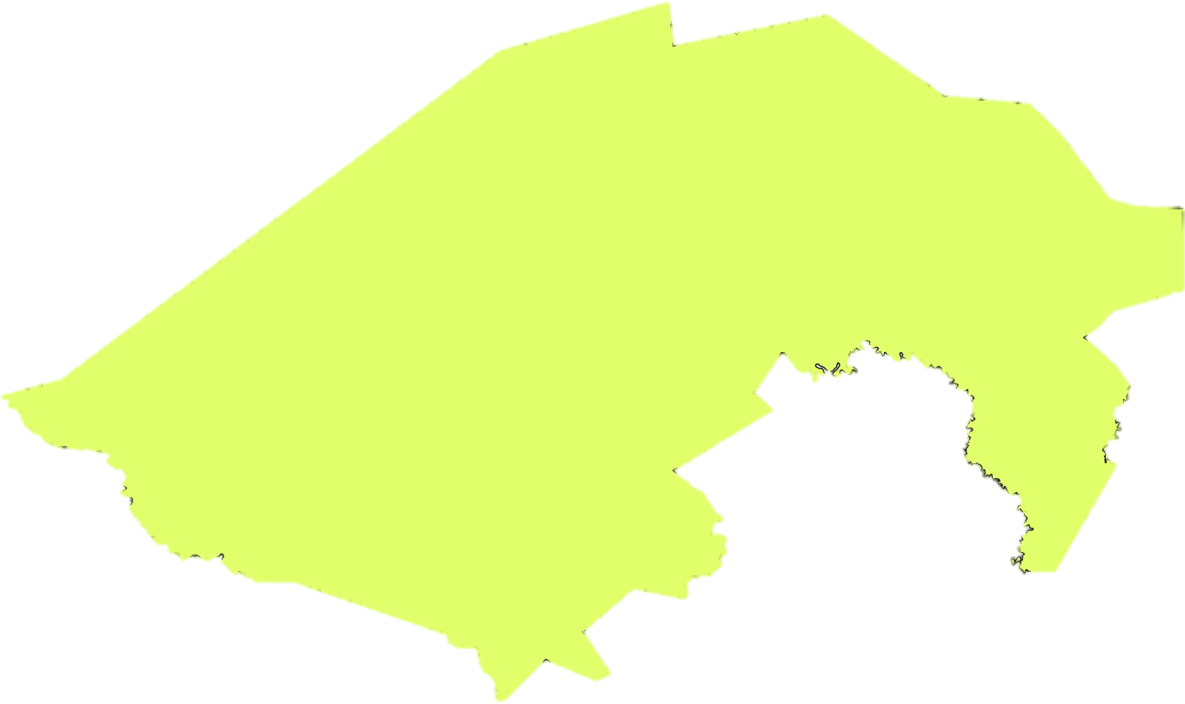

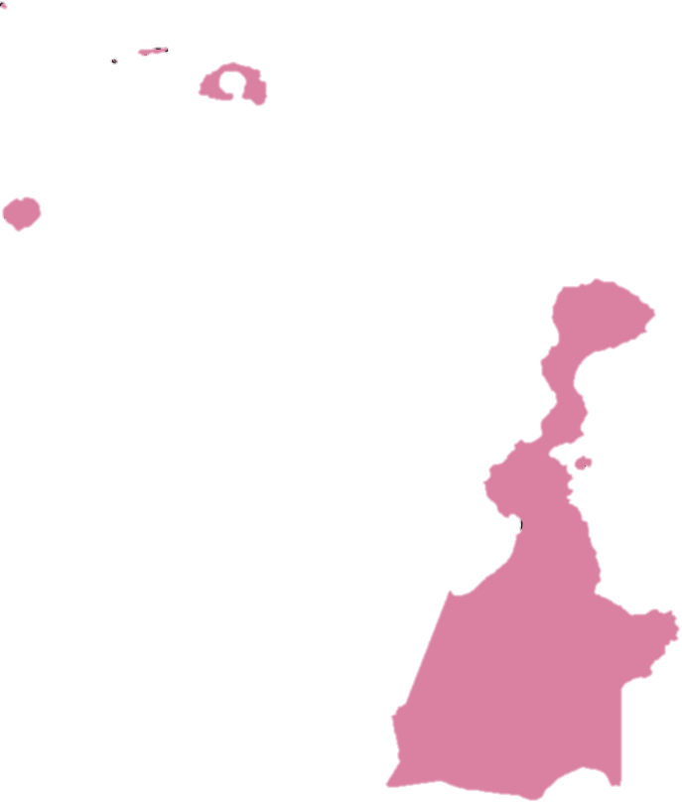

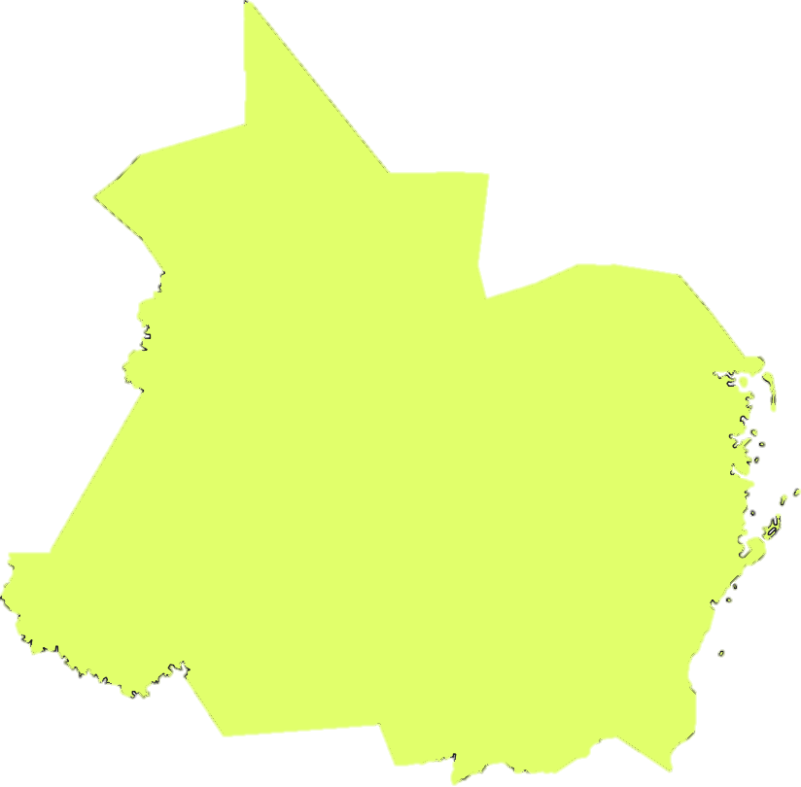



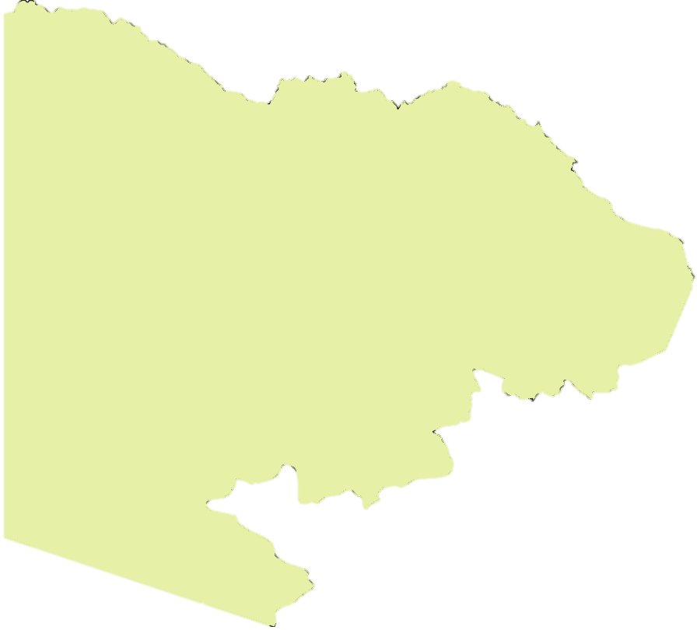

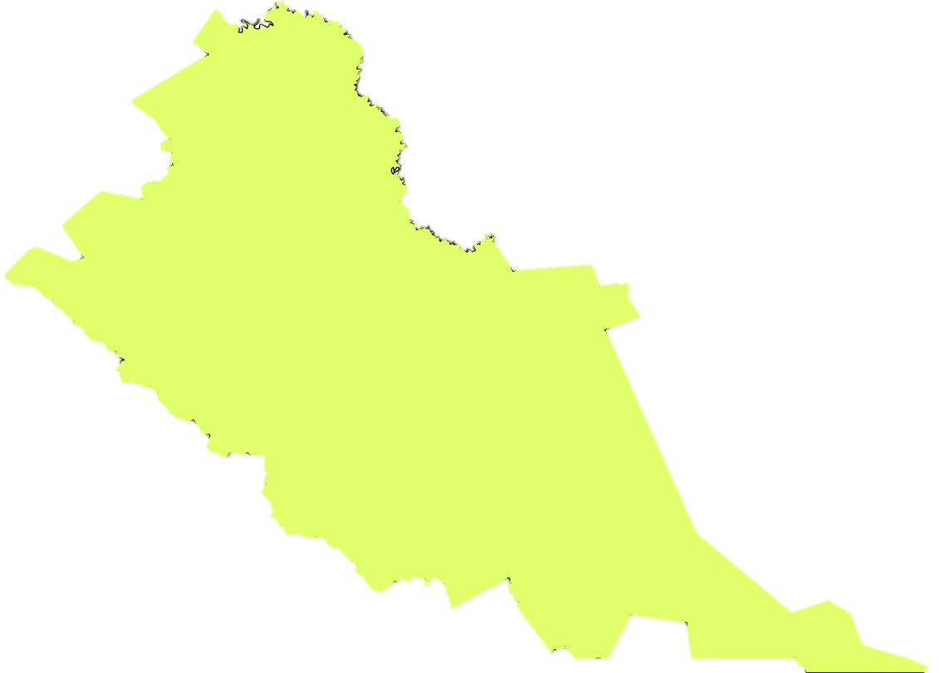



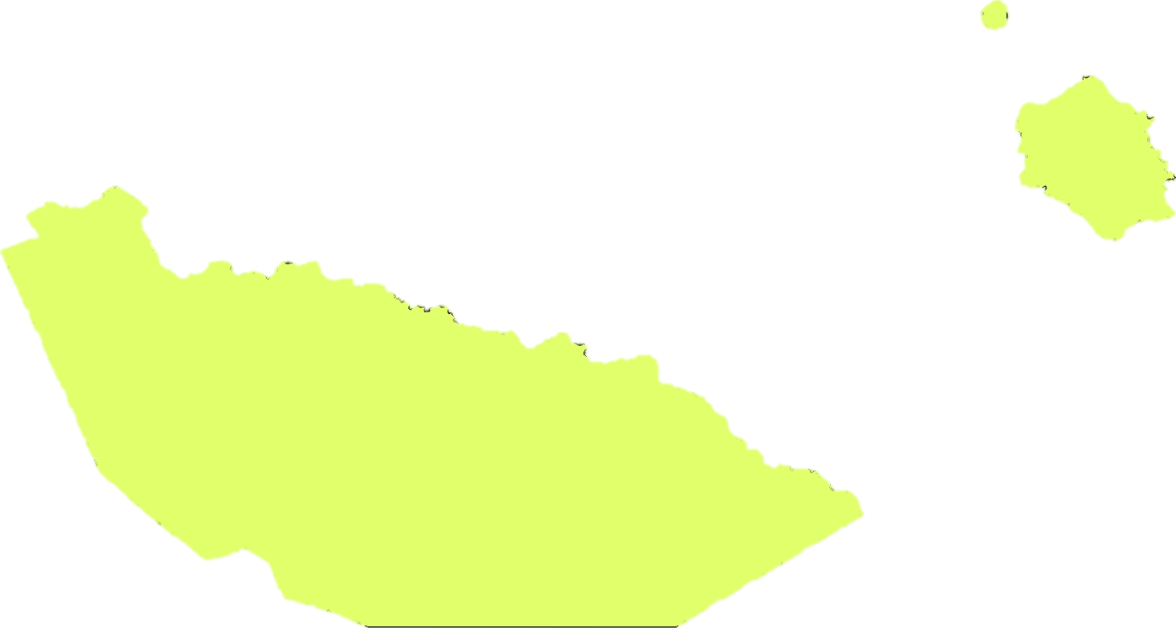

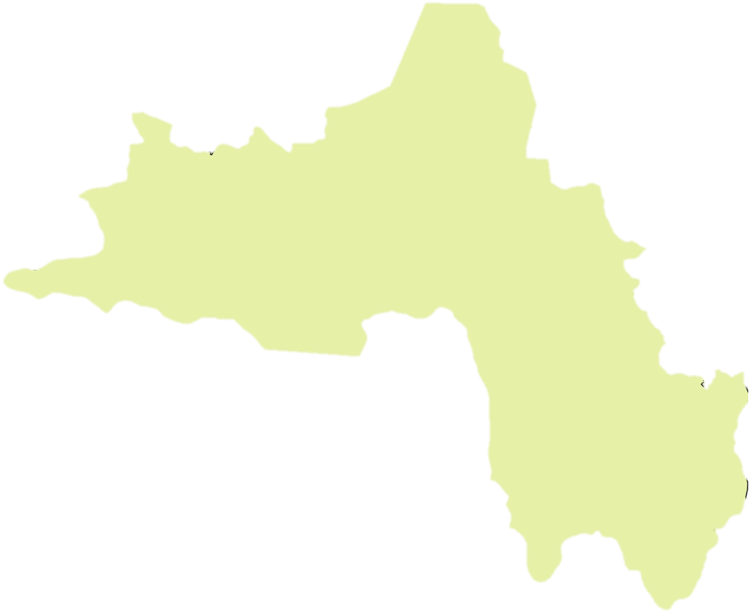

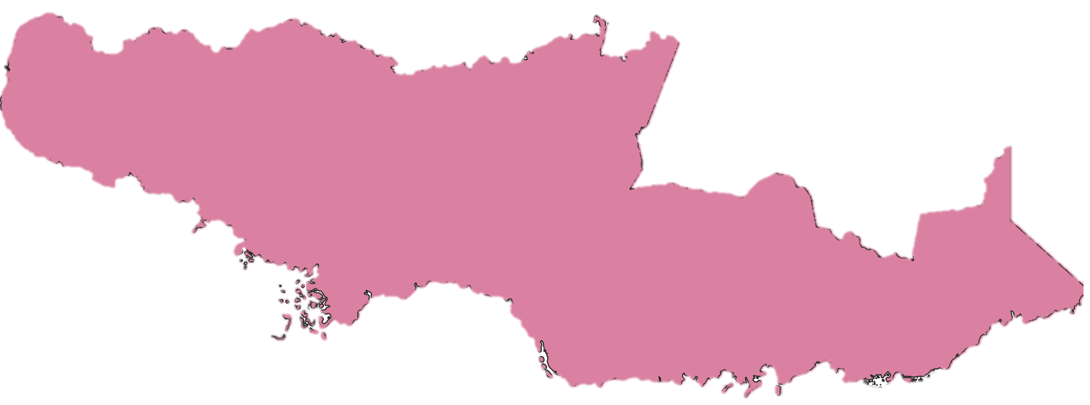






































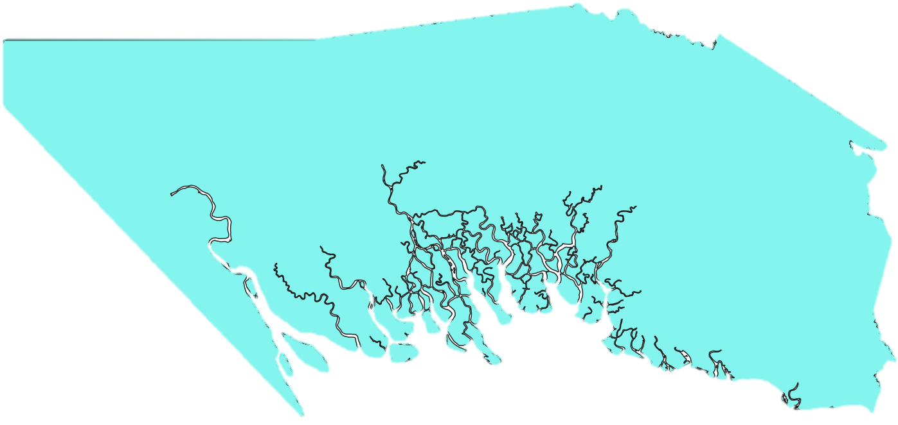




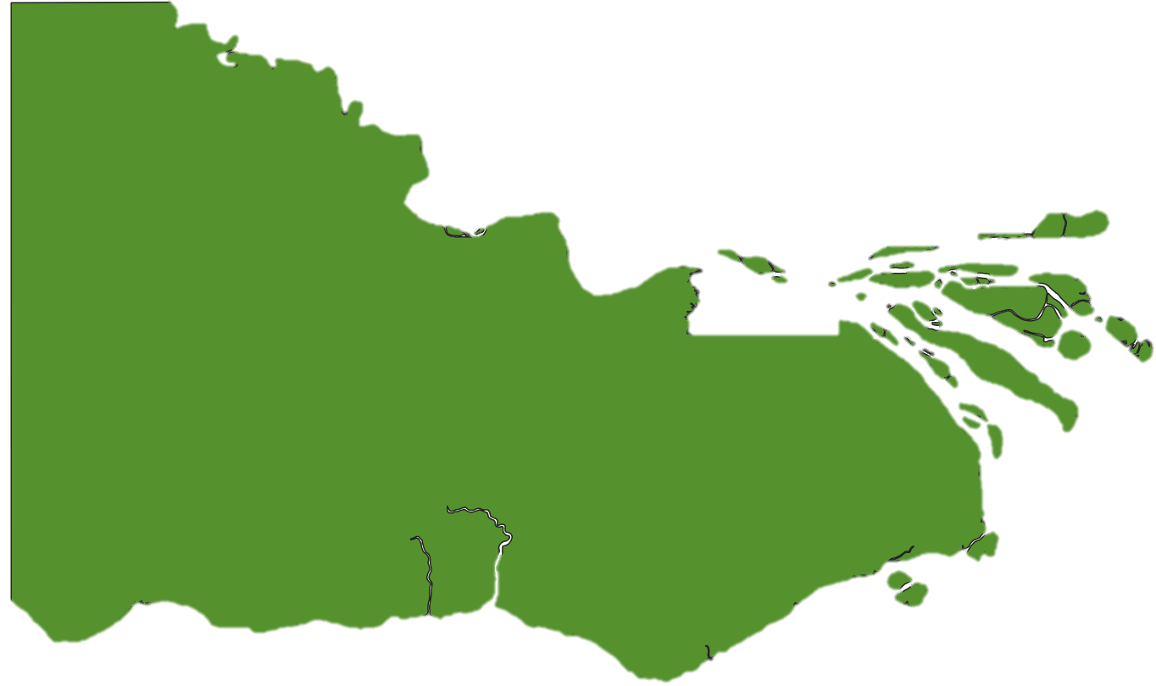





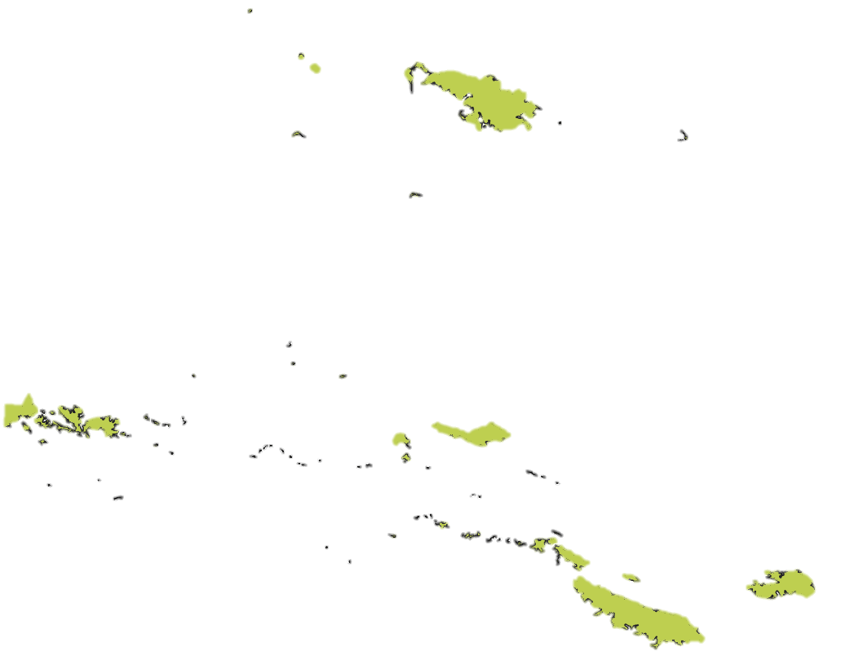

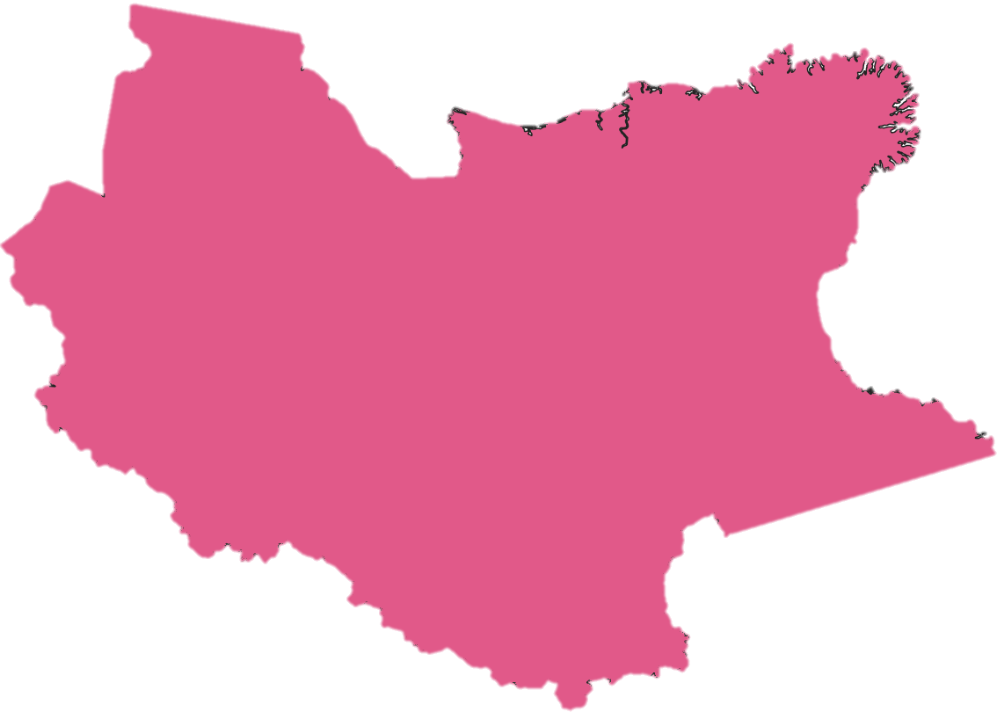





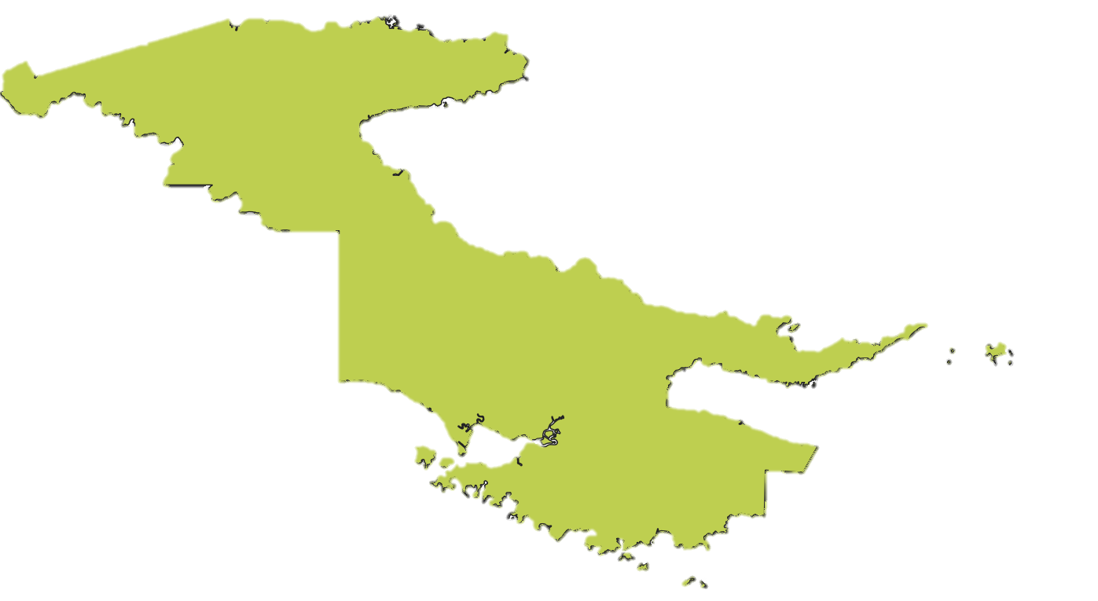

3G OVERALL COVERAGE
76% Population Covered
8,997,288

Slide 10
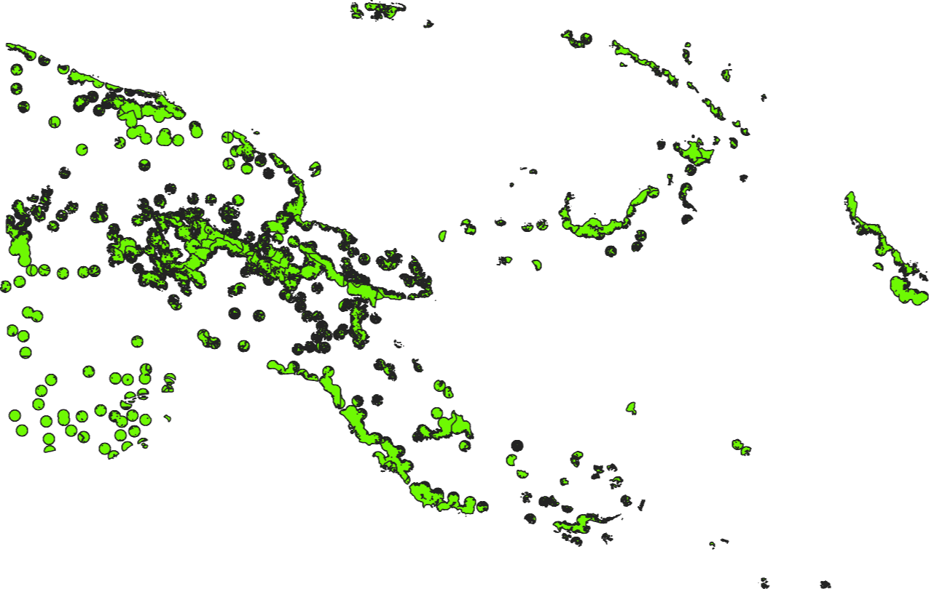
4G OVERALL COVERAGE
76% Population Covered
8,996,821

Slide 11
DEC 2023 | 2G |  | 3G |  | 4G
 | Population | % | Population | % | Population | %
Overall | 9,335,434 | 79% | 8,997,288 | 76% | 8,996,821 | 76%

Slide 12
Mobile Subscribers in PNG for the years 2013-2023

Slide 13


Connectivity Barriers - Challenges
Closing the coverage gap: even though 76 percent of the population (about 9 million) is now within the range of mobile broadband network, only less than 20 percent (2 million) people connect to the Internet
Closing the usage gap: afforability, lack of access to a device, and or lack of awareness, skills (literacy) or purpose.

Slide 14

Radio Frequency Spectrum –
Enabler for Digital Transformation
Wireless Communication Technology is a key enabler for Digital Transformation
Wireless Communications use Radio frequency Spectrum to carry information
Radio Frequency Spectrum is vital for promoting safe, innovative and efficient communication systems between people, people and machines and machines to machines
NICTA ensures the PNG Spectrum plan is updated every 4 years consistent with the revisions of the ITU Radio Regulations

Slide 15
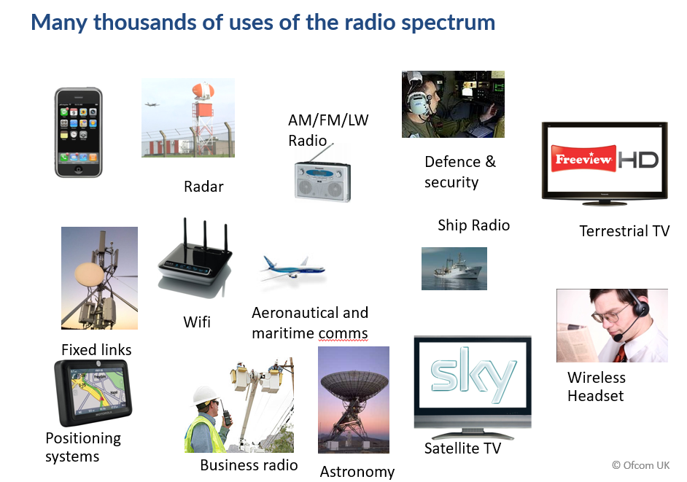
Digital Transformation needs Radio Spectrum
PNG Digital Transformation needs all of Fixed (e.g. fibre), Satellite (LEOs/MEOs) and Wireless Infrastructure
Spectrum is the oxygen of the wireless world
Wireless is by far the predominant digital connectivity approach in PNG – making the role of radio spectrum ever more critical

Slide 16





































Papua New Guinea Radiofrequency Spectrum Allocation Chart
The chart illustrates how the radio-frequency spectrum is allocated among radio-communications services in Papua New Guinea. It is derived from the Papua New Guinea Spectrum Plan or Frequency Allocation Table ( 2021 ), which in turn is based on the International Telecommunication Union (ITU) Radio Regulations (WRC-2019).
LEGEND
VLF
8.3
14
19.95
20.05
VLF
MM
H
MM
DN
F
F
3 kHz
30 kHz
LF
70
72
84
86
90
110
112
117.6
126
129
130
160
190
200
285
LF
MM
DN
MM
DN
MM
DN
F
DN
MM
DN
F
F
F
DNA
DNA
F
F
F
F
F
F
MM
F
DN
F
MM
MM
DNA
MA
DNM
30 kHz
MM
DN
MM
DN
DN
MM
F
MM
DN
DN
300 kHz
MF
325
405
415
1606.5
1800
2000
2065
2107
2170
2173.5
2190.5
2194
2300
2495
2501
2502
2505
2850
DNA
DNA
DN
MM
M M
M M
B
F
Z
F
MM
F
MM
M
MM
F
F
H
H
F
MAR
MF
DN A
B
M
F
MXR
DNM
MA
MA
DNA
M A
DL
DN
M
M
MX
M
M T
DN
MX
B
300 kHz
DL
3000 kHz
HF
19 800
19 990
19 995
20 010
21 000
21 450
21 850
21 924
22 000
22 855
23 000
23 200
23 350
24 000
24 990
25 005
25 010
25 070
25 210
25 550
25 670
26 100
28 000
29 700
HF
M A O
F
F
Z
M A
F
F
M M
M A R
F
F
F
F
M A O
M M A A R O
F
Z
F
F
F
H
H
F
M A O
B
F
M M
F
F
B
F
Z
F
H
H
F
M M
F
F
Z
F
M M
B
F
MM
F
H
H
F
Z
B
F
M A R
M M
F
F
F
F
F
Z
H
MM
F
SA
B
MM
F
Z
F
M X R
B
M A F R
B
B
M M
M X
B
B
M X
B
M X R
S Z
B
M X R
M M
M M
B
Z
F
S A
M X R
M X R
S Z
M X R
B
F B
S Z
M X R
M
SZ
M X R
M A O
M X
M T
SZ
MX
M X
SZ
M
M
X R
M
M T
M X
3000 kHz
30 000 kHz
VHF
41.015
50
54
68
74.8
75.2
88
100
108
117.975
SO SO SO SO
174
223
230
235
267
272
273
F
B
B
F
F
F
F
D N A
B B
DNA
MA
M
F
F
M
M
M
M M
S M
M S _{S}
S
M
M
DNA
M
M
MXRMXRMXRMXR
M
M M _{M M}
DL
Secondary Service Not Allocated
30 MHz
M
300 MHz
Earth to Space Space to Earth Space to Space
UHF
387
390
399.9
400.05
400.15
401
402
403
406
406.1
410
420
430
432
438
440
450
460
470
526
694
880
960
1164
1215
1240
1300
1350
1400
1427
1429
1452
1492
1518
1525
1530
1535
1559
1690
1700
1710
1980
2010
2025
2110
2170
2200
2290
2300
2450
2483.5
2500
2690
2700
2900
UHF
F
D
D SX ^{SX D}
S
F
SO SO
D
SA ^{W W} W
SO SX
F
F
W F F F _{D D} F
F
N A
S
F
S SM SM
F
F
F
F
F
S
L
F
F
F
DNA
N
X _{O F}
F
SM
N M
S
W
F
M SM
F
DNA
DL
SSM ^{O}
S M M X
L L
M X
A DL ^{DL}
S A
M
F
A
D
SA
M F F
SR F
S
F M
M
M S
Z
M
B
M
SDN
DL DL
F
M
N
SM
MX
SW
M M
M
VLF Very Low Frequency LF Low Frequency
MF Medium Frequency HF High Frequency
VHF Very High Frequency UHF Ultra-High Frequency SHF Super-High Frequency
EHF Extremely-High Frequency
_{M}H
S D N
SDN
B
S A
D D
F
S
SW
S W
DL
^{X} M S
SR
M
SR
S M ^{M}
M ^{S}
D
A A S
A
SM
M
MX
M
SM
SO
DL
MX
DL DN
3000 MHz
300 MHz
W
SR _{Z}
SDN
R X
SB
M
M M
D SD
M
^{MX} SA _{SM} ^{MX}
SM
SR
Z
^{DL} SD
SHF
SX ^{SX}
S
10.45
S
14.5
14.8
15.35
15.4
15.43
15.63
15.7
S X
D F F
N
F
SX
X S
SF
S
SX
D _{L} D
F F
F
F F F
F
L
F F
F
X
DL SF
F
SF _{F}
L L
X
S
F
Z SF
D
X
R X
S
F F
M
MX
S X
M
S
S M^{X}
Z ^{F} SF SF M
M
D D
DL
DD L L
M
^{X} M
A
M
S W
F
SF
A
B MX
M A
L L
F
D
X
A
A _{R}
_{M} SF SF
S
MX
Z
M
M M
S
_{N} S _{D} D _{D} M
M
S
M
D
M M
X
W
S
S
R L X
D D
D
M MX
M
N
R
L L
L
X _{X}
X ^{M} M ^{M} R
A
3 GHz
30 GHz
EHF
SF
EHF
30 GHz

Slide 17
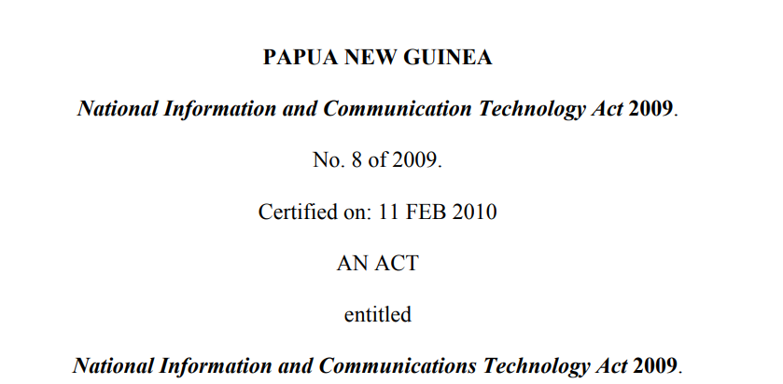
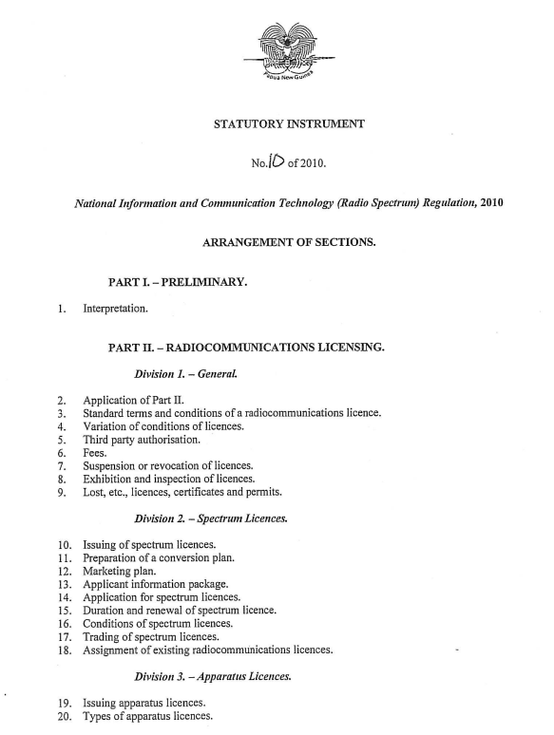
NICTA’s Role in Managing
PNG’s Spectrum
The 2009 NICT Act gives NICTA broad duties and powers to manage PNG’s radio spectrum resources
  e.g., “Section 164(a) - “maximise, by ensuring the efficient allocation and use of the spectrum, the overall public benefit derived from using spectrum”
The 2010 NICTA Spectrum Regulations guides NICTA’s Day-to-Day Management of PNG’s Spectrum
  e.g., Section 6(1) (a) and (b) clearly allows NICTA to determine market-based or administrative cost-based spectrum fees in the PNG
  E.g., Schedule 2 of the NICTA Spectrum Regulations – Annual Variable Spectrum Fee for Spectrum and Apparatus Licences uses the formula of Annual variable fee payable = V x (2600 / F) x B x T X L.
Everything NICTA does with regards to radio spectrum are underpinned by the 2009 NICT Law and the 2010 NICTA Spectrum Regulations

Slide 18
Key PNG Spectrum Challenges and NICTA Actions
KEY Challenges we face today in the management of PNG’s Spectrum and its results
Too much of the spectrum assigned are NOT being “efficiently” used and “maximised” by Operators – Recall “Section 164(a) - “maximise, by ensuring the efficient allocation and use of the spectrum, the overall public benefit derived from using spectrum”
Too many parts of PNG are still NOT covered by mobile signals – contributing, to date, to less than 35% of the population owning a mobile phone subscription and less than 20% of people are connected to the Internet, with nearly all these accessing the internet via mobile phones
There are of course demand-side issues like affordability and other supply-side issues like electricity at play here, and other key issues such as the largely rural nature of PNG

Slide 19


Key PNG Spectrum Challenges
and NICTA Actions
Stop doing things that lead to poor results – and correct
There are FOUR big BROAD things that NICTA is doing
REVIEWING SPECTRUM ASSIGNMENT APPROAH - STOP Assigning some Spectrum administratively
  This is a CORE reason why much spectrum is NOT being put to good use
  NICTA has consulted and designated certain spectrum to be HIGH DEMAND SPECTRUM (HDS)
  NICTA proposes going forward to assign such spectrums on a ‘market basis’
  NOTE - Article 173(2)(b) of 2009 NICTA Act states: “Spectrum licences may be allocated by NICTA on a market basis … (by a relevant allocation process under Section 36)”. Article 36 Valuable State Resources under 36(b) states: “… NICTA considers that an auction, tender, commercial negotiations, or market-based allocation process…”.
  And Section 13 (1) of the NICTA Radio Spectrum Regulations stipulates that – “for such any market-based approach - NICTA shall prepare an Information Package for applicants containing the Marketing Plan and any Conversion Plan”.
  NICTA is planning to assign IMT 2600MHz using a market-based approach – with IMT 800MHz likely next
Work with Government

Slide 20
Key PNG Spectrum Challenges
and NICTA Actions
Stop doing things that lead to poor results – and correct
There are FOUR big BROAD things that NICTA is doing
Reviewed and Updated all key HDS Band Plans to reflect their highest value use as per 2024, including new band plans. In 2023/24, NICTA consulted on and updated:
  The 2600MHz Band Plan making the entire 190MHz of the band TDD
  The 3500 MHz Band Plan
  The TDD Synchronization Guidelines for TDD bands such as IMT 2600 and IMT 3500
  The 60GHz Band Plan [a NEW one]
  The 800MHz Band Plan [updating from old CDMA technology to likely LTE use)
  Others Bands are being studied: IMT 2300, 6GHz for Wi-Fi and other mmWave bands
  Spectrum Sharing: NICTA has also revisited and reviewed Spectrum Sharing arrangements – to ensure that operators can share spectrum leading to more efficient use of spectrum
  Trials and testing
Work with Government

Slide 21
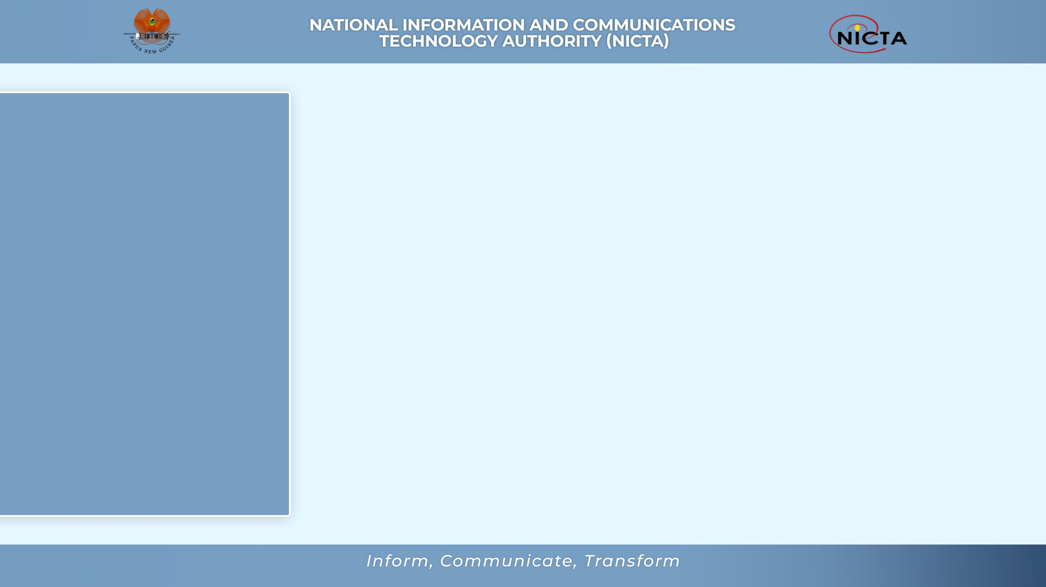

Evolution and development of Mobile technology

Slide 22
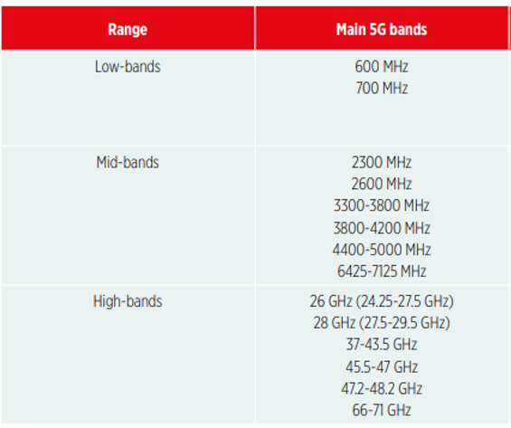
Key PNG Spectrum Challenges
and NICTA Actions
There are FOUR big BROAD things that NICTA is doing
Working on a (i) Comprehensive Spectrum Outlook, that will (ii) Propose new HDS spectrum bands to release and (iii) Reviewing Spectrum Pricing in PNG
  SPECTRUM OUTLOOK: Likely to propose DOUBLING the amount of HDS IMT spectrum (to circa 900MHz) to be released to Operators by 2030 – moving away from administrative
  NEW SPECTRUMS TO BE RELEASED: IMT 2600, reassigning IMT800, 60GHz and considering other spectrums like IMT 2300, IMT 3500, etc
  UPDATE SPECTRUM PRICING: the spectrum pricing formula was adopted in 2010, and is clearly NOT appropriate for bands beyond 2600M MHz.

Slide 23
Key PNG Spectrum Challenges
and NICTA Actions
Stop doing things that lead to poor results – and correct
There are FOUR big BROAD things that NICTA is doing
4. Working with DICT : Review of the National ICT Act 2009 and Regulations as they showing age, eg.
  Licensing satellite broadband (N-GSO systems like LEOs MEOs)
  Updating Spectrum Fees
  Updating the legal framework
Work with Government

Slide 24
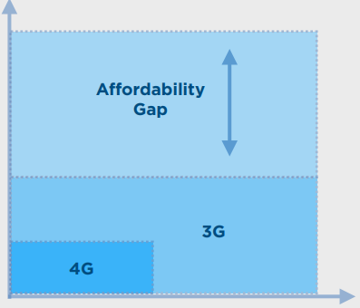
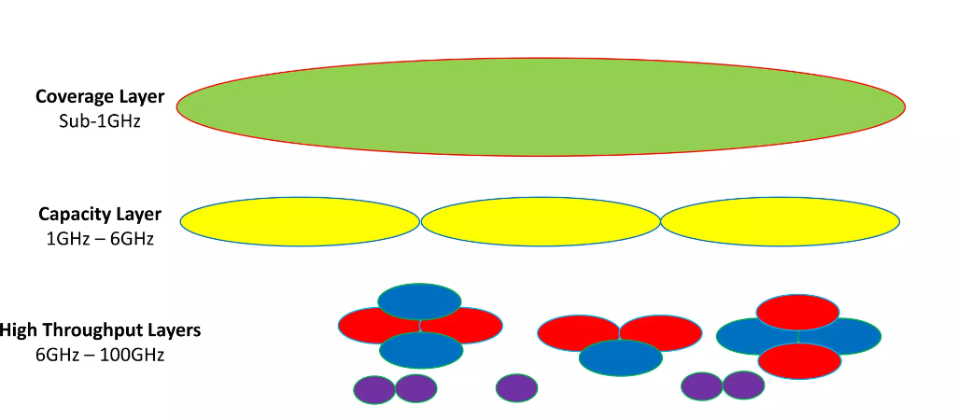
PNG Universal Connectivity and Spectrum Policy
NICTA – along with the Universal Access & Service Program – are working on several fronts:
More Coverage Spectrum: Seeking opportunities to release, reassign or use efficiently more sub-1 GHz spectrum (IMT 800, IMT 700, IMT 600, IMT 450)
More Capacity Spectrum like IMT2600, 3.5 GHz, 60GHz
Promoting use of Unlicensed (Wi-Fi) spectrum
Infrastructure Sharing
Universal Access and Services – UAS Fund
Planning Work on a Universal Access & Service GIS Portal that WOULD help drive where operators can share infrastructure, what spectrum bands could be used, where people live who can be covered, the economics of covering those people, etc – leading to BETTER targeted UASF Interventions

Slide 25
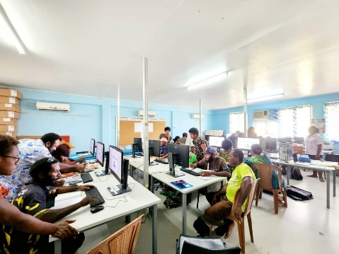

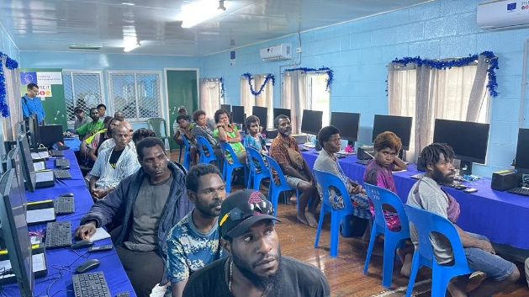
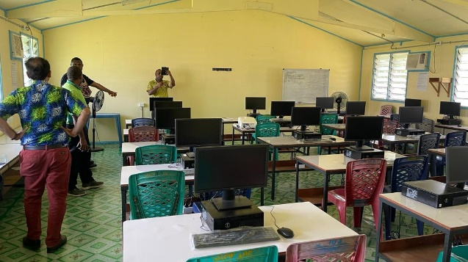
UAS Projects -2024 EU-STREIT/ITU
Don Bosco Secondary (Vanimo)
St. Ignatius (Aitape)
Maprik Secondary (Maprik)
Brandi Secondary (Wewak)
Notes:
The purpose of this slide is to highlight the importance of Partnerships and therefore it highlights the projects that have been delivered in Partnership with EU-Streit.

Slide 26

CONCLUSION –
Support Digital Transformation
Both the Government and Private Sectors are key to PNG Digital Transformation
Regulation is critical to a sustainable digital transformation
Universal Connectivity is critical
Wireless Infrastructure – based on Radio Spectrum – is by far the predominant infrastructure to realise PNG’s Digital Transformation
Therefore, Radio Spectrum Management is key to realising PNG Digital Transformation
…. and some of the ways spectrum is managed and assigned today is leading to inefficient use – so NICTA is working on updating spectrum management to include some market-based approaches
There are clear challenges to Spectrum Management today covered in this brief presentation
NICTA is addressing these challenges in FOUR broad ways: starting primarily with
    (i) Reviewing Spectrum Assignment Procedures - STOPping Assigning some Spectrum bands administratively
    (ii) Updated Key Band Plans and promote spectrum sharing
    (iii) Spectrum Outlook & Reviewing Spectrum Fees and
    (iv) Working with DICT on Revising the 2009 ICT Act and 2010 Regulations
Work in Planning on a Universal Access & Service GIS Portal that WOULD great assist with supply-side to connect more PNG citizens – and better-targeted USF Interventions

Slide 27


