Slide 1

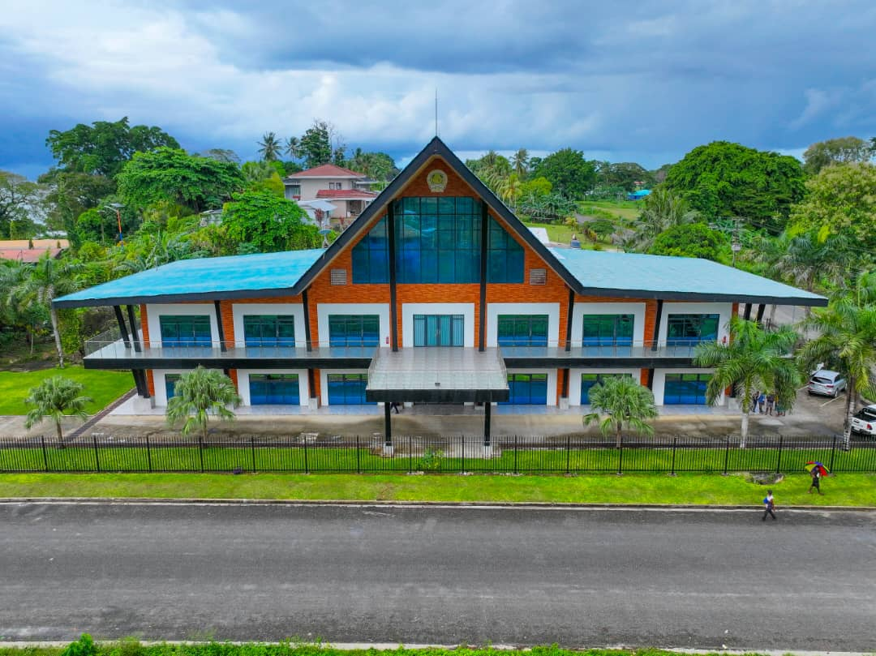

VILLAGE RECORD BOOK & DATA MANAGEMENT SYSTEM
NEW IRELAND PROVINCE
A JOINT PROJECT OF THE NEW IRELAND PROVINCIAL GOVERNMENT AND DEPARTMENT OF PROVINCIAL AND LOCAL GOVERNMENT AFFAIRS
By Ricky Fugonto – Director for Autonomy, District and LLG Affairs - NIP Administration

Slide 2
OUTLINE OF PRESENTATION
NEW IRELAND IN BRIEF
BRIEF HISTORY OF THE VILLAGE RECORD BOOK IN PNG
LEGAL MANDATE
IMPORTANCE OF VILLAGE RECORD BOOK
FEATURES OF PNG VILLAGE RECORD BOOK
VILLAGE RECORD BOOK - SYSTEM OVERVIEW
SUCCESS STORY OF NIP VRB SYSTEM

Slide 3
NEW IRELAND IN BRIEF
Total Area = 137,760.75 sq. km
(Land Area = 9,577.83 sq.km, Sea Area = 128,182.92 Sq. km)
POPULATION OF 194,067 (2011 CENSUS)
TWO DISTRICTS – NAMATANAI 110,905 , KAVIENG 83,162
10 LOCAL GOVERNMENTS,
142 COUNCIL WARDS
OVER 612 VILLAGES
TWO MINING – LIHIR AND SIMBERI
BOLUMINSKY HIGHWAY CONNECTS THE TWO DISTRICTS
FRIENDLY PEOPLE WITH VERY RICH AND DIVERSE CULTURES AND TRADITIONS
ONE OF THE MOST BEAUTIFUL AND SAFEST PLACES ANYWHERE IN PNG (yu yet kam pilim)

Slide 4
BRIEF HISTORY OF VILLAGE RECORD BOOK (VRB)
A data recording system was first introduced by the Colonial Administration to record demographic and socio-economic data for the purpose of planning and administering the local areas and villages during the colonial era and up to early post-independence period.
Baseline data was collected at the village and household level and recorded in a book which was known as “Village Record Book” (VRB)
In those days the Kiap would lined up people in the village, call their name from the roll and physically count the people. Also they tract movement of people (migration/immigration) from one place to another.
Social and economic activities were recorded in the VRB and kept safe in the government administration office.
A manual recording, very simple, easy and effective way to record and keep data and updated on a regular base.
This simple VRB system helped the Kiaps to use the data to plan and implement village based projects and programs in the communities in those days.

Slide 5
LEGAL MANDATE
1. ORGANIC LAW ON PGLLG
Section 106. Provincial Planning and Data System.
(1) There shall be established in each province an extended service of the Department responsible for planning matters and of the National Statistical Office.
(2) The functions of these services are to establish and maintain an effective and efficient provincial and local-level planning and data system.
(3) There shall be a census or the count of all natural persons in each province in the year proceeding a general election,
(4) An Act of the Parliament shall prescribe the types of records or data to be kept and details of the planning and data control system for the Provincial governments and Local-level Governments.

Slide 6
LEGAL MANDATE
2. LOCAL-LEVEL GOVERNMENT ADMINISTRATION ACT 1997
SECTION 57. Village Books.
(1) A Local-level Government shall establish and maintain for each ward within the Local-level Government area a register to be known as the Village Book.
(2) A Village Book shall contain information as to—
(a) the names, clans, ethnic groups and, where applicable, addresses of all persons within the ward; and
(b) the particulars of village officials; and
(c) such information on assets, facilities and other matters relating to the ward as the Minister directs.

Slide 7
INTRODUCTION
PNG is a country made up of rugged terrains, vast oceans and culturally diverse people.
Challenging for the Government to plan for effective delivery of basic goods & services to the people.
Nearly 80% of the population lives in rural areas.
Collecting and compiling an accurate database for each and every individual citizen including their economic, social, cultural, religious and political conditions is predominantly challenging for every public policy maker and planner.
PNG Ward Record Book was published by Department of Provincial & Local Government Affairs (DPLGA) with the aim to bridge this information gap that prevents the development of comprehensive plans both for the national and local levels. (Local Level Governments Administration Act 1997, Sections 57(1) & 57(5)
This will help in sound planning and policy making, resulting in the effective delivery of basic goods and services to the people, hence improving their living conditions.
PNG Ward Record Book will be used to capture data at the Village and Ward levels that can be used to develop Local Level plans which can be consolidated into the District, Provincial & National plans.

Slide 8
Importance of the PNG Village/ Ward Record Book – Data is Key
The World we live in today, Data is Key! Many world renowned economists believe that Data to this century is what Oil was for the last century – a driver for growth, change and success.
PNG Village Record Book will capture a wide range of critical data & in particular Local Level Government Ward. Based on that reliable data collected, Local Level Governments (LLGs) with their respective District Development Authorities (DDAs) and Provincial Governments will have a much better understanding of the actual development needs at their Wards.
This will lead to efficient and effective policy and planning for development, and distribution of basic goods and services right to the Wards and villages
The PNG village/Ward Record Book data can be used for Ward profiling, especially the projections and implementations of Government policies and programs.
The data from the village/Ward Record Book will help the Government with the overall planning processes around the country, as the data can be used to formulate sound policies and plans for effective service delivery to the community.
Based on the data from the village/Ward Record Book, LLG plans and policies can be derived and then amalgamated into District plans, Provincial plans and onto the National plans, utilizing the Bottom-Up planning process.

Slide 9
Features of PNG Village/Ward Record Book
Main Section
Ward Description
Ward Officials
Population
Disable Persons
Births & Marriages & Deaths
Movement of Persons in Wards
Community Resourceful People
Law & Order
Community Projects
Section A - EDUCATION
Schools
Infrastructure
Other Educational Institutions
Section B - HEALTH
Health Facilities
Drinking Water
Toilet Facilities
Cemeteries

Slide 10
Features of PNG Village/ Ward Record Book
Section C - TRANSPORT
Land Transport – Motor Vehicles
Land Transport - Roads
Water Transport – Outboard Motors
Water Transport – Inboard Motors
Water Transport – Jetty/Wharf
Water Transport – Shipping
Air Transport – Airports
Section D - COMMUNICATION
Telecommunication Facilities
Government Station
Town/City
Section E - OTHER
Other Services
Ward Assets
Section F – ECONOMIC SECTOR
Markets
Business Activities

Slide 11
Features of PNG Village/Ward Record Book
Section G - AGRICULTURE
Crops
Livestocks
Section H – AVAILABLE SERVICES
Government Services Available
Other Services Available
Section I – SPORTS AND RECREATION
Sports
Section J - TOURISM
Tourism
Section K – CROSS CUTTING ISSUES
Cross Cutting Issue: Gender
Cross Cutting Issue: HIV/AIDS
Cross Cutting Issue: Drug Abuse
Others
Natural Disasters
Climate Change
Visitors & Their Comments on the Village/Ward

Slide 12
Summary
PNG Village/Ward Record Book could become the Data Source for:
Population (Assist NSO with Census Statistics & EC with Electoral Rolls Updating)
Education
Health
Finance (Household Income)
Transport
Economy
Works
Infrastructures
Law & Order
Agriculture
Telecommunications
Tourism
Sports
NID Notification Forms

Slide 13
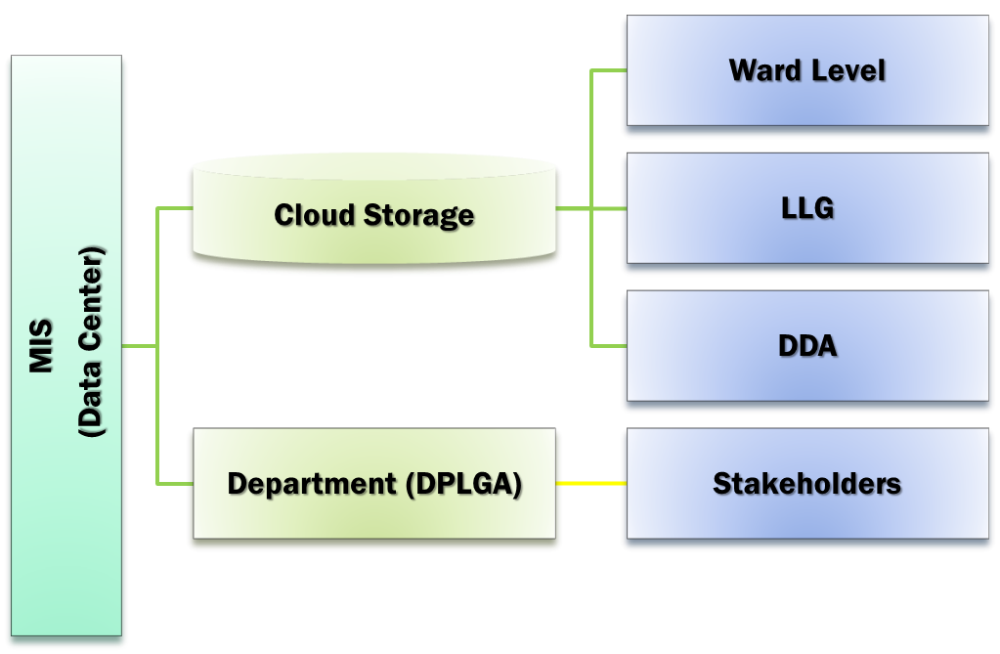
Village/Ward Record Book - System Overview

Slide 14



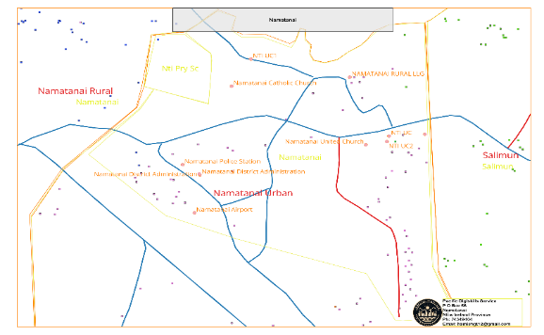
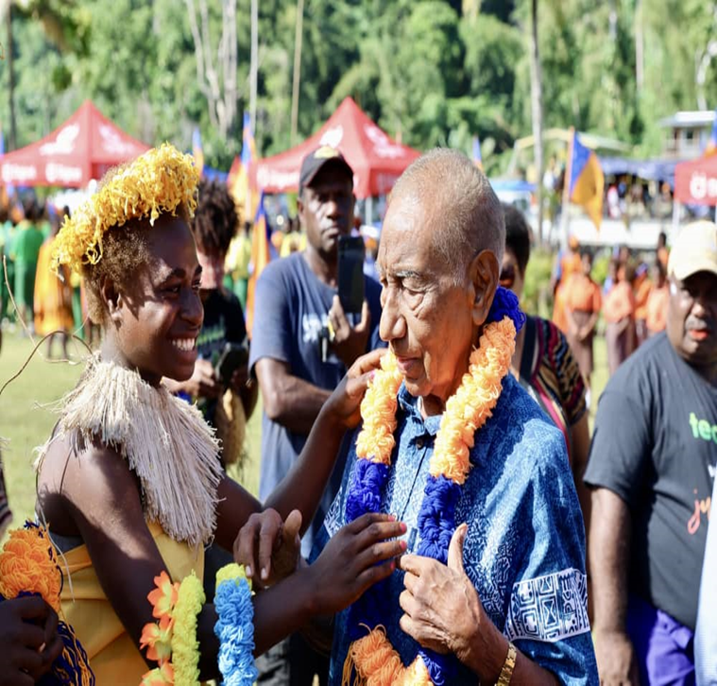
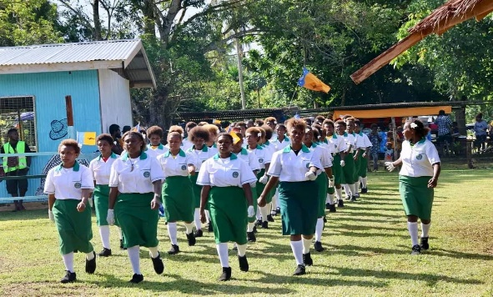
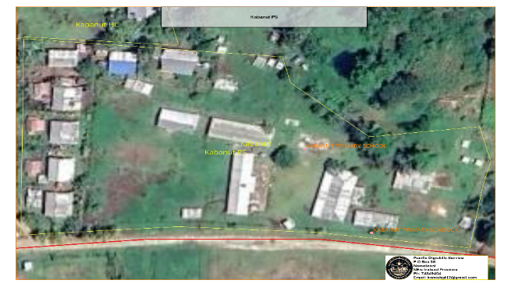
Data Extraction from VRB and Geographical Information System (GIS). Information Processing
Field Data Collection
Data Entry VRB
Exported Excel File
Geographical Information System
Processing
Information

Slide 15
Population by Districts and LLGs – 2011 Census and VRB 2020
17 | NEW IRELAND PROVINCE | 2011 CENSUS | VILLAGE RECORD BOOK (VRB)
17 | NIP | 194,067 | 171,671
1 | KAVIENG DISTRICT | 83,162 | 68,412
01 | Murat LLG | 4,210 | 4, 063
02 | Lavongai LLG | 29,005 | 27, 037
03 | Tikana LLG | 33,222 | 25, 715
04 | Kavieng Urban | 16,725 | 11, 597
2 | NAMATANAI DISTRICT | 110,905 | 103,259
05 | Namatanai LLG | 29,767 | 25,190
06 | Sentral Niu Ailan | 29,932 | 30, 990
07 | Konoagil | 13,132 | 13, 898
08 | Tanir LLG | 12,466 | 12,118
09 | Nimamar LLG | 25,608 | 21, 063
8,265 (Matalai)+16,925 (Nti)

Slide 16
Election Roll
NIP
40,498
Kavieng
19,500
Namatanai
20.998
142 Ward Common Roll produced for 2022 NGE
Biometric Voting

Slide 17
17 New Ireland Province
04 Kavieng Urban LLG
WARD 02. Kavieng Urban

Slide 18
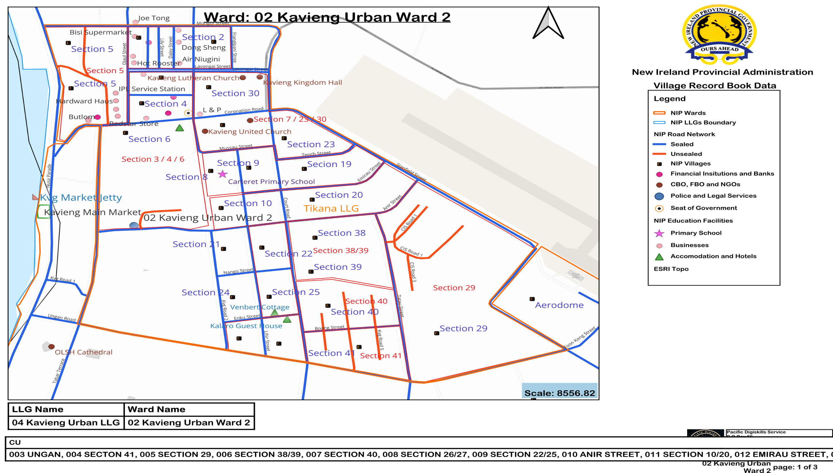

Slide 19
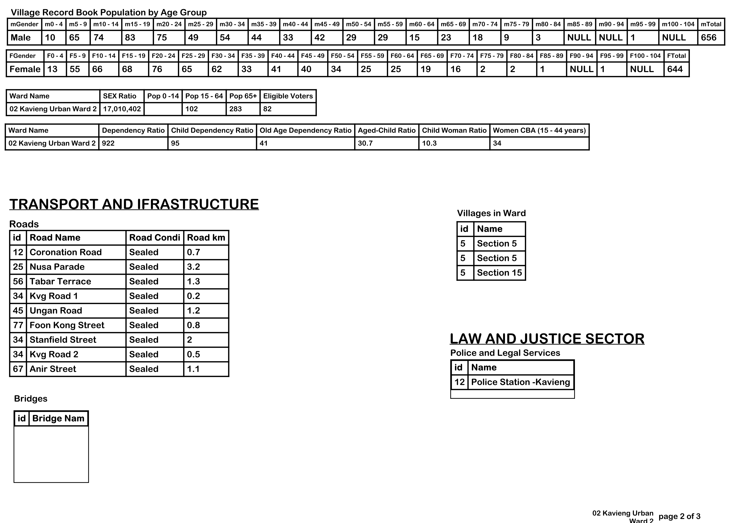

Slide 20
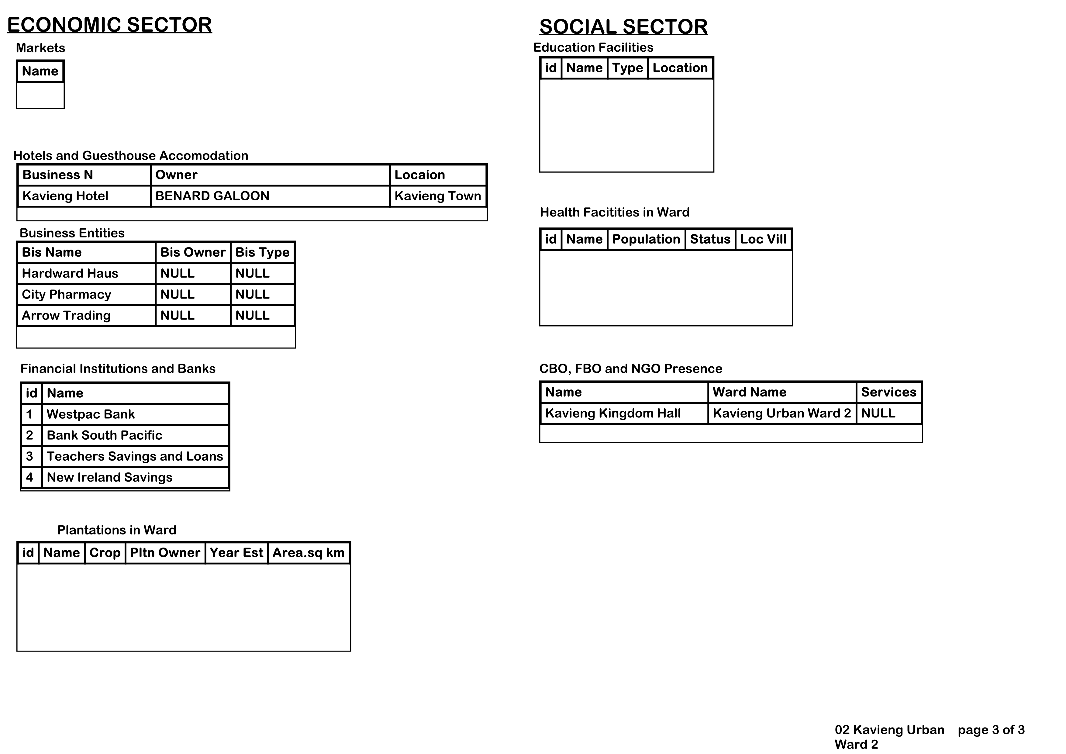

Slide 21


17 New Ireland Province
06 SENTRAL NIU AILAN RURAL
WARD 08. KONOS

Slide 22
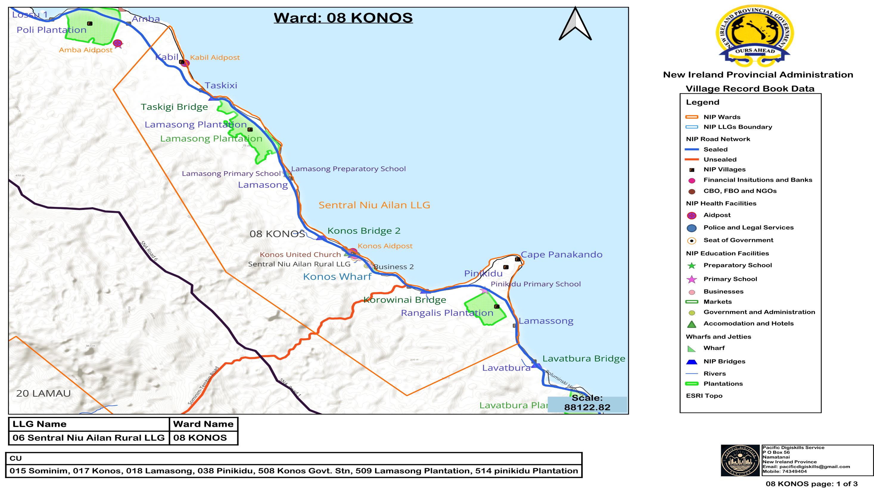

Slide 23
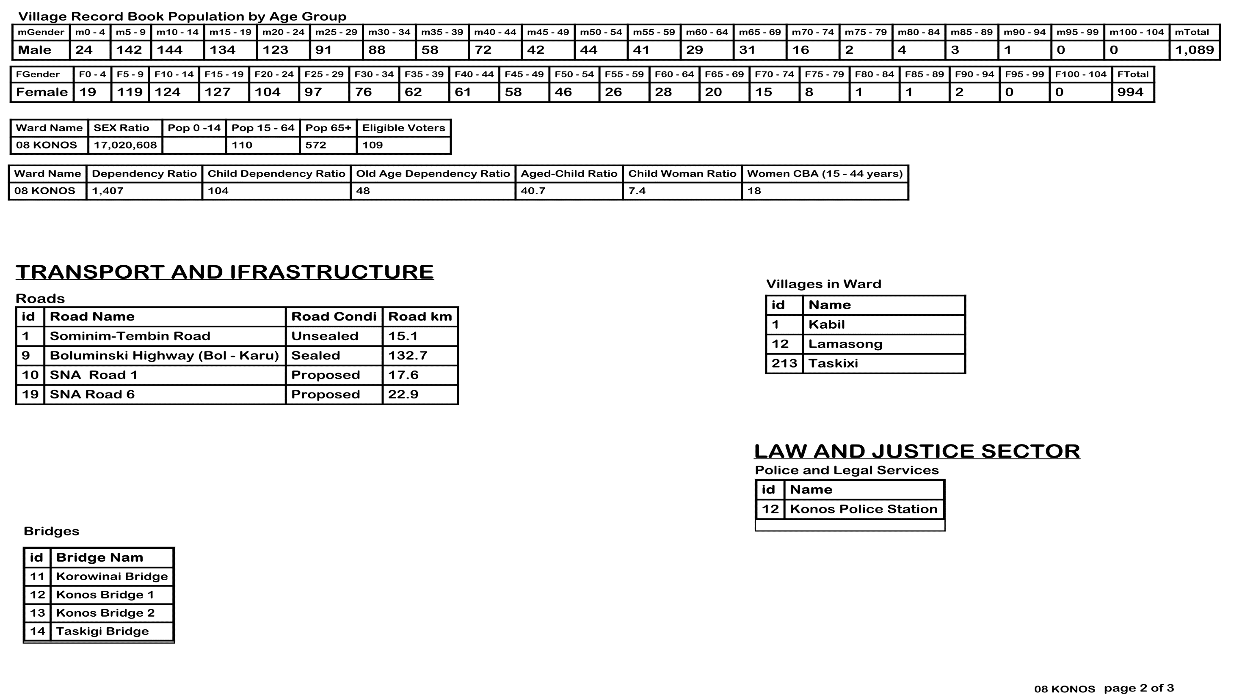

Slide 24
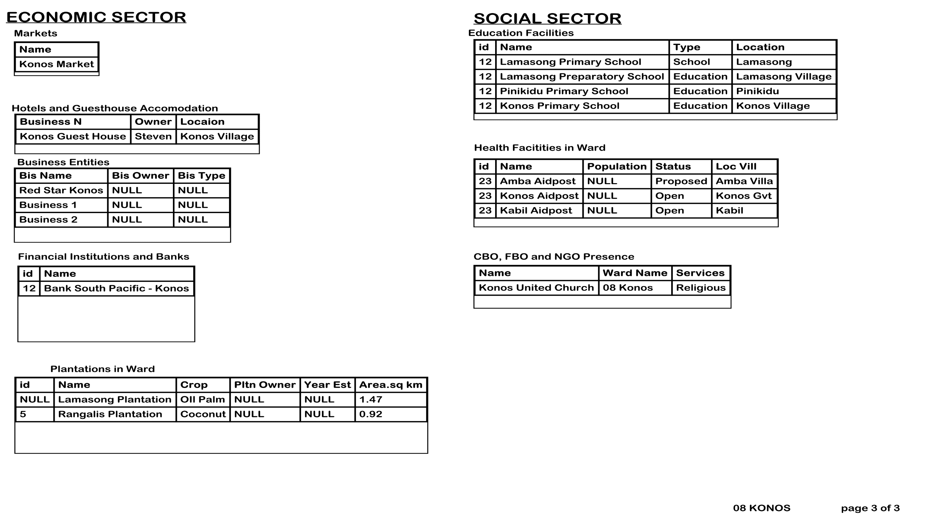

Slide 25
FUTURE
V-Sat Installation -10 LLG Seat of Government (LLG HQ)
Communication link to all 10 LLGS and 142 LLG Wards
Employment of Ward Recorders as full time workers on a fortnightly wages to collect and update Data (Currently on monthly allowance)
Training and equipping Ward Recorders and frontline workers in the LLGS with modern equipment for data collection
Establish a one-stop-shop Data Management System
Provincial Legislation to Regulate the collection, management , use and storage of data
NIP ID issued to all persons registered on the VRB Database
Election Roll update – PNGEC to ride on the VRB Data to update the election roll
NID can ride on the VRB Data
Re-introduce Provincial Data System (PDS) – make Census work easy

Slide 26
RECOMMENDATIONS/SUGGESTION
Provincial Data Office should be established in all Provinces under the auspices of the Provincial Governments/Administrations
State agencies like NSO, Electoral Commission, Civil Registry/NID and other agencies dealing with Demographic and Socio-Economic Data should use the Data in the VRB for their purpose. They should only be the end users. They Should Not spend huge money to go out and collect the information/data
The ICT department should establish regional or provincial offices or have an understanding with the provincial governments and administrations to implement the ICT policy in the provinces, districts and LLGS
There should be a standard provincial policy and legislation on Data Collection, Management, Use, and Storage of Data for the Province

Slide 27

End

