Slide 1



Department of Information And Communications Technology
PRIVATE GOVERNMENT NETWORK (GPN)
www.ict.govpg
www.ict.gov.pg

Slide 2

OVERVIEW
  Government Private Network (GPN) Overview
    GPN Project establishment and GPN design
  Connectivity
    GPN in agencies
  Delivery Model
    GPN delivery model and alignment to the tech stack
  Timeline and Expected Deliverables
    Project milestones
  End
Notes:
Deploy the Government critical core Network Infrastructure which will enable the PNG Government to deliver “ Digital Government services” thereby reducing cost and improving visibility while maintaining an Agile ,Secure and Robust Network

Slide 3

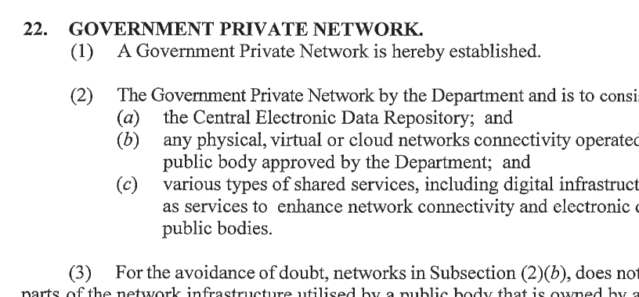

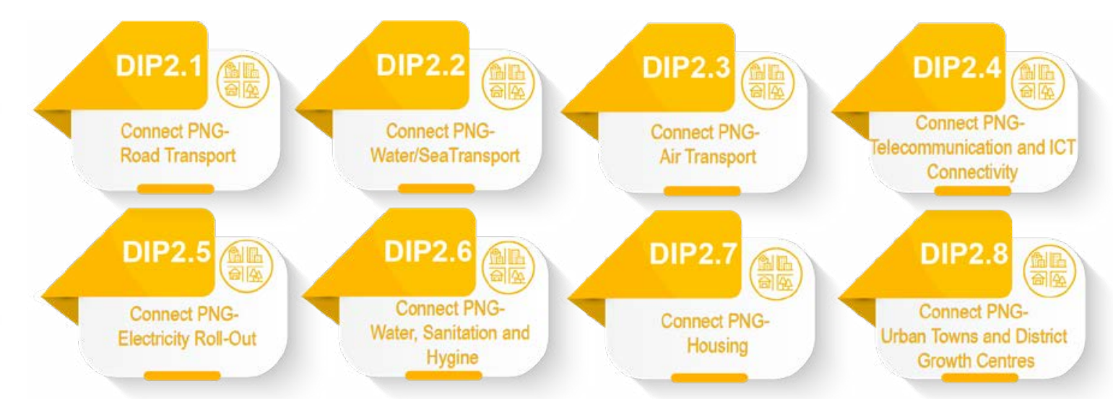
GOVERNMENT PRIVATE NETWORK (GPN) OVERVIEW
Establish under the Digital Government Act 2022
  Section 22, subsection 1
GPN project under the MTDP 4 2023 – 2027
  SPA 2, DIP 2.4 – Connect PNG telecommunication and ICT infrastructure
Notes:
Deploy the Government critical core Network Infrastructure which will enable the PNG Government to deliver “ Digital Government services” thereby reducing cost and improving visibility while maintaining an Agile ,Secure and Robust Network

Slide 4


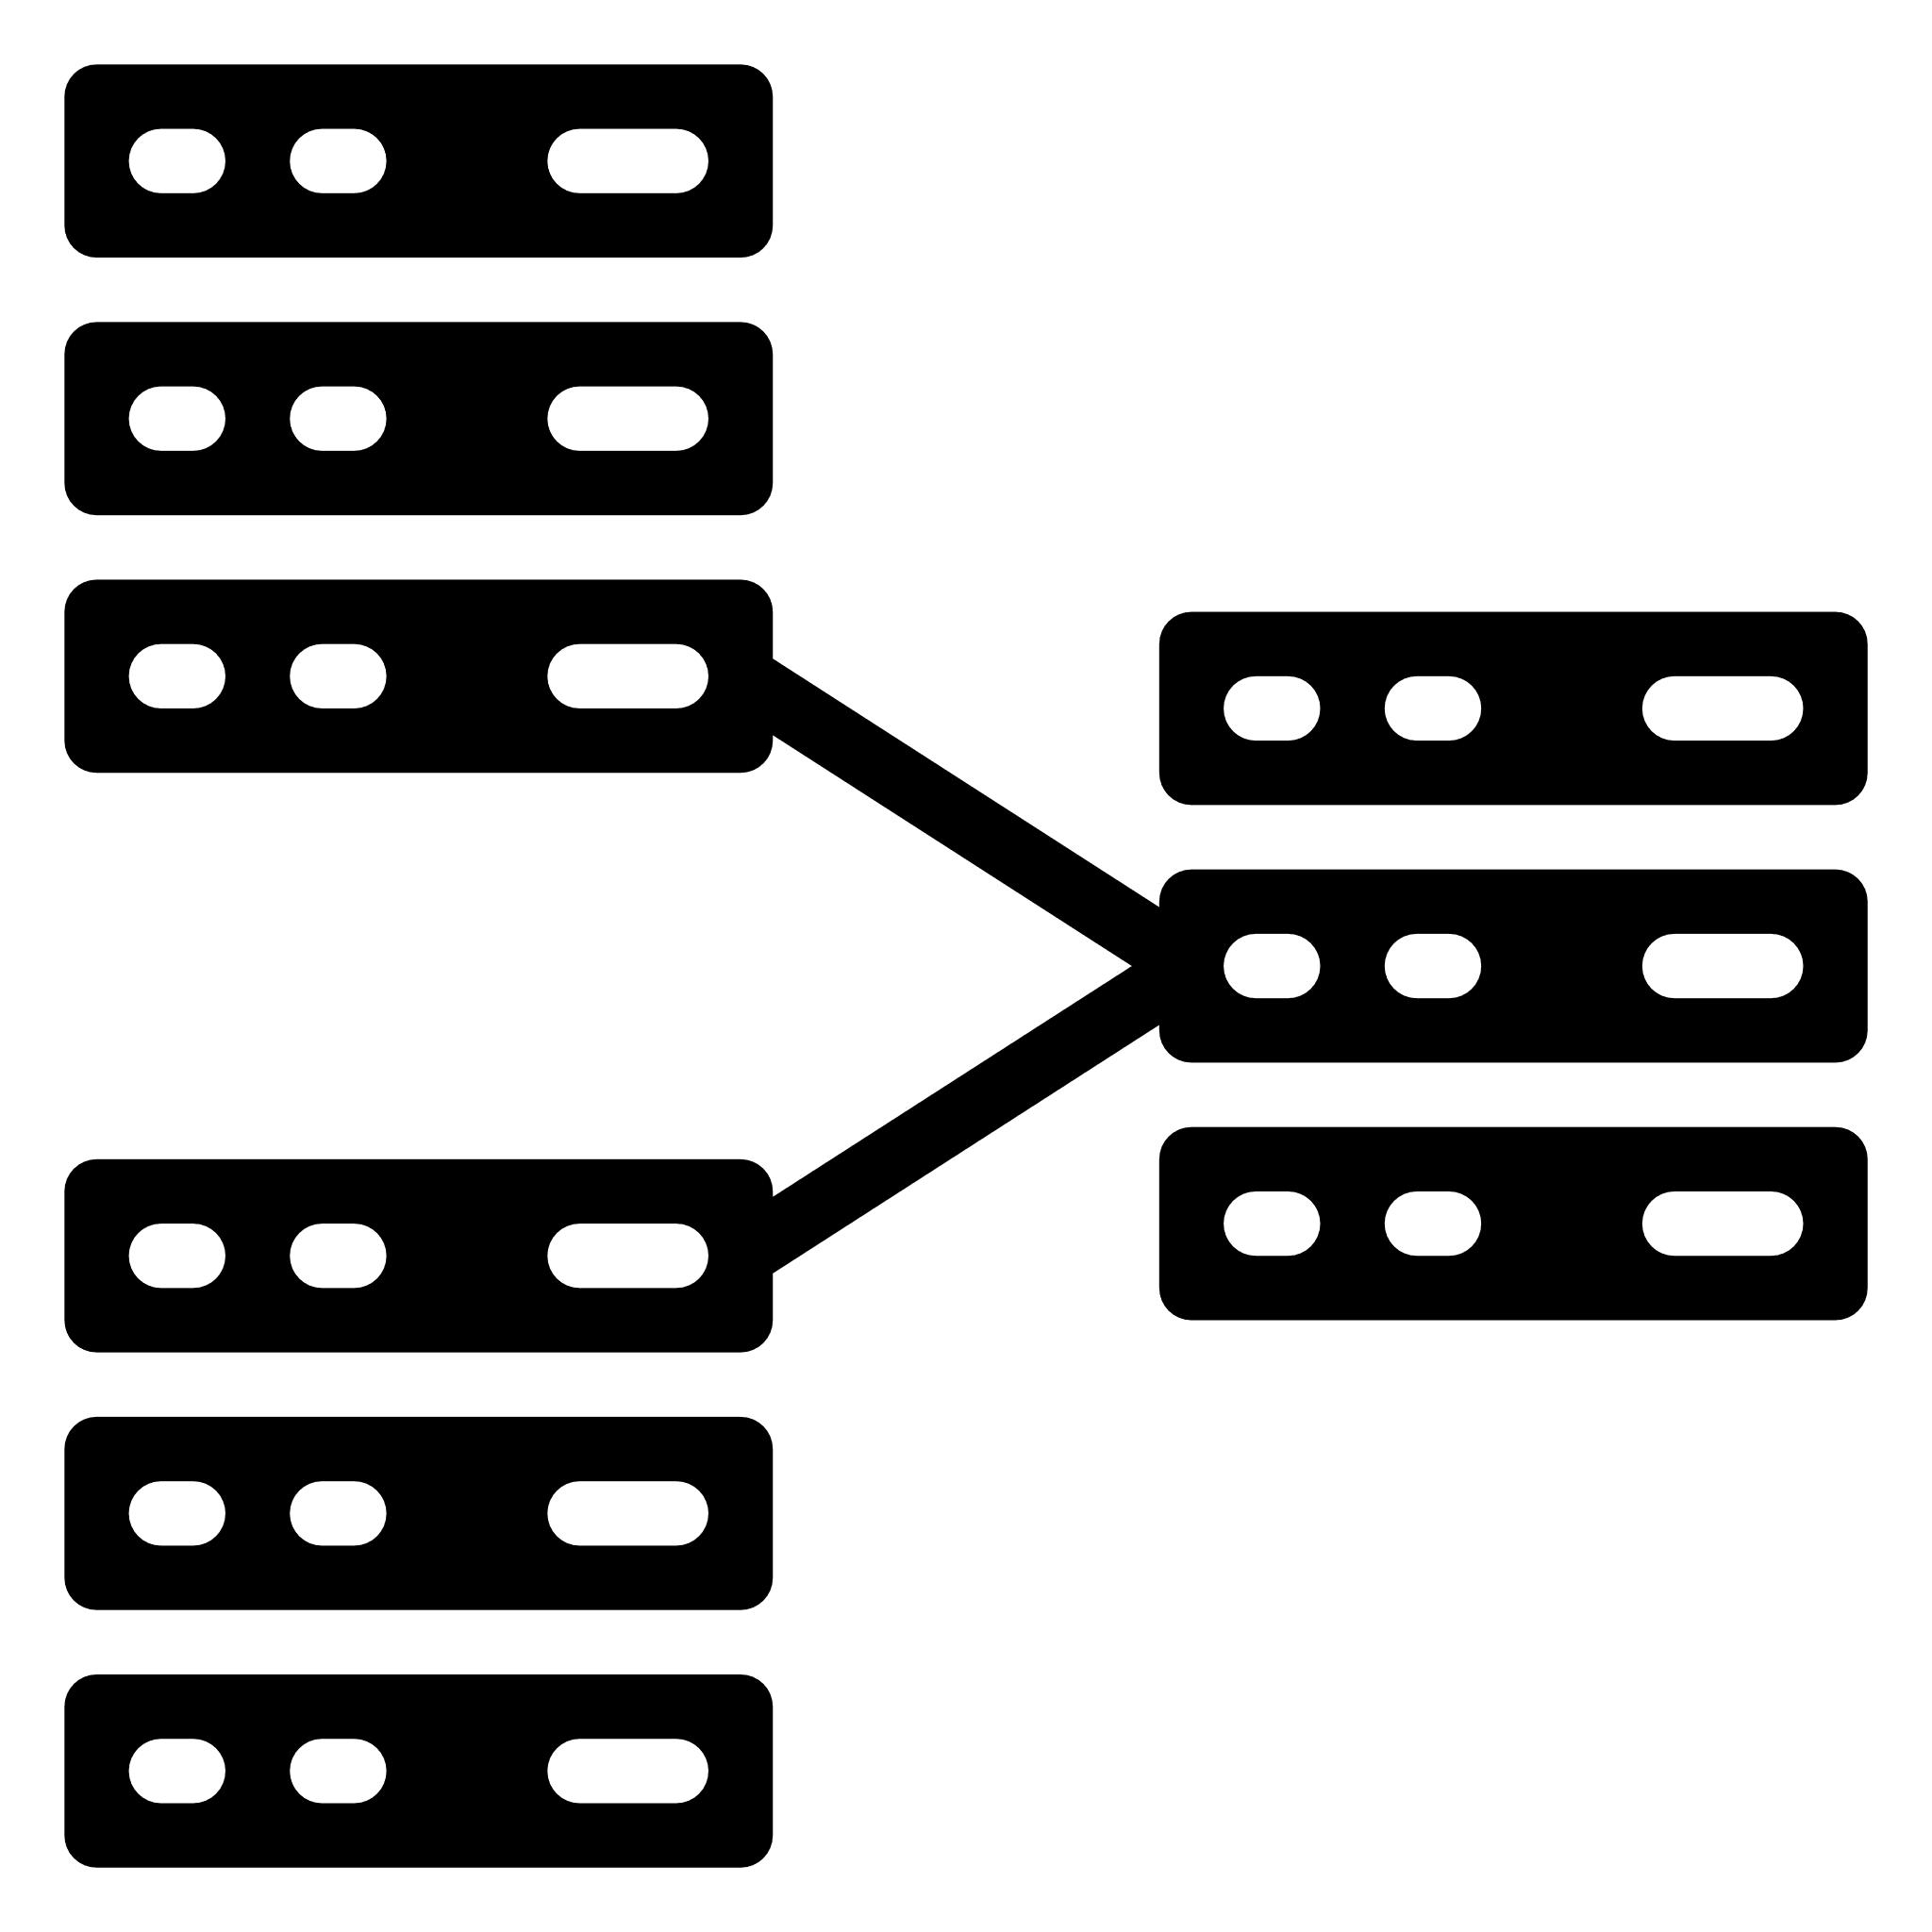
GOVERNMENT PRIVATE NETWORK (GPN) OVERVIEW
Purpose:
Service delivery for G2G, G2B, G2C
Fast service deployment
Service deployment to Remote areas
High availability and security
GPN overlay network
Cloud-based
Secure Access Service Edge
Government Data Center 1
Government Data Center 2
GPN underlay network
Infrastructure based
IP Core network
Purpose:
Service delivery for G2G, G2B, G2C
Data localization
DNS localization
Cloud integration (AWS, Azure, Oracle)
AWS
AZURE
Oracle
Internet Link
DataCo Layer 2 Fiber Link
Equinix virtual Link
Notes:
Deploy the Government critical core Network Infrastructure which will enable the PNG Government to deliver “ Digital Government services” thereby reducing cost and improving visibility while maintaining an Agile ,Secure and Robust Network

Slide 5


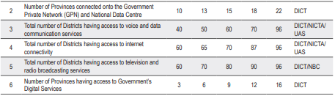
CONNECTIVITY
GOVERNMENT PRIVATE NETWORK
OVERLAY (CLOUD)
Districts, Provinces, and National agencies can connect to the GPN through the overlay, the underlay, or both depending on the available component
Connectivity is based on nature and purpose of services provided by the agency
NATIONAL AGENCIES
PROVINCES AGENCIES
Government Data Center 1
Government Data Center 2
DISTRICTS AGENCIES
UNDERLAY (INFRASTRUCTURE)
AWS
AZURE
Oracle
Notes:
Deploy the Government critical core Network Infrastructure which will enable the PNG Government to deliver “ Digital Government services” thereby reducing cost and improving visibility while maintaining an Agile ,Secure and Robust Network

Slide 6
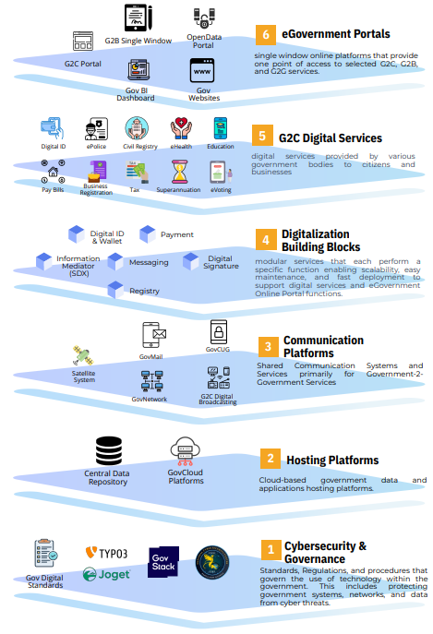





DELIVERY MODEL IN ALIGNMENT TO TECHNOLOGY STACK
STACK COMPONENTS
IMPLEMENTING AGENCIES
RELEVANT STAKEHOLDERS
DICT is working in collaboration with S.O.E to deliver the GPN
DICT will also be using other relevant stakeholders to deliver the GPN
By working in collaboration with S.O.Es and other relevant stakeholder who have already established themselves in the communications field, GPN will be able to achieve its KPI while limiting the government investment that is spent on infrastructure
Notes:
Deploy the Government critical core Network Infrastructure which will enable the PNG Government to deliver “ Digital Government services” thereby reducing cost and improving visibility while maintaining an Agile ,Secure and Robust Network

Slide 7
TIMELINE AND EXPECTED DELIVERABLES
GPN Overlay
Built, deployed and tested the overlay
Integrated Gov CUG into the overlay
Commissioning the overlay
Pilot site rollout
CONNECTIVITY
Link all provinces and districts to GPN
Link all government agencies to GPN
OPERATIONS
GPN operations
2024
2026
2028
2023
2025
2027
Project Initiation
Planning, Design and Procurement
GPN Underlay
Completion and deployment of the underlay
Provision of services through underlay
Pilot site rollout
Project completion
  GPN completion
  Deploy GPN sustainability plan
Notes:
Deploy the Government critical core Network Infrastructure which will enable the PNG Government to deliver “ Digital Government services” thereby reducing cost and improving visibility while maintaining an Agile ,Secure and Robust Network

Slide 8

END
Notes:
Deploy the Government critical core Network Infrastructure which will enable the PNG Government to deliver “ Digital Government services” thereby reducing cost and improving visibility while maintaining an Agile ,Secure and Robust Network

