Slide 1


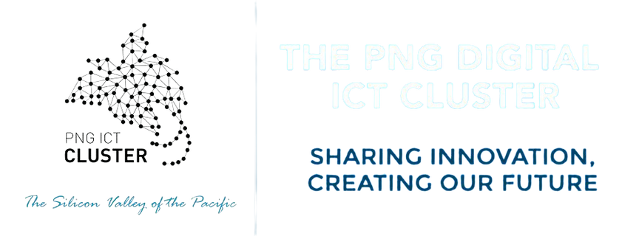
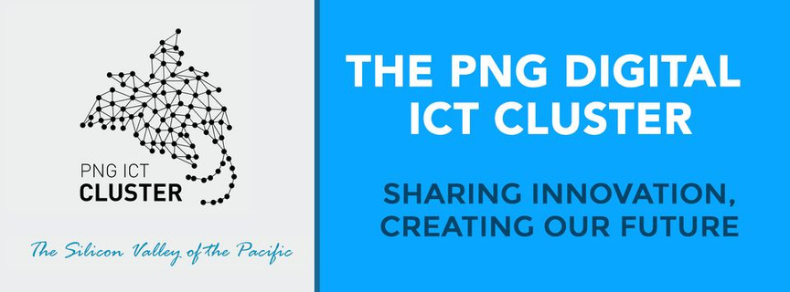




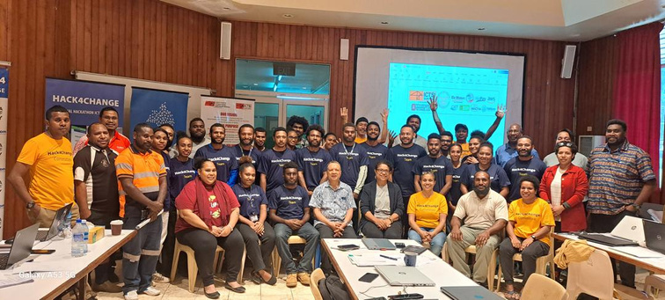
DIGITAL “STARTUPS AND SCALE-UPS”
NAVIGATING DIGITAL TRANSFORMATION TOWARDS 50 YEARS & BEYOND:
COLLABORATION & INNOVATION
1975

Slide 2



|
NAVIGATING DIGITAL TRANSFORMATION TOWARDS 50 YEARS & BEYOND:
COLLABORATION & INNOVATION
NAVIGATING CHANGE AND INNOVATION
ABOUT THE PNG DIGITAL ICT CLUSTER Digital Startups and Scale-ups
MOU STRATEGIC FRAMEWORK FOR CO-OPERATION AND COLLABORATION
ALIGNMENT OF THE GOVPNG TECH STACK
In this Presentation
This is the Agenda
DIGITAL TRANSFORMATION SUMMIT 2024 |DIGITAL “STARTUPS AND SCALE-UPS” - entrepreneurship

Slide 3
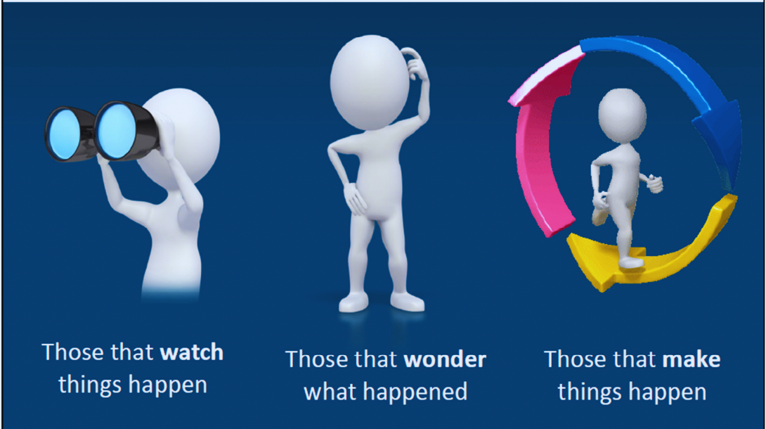
|
Change and Innovation
The world has changed, and only those that have kept pace with that change can succeed in difficult environments
Page 01
DIGITAL TRANSFORMATION SUMMIT 2024 |DIGITAL “STARTUPS AND SCALE-UPS” - entrepreneurship

Slide 4
|
Change and Innovation
Change is often very hard, but embracing the idea that change is constant can be a helpful perspective for adapting to the ever-changing world around us.
  Defining Change by type
  Defining Change by magnitude
  External Changes: Inflation, Climate Change, Geo-politics, Legislation, Disruptive Technology, Cybersecurity
  Internal Organisation Change
  Crisis and Risk Management: Ukraine War, Covid-19, Ransomware
  Cultural Change and Employee engagement
Incremental change
  Continuous Improvement
  Operational Changes
  Product or Service Improvement
  Cost reduction initatives
  Policy and Procedure Improvements
  Digital Transformation
  Mergers and Acquisitions
  Large-scale technology adoption
Tranformative change
Globally, countries are making their tech sector’s a security priority (cybersecurity) and using economic innovative legislation to preserve and capture technological advantage, impact on tech supply chains
Page 02
DIGITAL TRANSFORMATION SUMMIT 2024 |DIGITAL “STARTUPS AND SCALE-UPS” - entrepreneurship

Slide 5
























|
Cloud computing
Commercialisation of IT / Mobility - Smart Phones
Some Technology Trends Addressed by GovTech Stack
Internet
Artificial Intelligence and Machine Learning
Social Media
Database and Server Technology / Data Centers
Digital ID, Digital Wallet, Digital Payments
Big DATA, Data Analytics
BPaaS
Page 03
Business Process As A Service

Slide 6
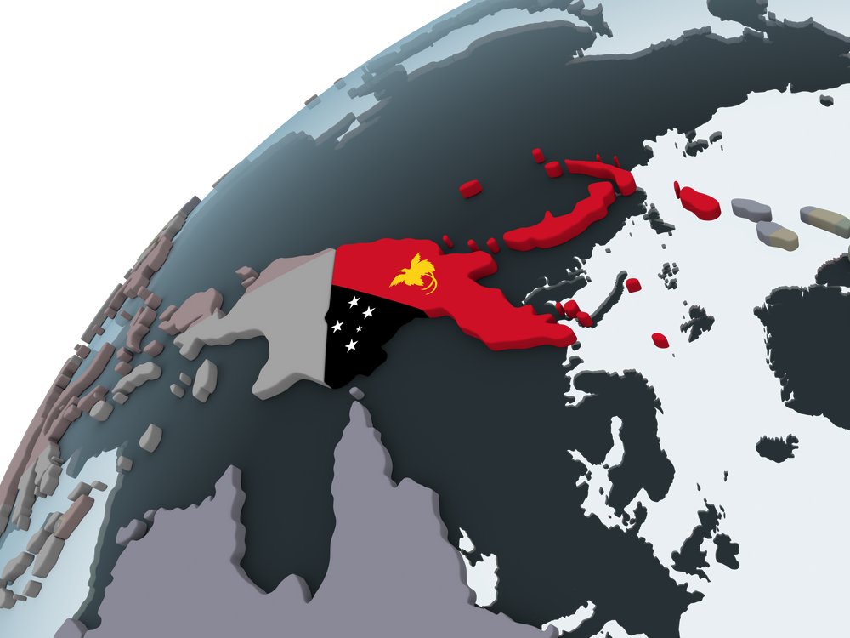
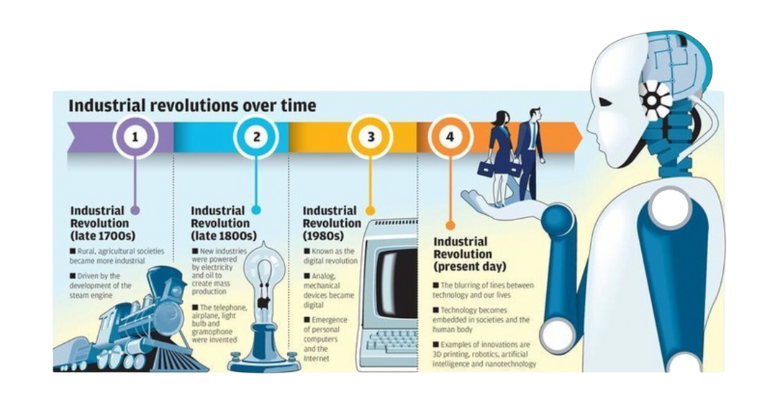



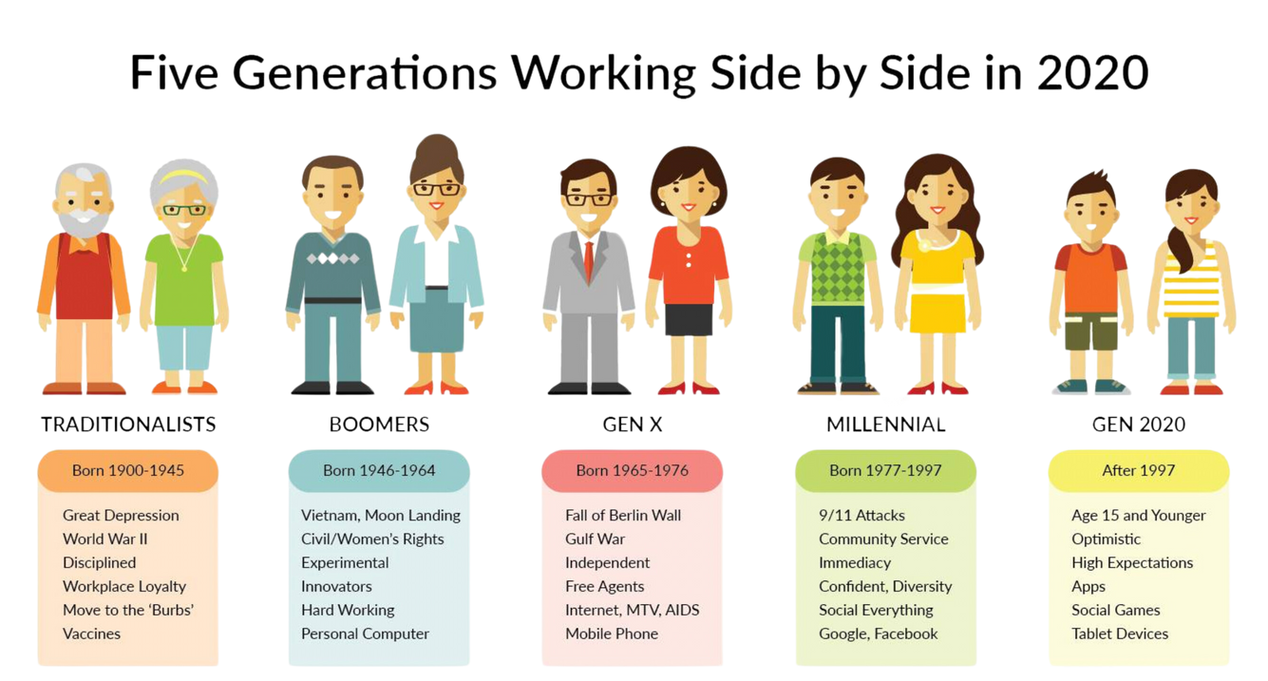
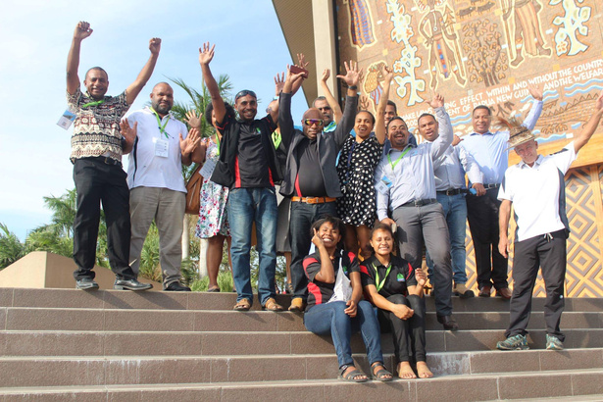
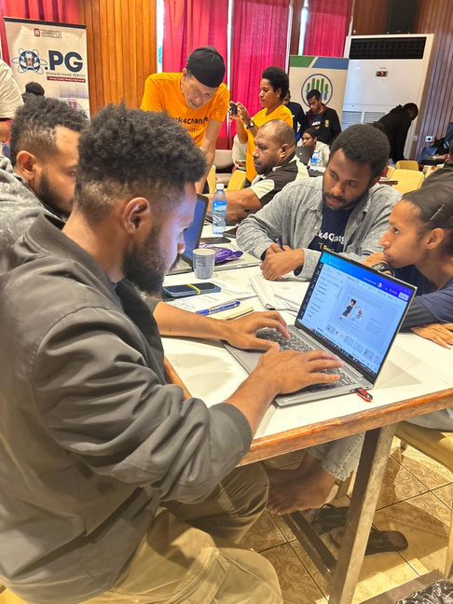
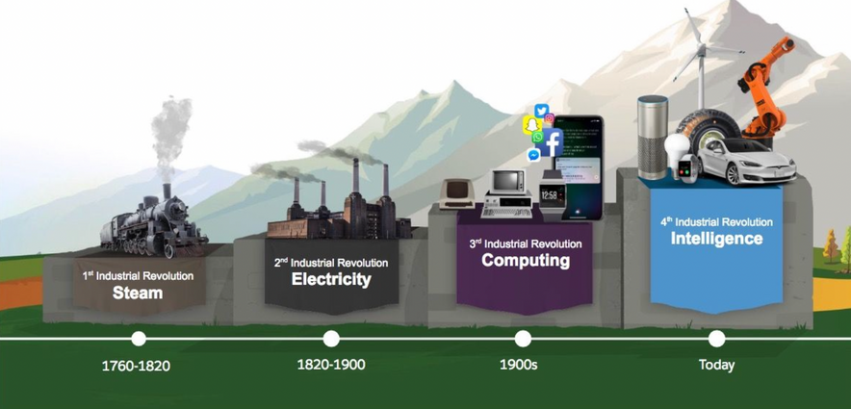
|
NAVIGATING DIGITAL TRANSFORMATION TOWARDS 50 YEARS & BEYOND:
COLLABORATION & INNOVATION
5 GENERATIONS WORKING
SIDE BY SIDE IN 2024
1975
TRADITIONALISTS
BORN 1900- 1944
Great depression
World War II
Disciplined
Vaccines
BOOMERS
BORN 1945-1964
Baby Boomers
Experimental
Innovators
Personal Computers
GEN X
BORN 1965-1980
TV Generation
MILLENNIAL
BORN 1981-1996
The Last to Grow Up Offline
Older Millennials
BORN 1996-1997
Digital Natives
Younger Millennial
GEN Z
BORN 1997-2005
The First Connected Kids
Older Gen Z
BORN 2006 -2024
Younger Gen Z
As technology becomes embedded in almost every aspect of our lives
DIGITAL TRANSFORMATION SUMMIT 2024 |DIGITAL “STARTUPS AND SCALE-UPS” - entrepreneurship
Page 04

Slide 7
|
NAVIGATING DIGITAL TRANSFORMATION TOWARDS 50 YEARS & BEYOND:
COLLABORATION & INNOVATION
THE OPPORTUNITY (GEN X AND GEN Y)
  As pioneer computer science graduates from UniTech, there was no established and sustainable platform for local innovation and creativity for local university graduates. (Whilst Universities mandated for research and teaching, there was no commercialisation happening in ICT.)
  The difference of value creation for a digital STEM (ICT) entrepreneur and a small business is not distinct in the PNG business ecosystem. Therefore, access to finance is difficult and entrepreneurs continue to struggle to get traction and translate ideas to marketable products and services.
  The Global technology sector particular digital ICT, is growing at twice the rate of the global economy, with much of the growth in startups.
  Digital ICT start-ups cover all sectors of the economy including agriculture, health, education, financial services, and manufacturing.
  Some of these digital entrepreneurs draw on strong digital ecosystems, accessing support networks, and a wealth of nearby knowledge, funds, skills and expertise.
  The uptake of Digital ICT can be initiated and driven by Women
  Young entrepreneurs have already become the driving force of job creation, in particular where ecosystems have been shaped by large companies and other “bridge makers” that help translate ideas to marketable products and services.
Page 05

Slide 8
|
ABOUT PNG DIGITAL ICT CLUSTTER
Overview
Vision
  Initiated in 2014 by Regional Project “Clusters inthe Pacific”
  Co-founded by Priscilla Kevin and Winifred Kula
  Established in March 2018 as a Not-for-Profit Organisation, membership-driven association; Founding Members Kumulsoft, Minsoft, In4net, eNova-X (to name as few)
  ICT Cluster is a high-tech innovation cluster to drive inclusive innovation and entrepreneurship for its SME and MSME members
  Unique platform for innovation between business, university and public authorities
By 2030, smart ICT use in economic life and social organisation will be a source of prosperity for PNG
Mission
To contribute to the recognition of the PNG Digital ICT Cluster as one of the most attractive clusters in the Pacific. PNG to be the home of many start-ups and global technology companies, and attract Direct Foreign Investment for global industry leaders
OUR VALUES - ALTRUISM & INNOVATION | TEAM WORK |INTEGRITY| PROFESSIONALISM | RESPECT |
DIGITAL TRANSFORMATION SUMMIT 2024 |DIGITAL “STARTUPS AND SCALE-UPS” - entrepreneurship
Page 06

Slide 9

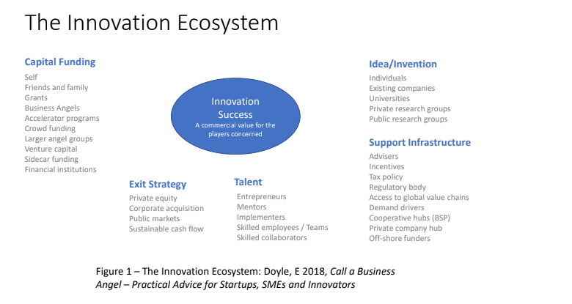
|
ABOUT PNG DIGITAL ICT CLUSTTER
Membership
  Startups, SME and MSME
  Large Companies
  Proactive and co-operative public depts/agencies
  Academia
  Investors
Service Offerices
  Collaborative Innovation (Projects)
  SME Accelerator
  Business Program
  Networking (Annual Business Conference - TechInnovate)
Former Director for Oil Search / Santos and Australia CSIRO
OUR VALUES - ALTRUISM & INNOVATION | TEAM WORK |INTEGRITY| PROFESSIONALISM | RESPECT |
DIGITAL TRANSFORMATION SUMMIT 2024 |DIGITAL “STARTUPS AND SCALE-UPS” - entrepreneurship
Page 07

Slide 10
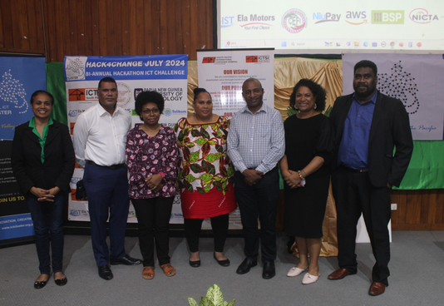

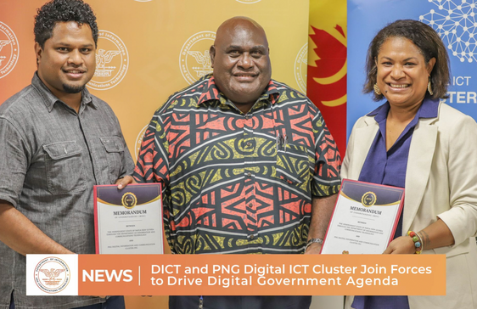

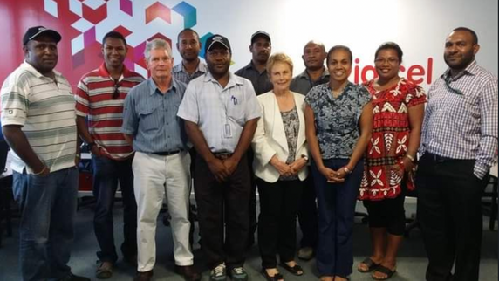
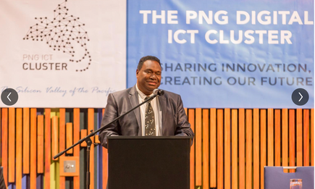
|
ABOUT PNG DIGITAL ICT CLUSTTER
Milestones
  1st TechInnovate Conference
  Launched establishment of PNG Digital ICT Cluster and
  1st Physical Space for Cluster City lab at Badili, Port Moresby
  Facilitate launchpad for young digital ICT entrepreneurs for APEC
  GIST Innovation Hub (US State Dept)
  1st Hackathon “HACK4CHANGE” for Industry
  Software Engineering Academy with SwitchMaven
  Incepted through EU Regional Project through PIPSO and PNG Chamber of Commerce & Business Council
  Project handover to ICT Cluster Volunteers
  Facilitate first Entreprenuship Training with ABV
  Partnership with Uot (Signed MOU)
  DEFINE Skills Project in Port Moresby
  1st Hackathon “HACK4CHANGE” for Academia
  Strategic Partnership Kyudo
2014
2018
2020
2022
2014
  Patron leadership support is established
  Soft Launch of PNG Digital ICT Cluster
2017
2019
2021
2023
2025
  2nd TechInnovate Conference
  1st BRIDGES at UPNG (Software Engineering ) with Nara Institute of Science and Technology, Japan
  3rd TechInnovate Conference
  Partnership with Catalyst Group (Former DEFINE Initative)
  Strategic Partnership with DICT (Signed MOU)
DIGITAL TRANSFORMATION SUMMIT 2024 |DIGITAL “STARTUPS AND SCALE-UPS” - entrepreneurship
Page 08

Slide 11


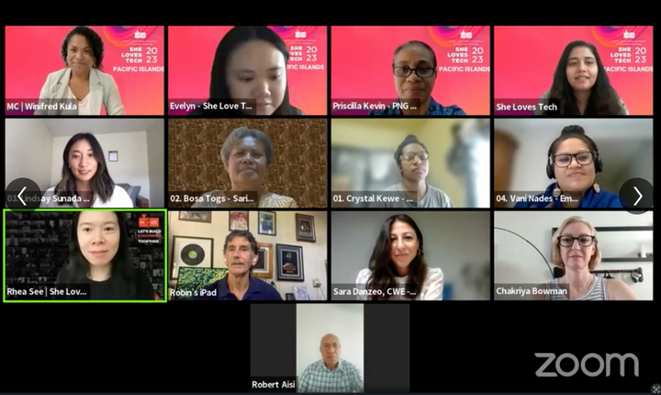
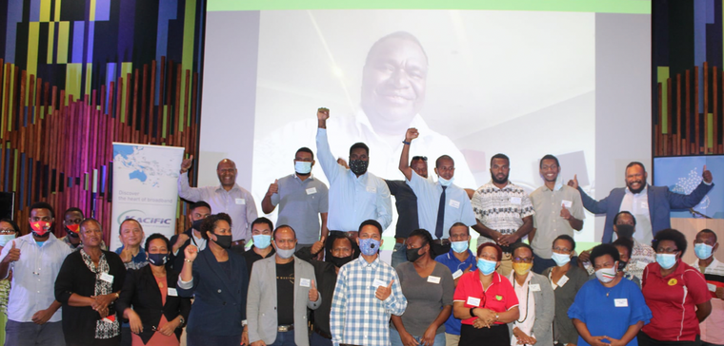
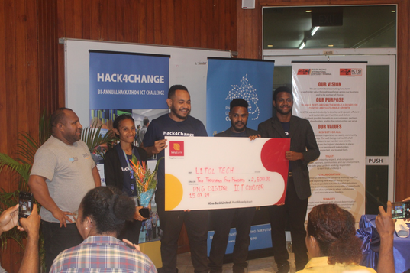
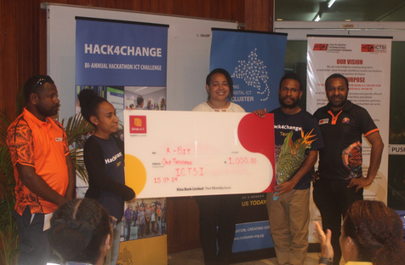
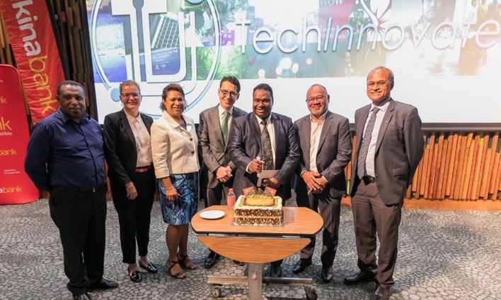
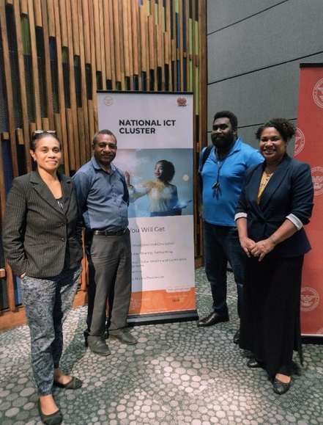
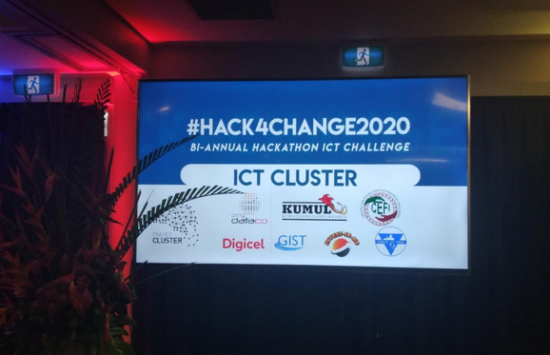
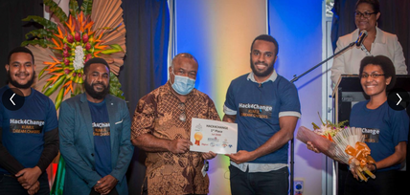
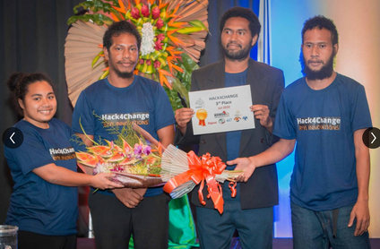

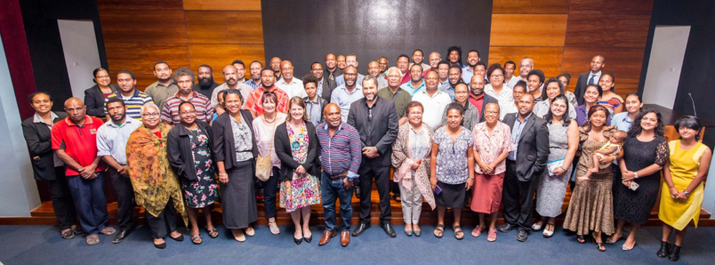
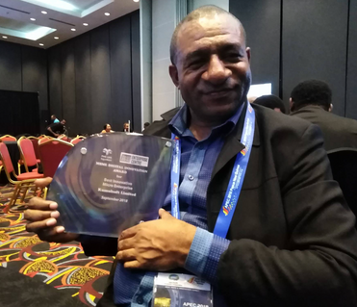

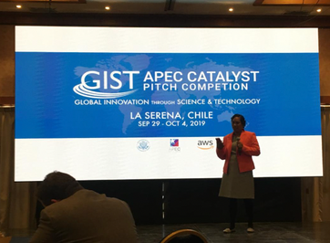
|
NAVIGATING DIGITAL TRANSFORMATION TOWARDS 50 YEARS & BEYOND:
COLLABORATION & INNOVATION
DIGITAL TRANSFORMATION SUMMIT 2024 |DIGITAL “STARTUPS AND SCALE-UPS” - entrepreneurship
Page 09

Slide 12
|
NAVIGATING DIGITAL TRANSFORMATION TOWARDS 50 YEARS & BEYOND:
COLLABORATION & INNOVATION
MOU STRATEGIC FRAMEWORK FOR CO-OPERATION & COLLABORATION
  Promote Good Governance and Communities of Practice:
  Establish and Operate the National ICT Incubation Center:
  Commitment to Developing and Improving Standards for Information Data and Software:
  Promote and Encourage Better Digital Services that are Accessible and User-Friendly:
  Encourage and Promote Programs to Build Digital Capacity and Skills:
DIGITAL TRANSFORMATION SUMMIT 2024 |DIGITAL “STARTUPS AND SCALE-UPS” - entrepreneurship
Page 10

Slide 13

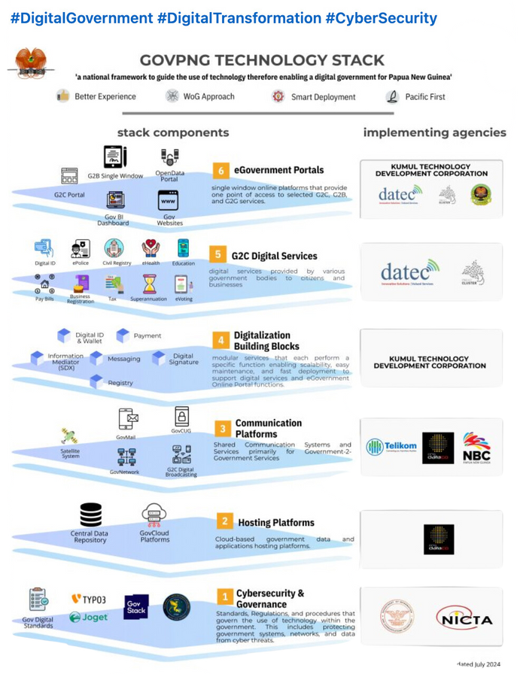
|
NAVIGATING DIGITAL TRANSFORMATION TOWARDS 50 YEARS & BEYOND:
COLLABORATION & INNOVATION
ALIGNMENT OF GOVPNG TECHNOLOGY STACK
1. Government Website Standardisation
DIGITAL TRANSFORMATION SUMMIT 2024 |DIGITAL “STARTUPS AND SCALE-UPS” - entrepreneurship
Page 11

Slide 14
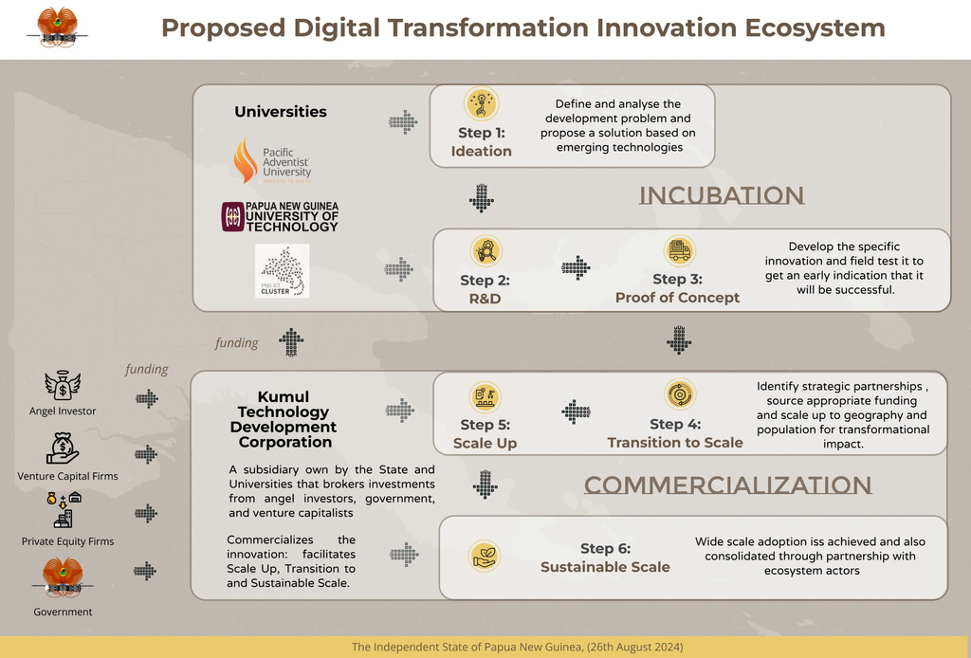



|
NAVIGATING DIGITAL TRANSFORMATION TOWARDS 50 YEARS & BEYOND:
COLLABORATION & INNOVATION
ALIGNMENT OF GOVPNG TECHNOLOGY STACK
2. Innovation Centers for Incubation & Acceleration
Cluster MoU with Kyudogrowth to support:
Development of Governance and Risk Management Frameworks for Digital ICT Incubation
DIGITAL TRANSFORMATION SUMMIT 2024 |DIGITAL “STARTUPS AND SCALE-UPS” - entrepreneurship
Page 12

Slide 15
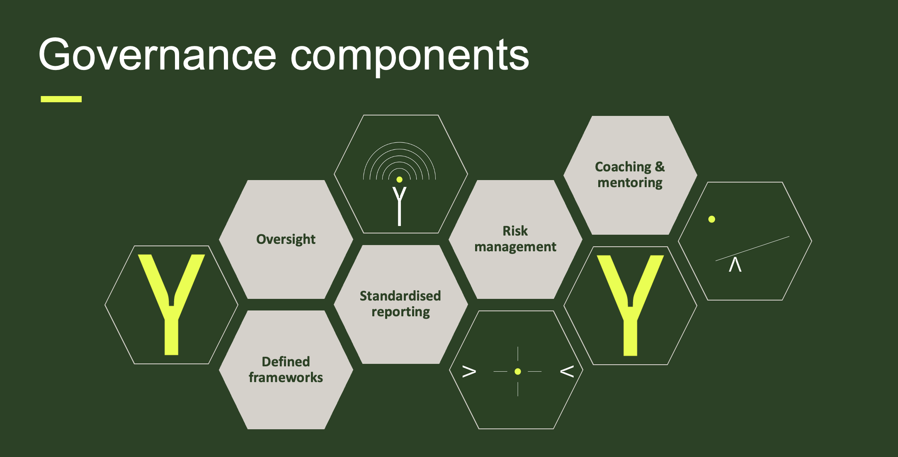
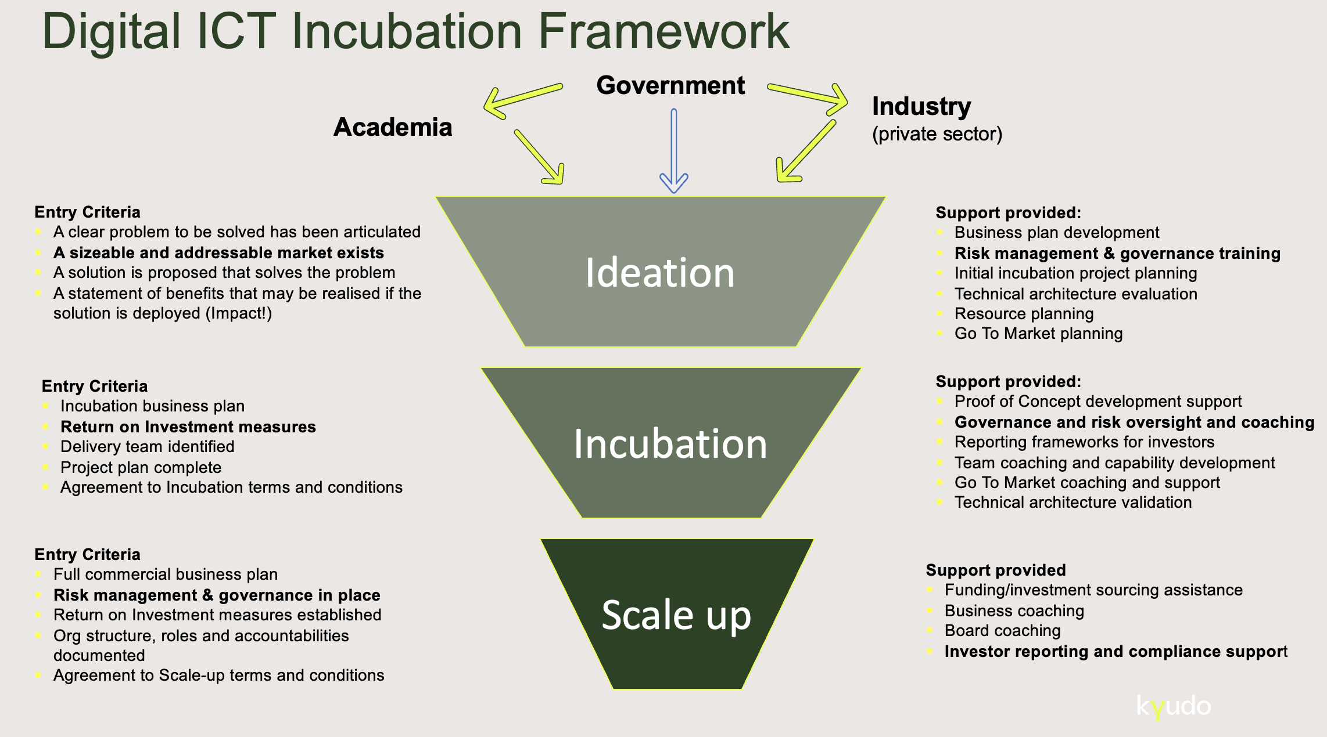
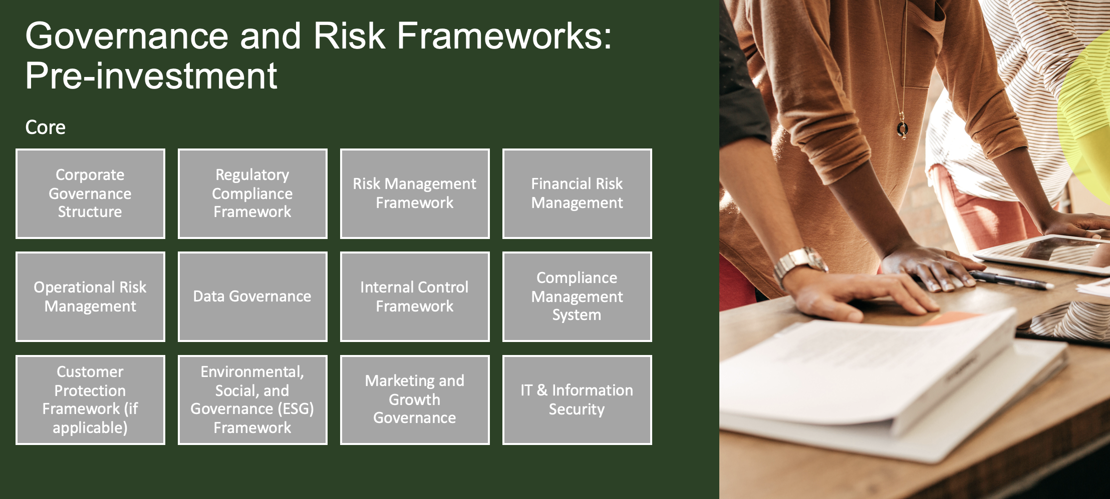
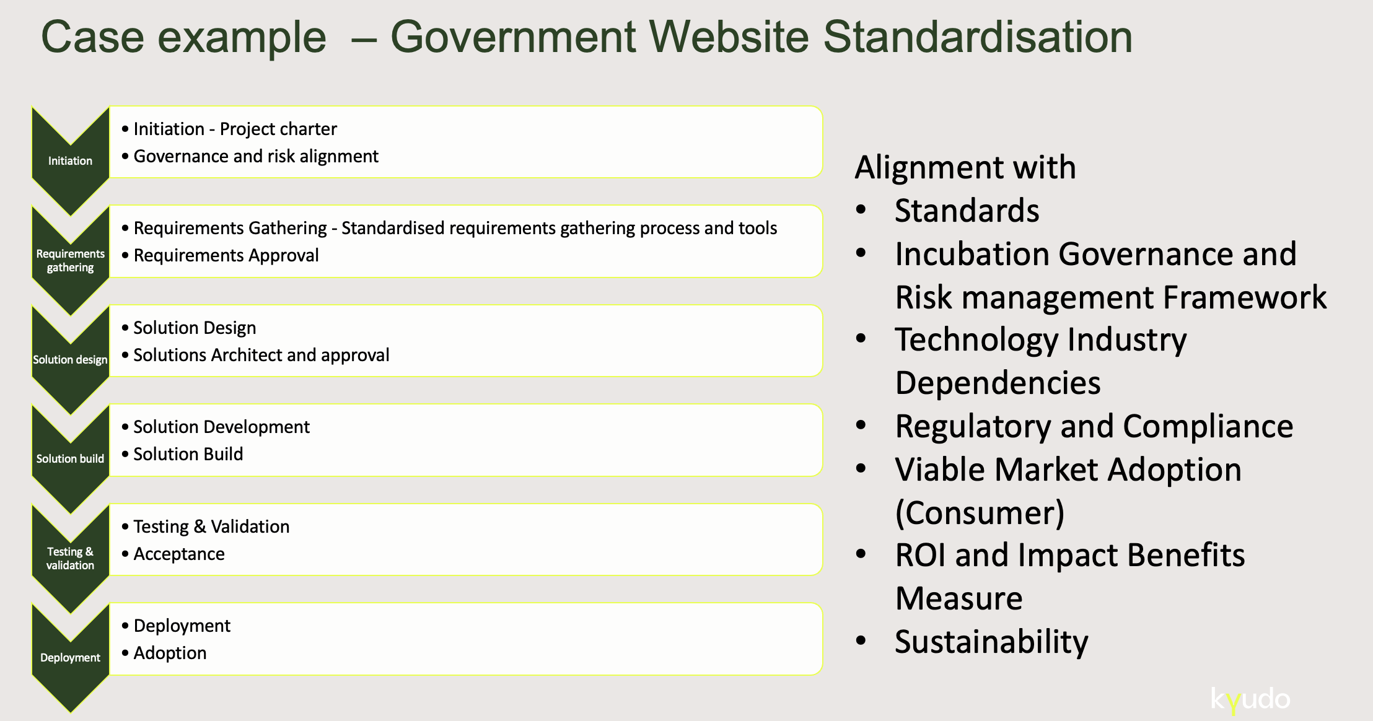
DIGITAL TRANSFORMATION SUMMIT 2024 |DIGITAL “STARTUPS AND SCALE-UPS” - entrepreneurship
Page 13

Slide 16
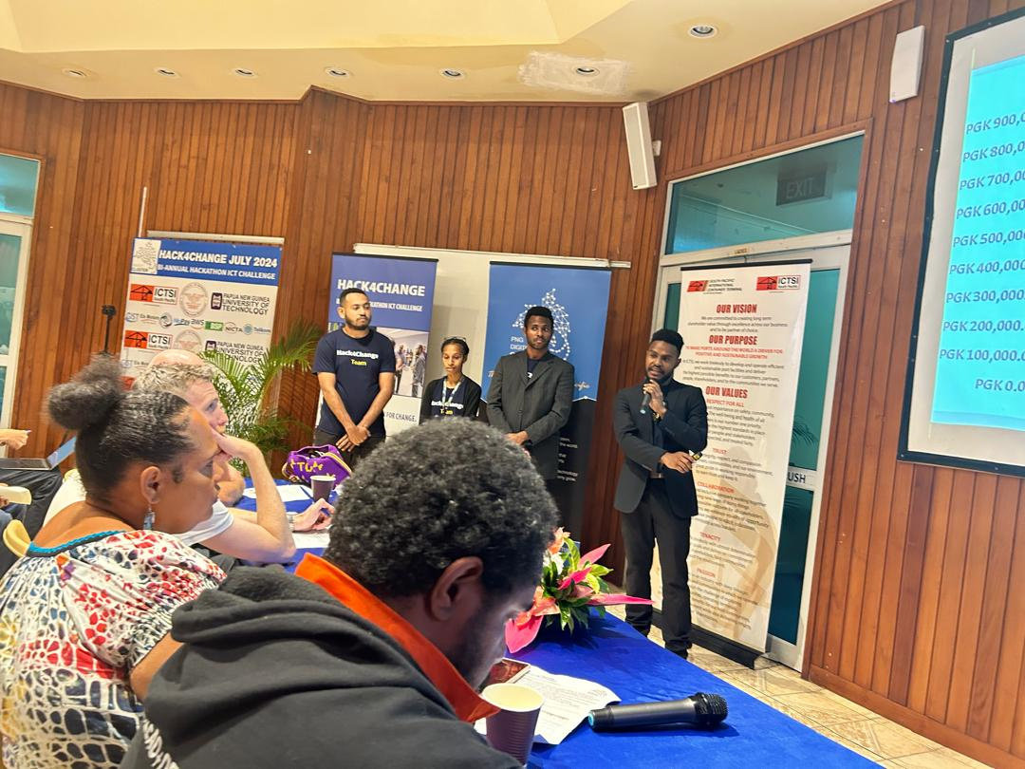
|
NAVIGATING DIGITAL TRANSFORMATION TOWARDS 50 YEARS & BEYOND:
COLLABORATION & INNOVATION
OBJECTIVES OF INNOVATION CENTERS FOR INCUBATION & ACCELERATION
Foster local entrepreneurship
Support PNG students and entrepreneurs in developing tech startups
Promote Research and Development
Assist in turning local research into market-ready solutions
Strengthen Industry and Academia Linkage
Build partnerships between universities, industry and government
DIGITAL TRANSFORMATION SUMMIT 2024 |DIGITAL “STARTUPS AND SCALE-UPS” - entrepreneurship
Page 14

Slide 17
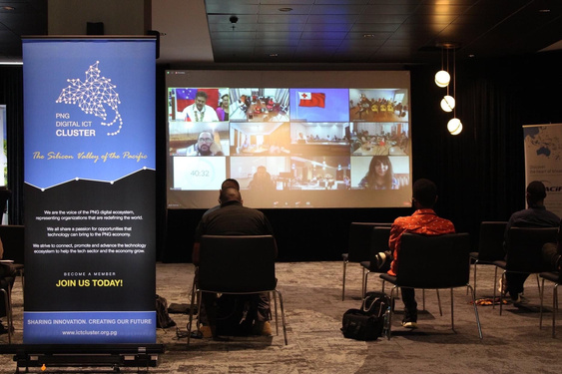
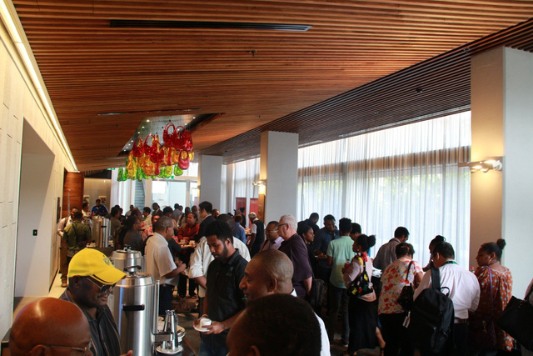
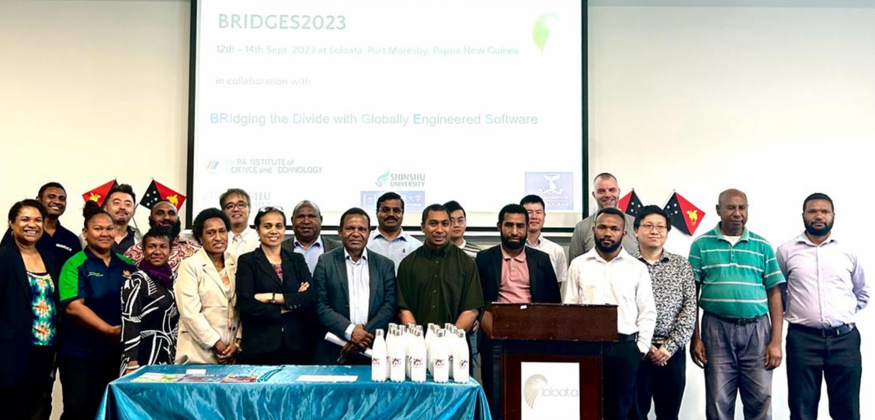
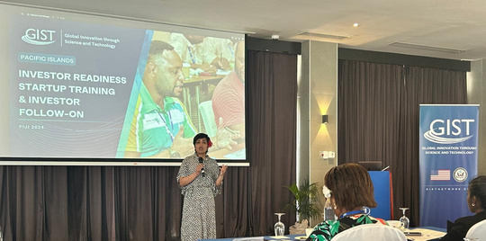
|
NAVIGATING DIGITAL TRANSFORMATION TOWARDS 50 YEARS & BEYOND:
COLLABORATION & INNOVATION
KEY COMPONENTS
OF EFFECTIVE INCUBATORS & ACCELERATOR PROGRAMS
Infrastructure and facilities
Office space, co-working areas, meeting rooms
Support Services
Mentorship, workshops, networking events.
Technology and Resources
Access to cutting-edge tools, software, and equipment
Funding and Investments
Seed funding, grant opportunities, investor connection
DIGITAL TRANSFORMATION SUMMIT 2024 |DIGITAL “STARTUPS AND SCALE-UPS” - entrepreneurship
Page 15

Slide 18
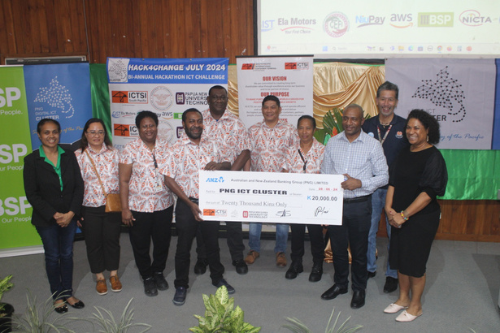

|
NAVIGATING DIGITAL TRANSFORMATION TOWARDS 50 YEARS & BEYOND:
COLLABORATION & INNOVATION
Boost Reputation
BENEFITS TO INDUSTRY- UNIVERSITIES-GOVERNMENT
Enhances the university’s profile as a hub for innovation
Attracts Talent
Draws high-quality students and faculty interested in entrepreneurship
Strengthen Industry Linkage
Creates opportunities for industry partnerships and collaborations
Drives Economic Development
Contributes to local and regional economic growth through successful startups.
DIGITAL TRANSFORMATION SUMMIT 2024 |DIGITAL “STARTUPS AND SCALE-UPS” - entrepreneurship
Page 16

Slide 19

ROADMAP FOR INCUBATION CENTERS AT UNIVERSITIES
4. Operations & Management
Manage programs, monitor performance, gather feedback.
2. Design & Development
5. Sustainability and Growth
Set up infrastructure, recruit staff, develop policies
Explore additional funding, expand offerings, continuous improvement.
  Planning & Strategy
3. Program Development & Launch
Define goals, engage stakeholders, secure funding
Launch programs, build partnerships, promote the centre
DIGITAL TRANSFORMATION SUMMIT 2024 |DIGITAL “STARTUPS AND SCALE-UPS” - entrepreneurship
Page 17

Slide 20
|
NAVIGATING DIGITAL TRANSFORMATION TOWARDS 50 YEARS & BEYOND:
COLLABORATION & INNOVATION
Funding and Resources
Diversify funding sources, establish strong partnerships
Scaling Programs
KEY CHALLENGES AND PROPOSED SOLUTIONS
Develop a scalable model, focus on sustainability
Industry Collaboration
Build and maintain strong industry relationships, align with industry needs
DIGITAL TRANSFORMATION SUMMIT 2024 |DIGITAL “STARTUPS AND SCALE-UPS” - entrepreneurship
Page 18

