Slide 1

CENSUS DATA CAPTURE SYSTEM
National Statistical Office
w: www.nso.gov.pg
3RD OCTOBER 2024
STANLEY HOTEL

Slide 2
Presentation Outline
Background of the Census
Census Coverage
Transition from PAPI to CAPI
Resources Required
Basic Data Flow Model (CAPI)
Benefits & Challenges
Summary

Slide 3
Background of Census
History of Census Taking in PNG
In progress

Slide 4
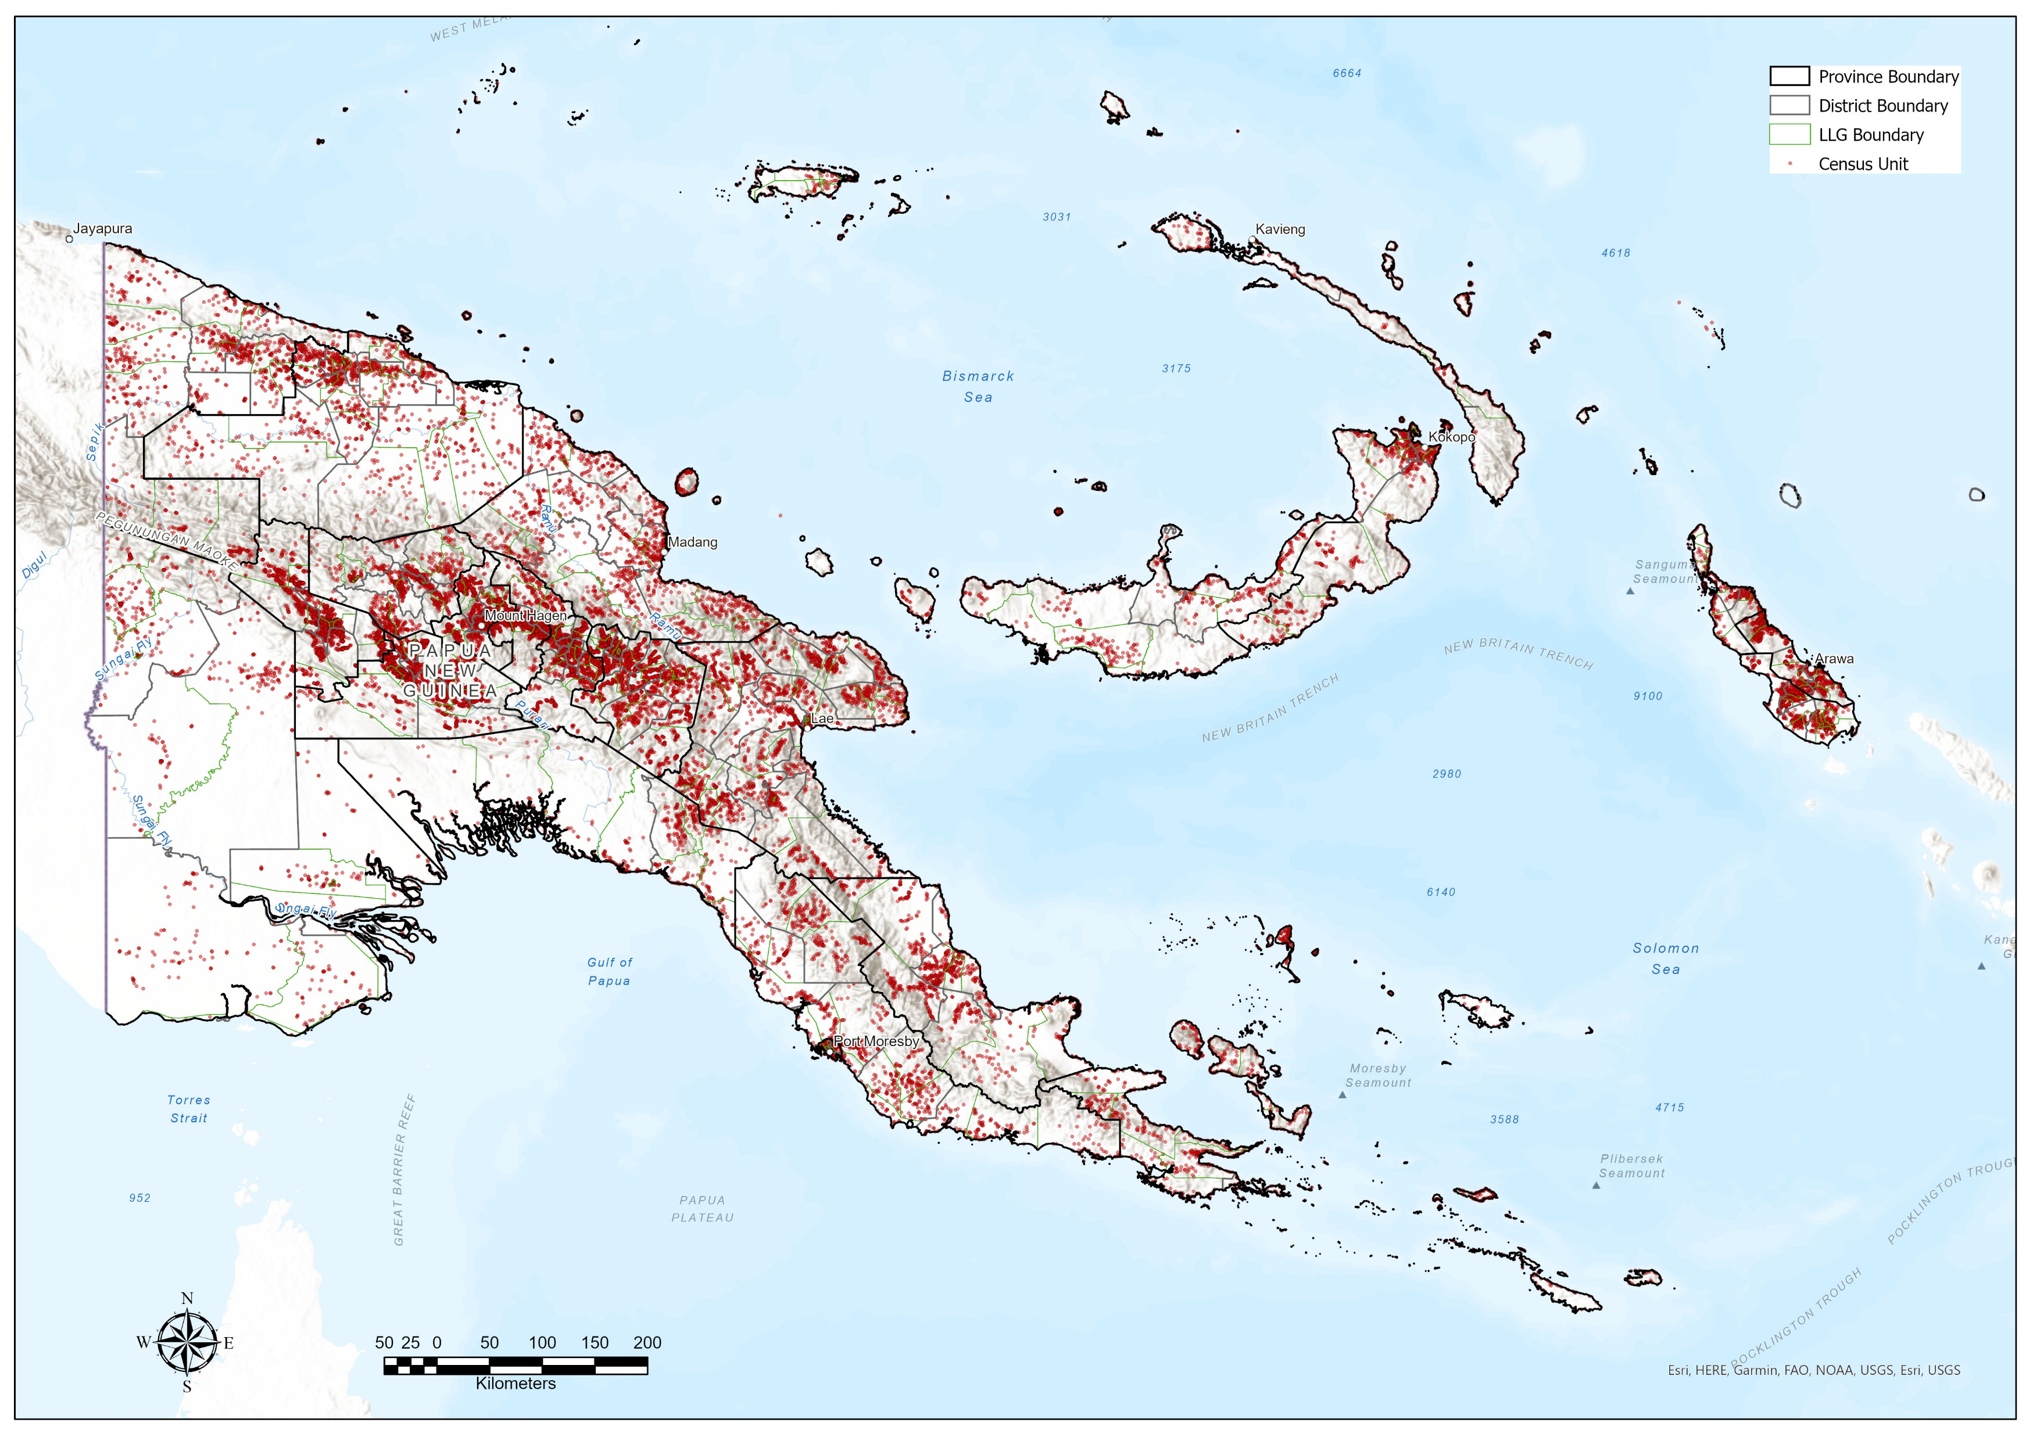
Census Coverage
Census enumerators are trained and equipped with census forms to collect data from individuals visiting all dwellings/households throughout the country.
In all provinces, districts, LLGs, wards, and census units (villages/communities)

Slide 5
Transition from a Paper-based Census
Start of our journey towards digital transformation
YEAR | 2000 | 2011 | 2022 | 2024
DATA COLLECTION OPERATION | National Population Census | National Population & Housing Census | Socio-Demographic & Economic Survey | National Population Census
CENSUS UNITS | 22,400 | 28,000 | 335 | 32,000
MODE OF COLLECTION | PAPI | PAPI | CAPI | CAPI
TABLETS USED | 0 | 0 | 450 | 22,000
* PAPI: Pen-And-Paper-Interview
* CAPI: Computer-Assisted-Personal-Interview

Slide 6
Resource required
CAPI ITEMS AND ESTIMATED COSTS REQUIRED FOR THE CONDUCT OF THE 2024 NATIONAL POPULATION CENSUS
NO | ITEM | QTY | COST (K) | DURATION
1 | Tablets | 22,000 | ~320 | 1 off payment
2 | Power-banks | 22,000 | ~100 | 1 off payment
3 | Backup Power-supply | 8,000 | ~700 | 1 off payment
4 | Slingbags | 22000 | ~100 | 1 off payment
5 | Access Point Name (APN) Service | 22,000 | ~60/month | 3 months
6 | Government Cloud Service
7 | Miscellaneous | n/a | n/a

Slide 7
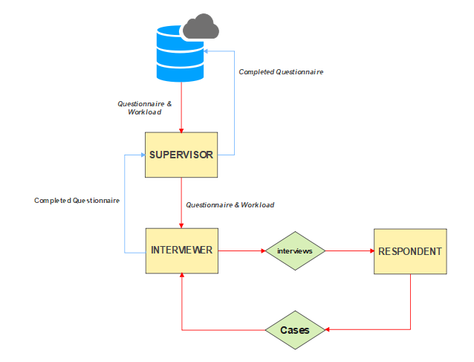
CAPI Data Flow
Government Cloud (DICT)
Connectivity (Digicel APN)

Slide 8
Benefits
Some of the main highlights of CAPI are more often categorized as benefits.
Allow collection of new types of information/data. Its capability of gathering data types such as GPS coordinates, pictures, audio clips, signature, sensors, decodes barcode etc.
Interviews can be done on a tablet or a smartphone.
Ensure data quality and comparability.
Cost-effective, sustainable solutions for NSOs
Improve timeliness of data collection
Reduce the likelihood of enumerators making errors during interviews.
Live data collection updates
Provides visibility to the enumeration exercise

Slide 9
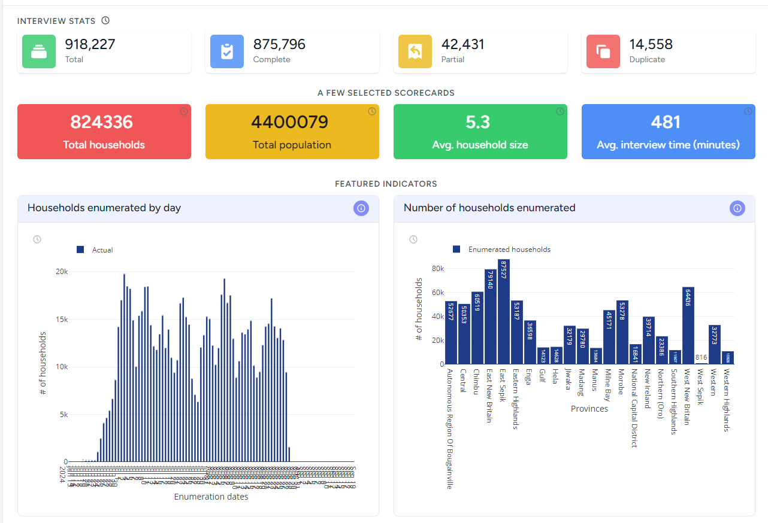
Benefits
VISIBILITY
* Live Census Dashboard

Slide 10
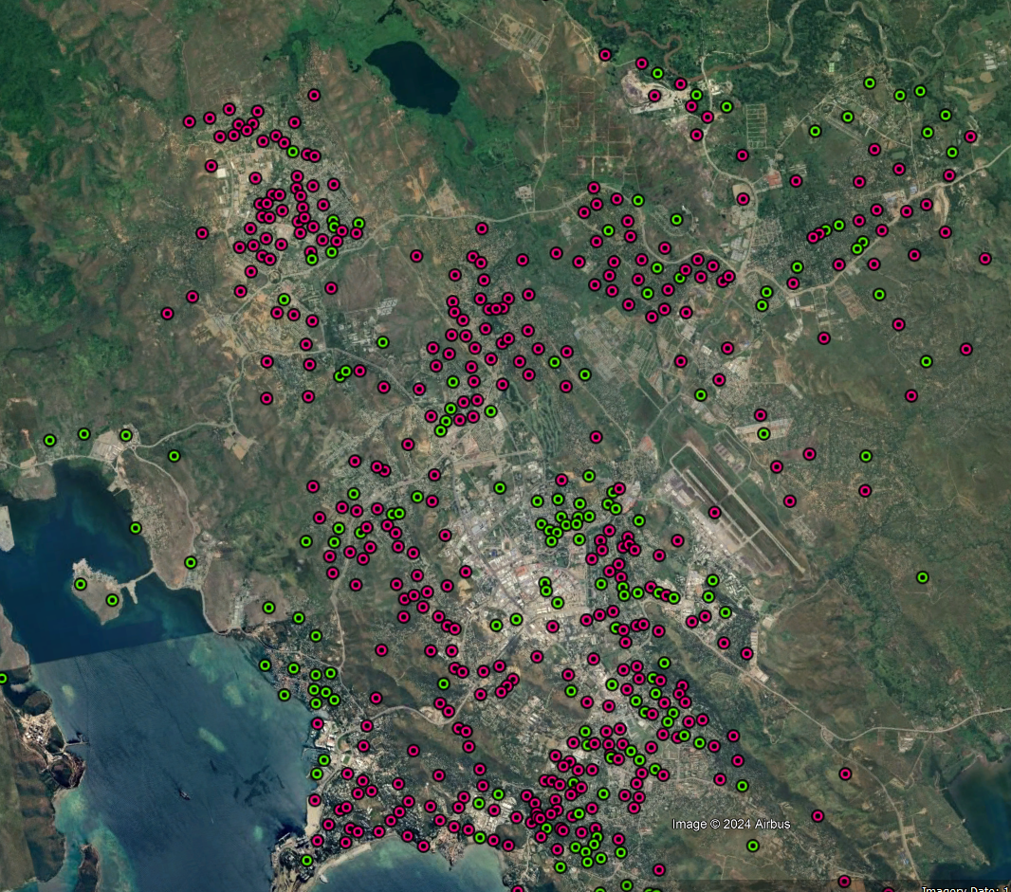
Benefits
VISIBILITY
Map of Port Moresby showing the status of Census Units.
Red = Not Enumerated,
Green = Enumerated

Slide 11
Challenges
Possibility of theft or loss of the mobile device in high-risk places.
The possibility of loss of information caused by device memory problems, low battery, falls and blows of the device, incorrect manipulation by the operator, etc.
When using a tablet or other similar device, the respondent may feel a certain threat, thinking that they are being recorded, this could stop them from expressing themselves freely. However, with proper explanations of the interviewers why they are using a tablet, this challenge could be avoided
Cost implications for Tablets and accessories
Connectivity (mobile coverage and consistent internet connection during data transmission)

Slide 12
Summary
CAPI will be the modus operandi for data collections in NSO going forward.
Implementing CAPI is technically and financially challenging.
Success of implementing CAPI hinges on coordination, cooperation and collaboration amongst all stake-holders, both public and private.

Slide 13


END OF PRESENTATION

