Slide 1

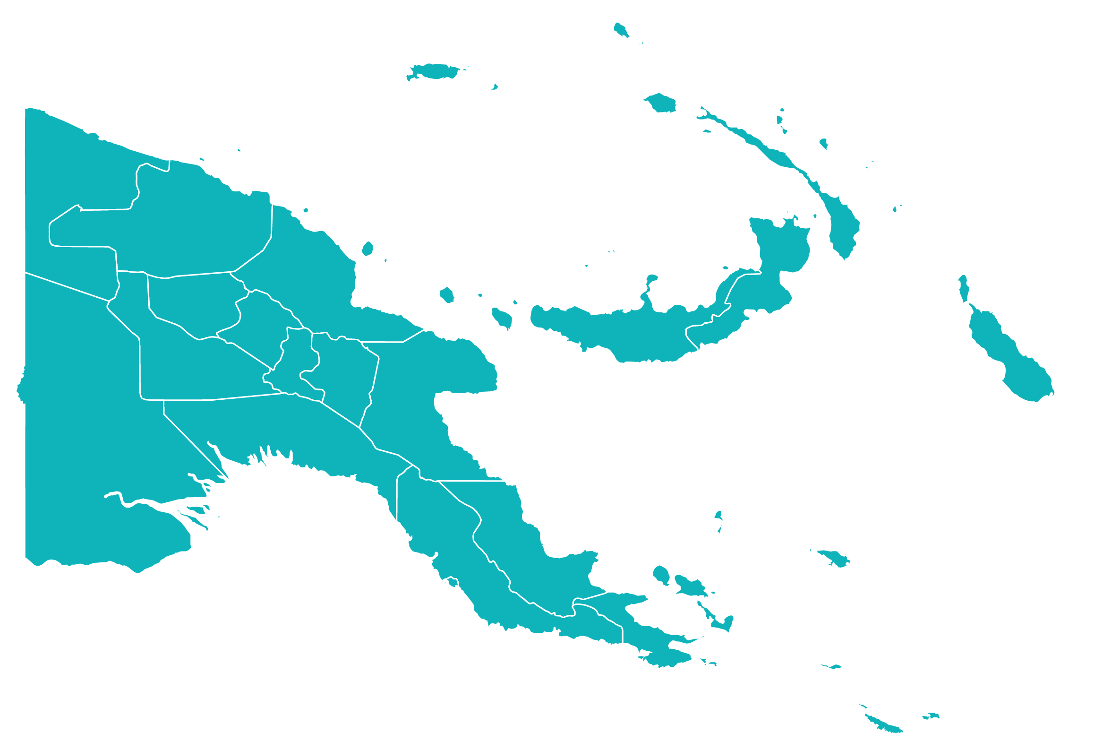



DataCo's Cloud Onboarding Process for Government Departments and Agencies
Under DICT Partnership and Supervision
Presentation By
PNG DataCo Limited
September 2024

Slide 2

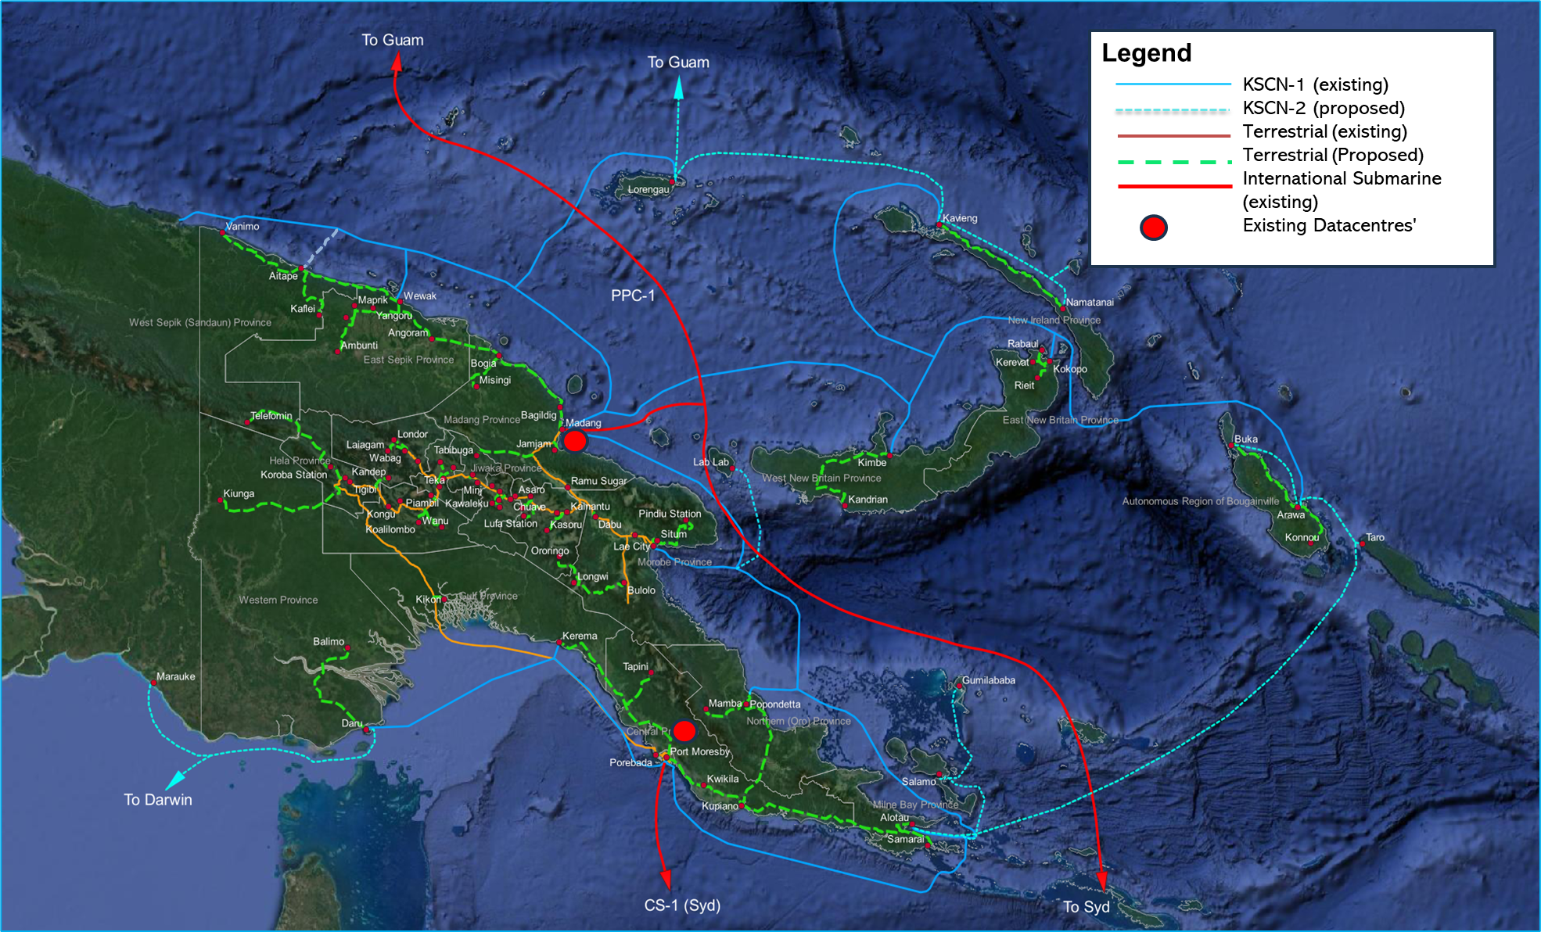
WHY PNG DataCo Limited?
DataCo is PNG’s State-Owned Enterprise responsible for building and managing the National Telecommunications Network and Critical Digital Infrastructure in PNG
1) Expansion of existing terrestrial and submarine networks
2) Continue Expansion of Data Centre/ Cloud Services
DataCo 15 Year Plan
3) Develop a new Wholesale Fibre Broadband
Access Network
4) Develop new Neutral Host Passive Communication Tower Infrastructure.
DataCo’s Masterplan indicative Terrestrial and Submarine Fibre Network plus Data Centres
Notes:
DataCo is a telecommunications State-Owned Enterprise (SOE) tasked with building the National Transmission Network (NTN) and providing wholesale, national and international transmission services, Data Centre and Cloud services and cybersecurity.
DataCo has over 12,000km of terrestrial and submarine fibre optic cables
DataCo has already provided fibre connectivity to 21 of the 22 Provincial Capitals; and 67 of the 96 Districts are connected (45 on fibre, 23 satellite).
DataCo also provides international connectivity to Guam in USA, Sydney in Australia and Jayapura in Indonesia.
DataCo has an essential role to play in delivering the Government’s ICT policy objectives and the Key Result Areas of the Government’s Medium-Term Development Plan.
PNG DataCo Limited is a State-Owned Entity (SOE), created in 2014 and is responsible for building and operating the National Transmission Network (NTN) as part of the Critical Digital Infrastructure Network. The services provided by DataCo on this infrastructure includes:
Wholesale Internet Service (WIS)
Domestic Long Haul and Metro Point to Point Circuits (LH P2P and Metro P2P)
International Private Leased Circuits (IPLCs)
Data Centre Colocation, Hosting and Cloud Service
DataCo’s Digital Infrastructure assets now include:
11,200km of terrestrial and submarine fibre networks
3 International POPs
14 Fibre POPs in country across 20 Provinces
5 Internet Gateway Nodes
15 Submarine Cable landing stations
Two Datacentres (Port Moresby and Madang)
15 YEAR PLAN Key Objectives
Expansion of existing terrestrial and submarine networks
Connect District Capitals
Increase resilience
Continue Expansion of Data Centre/Cloud Services
Support increasing demand for cloud and hyperscale services
Increase resilience and reduce latency
Develop a new Wholesale Fibre Broadband Access Network
Provide 100Mbps-1Gbps GPON services to business, commercial and residential premises
Wholesale-only to promote competition and innovation
Develop new Neutral Host Passive Communication Tower Infra.
Reduce the cost of mobile broadband through tower sharing
Extend coverage and increase competition

Slide 3
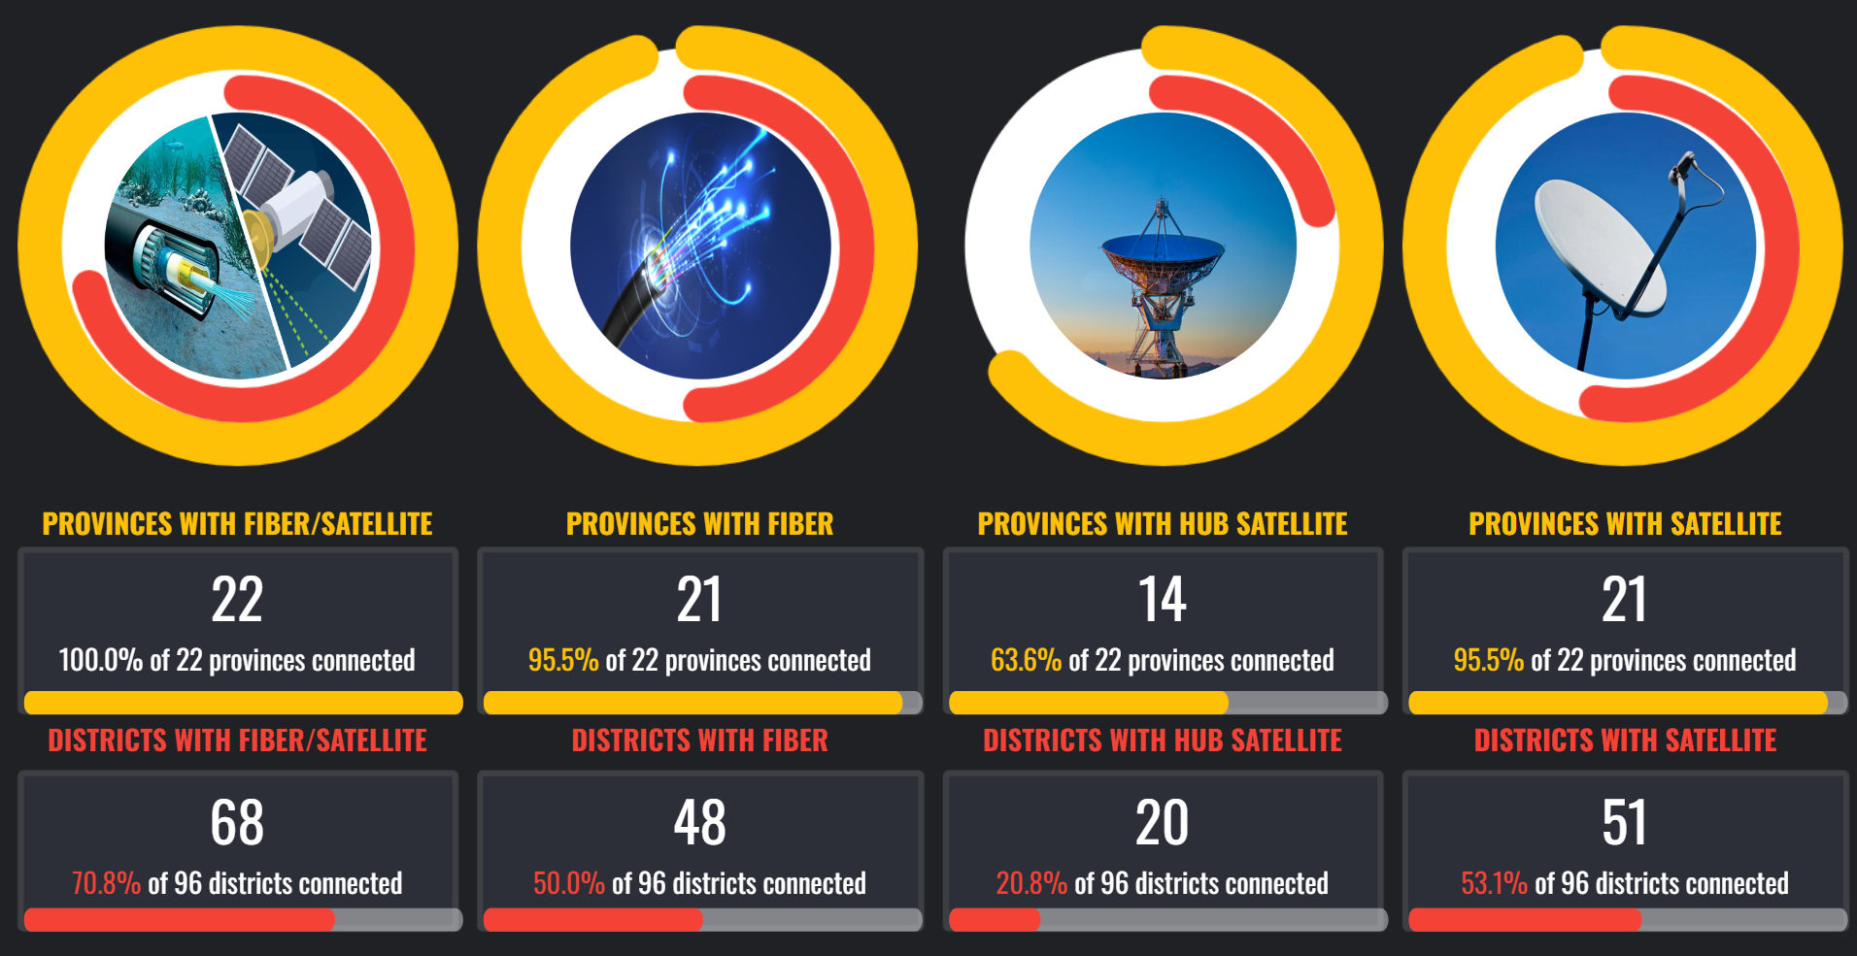
DATACO COVERAGE

Slide 4



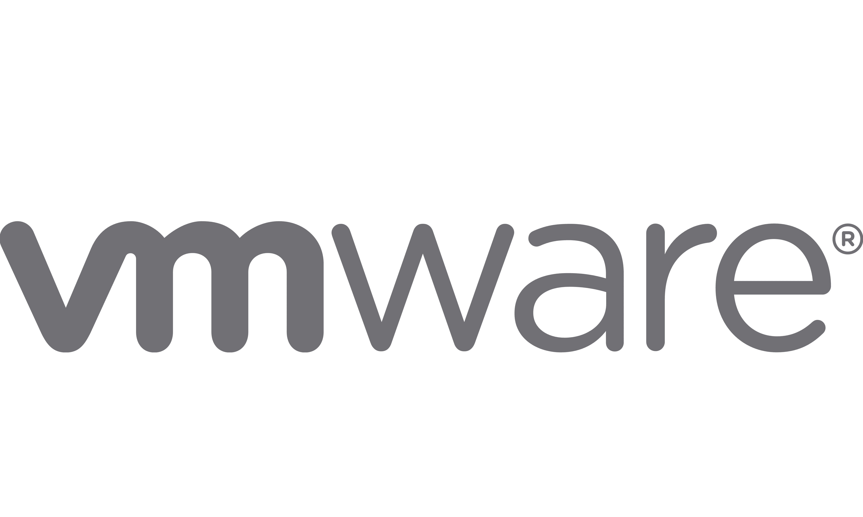

DataCo Multi-Cloud and Multi-Data Centre Infrastructure
AWS
Choose the flexibility to host your data on your preferred Platform – tailored to meet Government Digital needs.

Slide 5
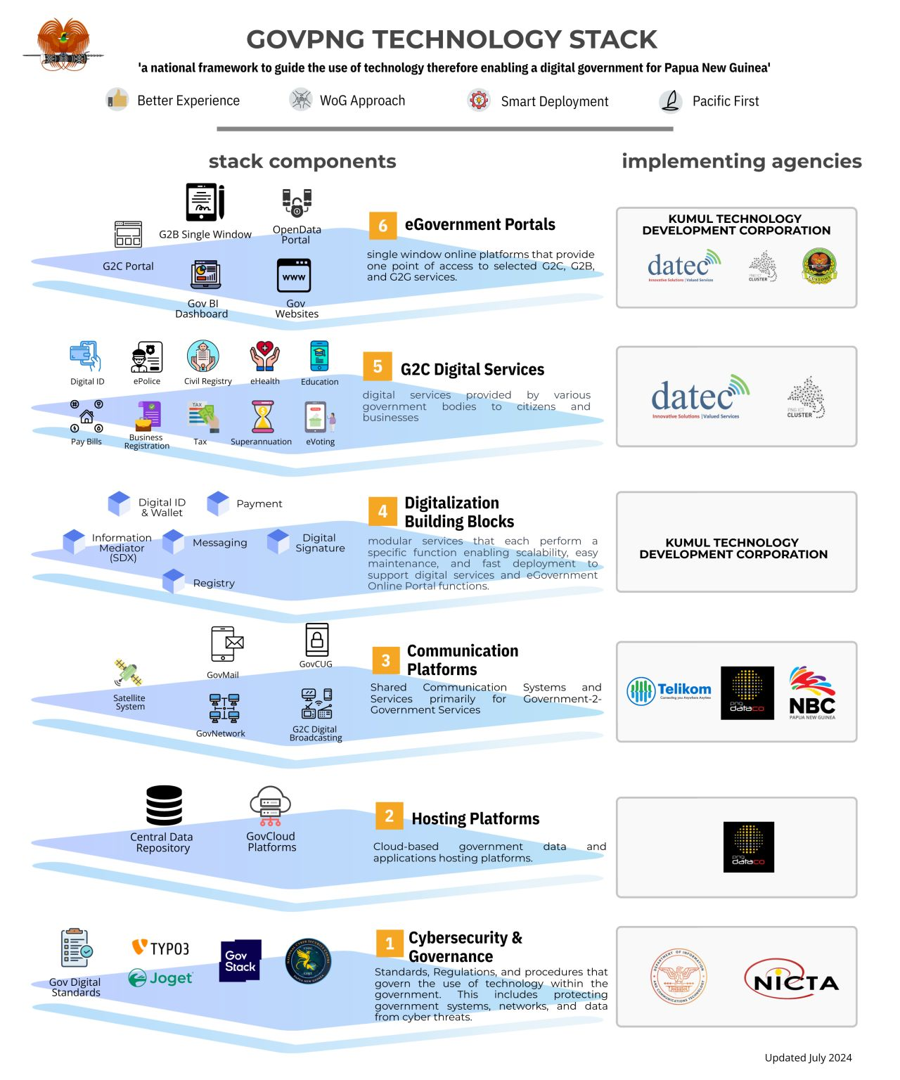
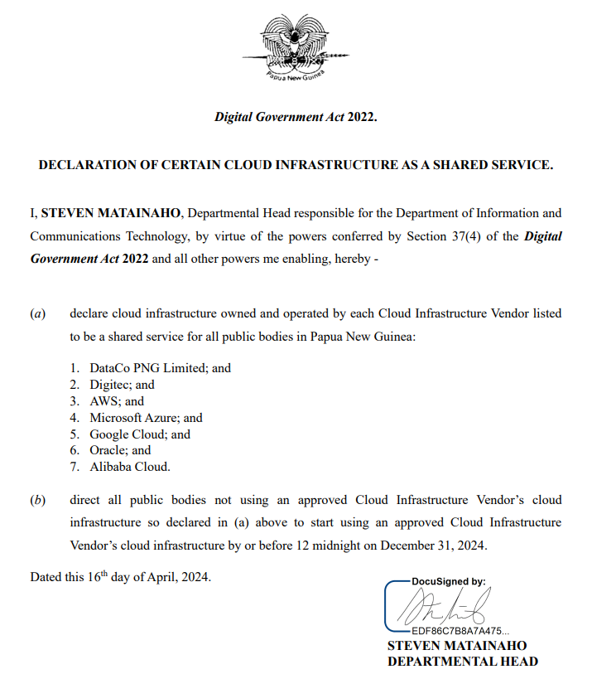
DATACO/DICT MANAGE SERVICE – GPN AND HOSTING PLATFORM
https://www.linkedin.com/posts/steven-matainaho-57134640_digitalgovernment-digitaltransformation-cybersecurity-activity-7222459587474382849-_5Kc?utm_source=share&utm_medium=member_desktop

Slide 6
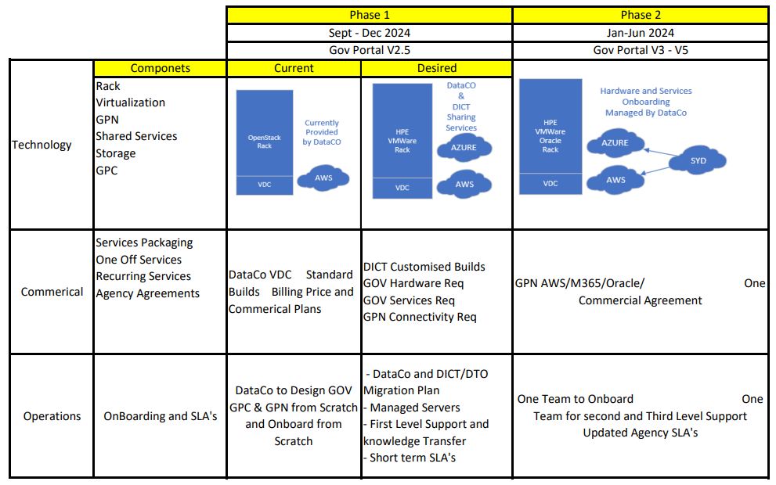
DICT – DataCo Phase - Migration

Slide 7







Overview of the Cloud Onboarding Process
PROCESS STAGES
1 week | 1 week | 4 weeks | 1 weeks | n weeks
*STAGE 1:
Initial Consultation and Assessment
*STAGE 2:
System Discovery Scoping, Planning and Design
*STAGE 3:
Implementation and Migration
STAGE 4:
Training and Change Management
STAGE 5:
Ongoing Support and Monitoring
* Stage 1: Agreement and contract signing, MSA, MOU, NDA, etc.
* Stage 2: Workload register, payment plans, credit commitments, commercial agreement, ongoing support, etc.
* Stage 3: Post-Migration Review, etc.
Notes:
End of stage 1, agreement and contract signing, MSA MOU
End of Stage 2: Workload register, payment plans, credit commitments, commercial agreement, ongoing support, etc.

Slide 8



DICT – DataCo – Govt Institutions Delivery Matrix
DICT
DataCo
Government
Institutions
Governance |  | Agreement / Proposals |  | Invoice
Legal & Policy |  | MSA |  | MSA / Service Order
Services |  | Professional Services |  | Transmission - GPN WIS P2P Cloud Infra Solutions - GLCI IaaS and Hybrid SaaS Core Repository
Commercials |  | Pricing, TCO, Rate per month, Payment process |  | Pricing. Transmission & Cloud Solutions Pricing
Technical |  | Technical (Hosting, Alignment) |  | Technical Solution
Overview of the high-level process involved in the Manage Service core responsibilities and operations between DICT, DataCo and Government institutions for the Government Private Network and Government Leased Cloud Infrastructure Implementation
Notes:
DICT Technical – ensuring compliance to GOVstack

Slide 9

1. NEW CLIENT ONBOARDING JOURNEY
All Govt. Department and Agencies
GPN / Cloud Requirements
Governance.
Policy.
Compliance.
SCOPING
NO
Qualified
YES
REVIEW
PROPOSAL / QUOTE
DOF / DICT / Govt.
ONBOARDING
AND BILLING
ACCEPTED
YES
NO

Slide 10
2. EXISTING DICT and DATACO CLIENT MIGRATION JOURNEY
All Govt. Department and Agencies
Request to Commence Migration Process
Governance.
Policy.
Compliance.
Migration Plan
NO
Qualified
YES
REVIEW
IMPLEMENTATION, ACTIVATION AND BILLING
DOF / DICT / Govt.
ACCEPTED
NO
YES

Slide 11




DataCo Managed Service Support Model Flow chart (Ticketing)
Digital Solutions
DICT Digital Govt Policy Managers – GPN & GLCI
Policy Alignment
Legend:
DICT/ DTOs/ Admins
(3rd Party/ Govt User)
Government
Institutions
DICT & Govt Institut’n Scope
DICT Cloud Mgmt. Team & Govt Institution DTOs
DataCo Manage Service Support
Incidents /Requests
DICT Services Coordinators
GovtStack (GPN & GLCI) Admin
Admin
User
Solutions/Automated Support
DICT & Govt Institutions
Tier-0
Self-Service
Auto-provisioning
DataCo Hybrid Cloud Infrastructure
Review
Alert
Tier-1
Service Desktop
Monitoring
Incident Mgmt
Request Mgmt
Problem Mgmt
Operations Mgmt
Resolution Basic Account Issues Team
Technical Service Desk
Escalation
First Line Maintenance
(24/7 NOC Monitoring)
Escalation
Escalation
Tier-2
Second Line Support
Technical Support
Incident Mgmt
Request Mgmt
Problem Mgmt
Operations Mgmt
IaaS/ SaaS Solutions Team
Security/ Policy/ Governance
Virtualization
Application
A
Application
B
Application
n
Escalation
DataCo Account & Billing Management Team
Tier-3
Deep-Level Tech Support
Vendor Support
Incident Mgmt
Request Mgmt
Problem Mgmt
Operations Mgmt
IaaS/ SaaS Support Team
Security/ Policy/ Governance
Virtualization
Application
A
Application
B
Application
n

Slide 12

DataCo Cloud - Managed Service Support Scope
DataCo / DICT / DTO Support Scope
Applications
Application Development, Enhancement, Performance Tuning, Maintenance, etc.
Network
LAN and WAN network mgmt, Proactive monitoring, Trouble-shooting and network administration, Network Security Mgmt, Patching, etc..
DC Facilities
DC Building Mgmt, Rack Mgmt, Power, Cooling, UPS, Cabling, DC Security, etc.
Middleware
Virtual Machines (VMs)
Virtualisation & Management Software
Physical Servers & OS
Middleware SW Licenses, Installation, Configuration, Upgrade, Patching, etc.
VM OS patching, configuration, OS Administration, Security log review, Trouble-shooting and Administration, etc.
Virtualisation SW mgmt, VM resources tracking, Capacity Mgmt, Trouble-shooting and Administration, etc.
Server Hw and Sw mgmt, Capacity Mgmt, Trouble-shooting and administration, Hw breakfix, OS patching, etc.
DATACO MANAGED SERVICE SCOPE
Notes:
OCI Infrastructure (Servers, racks) will be managed by Oracle, DataCo will be the SPOC.

Slide 13

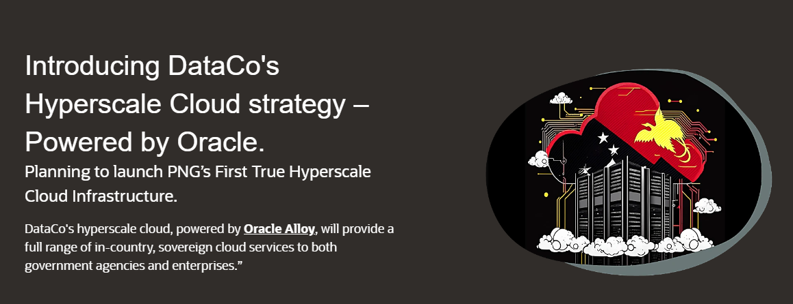
Sovereign DataCo/Oracle Multi-Cloud Infrastructure
Driving Digital Transformation in Papua New Guinea
https://www.pngdataco.com/services/cloud-enterprise-solutions/the-big-cloud
https://engage.oracle.com/oracledataco?token=ce148d9164&token=dc14107b46

Slide 14

THANK YOU
Questions, to move forward

