Slide 1




Department of Information And Communications Technology
Certificate of Compliance(CoC)Process
George Memafu
Compliance Advisor
www.ict.gov.pg
www.ict.gov.pg
Notes:
Thank you all….Lucky last again. I’ll keep my short, sharp and simple.
My name is George Memafu, and I am the compliance advisor to DICT.
I am responsible for establishing the vetting process behind the issuance of CoC

Slide 2

OUTLINE
OVERVIEW OF COMPLIANCE PROCESS
OUTLINE OF COMPLIANCE REQUIREMENTS
STAKEHOLDER EXPECTATIONS
Notes:
By now, this will be a recap for a number of you stakeholders
And for a good number of you, this will be new

Slide 3
1. OVERVIEW OF COMPLIANCE PROCESS
What is Compliance?
Compliance management refers to the process of ensuring an organization and its employees are following Acts, Regulations, Standards, and Guidelines.
What is purpose Compliance?
The purpose of compliance management is to ensure that DICT as an organization has internal controls that effectively identify and monitor all its internal and external requirements (as mentioned above)

Slide 4
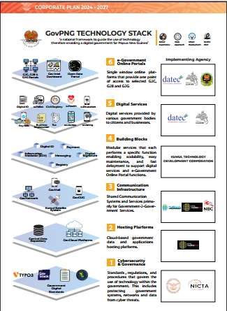
1. OVERVIEW OF COMPLIANCE PROCESS
Internal
Management
Control?
Notes:
So we use the Digital Stack as a Internal Management Control

Slide 5
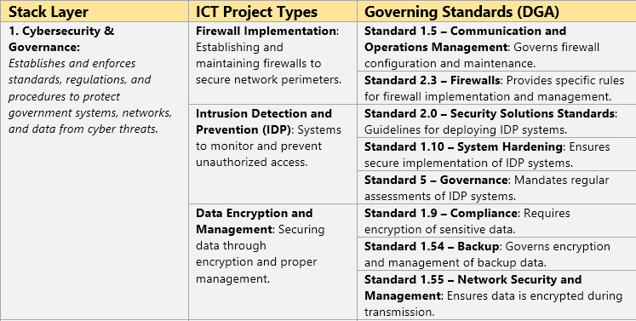
1. OVERVIEW OF COMPLIANCE PROCESS
Internal Management Control
Notes:
How did we do that, well we mapped out ICT Project to Stack Layer and Governing Standard – Hence Stack 1 would look like this

Slide 6
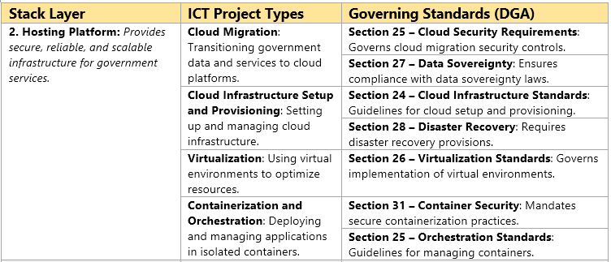
1. OVERVIEW OF COMPLIANCE PROCESS
Internal Management Control
Notes:
Stack 2 would look like this

Slide 7
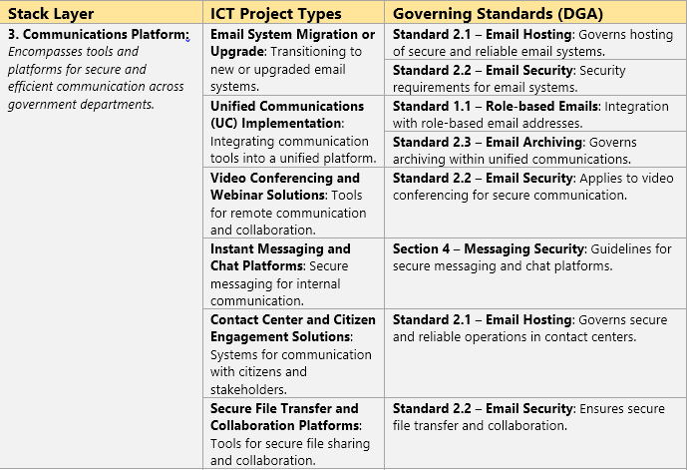
1. OVERVIEW OF COMPLIANCE PROCESS
Internal Management Control
Notes:
Stack 3

Slide 8
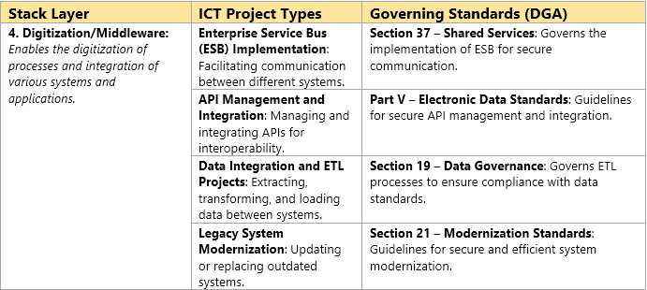
1. OVERVIEW OF COMPLIANCE PROCESS
Internal Management Control
Notes:
Stack 4

Slide 9
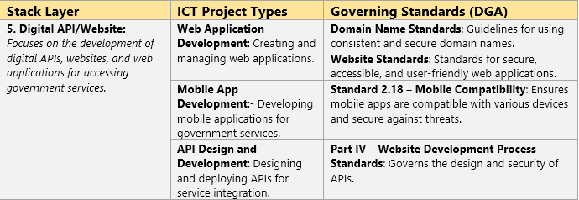
1. OVERVIEW OF COMPLIANCE PROCESS
Internal Management Control
Notes:
Stack 5

Slide 10
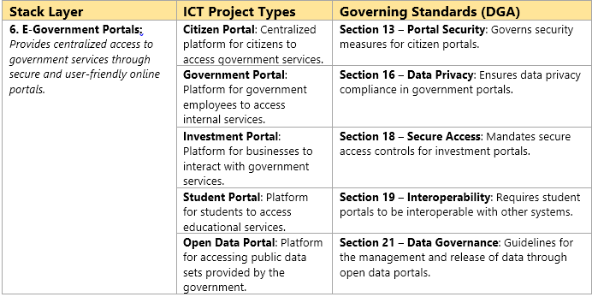
1. OVERVIEW OF COMPLIANCE PROCESS
Internal Management Control
Notes:
Stack 6

Slide 11
2. OUTLINE OF COMPLIANCE REQUIREMENTS
Submission: All public bodies must submits a formal request to the (DICT); key to this documentation is your ICT
project design and the relevant supporting documentation which includes your project plan (proposal), the source of
your funding.
Initial Review: DICT Compliance division shall do an administrate review to assess if your project design is in line with
the Act and its Standards
Secondary Review: DICT Technical team shall then do a technical assessment to asses your ICT Design
Endorsement: Once this is done, an endorsement will be done by the Compliance division for the Public Service ICT
Steering Committee (PSISC) to approve
Approval: The Public Service ICT Steering Committee, composed of key department heads and experts, approves
the project for compliance with Digital Act and standards.
6. Issuance of CoC: A conditional CoC is issued for one year (subject to conditions stated and review within a year)

Slide 12
3. STAKEHOLDER EXPECTATIONS
Completeness of Documentation for Submission: Our process can only start once you have provided all documentation
Conflict of Interest Declaration: Public bodies must ensure there is no conflict of interest in their ICT project designs or
procurement processes. If any conflict arises, it must be declared and appropriately managed​
3. Initial Review, Secondary Review, Endorsement, and Approval: This processes take up to 30 days

Slide 13
Department of Information And Communications Technology
Thank you !
www.ict.gov.pg
www.ict.gov.pg

