Slide 1




Department of Information And Communications Technology
DIGITAL TRANSFORMATION SUMMIT 2024
Data Governance Workshop, Baseline Survey Report, & Information Mediator Building Block (SDE)
Presented By: Lillian Smith, (DICT)
Date: 1st – 3rd October, 2024
Stanley Hotel
www.ict.gov.pg
www.ict.gov.pg

Slide 2

PRESENTATION OUTLINE
1. DATA GOVERNANCE WORKSHOP OUTCOME
2. DATA GOVERNANCE BASELINE SURVEY FINDINGS
3. INFORMATION MEDIATOR BUILDING BLOCK – PROJECT UPDATE
www.ict.gov.pg

Slide 3
DATA GOVERNANCE Vs DATA MANAGEMENT
DEFINITIONS
KEY DIFFERENCE
Scope
Objective
Implementation
Data Governance: Encompasses the policies, standards, and procedures that ensure the effective and responsible management of data within an organization.
Data management is more operational and technical, while data governance is strategic and policy-oriented.
Data management aims to ensure that data is available and usable, whereas data governance aims to ensure data integrity , security, and compliance.
Data management involves tools and technologies, whereas data governance involves frameworks and guidelines for decision-making
Data Management: Refers to the practices, processes, and technologies used in collection, store organize, maintain, and utilize data effectively.
www.ict.gov.pg

Slide 4




1.0. DATA GOVERNANCE WORKSHOP OUTCOME
Workshop Overview & Objectives
Date & Context
June 5th -6th , 2024 at Holiday Inn
21 government agencies presented during the workshop
Objectives of the Workshop
Enhance Collaboration with stakeholders
Identify and understand current data governance practices within government agencies
Define a unified data governance framework for GoPNG
www.ict.gov.pg

Slide 5

1.1. DATA GOVERNANCE WORKSHOP OUTCOME
Key Outcomes and Insights
Defined Data Governance Framework
Challenges Identified
Opportunities Highlighted
Incorporating best practices and compliance with local and international regulations
Focus on data quality, data privacy, and access management
Lack a Standardized data governance practices across all public Sector
Availability and accessibility of data
Need for a robust data security and privacy legislation
Potential for improved data sharing and collaboration
Enhanced decision-making through better data quality and availability
Development of the IMBB for streamlined access and management.
www.ict.gov.pg

Slide 6
Baseline Survey Report
www.ict.gov.pg
www.ict.gov.pg

Slide 7
2.0. WHY THE SURVEY?
Assess Current Data Governance Practices
Enhance Security & Compliance
Identify Gaps and Challenges
Guide Future Digital Transformation
Support Capacity Building & Training
www.ict.gov.pg

Slide 8
2.3. QUESTION STRUCTURE
Data Governance Focus Areas
Data Governance Development
Institutional Framework
Oversight & Accountability
Legal & Regulatory Framework
www.ict.gov.pg

Slide 9
2.3. SURVEY RESULTS
Presence of Data Governance: Lack of Standard Guidelines, frameworks, policies, legislations, and strategies for data accessibility & availability (30%)
Access Control is the main form of data protection. Regular security assessments are also quite prevalent (55%)
Agencies (70%) are unsure of specific regulations and best practices for governing their data.
59% of participating agencies lack formal policies, or guidelines for data retention & Archiving
Data Collection Method (Manual Collection is 70%/Digital 30% )
Data Sharing (90% Challenge)
www.ict.gov.pg

Slide 10
2.1. RESULTS AGAINST MATURITY LEVEL
Measuring Survey Findings against Data Governance Maturity
Percentage
E
Initial
D
A
Reactive
C
B
MATURITY
Proactive
C
Managed
B
D
A
Optimized
E
20%
40%
60%
80%
100%
TIME

Slide 11
2.2. FINDINGS AGAINST MATURITY MODEL
5
4
Optimizing
3
Managed
2
Data governance becomes an enterprise-wide effort that improves productivity and efficiency.
Proactive
1
Measurable quality goals are set for each project, data process and maintenance.
Reactive
Data regulation and management guidelines are defined better and are integrated with the company processes.
Initial (Aware)
The important of data in the organization is realized
There is little to no awareness of the important of data and there are no set standards for managing data.
www.ict.gov.pg
Notes:
The presence of Data Governance Practices (40% FAIR)
Data Collection Methos (Manual Collection is 70%/Digital 30% )
Data Sharing (90% Challenge)
Lack of Standard Guidelines, frameworks, policies, legislations, and strategies for data accessibility & availability
Access Control is the main form of data protection. Regular security assessments are also quite prevalent
Agencies (70%) are unsure of specific regulations and best practices for governing their data.
59% of participating agencies lack formal policies, or guidelines for data retention & Archiving

Slide 12
2.4. RECOMMENDATION
Institutional Framework
Establish & empower Data Governance Teams
Modernize Data Collection Methods
Oversight & Accountability
Increase the frequency of Data Governance Reviews & Audits
Legal & Regulatory Framework
Develop & Implement Data Protection Legislation
Enhance Compliance with Regulatory Requirements
Develop Standard Guidelines for Data Lifecycle
www.ict.gov.pg
Notes:
1. Institutional Framework
Establish & Empower Data Governance Teams:
Each agency should create dedicated data governance teams to oversee data management, security, and compliance across their operations. These teams will be responsible for ensuring data governance practices are aligned with national policies and best practices.
Modernize Data Collection Methods:
Transition from predominantly manual data collection methods (currently 70%) to more automated and digital systems to improve accuracy, efficiency, and data quality.
2. Oversight & Accountability
Increase Frequency of Data Governance Reviews & Audits:
Agencies should implement regular data governance reviews and audits to ensure ongoing compliance with policies, identify potential risks, and drive continuous improvements in data handling and security.
3. Legal & Regulatory Framework
Develop & Implement Data Protection Legislation:
Introduce comprehensive data protection laws that outline requirements for managing, securing, and sharing government data in compliance with national and international standards.
Enhance Compliance with Regulatory Requirements:
Increase awareness and training on existing regulations and conduct frequent compliance assessments to ensure agencies adhere to data protection standards. Agencies need clear policies for data retention, archiving, and security to mitigate risks and ensure operational continuity.
Develop Standard Guidelines for the Data Lifecycle:
Establish standardized processes for data classification, retention, sharing, and disposal. This will ensure consistency in data governance practices and enhance data accessibility across agencies.
These recommendations are designed to address the identified gaps in data governance practices, including insufficient policies for data retention and archiving, the absence of standard guidelines for data sharing, and the reliance on manual data collection methods. Implementing these steps will align agencies with the Gartner Data Governance Maturity Model, driving them towards more proactive and optimized data management frameworks.

Slide 13
2.5. RESPONSIBILITIES
AGENCIES
Develop Agency-Specific Data Policies
DICT
Develop Data Standard & Frameworks'
Enhance Data Collection Methods
Establish Data Governance Team
Conduct Regular Data Audits
Adopt Data Sharing Guidelines
Train and Build Capacity for Staff
Implement Data Security Measure
Implement Data Governance & Data Protection Policy (Implementation Strategy)
Coordinate Implementation Across Agencies
Monitor Compliance and Conduct Audits
Develop and Implement Data Protection Legislation
Facilitate Centralized Data Infrastructure (Information Mediator Building Block - SDE )
www.ict.gov.pg
Notes:
Next Steps for Individual Agencies:
Establish Data Governance Teams: Form dedicated teams within each agency responsible for managing and overseeing data governance efforts, ensuring accountability and execution of governance policies.
Develop Agency-Specific Data Policies: Create and implement data governance policies tailored to the specific needs of each agency, aligned with national standards and frameworks.
Enhance Data Collection Methods: Shift from manual to digital data collection systems, aiming for greater accuracy, consistency, and efficiency in data gathering processes.
Conduct Regular Data Audits: Implement frequent reviews and audits of data management practices to ensure compliance with governance policies and the improvement of data quality.
Adopt Data Sharing Guidelines: Develop clear guidelines and frameworks to facilitate secure and compliant data sharing within and between agencies, reducing barriers to collaboration.
Train and Build Capacity for Staff: Provide ongoing training and capacity-building programs to educate staff on data governance best practices, ensuring proper implementation and compliance.
Implement Data Security Measures: Strengthen security protocols, including role-based access controls, encryption, and multi-factor authentication, to protect sensitive data from breaches or unauthorized access.
Next Steps for DICT:
Develop Standard Frameworks: Establish comprehensive data governance frameworks that can be adapted by individual agencies, providing clear guidelines on data governance policies, security measures, and data lifecycle management.
Establish a Working Group: Form a cross-agency working group to coordinate data governance efforts, ensure alignment across government bodies, and support the implementation of national data governance standards.
Coordinate Implementation Across Agencies: Lead and manage the rollout of data governance frameworks, ensuring consistency and proper adherence to policies across all government agencies.
Monitor Compliance and Conduct Audits: Schedule ongoing audits and reviews to assess agencies’ adherence to data governance policies, ensuring compliance and the continuous improvement of governance practices.
Develop and Implement Data Protection Legislation: Draft and enforce legislation that provides a legal foundation for data protection, security, and governance across all public sector bodies, ensuring long-term sustainability.
Facilitate Centralized Data Infrastructure: Ensure that the Central Electronic Data Repository and other centralized systems are effectively integrated into agencies’ data governance efforts, promoting data sharing and accessibility across the public sector.

Slide 14
2.6. DATA GOVERNANCE IMPROVEMENT ROADMAP
Development
Data Governance & Protection Policy
Data Protection Legislation
IMBB –Secured Data Exchange (SDE)
Data Standards
Implementation
Data Governance Implementation Strategy
Monitoring & Reporting
Develop ongoing monitoring & quality reporting
Develop & document protocols
Ongoing Audit & Maintenance
Schedule ongoing audits & reports
Monitor third party data providers
www.ict.gov.pg
Notes:
Ht

Slide 15
Secured Data Exchange Platform – Project Update
www.ict.gov.pg
www.ict.gov.pg

Slide 16
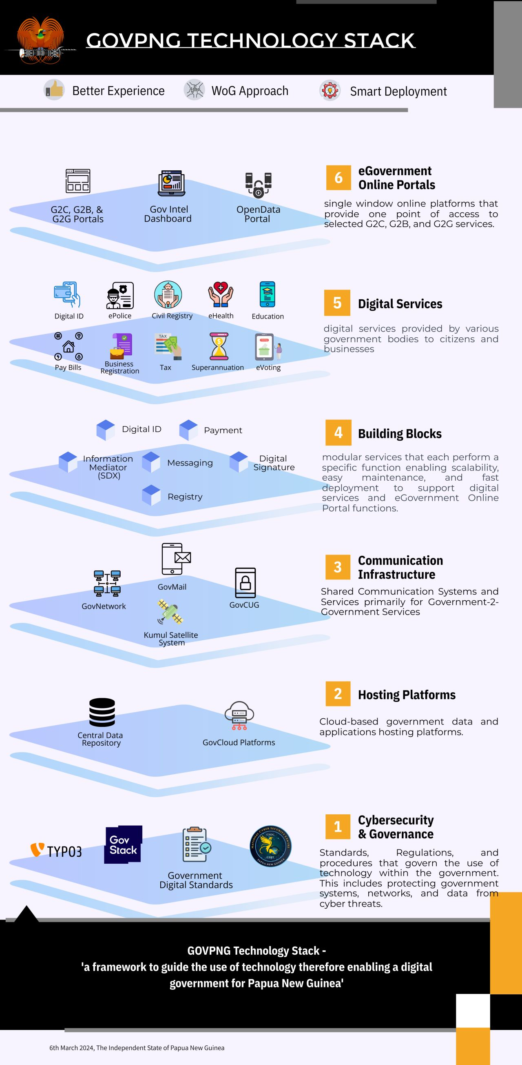




3.0. INFORMATION MEDIATOR - SDE
Secured Data Exchange Platform - IMBB ( DGA 2022 - Sec 31)
Governing Authority
Agency B
Citizen Portal
Information System
Security Server
Security Server
Information System
User
Agency A
Agency C
User
Information System
Security Server
Security Server
Information System
User
www.ict.gov.pg
Notes:
Peer-to-peer data exchange over encrypted and mutually authenticated channels. Allows service providers to retain control over their systems and data, while making them a member of an infinitely scalable and decentralised data exchange network

Slide 17
IPA( Certificate of Registration)
IRC (TIN)
Customs (Trading License)
3.1. DATA EXCHANGE – USE CASE
Issuance of a Trading License
Governing Authority
Customs
Citizen Portal
Information System
Security Server
Security Server
Information System
User
IPA
IRC
User
Information System
Security Server
Security Server
Information System
User
www.ict.gov.pg
Notes:
Peer-to-peer data exchange over encrypted and mutually authenticated channels. Allows service providers to retain control over their systems and data, while making them a member of an infinitely scalable and decentralised data exchange network

Slide 18
3.2. PROJECT ACTION PLAN
Task Description
2024
2025
Sept
Oct
Nov
Dec
Jan
Feb
Mar
Apr
May
Jun
Jul
Aug
Project Initiation
Project initiation
Project Planning
Project planning
Project Execution & Development
Execution & Development
Pilot Launch & Feedback
Pilot Launch
Project closure
Final Launch & Project Closure
www.ict.gov.pg

Slide 19
Thank You !
www.ict.gov.pg
www.ict.gov.pg

