Slide 1




Department of Information And Communications Technology
eSafety & Social Media Management Desk (SMMD)
www.ict.gov.pg
www.ict.gov.pg

Slide 2
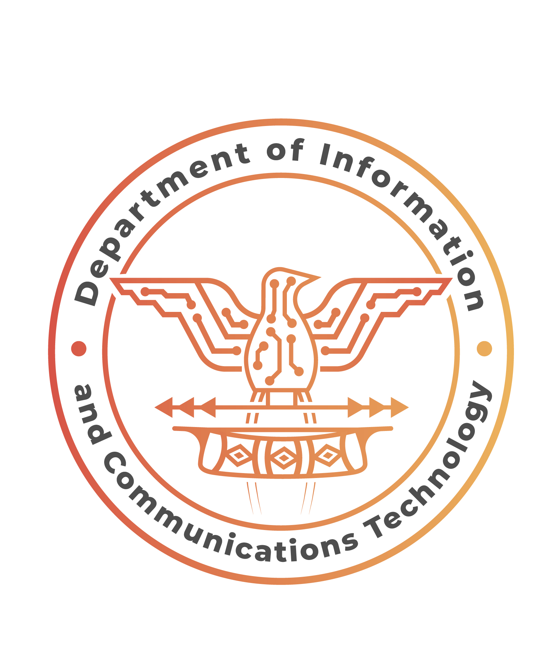

OUTLINE
Introduction: Overview of the Cyber Safety and Social Media Management Desk and presentation agenda.
Current Landscape:
  Social media usage statistics (global and local).
  Common cyber threats (e.g., fake accounts, phishing) and recent case studies.
Key Responsibilities:
  Tools for monitoring and analyzing social media threats.
  Collaboration with government agencies and examples of successful operations.
Challenges and Solutions:
  Challenges: outdated tools, high data volume, limited resources.
  Solutions: upgrade tools, capacity building, implement automated threat detection.
Best Practices for Cyber Safety:
  Personal: strong passwords, avoiding phishing.
  Organizational: social media guidelines, regular security audits.
Case Studies and Success Stories: Highlight successful interventions and community impact.
Future Plans:
  Goals: improve collaboration, explore new technologies, and continue innovation.
Conclusion: Recap key points and closing remarks.
www.ict.gov.pg

Slide 3
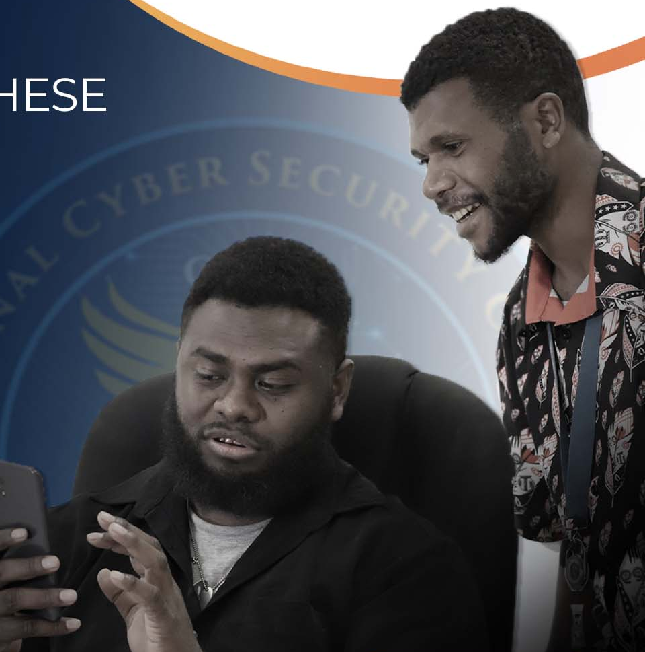
Introduction to the Cyber Safety and Social Media Management Desk
The Cyber Safety and Social Media Management Desk was established in response to the National Government’s directive, as outlined in NEC Decision 100/2021. This decision called upon the Department of Information and Communications Technology (ICT) to spearhead the rapid enhancement of the Government’s information delivery and citizen engagement through social media platforms. Our desk is dedicated to ensuring the safety and security of online interactions, monitoring social media for potential threats, and fostering a secure digital environment for all citizens.
www.ict.gov.pg
Notes:
GOVERNMENT CLOUD –- It provides computing resources, such as servers, storage, networking, and software applications, delivered as a service over the internet. It also support the unique needs of government operations, such as handling sensitive data, facilitating collaboration among agencies, and delivering citizen services securely and efficiently. They may also integrate with other government IT systems and services to enable interoperability and seamless data exchange

Slide 4
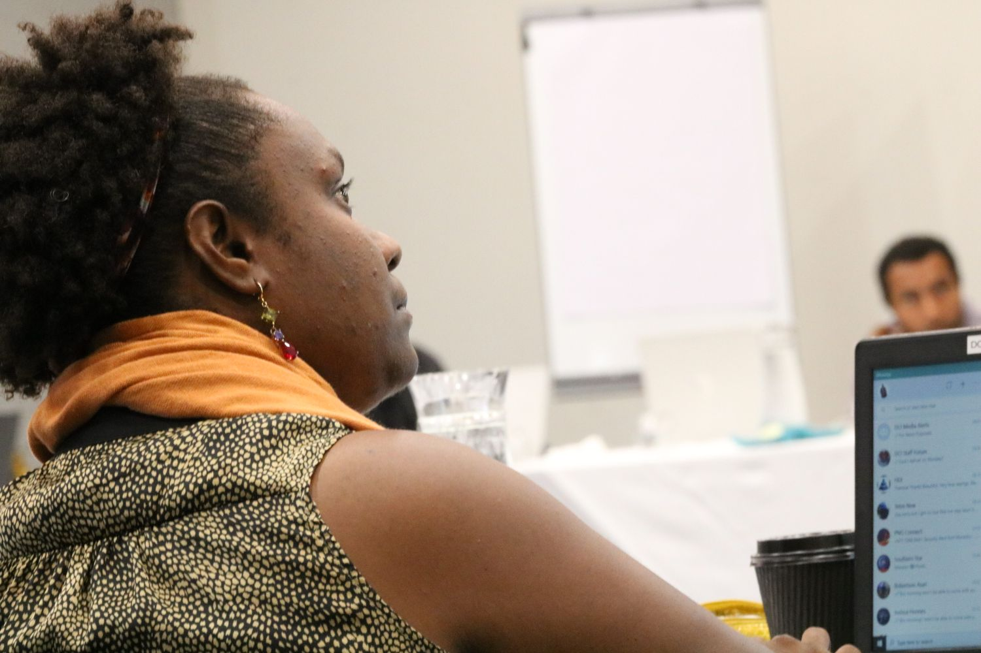
OVERVIEW
Current Landscape
Key responsibilities
Challenges and Solutions
Successful Coordination with
other agencies
Best practice for Cyber Safety
Vision

Slide 5
Current Landscape Overivew of Social Media Usage Statistics and trends in PNG
Internet and Social Media Penetration
Approximately 1.3 million internet users in Papua New Guinea, representing about 14% of the total population.
Social media usage is growing, with around 1.1 million active social media users, which is about 12% of the population.
The most popular social media platform in PNG is Facebook.

Slide 6
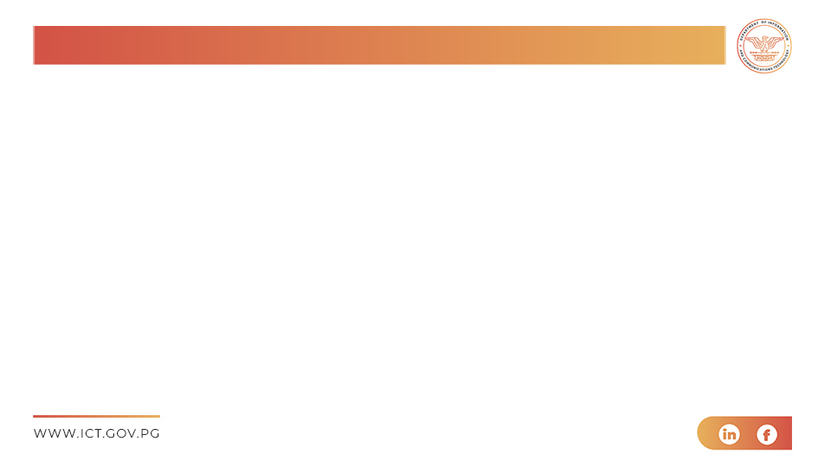
Trends
Mobile Connectivity
The majority of social media access is through mobile devices, with mobile connections significantly outnumbering fixed internet connections.
Youth Engagement
A large portion of social media users are young people, who are highly active on platforms like Facebook and Instagram.
Content Sharing
There is a high level of content sharing, including news, entertainment, and personal updates, which drives engagement on these platforms.

Slide 7
Common Cyber Threats on Social Media in PNG
1. Cyberbullying
Cyberbullying is a significant issue, particularly among the youth. Many young people spend considerable time on social media, making them vulnerable to online harassment and bullying.
2. Phishing and Fraud
Phishing attacks are common, where malicious actors attempt to steal personal information through deceptive messages and links.
Fraudulent activities, including scams and fake accounts, are prevalent, targeting unsuspecting users to extract money or sensitive information.
3. Child Exploitation
Child exploitation and the sharing of inappropriate content are serious issues that the authorities are actively working to combat.
4. Data Privacy Issues
Users often face data privacy challenges, with personal information being at risk due to inadequate security measures and awareness
Notes:
These statistics and trends highlight the importance of robust cyber safety measures and the need for continuous monitoring and education to protect the citizens of Papua New Guinea from these evolving threats.

Slide 8
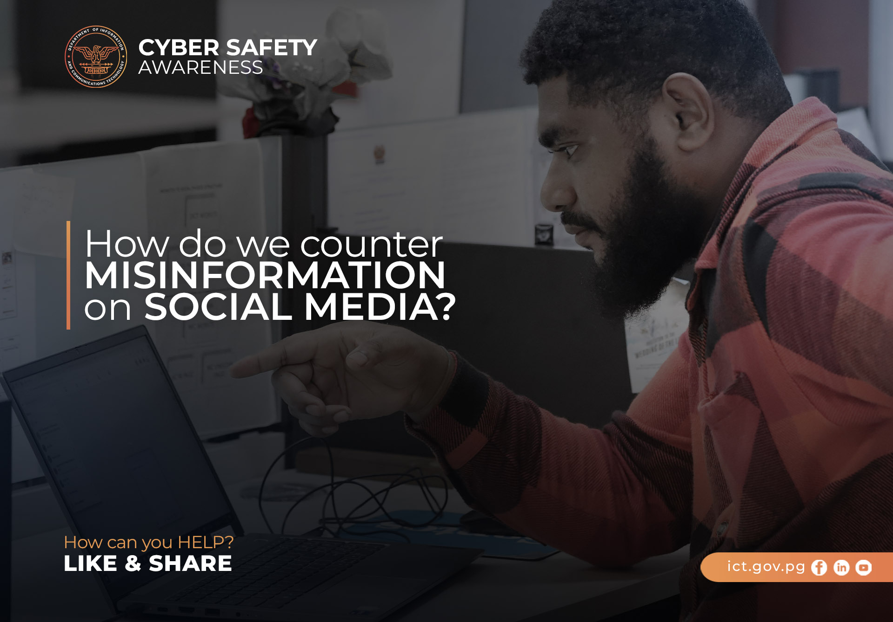
Key Responsibilities
1. Social Media Monitoring
Real-Time Monitoring: We continuously monitor social media platforms for any suspicious activities, fake accounts, defamatory content, and potential threats.
2. Keyword Tracking
Using advanced tools, we track specific keywords and phrases that might indicate harmful activities or threats.
3. Sentiment Analysis
We analyze the sentiment of social media posts to identify negative trends or potential issues that require attention.
4. Threat Identification and Analysis
Pattern Recognition
By analyzing data patterns, we can identify unusual activities that may indicate cyber threats.
Incident Reporting
We document and report incidents of cyberbullying, phishing, and other malicious activities to the relevant authorities.
5. Data Collection
Gathering and storing data from social media platforms to build comprehensive threat profiles.
6. Response and Mitigation
Immediate Action
Taking swift action to mitigate identified threats, such as reporting fake accounts and removing harmful content.
7. User Support
Providing support and guidance to individuals affected by cyber threats, including advice on securing their accounts and reporting incidents.

Slide 9

Collaboration with government agencies
Information Sharing
Regular Updates
We maintain a close relationship with other government agenices, sharing regular updates on identified threats and ongoing investigations.
Joint Databases
Utilizing shared databases to ensure both teams have access to the latest information and can coordinate effectively.
Joint Operations
Coordinated Efforts
Working together on joint operations to tackle significant cyber threats, combining resources and expertise for more effective outcomes.
Notes:
By leveraging these responsibilities and collaborative efforts, the Cyber Safety and Social Media Management Desk aims to create a safer online environment for all citizens of Papua New Guinea.

Slide 10
Challenges and Solutions
Challenges We Face
Outdated Tools
Limited Capabilities
Our current tools lack the advanced features needed for efficient monitoring and analysis, making it difficult to keep up with the evolving cyber threat landscape.
Slow Response Times
Outdated technology results in slower response times, which can hinder our ability to address threats promptly.
Communication Barriers
Inter-Agency Coordination
Effective communication between different agencies, including the RPNGC Cyber Crime Unit, can be challenging due to differing protocols and systems.
Public Awareness
There is often a gap in communication with the public regarding cyber threats and safety measures, leading to lower awareness and preparedness.
Manual Processes
Resource Intensive
Manual monitoring and analysis are time-consuming and require significant human resources, which can be a strain on our team.
Inconsistencies
Manual processes can lead to inconsistencies in data collection and threat analysis, affecting the overall effectiveness of our operations.

Slide 11
Proposed Solutions
Upgrading Tools and Technologies:
To enhance cybersecurity, the strategy focuses on upgrading tools, improving communication, automating processes, and building capacity:
Upgrading Tools and Technologies:
Invest in advanced monitoring software with real-time data analysis and automated threat detection.
Use AI and machine learning for more accurate and faster threat detection.
2. Improving Communication:
Adopt unified communication platforms to improve inter-agency coordination.
Launch public awareness campaigns to educate citizens about cyber threats using social media, workshops, and community events.
3. Automating Processes: Implement automated threat detection systems for efficiency.
Develop robust data management systems for consistent and accurate data handling.
4. Training and Capacity Building:
Conduct regular training for teams on the latest tools and cyber safety practices.
Invest in capacity-building initiatives to equip teams for handling emerging cyber threats.
Notes:
By addressing these challenges with targeted solutions, we can significantly improve our ability to monitor, analyze, and respond to cyber threats, ensuring a safer online environment for the citizens of Papua New Guinea.

Slide 12
Best Practices for Cyber Safety
Personal Security Measures for Individuals
To enhance online security, the key recommendations are:
Strong Passwords:
  Use complex passwords with a mix of letters, numbers, and special characters.
  Avoid easily guessable information and change passwords regularly without reusing them.
Two-Factor Authentication (2FA):
  Enable 2FA on all accounts for added security using apps or SMS codes.
Privacy Settings:
  Adjust privacy settings on social media and limit personal information shared online.
4. Recognizing Phishing Attempts:
  Be cautious with unsolicited messages and verify senders before clicking links or downloading attachments.
5. Secure Connections:
  Use encrypted connections (HTTPS) and avoid public Wi-Fi for sensitive activities; use a VPN when needed.
6. Regular Updates:
  Keep software and systems updated to protect against vulnerabilities and enable automatic updates.
7. Backup Data:
  Regularly back up data to encrypted, secure storage locations like external drives or cloud services.

Slide 13
Organizational Policies for Maintaining Cyber Safety
To strengthen cybersecurity, the following strategies are recommended:
Comprehensive Cybersecurity Policy:
  Develop a policy outlining data protection, incident response, and employee responsibilities for cyber safety.
Employee Training and Awareness:
  Provide regular training to educate employees about cyber threats and promote a cybersecurity-aware culture.
Access Controls:
  Implement strict, role-based access controls to ensure only authorized personnel access sensitive data.
Incident Response Plan:
  Create a detailed plan for detecting, reporting, and mitigating cyber threats.
5. Regular Audits and Assessments:
  Conduct regular security audits to identify vulnerabilities and implement corrective actions.
6. Data Encryption:
  Encrypt sensitive data both in transit and at rest using strong protocols, and regularly update encryption keys.
7. Secure Communication Channels:
  Use encrypted communication tools for sharing sensitive information within the organization.
8. Third-Party Security:
  Ensure vendors comply with cybersecurity standards and conduct regular security assessments of third-party services.
Notes:
By following these best practices, both individuals and organizations can significantly enhance their cyber safety and protect against a wide range of cyber threats.

Slide 14
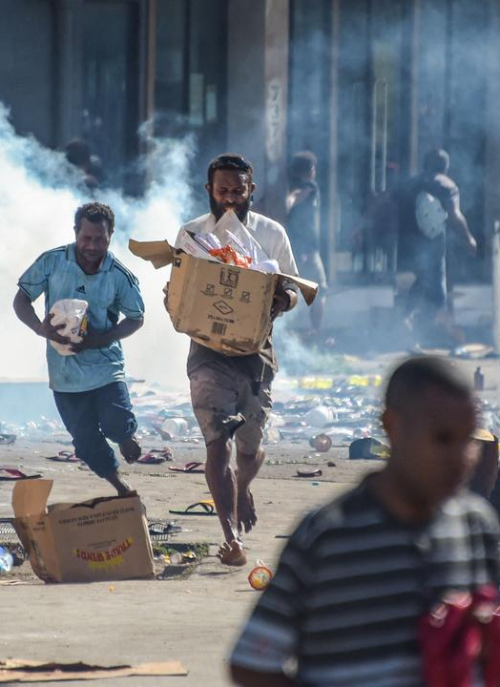
Case Studies and Success Stories
The summary highlights key operations and interventions:
Black Wednesday Operation (January 10th): The team responded to a major cyber threat involving coordinated misinformation campaigns aimed at inciting public unrest on social media.
Vote of No Confidence (VONC) Operation (May): During the VONC period, the team monitored social media to detect any unrest or misinformation that could disrupt the political process.
Pope’s Visit: The team provided situation reports and updates, crucial for security planning, working closely with the Joint Security Task Force.
Intervention and Impact:
Rapid Response: The team swiftly identified misinformation sources.
Public Communication: They collaborated with government channels to counter false narratives, ensuring accurate information was disseminated.
Outcome: These efforts successfully mitigated threats, preventing unrest and maintaining stability

Slide 15

Impact of Our Interventions
Increased Public Trust
Our successful interventions have significantly increased public trust in the government’s ability to manage and respond to cyber threats.
Enhanced Security
By proactively addressing potential threats, we have enhanced the overall security and stability of major events and political processes.
Improved Collaboration
These operations have strengthened our collaboration with other government agencies, leading to more efficient and effective responses to cyber threats.
Notes:
These case studies highlight the critical role of the Cyber Safety and Social Media Management Desk in safeguarding the digital landscape of Papua New Guinea and ensuring the safety and security of its citizens.

Slide 16
VISION Strategic Goals
The strategy focuses on enhancing cybersecurity through the following key goals and plans:
Enhance Cyber Threat Detection and Response:
  Goal: Improve real-time detection and response to cyber threats.
  Plan: Invest in advanced tools like AI and machine learning to boost threat detection capabilities.
Strengthen Collaboration with Government Agencies:
  Goal: Foster stronger partnerships with government agencies and security forces.
  Plan: Hold regular coordination meetings, joint training sessions, and adopt unified communication platforms.
3. Increase Public Awareness and Engagement:
  Goal: Educate the public on cyber safety.
  Plan: Launch awareness campaigns, workshops, and community initiatives to promote cyber safety practices.
4. Develop Robust Cybersecurity Policies:
  Goal: Establish comprehensive cybersecurity policies.
  Plan: Implement policies on data protection, incident response, and employee responsibilities, with regular updates.
5. Expand Training and Capacity Building:
  Goal: Strengthen team and partner skills.
  Plan: Conduct continuous training and capacity-building initiatives to stay updated on cyber threats and mitigation strategies

Slide 17

Innovation and Development Initiatives
The strategy focuses on improving cybersecurity through several key initiatives:
Adoption of Advanced Technologies: Integrate AI, machine learning, and big data analytics for better monitoring and response.
Automated Threat Detection Systems: Deploy automated systems to detect and report threats efficiently.
Enhanced Data Management Systems: Develop robust systems for secure and accurate data handling.
Cybersecurity Innovation Hub: Establish a hub for research and innovation in cybersecurity.
Public-Private Partnerships: Collaborate with private sector experts to enhance capabilities.
Community-Based Cyber Safety Programs: Educate communities on cyber safety through workshops and awareness campaigns.
Notes:
By pursuing these strategic goals and innovation initiatives, the Cyber Safety and Social Media Management Desk aims to create a safer and more secure digital environment for the citizens of Papua New Guinea, ensuring that we are well-prepared to tackle the evolving landscape of cyber threats.

Slide 18
Closing Remarks
In conclusion, the Cyber Safety and Social Media Management Desk plays a vital role in safeguarding the digital landscape of Papua New Guinea. Through our dedicated efforts in monitoring, analysis, and collaboration, we have successfully addressed numerous cyber threats and ensured the safety of our citizens. Moving forward, we are committed to enhancing our capabilities, embracing innovation, and fostering strong partnerships to stay ahead of emerging cyber threats.
Thank you for your attention and support. Together, we can create a safer and more secure online environment for everyone. If you have any questions or need further information, please feel free to ask during the Q&A session.

Slide 19
Thank you!

