Slide 1

CENSUS DATA CAPTURE SYSTEM
JOHN A. IGITOI
NATIONAL STATISTICIAN
e: john.igitoi@nso.gov.pg
w: www.nso.gov.pg
2ND OCTOBER 2024
STANLEY HOTEL

Slide 2
BENEFITS
Some of the main highlights of CAPI are more often categorized as benefits.
Allow collection of new types of information/data. Its capability of gathering data types such as GPS coordinates, pictures, audio clips, signature, sensors, decodes barcode etc.
Interviews can be done on a tablet or a smartphone.
Ensure data quality and comparability.
Cost-effective, sustainable solutions for NSOs
Improve timeliness of data collection
Reduce the likelihood of enumerators making errors during interviews.
Live data collection updates
Provides visibility to the enumeration exercise

Slide 3
CHALLENGES
Possibility of theft or loss of the mobile device in high-risk places.
The possibility of loss of information caused by device memory problems, low battery, falls and blows of the device, incorrect manipulation by the operator, etc.
When using a tablet or other similar device, the respondent may feel a certain threat, thinking that they are being recorded, this could stop them from expressing themselves freely. However, with proper explanations of the interviewers why they are using a tablet, this challenge could be avoided
Cost implications for Tablets and accessories

Slide 4
BRIEF HISTORY OF DATA COLLECTIONIN NSO
YEAR | 2000 | 2011 | 2022 | 2024
DATA COLLECTION OPERATION | National Population Census | National Population & Housing Census | Socio-Demographic & Economic Survey | National Population Census
CENSUS UNITS | 22,400 | 28,000 | 335 | 32,000
MODE OF COLLECTION | PAPI | PAPI | CAPI | CAPI
TABLETS USED | 0 | 0 | 450 | 22,000
* PAPI: Pen-And-Paper-Interview
* CAPI: Computer-Assisted-Personal-Interview

Slide 5
RESOURCES USED
CAPI ITEMS AND ESTIMATED COSTS REQUIRED FOR THE CONDUCT OF THE 2024 NATIONAL POPULATION CENSUS
NO | ITEM | QTY | COST (K) | DURATION
1 | Tablets | 22,000 | ~320 | 1 off payment
2 | Power-banks | 22,000 | ~100 | 1 off payment
3 | Backup Power-supply | 8,000 | ~700 | 1 off payment
4 | Slingbags | 22000 | ~100 | 1 off payment
5 | Access Point Name (APN) Service | 22,000 | ~60/month | 3 months
6 | Miscellaneous | n/a | n/a

Slide 6
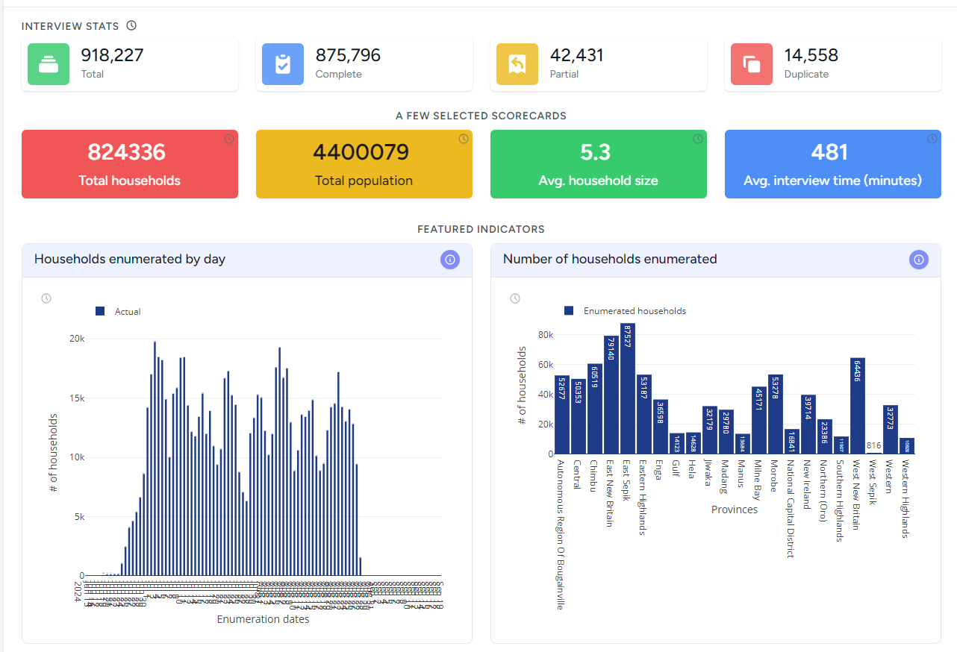
VISIBILITY
* Live Census Dashboard

Slide 7
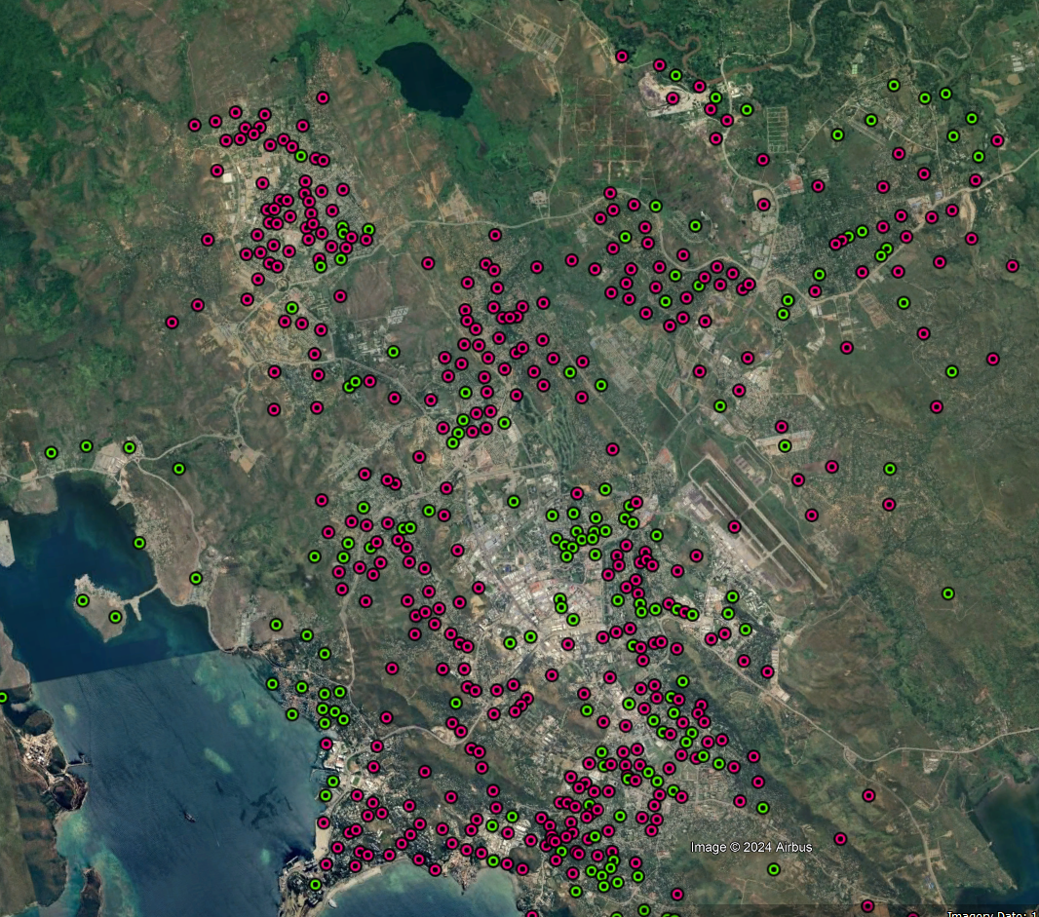
VISIBILITY
Map of Port Moresby showing the status of Census Units.
Red = Not Enumerated, Green = Enumerated

Slide 8
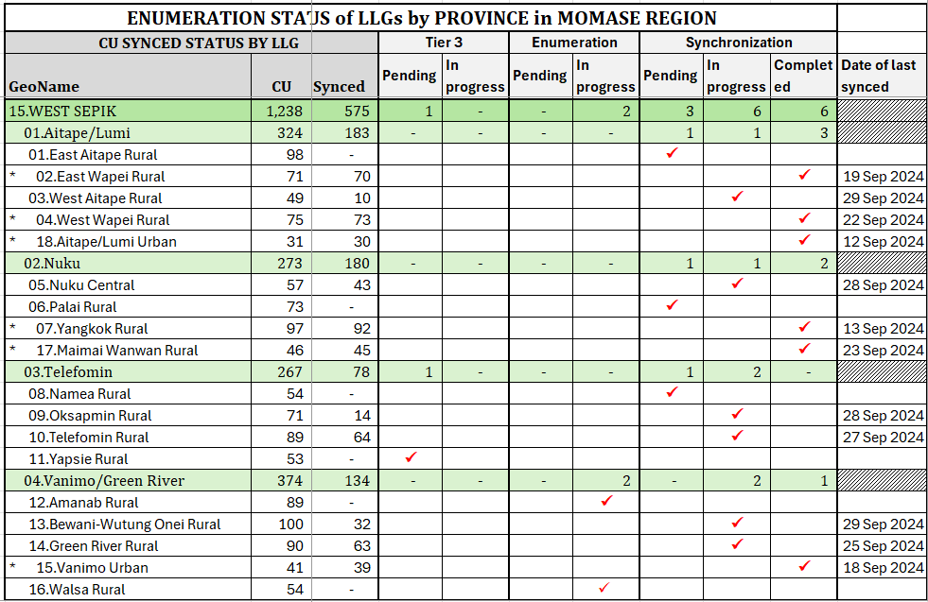
VISIBILITY
* LLG Status of each Province

Slide 9
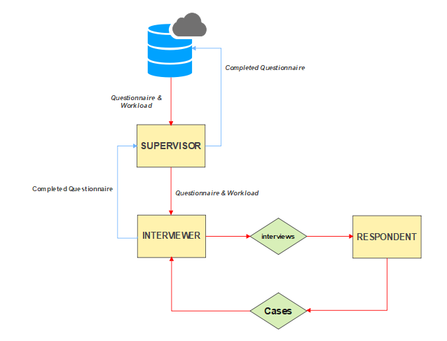
CAPI DATA FLOW

Slide 10
SUMMARY
CAPI will be the modus operandi for data collections in NSO going forward.
Implementing CAPI is technically and financially challenging.
Success of implementing CAPI hinges on coordination, cooperation and collaboration amongst all stake-holders, both public and private.

Slide 11


END OF PRESENTATION

