Slide 1



e-Procurement
Digital Transformation Summit 2024
Content copyright Globaltraid Limited, CAS Procurement Consulting Ltd 2024, Logos property of respective owners

Slide 2
Agenda
What is eProcurement?
Why governments implement eProcurement
Key principles
How systems can improve efficiency of procurement

Slide 3
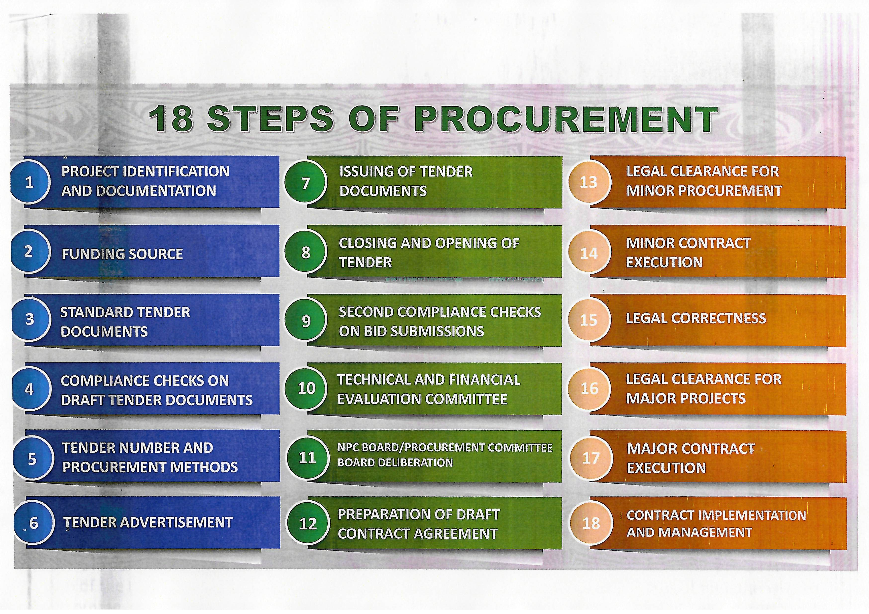
Manual Procurement Process

Slide 4
WHY GOVERNMENTS IMPLEMENT ePROCUREMENT
    Part of eGovernment strategy
    Cost savings – increase competition through greater supplier participation
    Public Sector efficiency – reduce paper, manual processes and delays
    Improved governance and transparency – publish data + ability to check on stage in process
    Measure Sustainable Development effects
Notes:
Cost and price savings – releasing money for front line services
Public Sector efficiency:
Time: faster procurement process, negotiations
Transfer data to other systems: Straight Through Processing
Improved governance and Accountability:
Transparency for government, suppliers and public
Reduction in corruption: less human intervention
Economic Development effects
Easier access/level playing field for SMEs
Catalyst for take-up of new technologies in wider economy
Sustainability: less paper, couriers

Slide 5
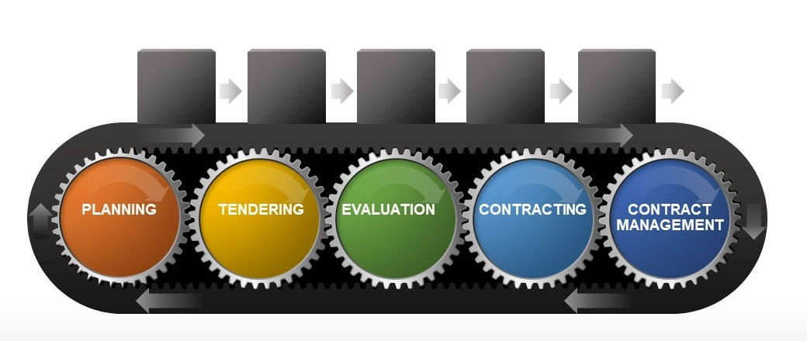
CAN MANAGE ALL STAGES OF PUBLIC PROCUREMENT CYCLE

Slide 6
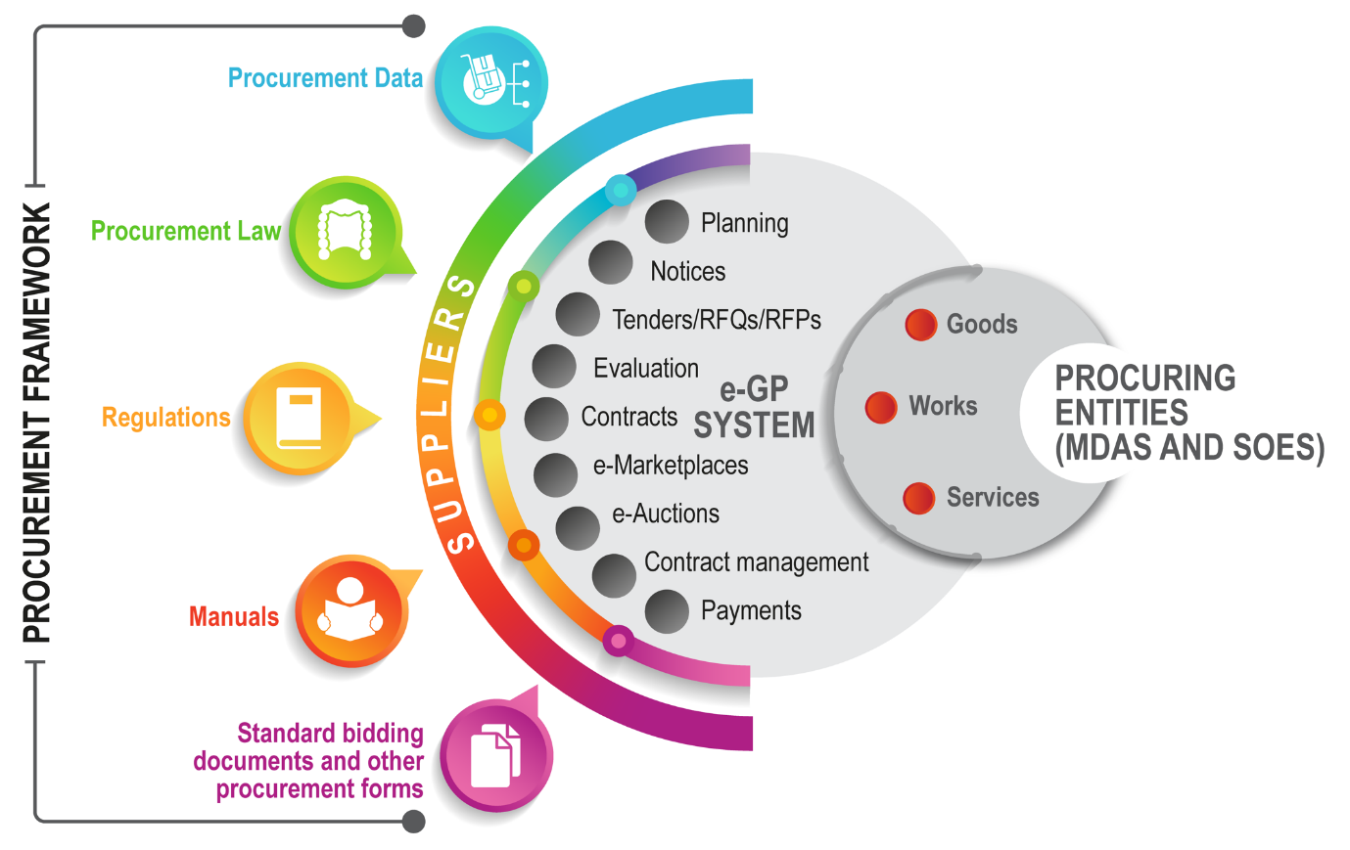
TYPICAL ePROCUREMENT ECOSYSTEM
- May be more than one system

Slide 7
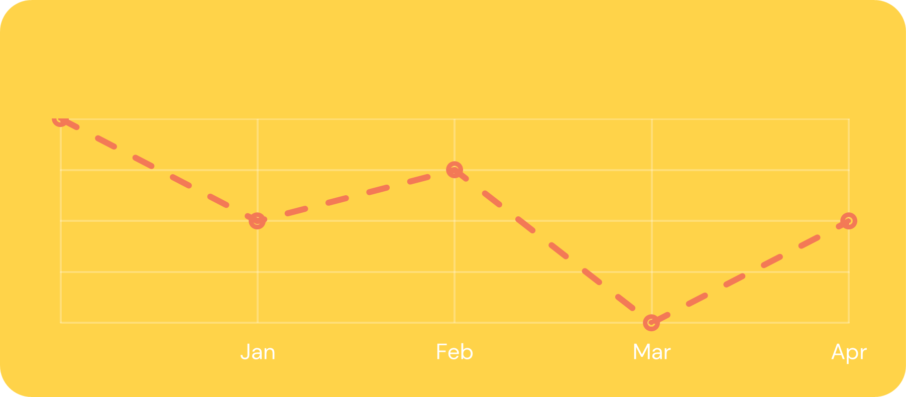
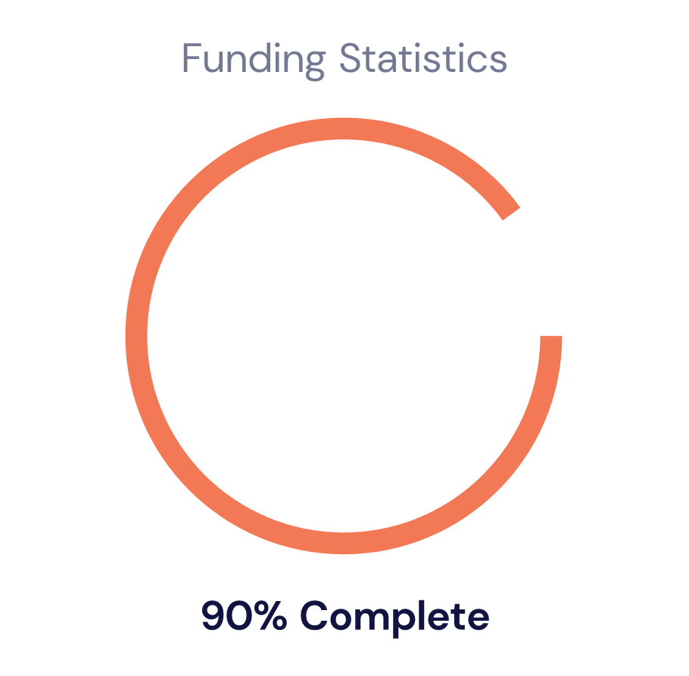
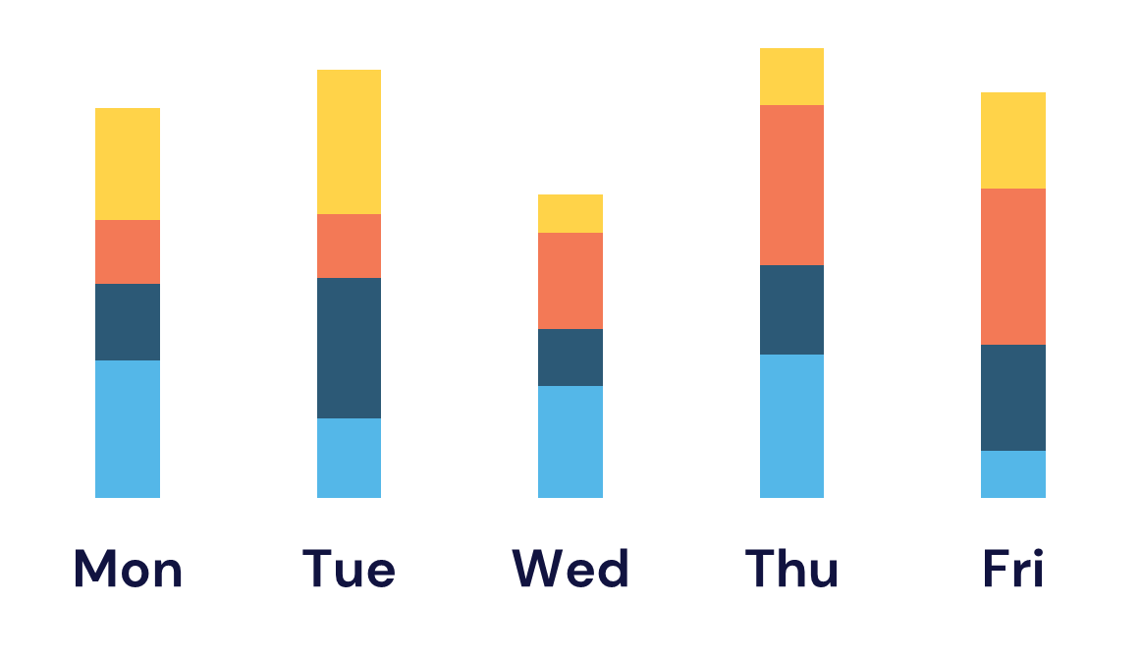

TOOLS – DATA AND REGISTERS
    Supplier register
    Contract register
    Register of buying organisations
    Spend analysis
    Red flags
    Analytics
    - Ask only once
    - More data and less documents

Slide 8

IMPROVEMENTS
    Competition for contracts
    Procurement planning and monitoring
    Statistics on how taxpayers’ money is spent
    Budget planning and monitoring
    Support compliance with legislation by buyers and suppliers
    Support activities of oversight body and auditors
    Capability of procurement personnel and private sector
    Collaboration amongst purchasing entities
    Reduction in number of complaints and legal disputes

Slide 9

REDUCTIONS IN TIME
    Prepare and publish procurement notices and request for tenders, request for quotations
    Complete and submit tenders
    Evaluate quotations and bids
    Access procurement data (in real time)
    Complete the procurement life cycle

Slide 10

ECONOMIC BENEFITS
    Reduction in costs for private sector
    Provide new opportunities for SMEs
    Cost savings
    Stimulating economy
    Job creation and capacity building in private sector
    Better value for money in public services

Slide 11





ePROCUREMENT IS A JOURNEY, NOT A DESTINATION
Using international electronic messaging standards
Integration with other eGovernment systems
Cross Border supplier verification
Cross border trading and payment
Public access to expenditure data
Public access to government eProcurement to order services / goods
Open Contracting Data Standard
Spend Management
Commodity data benchmark costs
Online Catalogues and Marketplaces
eContract formation
eContract Management
eSignature authentication
eVendor Management
eEnabled Shared Services
Open reverse auctions
eTendering (electronic forms)
eAuctions
ePayment
Government Procurement Card integration
eTravel booking
eNotices
eTender Vault
eRequisition
eOrder (purchase orders)

Slide 12
SUGGESTIONS RECEIVED
eTendering
Cover all sourcing and contracting processes: above threshold tenders, below threshold competitive quotations, emergency procurement
Procurement at national, provincial and district level
Automated evaluation preferred where possible
Calculation of financial ratios during due diligence
Record conflict of interest declarations
Automated bid opening and reporting
Secure system based on tightly controlled user rights
Use Geographical Information System (GIS) data for remote locations (e.g. schools, prisons)
Easier / quicker allocation of tender numbers, APC Certificates, Certificates of Inexpediency
Ability to track progress – record completion and time of steps
Improve the current manual process before automating it
Other functionality?
eAuctions for disposals
Logistics and Stock control

Slide 13
SUMMARY
    Tool to support central, provincial and district procurement
    Return on investment is high
    Supports compliance in procuring entities
    Strengthens integrity, oversight and audit functions
    Enables collaboration between procuring entities - sharing of information on suppliers, specifications, and prices
    Benefits private sector and SMEs - transact at lower cost
    Spend and process visibility supports transition from procedural to strategic procurement
    Implemented in a phased manner aligned to national priorities

Slide 14
END PRESENTATION
Thank you

