Slide 1







Department of Information And Communications Technology
SECURING OUR
CYBERSPACE
BY GEORGINA KIELE
Executive Manager for Cybersecurity and Digital Government Standards
www.ict.gov.pg
www.ict.gov.pg

Slide 2


Outline
Gov Stack
IT assets
Cybersecurity Controls
NCSC Threats monitoring
Cybersecurity Governance
Global Cybersecurity Rankings
What’s Coming ?
www.ict.gov.pg

Slide 3
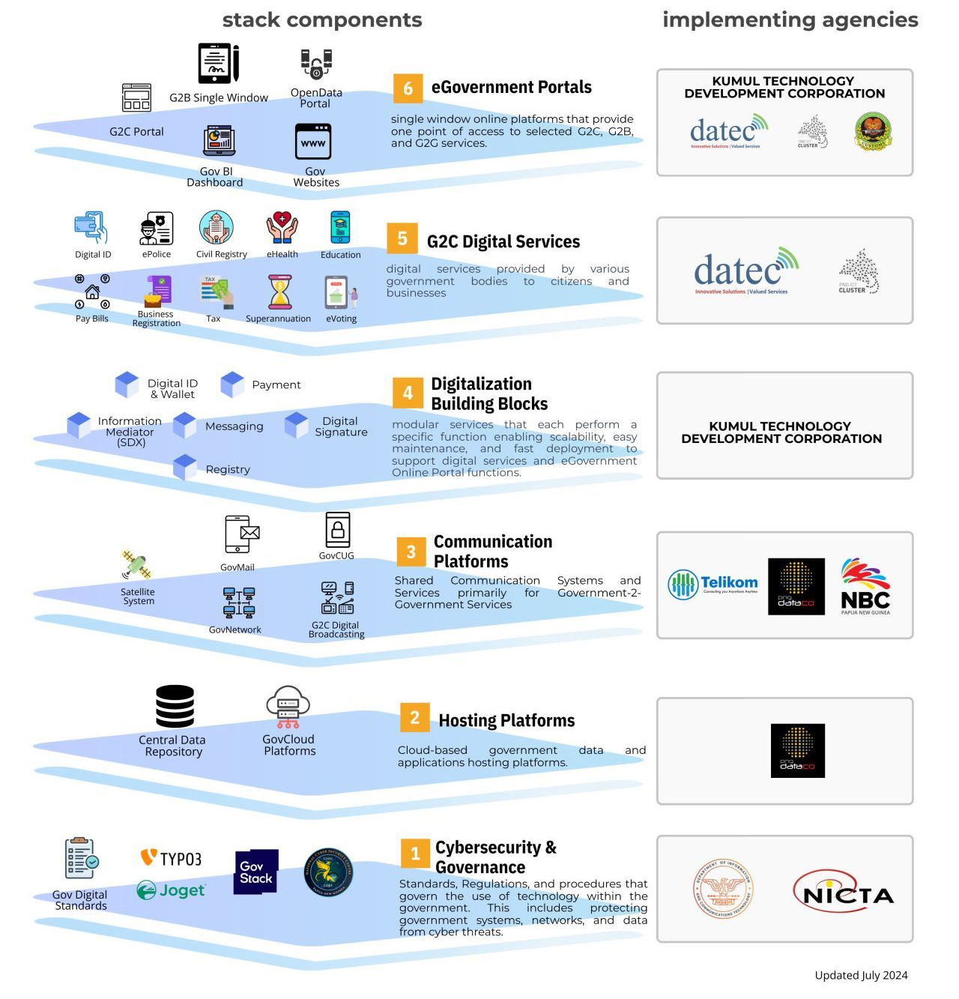
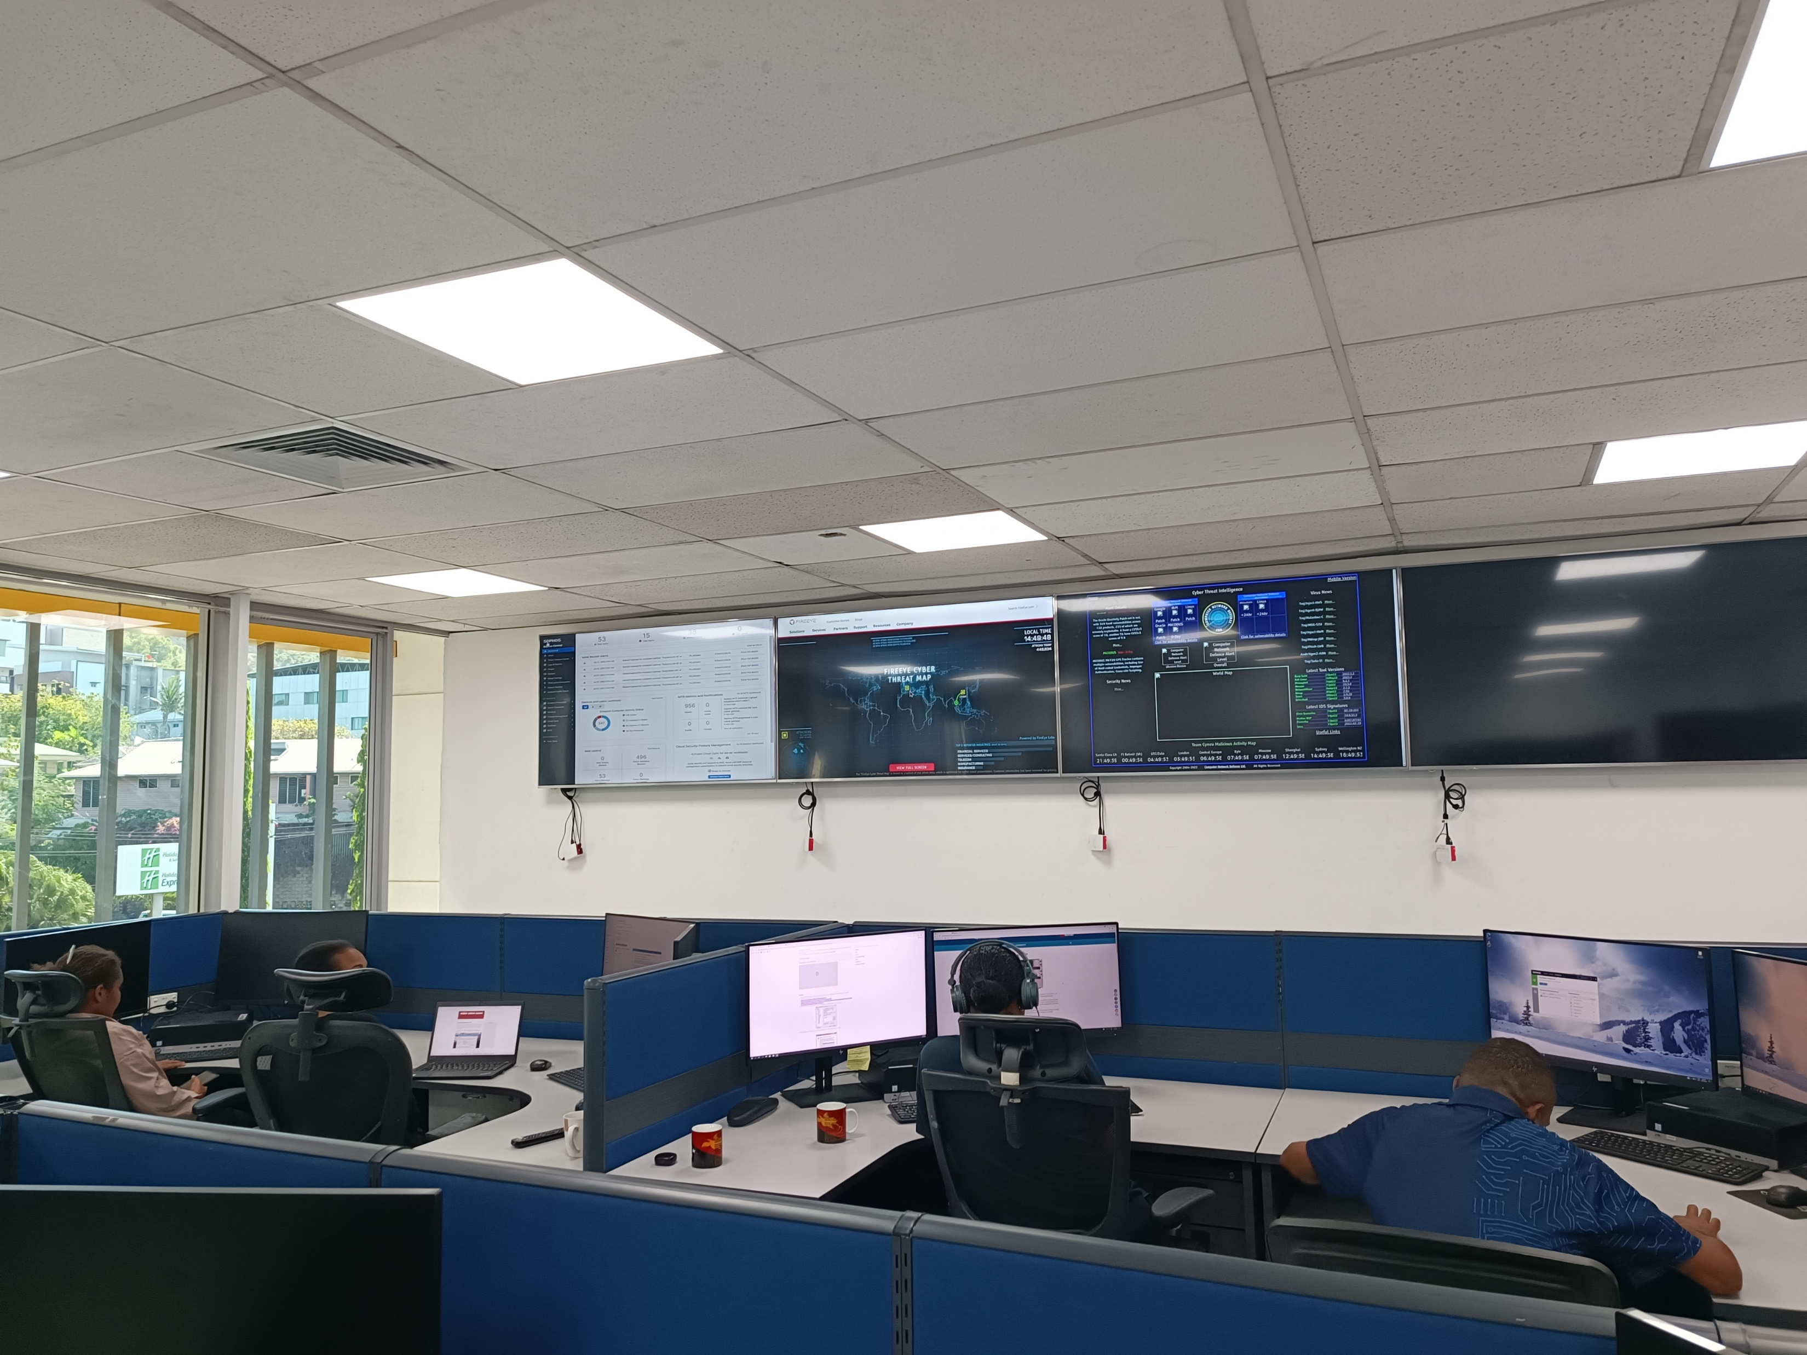
GOV STACK
  NCSC Support
www.ict.gov.pg

Slide 4
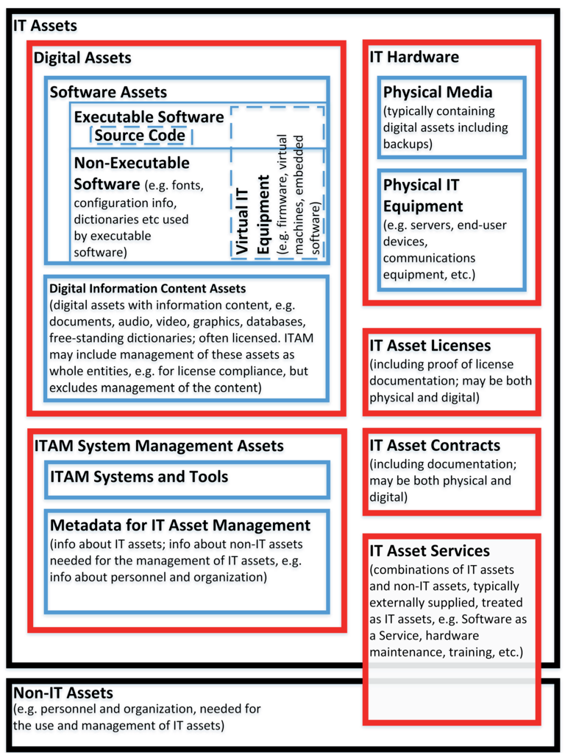
IT ASSETS
Identify the IT Assets within your Organization
      Hardware Assets (E.g. Servers, Network devices, Storage Devices, PCs, Laptops, phones, etc)
      Software Assets (E.g. Microsoft Office, Email applications, Unified Communication Applications, etc)
      Digital Assets (Data, intellectual property documents, etc)
      Other IT Assets (Licenses, Contracts, Procedures, Structure etc.)
www.ict.gov.pg
ISO/IEC 19770-1:2017

Slide 5

CONTROL MEASURES
Cybersecurity Controls (Cybersecurity Digital Government Standards and Gov Stack)
      Administrative controls
        Internal Polices (E.g. Patching, Incident Handling, Procurement, etc )
        Procedures (E.g. Shutdown)
        Risk Management (Mandatory)
        Change Management Process
        Others
      Physical Security
        Access Controls,
        CCTv
        Biometrics and ID Cards
        Door
        Others
      Technical Controls
        Network Protection (Firewalls)
        Endpoint Protection
        Two factor Authentication
        Cloud Security
        Monitoring and Threat Detection
        Others
www.ict.gov.pg
Notes:
There are different Types of Security Controls. These three are from the Digital Government Standards. For Endpoint and firewall, there are only a few solutions accepted to be used in government. Other solutions can be approved through writing to DICT.
Risk Management Process in place? Some départements are still using End of Life systems, like Exchanges servers, Windows 7, server 2016. Microsoft do not support OS anymore. How do you manage Vulnerabilities.

Slide 6
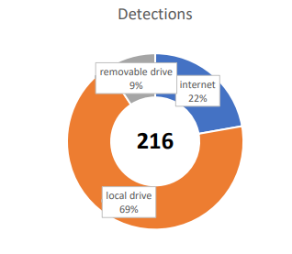
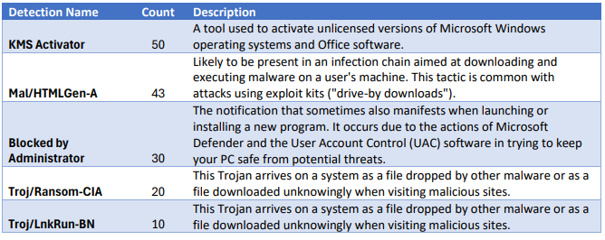
NCSC THREAT MONITORING
1153 Endpoints, 3 Firewalls and 1 cloud environment | 24 Departments
Many of the detections originating from the local drive came from third-party antivirus SMADAV and malicious scripts and code delivered by common infection vectors including ‘drive-by’ infection techniques from compromised websites. These detections were blocked from running. Government agencies are still using patch software and using KMS software for Microsoft products. The detections from the internet are mainly from websites that are known to be malicious or have a low reputation score or used for phishing attacks.
2 Critical Incidents through detection. Potential Ransomware attacks were stopped
13 Exchange Servers in the country detected with vulnerabilities. 1 End of Life
www.ict.gov.pg
Notes:
The Exchange server vulnerabilities, we will be writing to the agency heads.
DTOs do not responds. We are looking into communication mechanism that is effective for the case of critical incident handling

Slide 7
CYBERSECURITY GOVERNANCE
2021
National Cybersecurity Policy 2021
2022
Digital Government Act 2022
2023
Digital Government Plan 2023 - 2027
Establishment of the National Cyber Security Center (NCSC)
Fully Operationalise the NCSC
Cyber Resilience Design
Gazette the Government Cybersecurity Standards
2024
National Cybersecurity Strategy 2024
Strategy Implementation plan (Cyber Resilience)
2025
National Cybersecurity and Critical Infrastructure Act
2026
National Cybersecurity Authority (NCSC Upgrade)
Cyber Resilience Matures (Digital Government Plan 2023 - 2027)
National Cyber Coordination Center (N3C) fully operational
2018
NCSC built to support APEC
NEC Decision 100/2021 for Social Media Management Desk
www.ict.gov.pg
Notes:
Two Components of the NCSC are:
CSOC (Support Digital Services)
CERT (Incident Response)

Slide 8
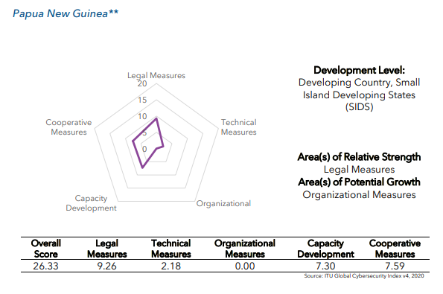
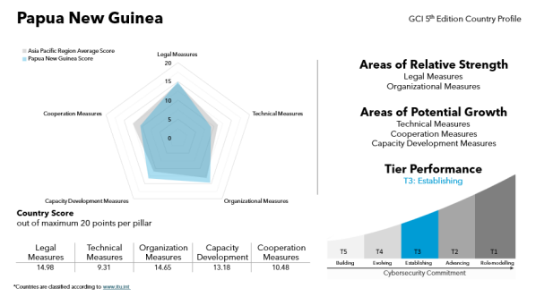
PNG RANKING IN THE GLOBAL CYBERSECURITY INDEX
2020: Overall Score 26.33/100 (Tier 5)
2024: Overall Score 62.59/100 (Tier 3)
Key Intervention included the National Cybersecurity Policy 2021, Legal provisioning of the NCSC in the Digital Government Act 2022, Fully operationalizing CSOC in 2023 and Finalizing the National Cybersecurity Strategy 2024. Also, active members to Regional and Global Cybersecurity Communities.
www.ict.gov.pg
Notes:
Improving on the rankings is everyone’s responsibility. Its not just NCSC or the departments
We are members to PaCSON (Pacific Cybersecurity Operations Network). We currently the incoming chair in the Executive committee. We will be Chair in 2026 and will be hosting the Annual General meeting in 2026.
We are member to GFCE (Global Forum Cyber Expertise), we are chair to capacity building working group. We are been nominated to be chair to the Awareness working group this year.
We are members to Counter Ransomware Initiative. We are in Progress to be members to global FIRST (Forum of Incident Response and Security Teams).

Slide 9
WHAT’S COMING?
DTO Guidelines
Audit and Compliance (Digital Government Standards)
CSOC’s integration project
Roadmap and Strategy implementation plan
Capacity Building programs
Universities collaborations (Internship)
www.ict.gov.pg
Notes:
Internship programs going on. Example of the

Slide 10

THANKYOU

