Slide 1

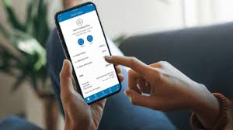
DEPARTMENT OF FINANCE
GoPNG Non-Tax Revenue Digital Payment &
E-Receipting Solutions
DIGITAL TRANSFORMATION SUBMIT 2024
STANELY HOTEL-PORT MORESY
02nd October, 2024
Presenter: Charles Ikitae
A/FAS-Non-Tax Revenue Division

Slide 2
Outline
Objective
Reform Background on the Digital Payment & E-receipting Solutions
Digital Payment Solution Developments
Mode of Digital Payment Solutions
Benefits of Digital Payment Solutions
Soft launch of the Digital Payment Solutions
Roll-out of the Digitalisation Project Implementation
Conclusion

Slide 3
Objective
This presentation, aims to inform participants about the new reforms that the Department of Finance has embarked on especially the receipting of Government Fees and Charges:
  Understand the new e-Receipting system and how it works
  Identify the different portals with their specific functions
  Discuss the features and key benefits

Slide 4
Reform Background-Digital Payment Solutions
The PNG Department of Finance required a centralized Person to Government (P2G) digital payment solution in which the public can access to pay for any government service fee 24/7 and allows for the ease of reconciliation of payments against the Departments financial management system IFMS.
Digital Payment & E-receipting solution was first initiated in 2021
Project Development;
  In line with 2019-2022 Medium Term Revenue Strategy (MTRS) policy 2018
  In line with MTD4:-
    SPA 07- On National Revenue & Public Finance Management
    SPA 08 – Integrated Digital Government System

Slide 5
Digital Payment Solutions Developments
Department of Finance and BSP Financial Group Limited have signed an MoU on the 14th of May, 2021
Signing of the MOA on the 10th March, 2023 between DoF and BSP Financial Group Limited
All certification requirements including MOU & MOA between Department of Finance and BSP have been sighted, vetted and cleared by State Solicitor's Office

Slide 6
Mode of Digital Payment Solutions
  Web Service Based Online Payment & E-receipting
  USSD Mobile Phone Banking Payments
    Scheme cards developments-Vodafone, Bmobile, Telikom & Digicel
    BSP (other banks Kina, ANZ, Westpac
    Above developments to be completed 31st December, 2024
  Kiosk Payment Solutions

Slide 7
Online eReceipting Web Based Portals
The MVP of the GoPNG Non-Tax Online Receipting System consists of three portals with the functionalities listed below:
1. Customer Portal
2. Agency Portal
3. Admin Portal

Slide 8


User Portal Features
Customer Portal
Agency Portal
Admin
Pay for service item
Retrieve Receipts
View and verify receipts
Change receipt status
Track receipts
Generate reports
View receipts
Track receipts
Generate reports (agency specific)

Slide 9
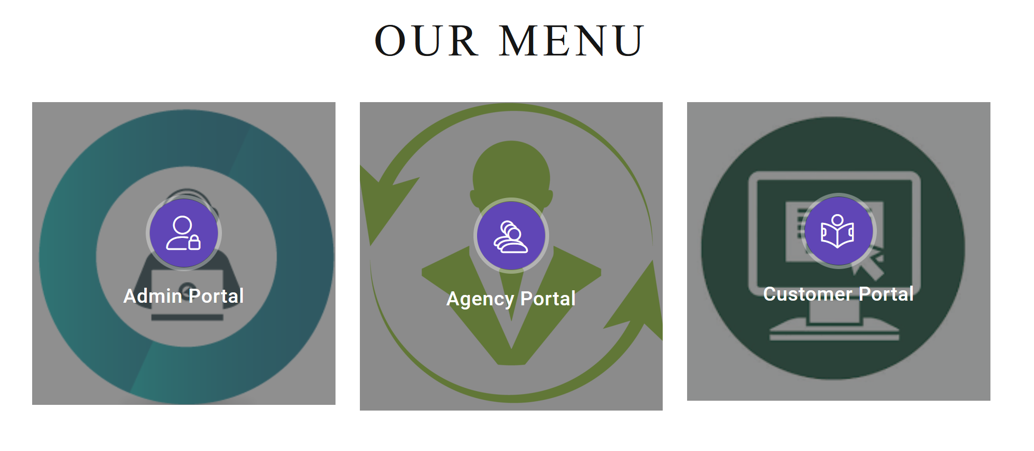
Portal – https://epay.finance.gov.pg

Slide 10
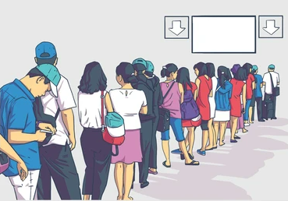
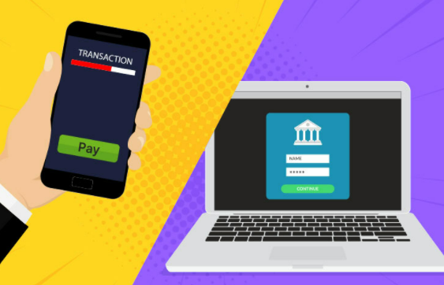


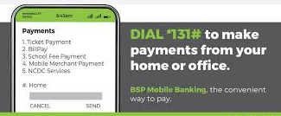
What's new?
Benefits Of The Digital Payment System
OLD
NEW

Slide 11
Benefits Of The Digital Payment System
Payments can be done 24/7 including weekends from anywhere (country & abroad)
It will eliminate the paying ques at Cash Offices
It will eliminate theft and fraud in the payment process
Eliminate Collector of Public Moneys Punctuality and non-attendance
Eliminate customer travel cost for receipting
Real time fund transfer from customer to gov’t main account (CRF)

Slide 12
Soft launch of the Digitalisation Project
A soft launch of the digitalisation project on the payment & e-receipting of government non-tax revenue fees & charges was done on the 03rd of May, 2024 at APEC Haus by the Secretary for Finance.
PNG Royal Constabulary has been selected as the pilot agency to trail out the online payment & e-receipting system.

Slide 13
Roll-out of the Digital Project Implementation
Department of Police, NCD Police Collection sites have been installed with computers for online payments and e-receipting;
  Gordens Forensic Center
  Boroko Traffic Office
  Konedobu Firearms Office
The trial out with Police Department will happen for 6 months and to be completed by December 2024.
Currently rolling out at the Provincial Police Headquarters before rolling out to other non-tax revenue collecting agencies as the full solution of the project
By end of 2025, all government non-tax revenue collecting agencies will be onboard on the Digital payment & e-receipting solution.
By January, 2026, all cash office throughout the country will be closed and all agencies will pay online.

Slide 14
Phase 1 – Agency 1 Rollout RPNG Completed
Southern Region
  National Capital District
  Milne Bay Province
  Northern Province
Niugini Islands
  West New Britain Province
  East New Britain Province
Momase
  Madang Province
  Morobe Province
Highlands
  Eastern Highlands Province
  Chimbu Province
  Jiwaka Province
  Western Highlands

Slide 15
Phase 2 – Agency 1 Rollout RPNG -Planning Stage
Southern Region
  Gulf Province
  Western Province
Niugini Islands
  Manus Province
  New Ireland Province
Momase
  East Sepik Province
  West Sepik Province
Highlands
  Southern Highlands Province
  Enga Province
  Hela Province

Slide 16
End of Presentation
Thank you!

