Slide 1

Digital Summit
October 2024
Integrated
Financial Management
System
(IFMS)
Heau Kengasa
IFMS

Slide 2
GoPNG
Accounting & Finance Systems Evolutionary Steps
1970’s 1980’s 2017
I
B
M
PGAS
IFMS
PBS
TMS
Central batch
Ø
Multiple applications
Ø
Common database
processing &
Ø
Multiple databases
Ø
Data visibility by permission
manual record
Ø
Re-enter data
Ø
Real time accounting system
Visibility, accountability, transparency
Enables compilation of GFS
keeping
Ø
Still in use today at
some Departments
and the sub-national
level
Ø
Ø
Notes:
The IFMS is a major step in a continuous process of change.
Computers were first brought into use by the Government of PNG in the early 1970’s.
Followed just over 10 years later by the introduction of PGAS and in the late 1990’s TMS.
25 years further down the road we are now looking at IFMS!

Slide 3
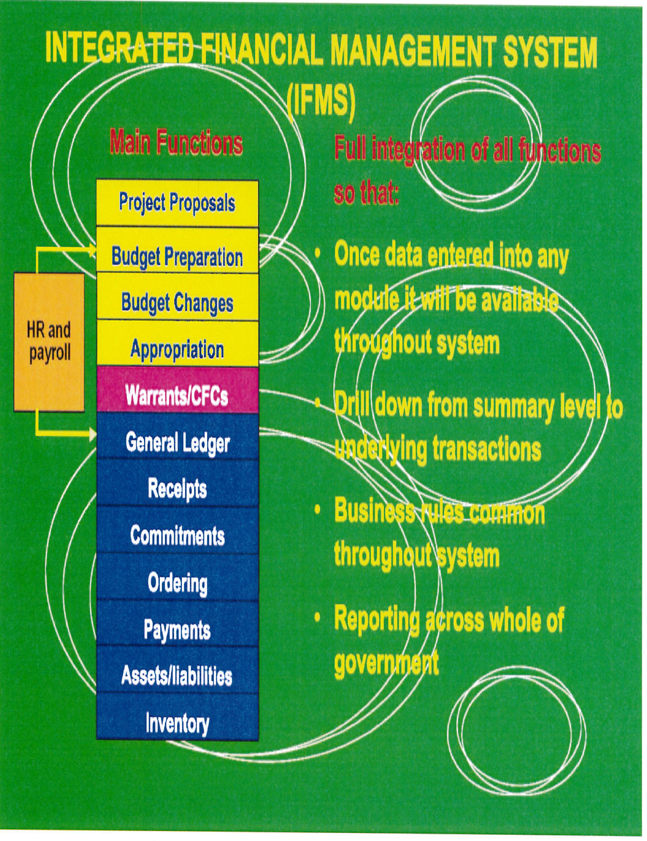

Slide 4
NEXT STEP?
- MIGRATION FROM ON-PREMISE TO TECHNOLOGYONE SaaS ENVIRONMENT ON AWS CLOUD
2024 - IMPROVE CONNECTIVITY
2025 - UPGRADE TO THE CiANYWHERE VERSION OF SOFTWARE

Slide 5
IFMS Implementation is Mandatory
PFM Act 1995 and 2016 Amendments
Minister of Finance and the Secretary are responsible for financial activities, assets and reporting
Section 117 of the Public Finances (Management) Act, 1995 whereby the Finance Departmental Head may issue Financial Instructions that are necessary or desirable for carrying out or giving effect to this Act and in general for the better control and management of public moneys and public property.

Slide 6
IFMS Implementation is Mandatory
FINANCIAL INSTRUCTION 08/2017
7th NOVEMBER 2017
USE OF INTEGRATED FINANCIAL MANAGEMENT SYSTEM
This Instruction is designed to ensure that all public and statutory bodies comply with the operationalization of the Integrated Financial Management System as it is rolled out throughout the country.

Slide 7
IFMS Main Features
The planning, budgeting and accounting modules are integrated and form a single real time accounting and finance system
Utilizes workflow systems with access and visibility restricted to users’ functional roles
Full audit trail, drill down capability and full visibility means increased transparency and accountability
Automated bank reconciliations means strengthened internal controls
Electronic Funds Transfers to replace cheques, allowing more accurate cash flow forecasting
.

Slide 8
IFMS Implementation Status
A fully functional IFMS has been delivered to 37 National Departments,11 Statutory Authorities, 19 provincial Governments and their DDAs and LLGs and 13 PHAs.
  National/Sub National Budget – budget preparation, budget maintenance and budget execution
  Consolidated Recurrent and Development Budgets
  Budget reports are IFMS generated
  A consolidated General Ledger, real time system with drill down capability into all transactions
  Extensive Financial Management Reporting
  GoPNG Public Accounts are IFMS generated

Slide 9
Other Features
  Ability to transfer electronicaly financial Information to other systems

Slide 10
Questions
??

