Slide 1


DIGITAL TRANSFORMATION SUMMIT 2024
“Progress Update on the PNG National Single Window Project.”
Chief Commissioner of Customs
David Towe

Slide 2
Presentation Outline
Administration of the Project
Stages of Progress – 3 Phases
The Way Forward - Preferred Single Window
Notes:
5 Points to Present

Slide 3




1. Administration of the Project
NTO -
Facilitates WTO Initiatives & negotiations of trade
PNGCS
Administers & Implement WCO Trade best practices
(Single Window)
MITI
Oversees the Single Window Project
NEC endorsement for implementation 12th June 2024
Notes:
5 Points to Present

Slide 4

Road to the National Single Window
In Progress
6. Operationalization of PNGeSW
12th June 2024
4. Hand-over of the PNGeSW Blueprint to the Minister for International Trade & Investment
19th June 2024
5. NEC approved both the PNGeSW Blueprint for implementation
22nd November 2023
2. Validation by UNCTAD received after sending the completed draft over
03rd May 2024
3. PNGeSW Blueprint endorsed by the NTFC
Feb – Dec 2023
1. Consultation with 37 agencies and development of the PNGeSW Blueprint

Slide 5
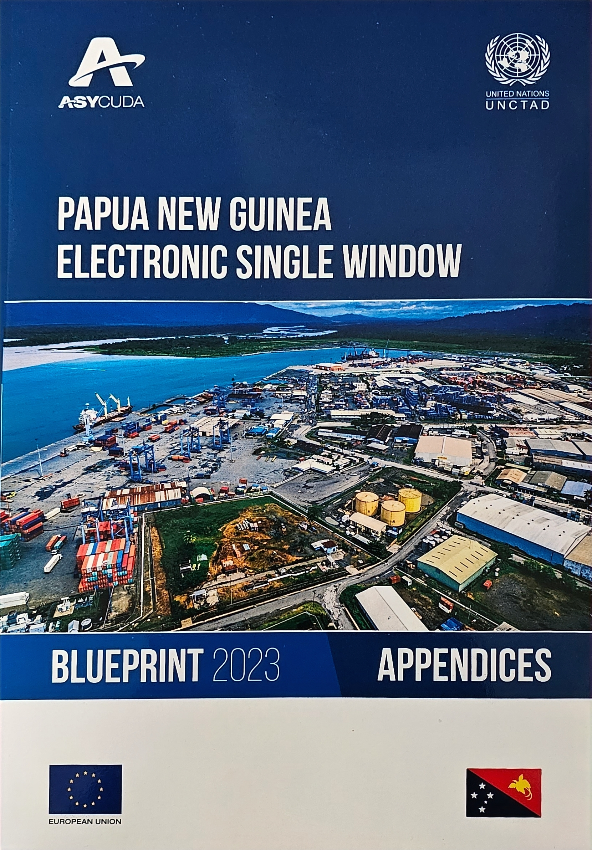
2. Stages and Progress – 3 Phases
Phase1.
Strategic Business Case for Single Window
Phase 2.
Data Harmonization
Phase 3.
Project Implementation ICT infrastructure
Achieved
Single Window Blueprint
In progress..
Data harmonization with 37 Govt Regulatory Agencies
Time Release Study (TRS) with shipping and logistics
Networking with T1 & T2 agencies under the Blueprint
Yet to implement
Notes:
5 Points to Present

Slide 6
Phase 2: Data Harmonisation
Lodgment of standardized information and documents with a single entry / point.
Fulfill all imports, export and transit related regulatory requirement
Certifications. E.g: Rules of Origin, permits, or Inspection document.
Notes:
5 Points to Present

Slide 7
Establishment of Single Window Network Team
State Regulators
Agricultural Commodity Boards
State Policy owners
Economic Sectors
Trade and Transport Industries
Private Sector
Notes:
5 Points to Present

Slide 8
Phase 3: Establishment of the Single Window
Development of Paperless Customs Declaration
Integration of all the Regulatory Agencies to a Single Window Platform
G2G & G2B Port Community Systems to service entire trade and logistics
Integration of Traders and logistics service providers
Regional Information Exchange system
Notes:
5 Points to Present

Slide 9
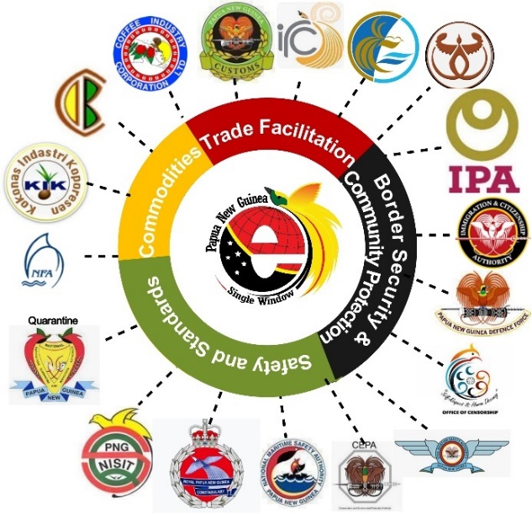

3. Way Forward: One-Stop-Shop with Single Window for Trade Facilitation
Notes:
The National Single Window will now coordinate the trade process to seamlessly facilitate trade (import &export) process in PNG.
This exporter/importer will now have a central coordination platform of the National Single Window to assist her to trade her products.
Therefore, I invite the new Asian investors to PNG because we at PNG Customs have initiated reforms and procedures to support the Government’s vision of growing our economy to a 200 billion kina economy by 2030.
This ends my presentation.
Safe travels and see you on the next PNG-Asia Investment Conference.
Thank you!
The National Single Window will connect all Regulatory Agencies for a One-Stop-Shop trade process in PNG.
We welcome Asian Investors because we are Customs have already initiated process such as the National Single Window to facilitate and support investments in Papua New Guinea.
Thank you all for your attention!

Slide 10

THANK YOU!
Please visit PNG Customs website for more information
https://customs.gov.pg/
Notes:
For more information of Customs Processes, please visit our website.
Thank you!

