Slide 1



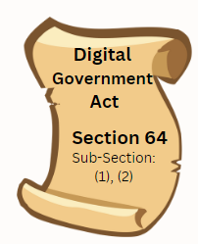

Department of Information And Communications Technology
DIGITAL GOVERNMENT SERVICES STANDARDS
OVERVIEW
Benedict Sike
Manager – Digital Government Services Standards
www.ict.gov.pg
www.ict.gov.pg

Slide 2


WHAT ARE DIGITAL GOVERNMENT SERVICES STANDARDS
Digital government standards are standards for creating accessible, user-friendly, secure, transparent, interoperable, open, and privacy-respecting digital services and systems in government.
While the government is in the process of a digital transformation, it is important to set a framework that will aid in digitizing the public sector. By following these standards, governments can build efficient, effective, and trustworthy services that meet citizens' needs.
www.ict.gov.pg

Slide 3
ALIGNMENT
Digital Government Standards takes its cue from;
Digital Transformation Policy 2020
DICT Digital Plan 2023-2027
All standards are developed under Section 64, Digital Government Act 2022
www.ict.gov.pg

Slide 4
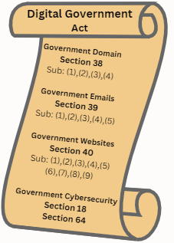
GAZETTED DIGITAL GOVERNMENT SERVICES STANDARDS
Gazetted standards include;
Government Domain Name Standards 2023 prescribe standards for the creation, use and management of the government domain .gov.pg to provide a consistent, effective and coordinated management system for assigning domain names to public bodies.
Government Website Standards and Guidelines 2023 prescribe minimum requirements for all government websites to ensure an intuitive, consistent, and seamless online experience for all users.
Government Email Standards and Guidelines 2023 prescribes standard for the creation, use and management of all government emails.
Cybersecurity Standards, Guidelines and Best Practices 2023 prescribe technical standards, requirements and guidelines public bodies must consider to ensure critical infrastructures, networks, data, and information technology systems are secure.
www.ict.gov.pg

Slide 5

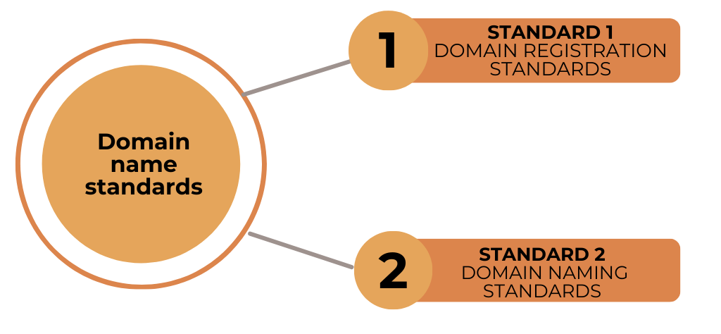

DOMAIN NAME STANDARDS
www.ict.gov.pg

Slide 6
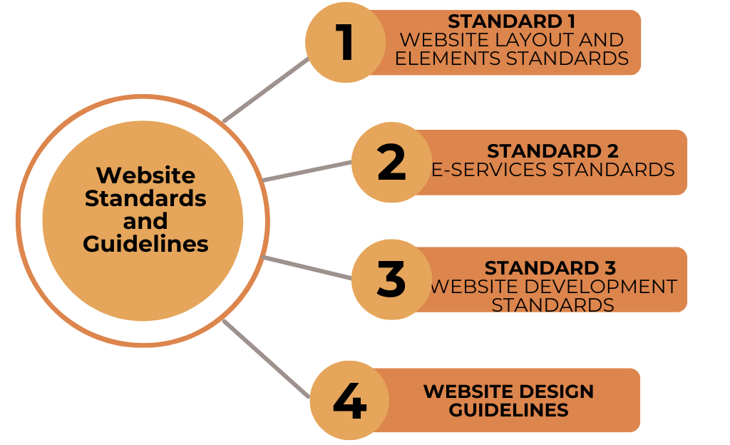
WEBSITE STANDARDS
www.ict.gov.pg

Slide 7
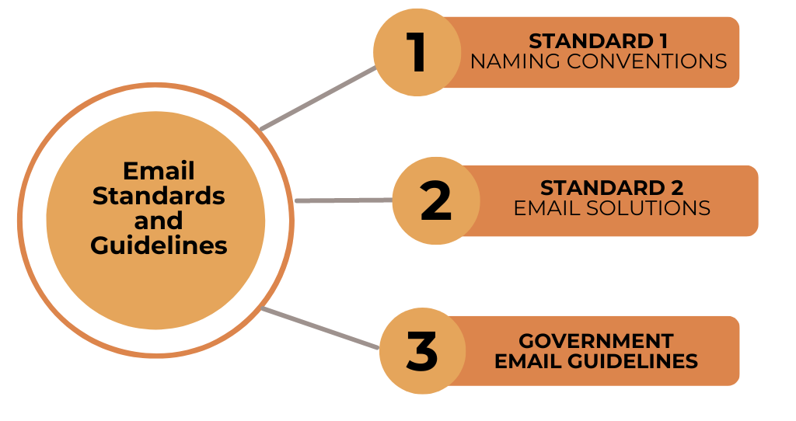
EMAIL STANDARDS
www.ict.gov.pg

Slide 8
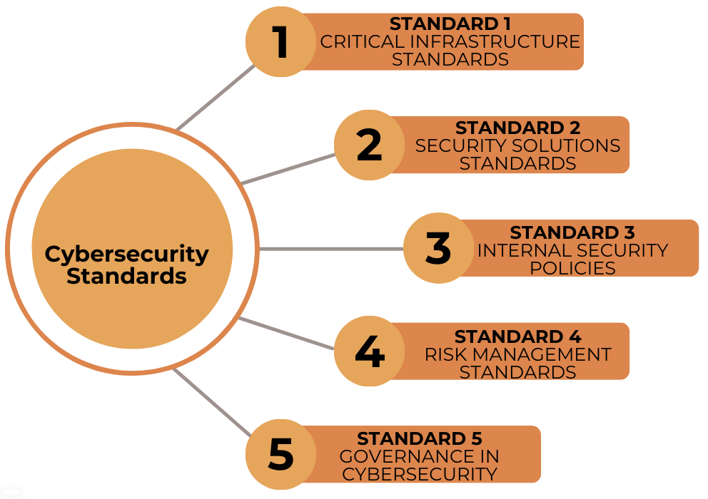
CYBERSECURITY STANDARDS
www.ict.gov.pg

Slide 9

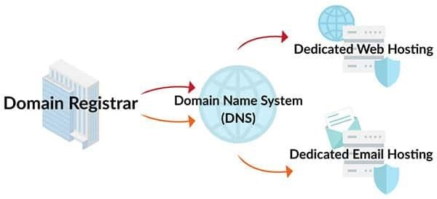
RELATIONSHIPS BETWEEN THE FOUR DIGITAL STANDARDS
GOVERNMENT NEWTWORK & INFRASTRUCTURE
Cybersecurity Standards Covers the Security aspects of all the Standards
GOVERNMENT CLOUD
CYBERSECURITY STANDARD
GOVERNMENT DEVELOPMENT & OPERATIONS
GOVERNMENT CYBERSECURITY & STANDARDS
WEBSITE STANDARD
DOMAIN NAME STANDARD
Converts your domain to an Internet Protocol (IP) address. Every host has a unique IP address where your website files and emails are stored
AWS
www.ict.gov.pg
EMAIL STANDARD
.gov.pg
Google Suite Microsoft 365
UNITECH DICT
first name.last name@ict.gov.pg
www.ict.gov.pg
www.ict.gov.pg

Slide 10


DIGITAL SERVICES STANDARDS AND GUIDELINES ON THE PIPELINE TO BE APPROVED
These include;
Digital Identification (ID) Standards prescribes standards and guidelines to ensure a secure and standardized method for verifying the identity of individuals or entities in the digital realm.
Data Standards and Guidelines prescribes standards for the representation, format, classification, structuring, tagging, transmission, manipulation, use, and management of data.
Cloud Standards prescribes standards and guidelines for cloud computing services, ensuring security, privacy, and interoperability.
Social Media Standards prescribe standards and guidelines for the use and management of all government social media accounts.
Procurement Standards prescribe standards and guidelines to promote fairness, transparency, and efficiency in procurement in the public sector.
www.ict.gov.pg

Slide 11
DIGITAL SERVICES STANDARDS AND GUIDELINES ON THE PIPELINE TO BE APPROVED (cont)
6. ISP Standards prescribe standards and guidelines for the quality of service, network reliability, and security measures that ISPs must adhere to when providing internet services to consumers.
7. Data Centre Standards prescribe standards and guidelines for the requirements for the design, construction, and operation of data centers.
8. Online Payment Standards prescribes standards that define protocols and security measures managing electronic payment transactions, ensuring secure and efficient online payment processes, protecting both consumers and businesses from fraud and unauthorized access.
9. Unified Communications Guidelines prescribe recommendations for the use of different applications, tools, or software, to connect and collaborate whether in the public sector, private sector or communicating to international organizations.
www.ict.gov.pg

Slide 12
DIGITAL SERVICES STANDARDS AND GUIDELINES ON THE PIPELINE TO BE APPROVED (cont)
10. DTO Guidelines
Digital Transformation Office (DTO) guidelines offer strategic and practical advice for all digital transformation officers.
DTO Guidelines include:
DTO Appointments
DTO Functions
Access, Use and Management of Digital Services
Resources and Tools
Training and Development
www.ict.gov.pg

Slide 13

DIGITAL SERVICES STANDARDS APPROVAL PROCESSES
1
2
3
4
5
6
7
8
9
10
11
12
13
14
Research Specific Digital Standards
Drafting Digital Standards
Internal Consultations
Updating of the First Draft
Internal Review
Updating of the Second Draft
DICT SMT Approval
Public Consultations(Workshops)
Updating of the Third Draft
PS ICT Steering Committee Approval
Validation Workshop
Updating the Final Draft
Government Print office for print & Gazettal
Enforcement
DIGITAL GOVERNMENT STANDARDS APPROVAL PROCESSES
www.ict.gov.pg

Slide 14

THANKYOU

