Slide 1
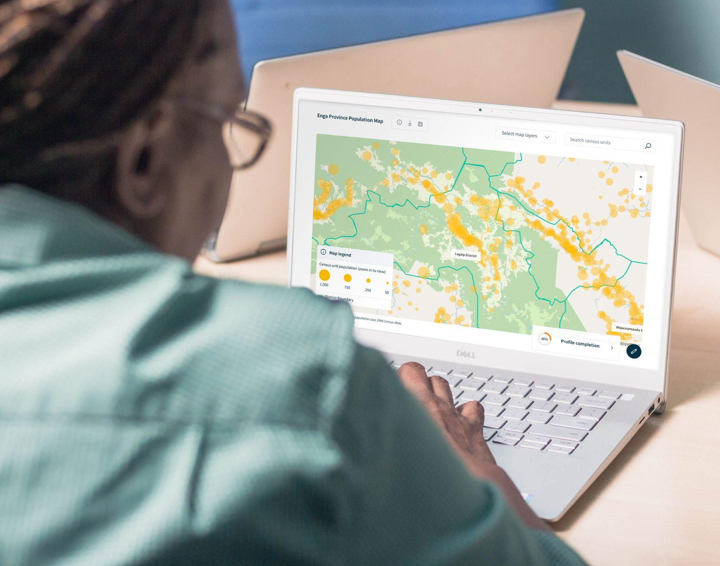





DIRD & Digital Transformation Summit 2024
The Bilum
Digital Platform
Driving Sustainable and Effective Digital Transformation for SIP Funds Management, Reporting, and Accountability

Slide 2
Introduction:
DIRD’s Mandate
DIRD’s Challenge
The Bilum Digital Platform
Alignment with DICTs - Digital Transformation Agenda
Looking forward

Slide 3
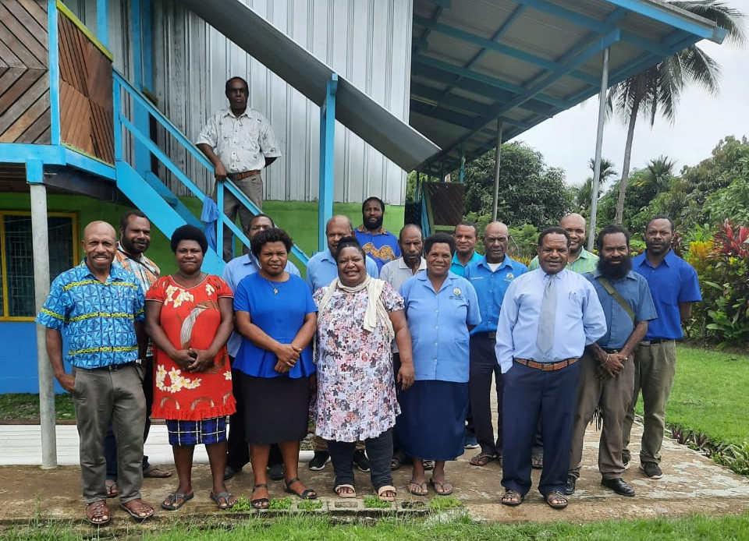
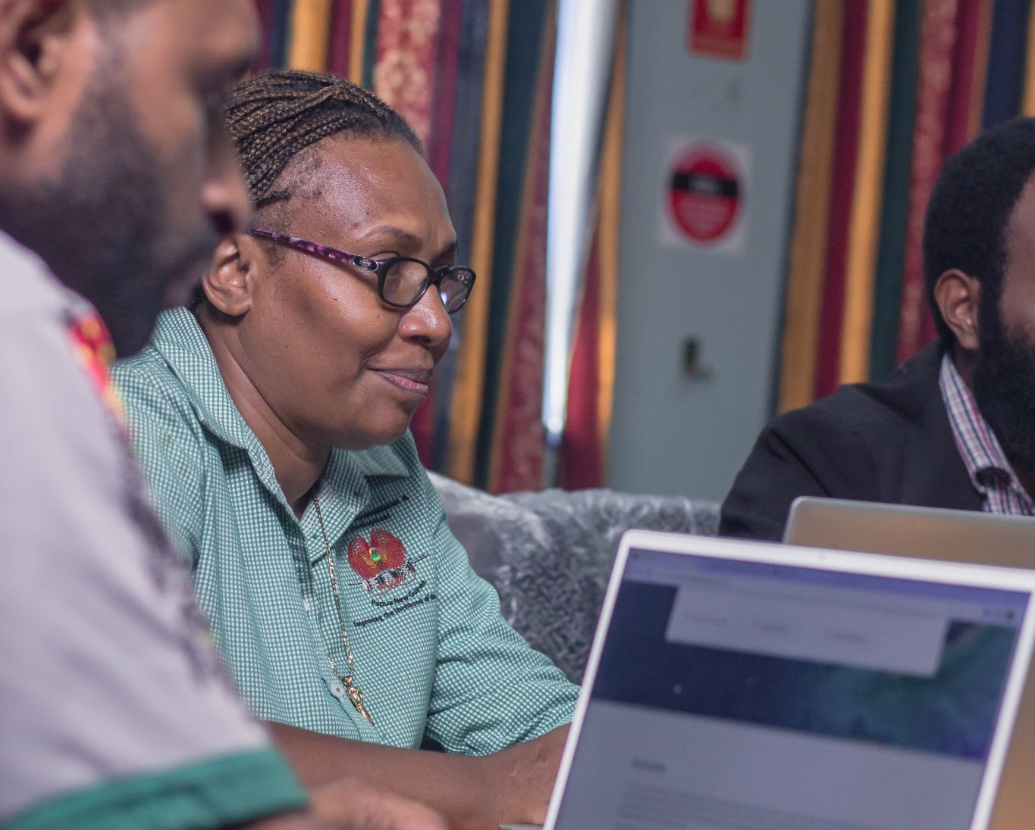
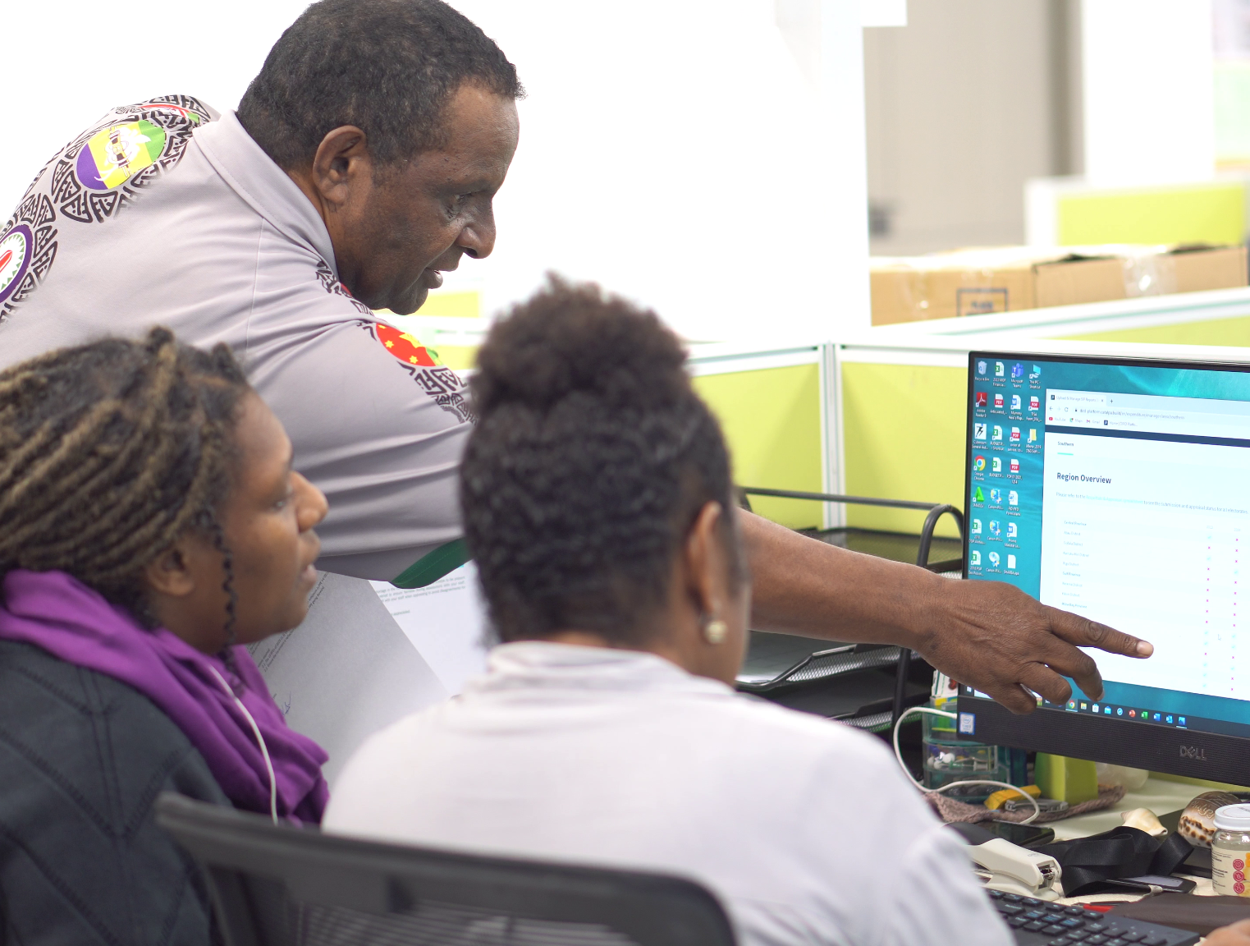
DIRD’s Mandate
DIRD is entrusted with overseeing and managing the Service Improvement Program (SIP), which is a critical mechanism for delivering essential services across Papua New Guinea. Mandate Includes:
Policy and Administrative oversight of SIP funds:
Ensuring alignment with the government’s rural development policies.
Managing stakeholder relationships at both national and sub-national levels.
Administering approximately K1.2 billion annually in SIP and constitutional grants.
Key Responsibilities:
Monitoring and reporting on the utilization and impact of SIP funds across 118 electorates, including 22 provinces and 96 districts.
Implementing systems for effective tracking, reporting, and accountability of SIP fund disbursements and outcomes.

Slide 4
Challenges in
Managing the Service Improvement Program
DIRD is proactively addressing the challenges of outdated, paper-based systems and complex national reporting requirements to enhance the efficiency, effectiveness, and accountability of SIP fund management

Slide 5
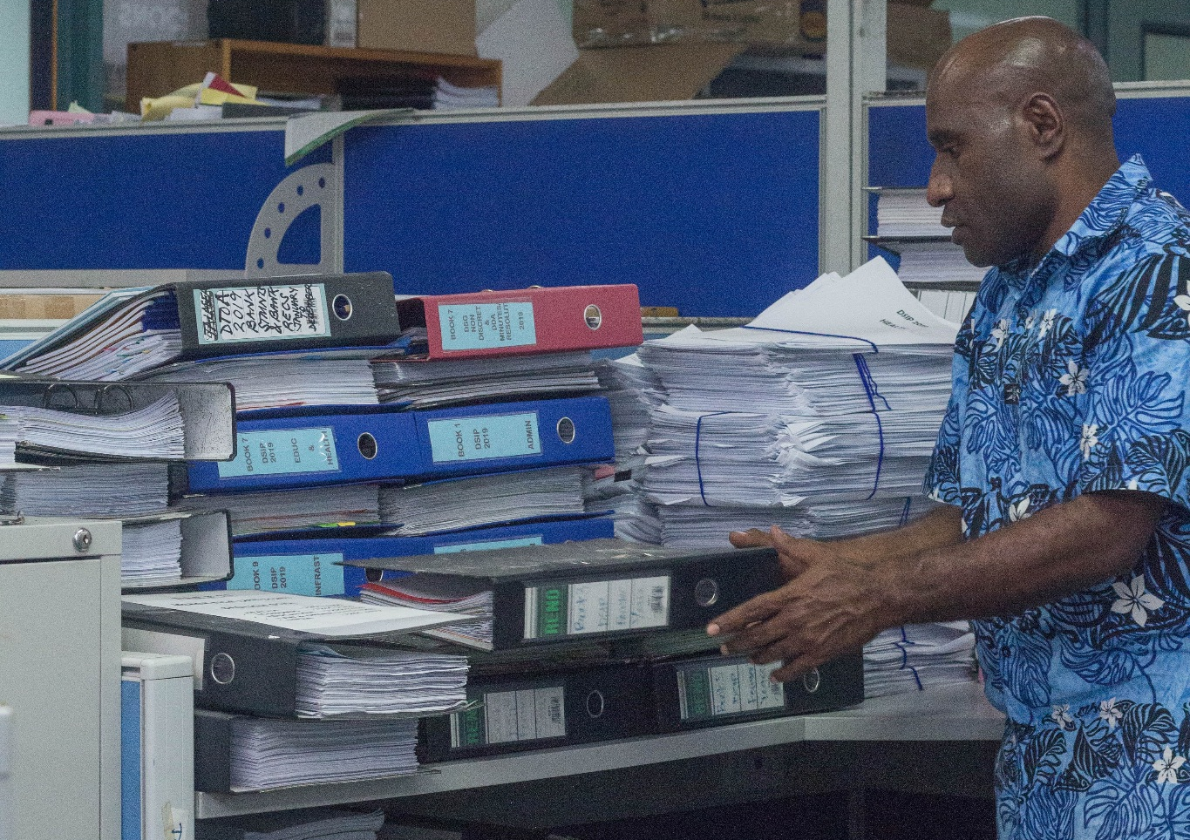
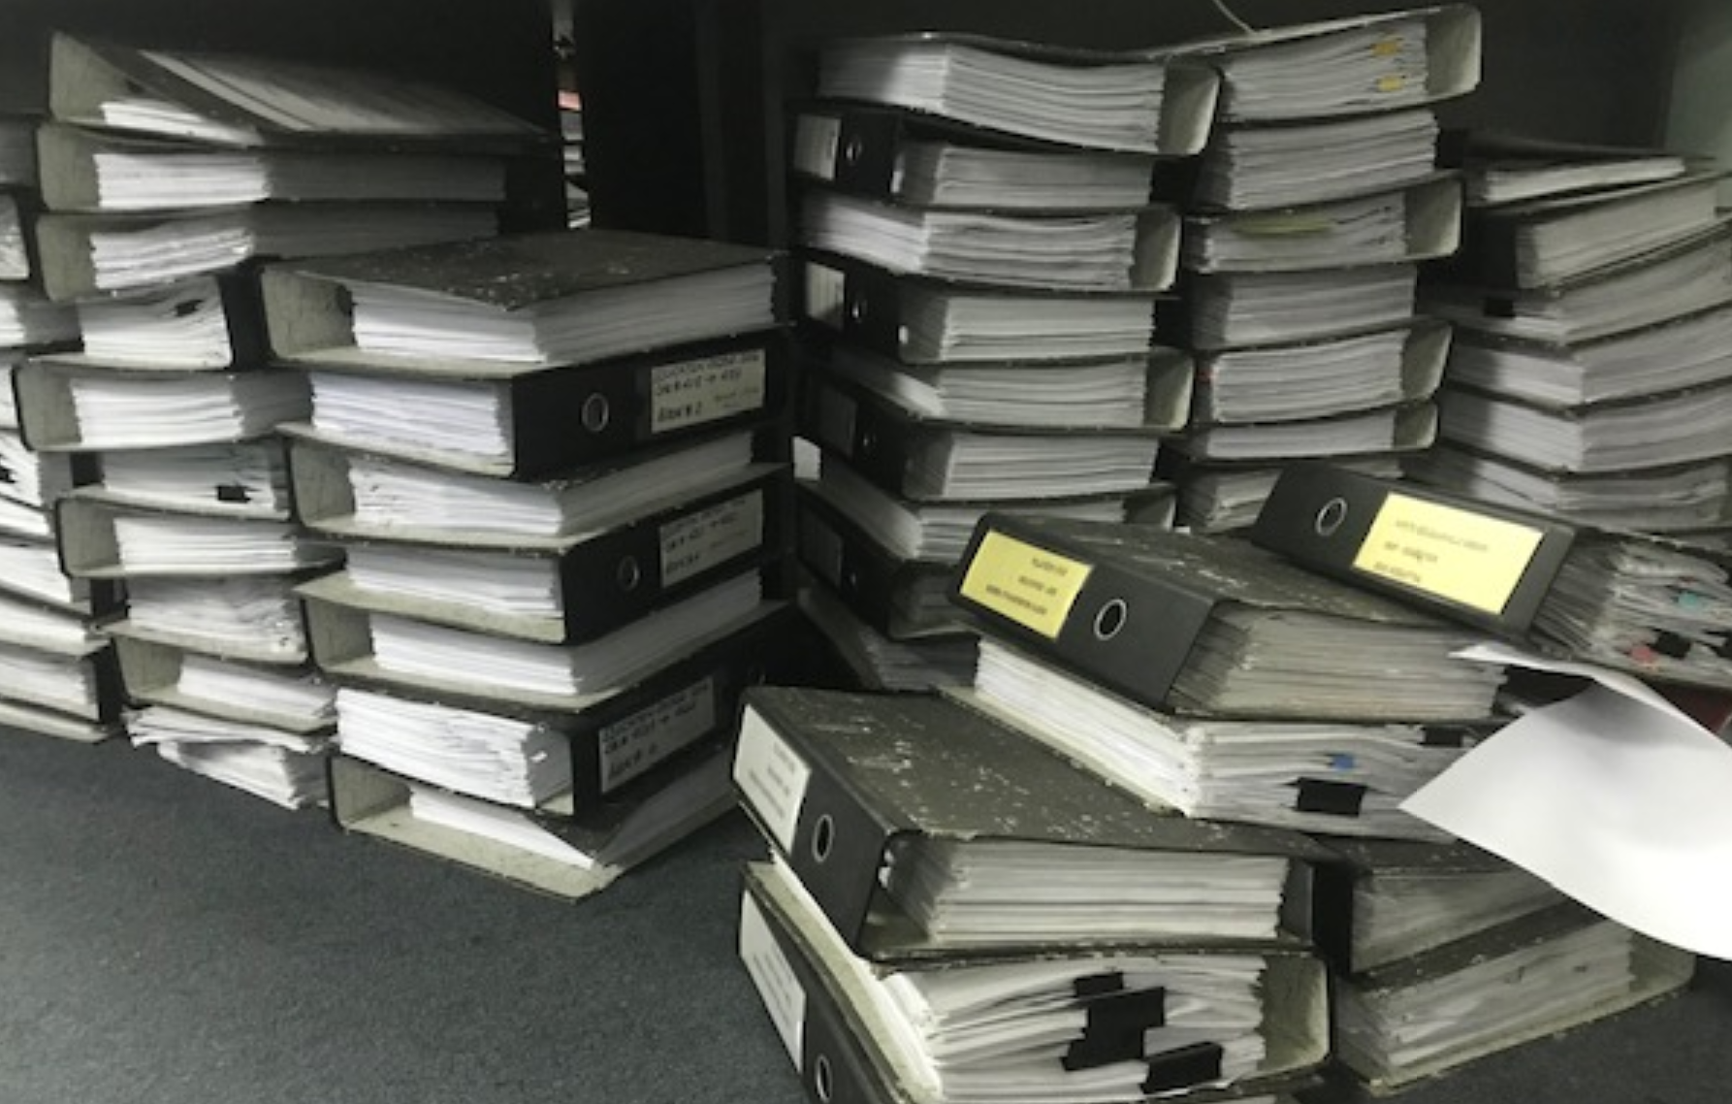
Inefficient Data Management: Outdated, paper-based systems have led to delays, errors, and challenges in tracking funds and outcomes.
High Operational Costs: Manual reporting has resulted in significant expenses, diverting resources from program delivery and impact.
Lack of Reporting Mechanisms: The absence of a digital system for monitoring SIP funds has hindered transparency and accountability.
Complex Stakeholder Coordination: Managing alignment between national and sub-national stakeholders has been difficult due to the lack of integrated data systems.
Limited Oversight Capacity: Without digital tools, DIRD struggled to oversee K1.2 billion annually, leading to gaps in reporting, compliance, and evaluation.
Regulatory Compliance Issues: Ensuring compliance with legislative and financial requirements has been challenging due to fragmented, manual systems.
OUR CHALLENGE
These challenges include

Slide 6

The Bilum
Digital System
INTRODUCTION
Objectives:
Strengthen oversight and coordination of SIP projects.
Support sub-national reporting systems and improve access to information.
Reduce operational costs by eliminating manual, paper-based reporting.
Ensure compliance with SIP Administrative Guidelines and Financial Instructions.
Facilitate equitable rural development through efficient project and data management.
Improve service delivery to citizens by enhancing resource allocation and project accountability.

Slide 7
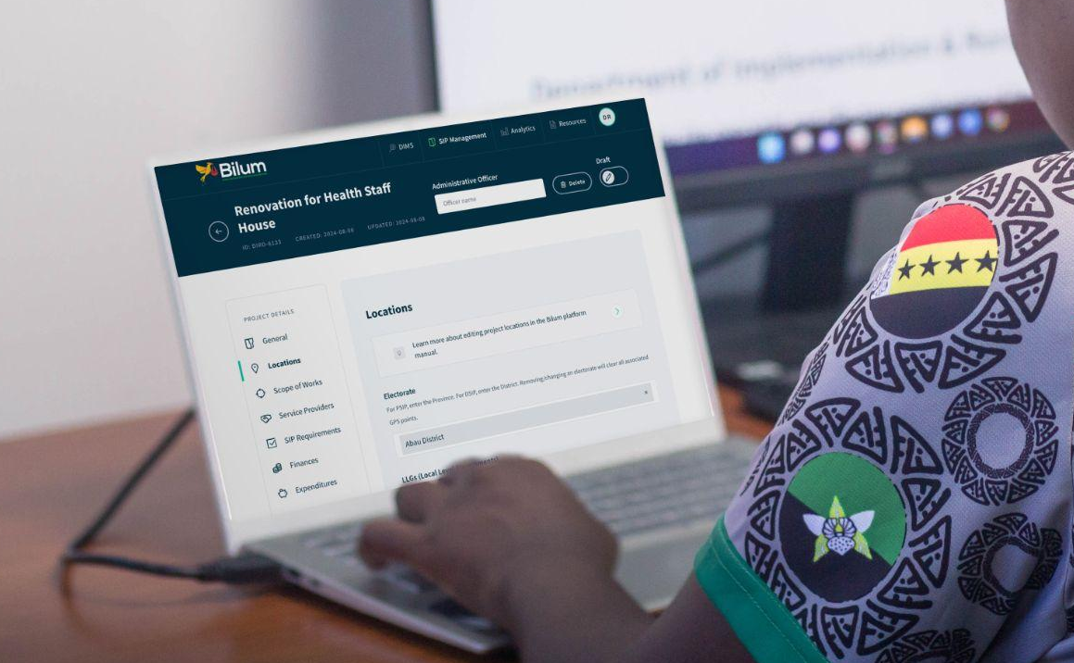

Key Components - SIP & DIMS
A fully digitally integrated MIS - the SIP Management System, and the District Information Management system
Component One: SIP Management
Component Two- DIMS - District information
Strengthening reporting, compliance and oversight of SIP activities
Providing access to high quality information to inform sub-national planning

Slide 8
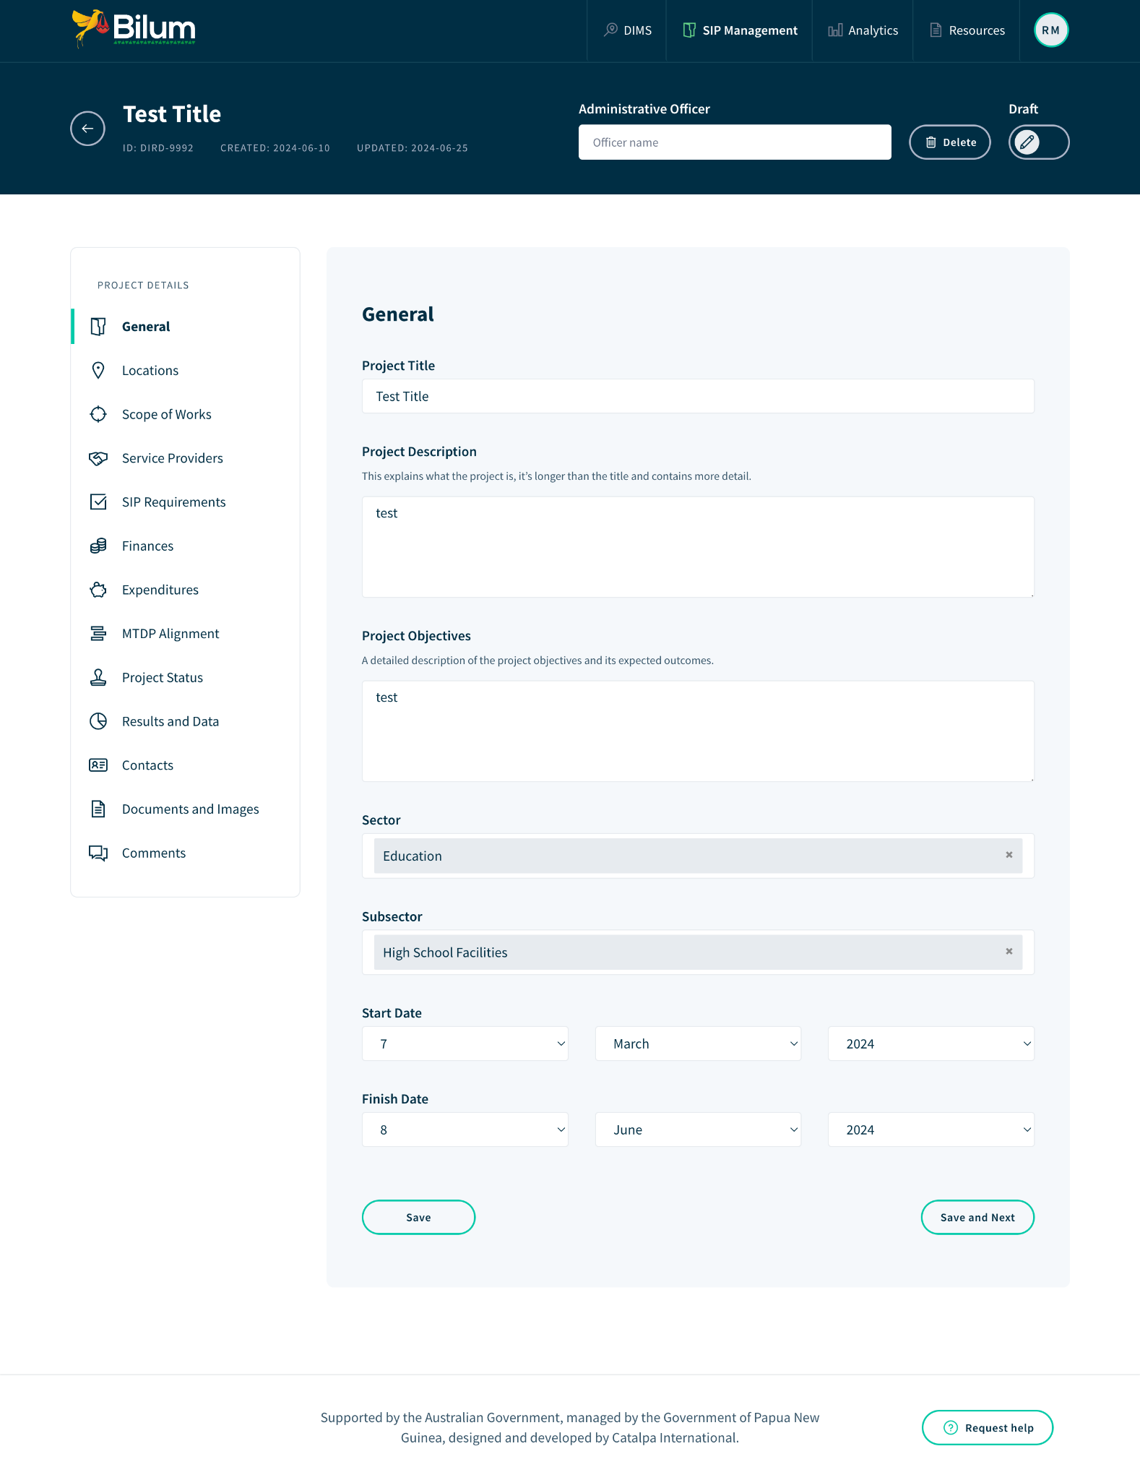
COMPONENT ONE: SIP - Management
Strengthening SIP Management
SIP Reporting:
  Enables direct data input and report submission by districts and provinces,
  Decentralising the reporting process to empower local governments and strengthen DIRD's compliance, quality, and oversight efforts.
Detailed Project Editor:
  Comprehensive entry of project information, including location, scope, finances, and results
  Collaborative tools for edits and comments between DIRD and sub-national partners.
  Tracks alignment of investments to MTDP IV
  Includes per project compliance checks & scores

Slide 9
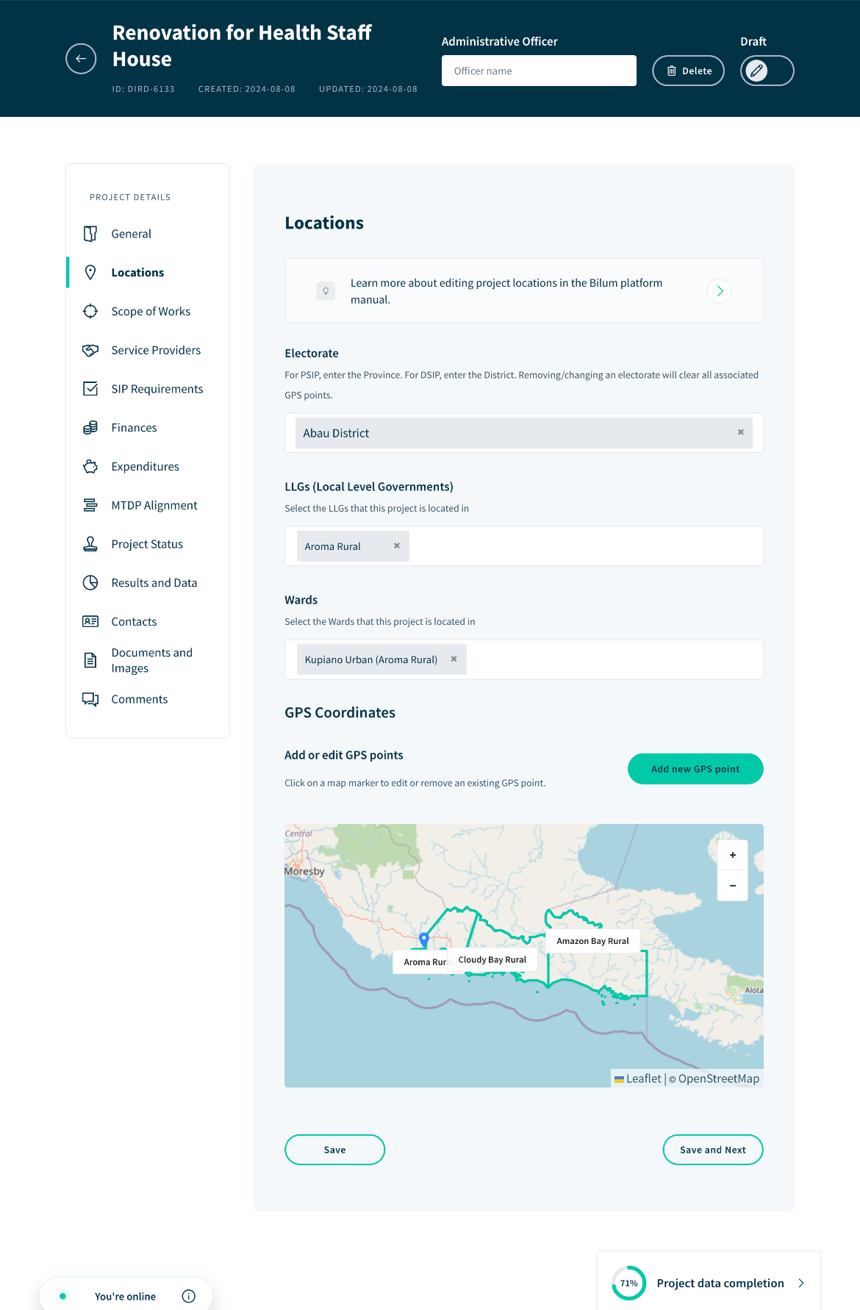
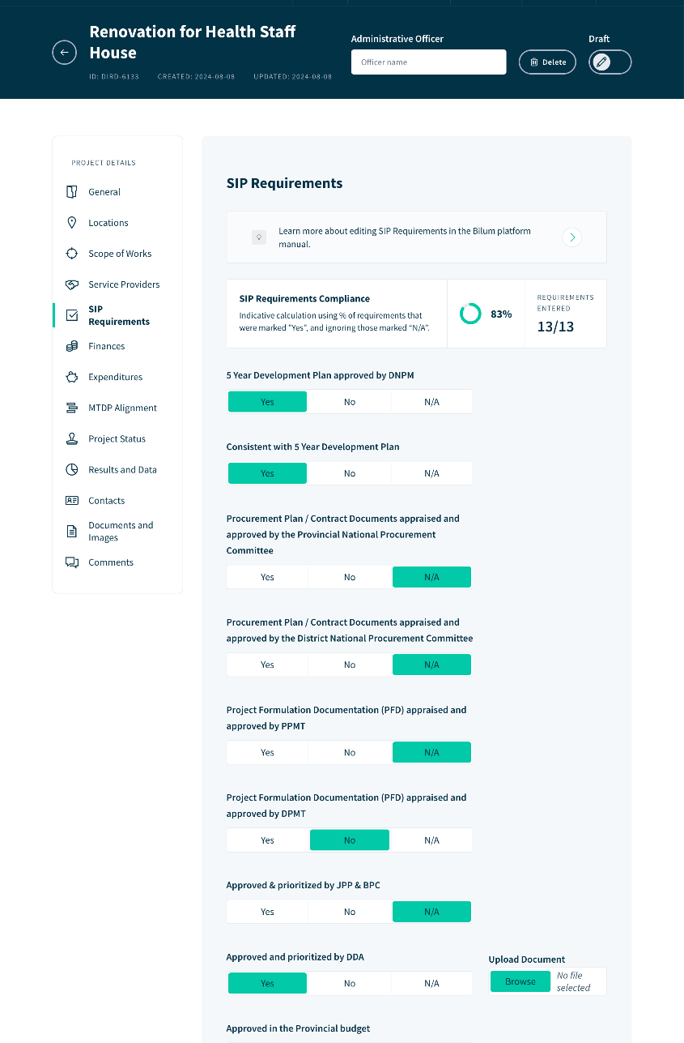
Reporting on project Locations, Scope of Works, Finances, Status, Results & more
SIP Compliance scores - automatically evaluating projects alignments and compliance with regulatory frameworks.

Slide 10
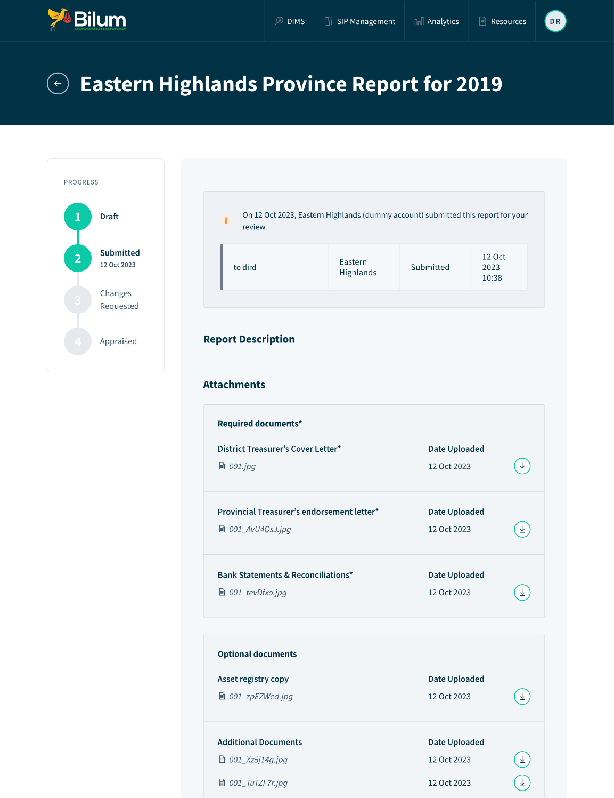
COMPONENT ONE: SIP - Management
Streamlining annual SIP Acquitals
Simplified Report Preparation with Sub-National Reporting:
  Allows districts and provinces to prepare and submit SIP reports directly in the system.
  Streamlines the reporting process, improves accuracy, and empowers local governments to contribute directly.
Integrated Report Review Process:
  Provides DIRD with tools to review and appraise submitted reports, including notifications for approvals or requests for further information.
  Ensures compliance with SIP guidelines, improves report quality.

Slide 11
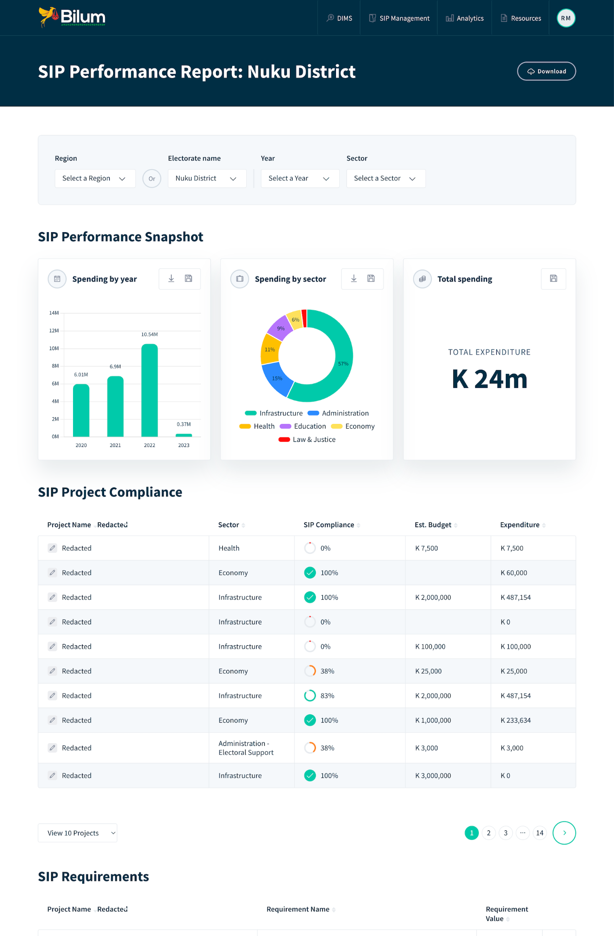
COMPONENT TWO: DIMS - District Information Management
Data informed decision making
Automated Reporting Across Critical Indicators:
Automatically generates reports on key performance indicators, ensuring timely and accurate data.
Provides real-time insights into the progress of SIP-funded projects across districts and provinces.
Empowering Sub-National Partners:
Delivers accessible performance statistics to districts and provinces, enabling them to better understand and manage their projects.
Supports local decision-making by providing valuable data to support their planning needs.
Creating Value for Partners:
Offering tools that help districts and provinces enhance their project outcomes.
Moves beyond a top-down, compliance-driven approach by focusing on practical benefits and on-the-ground impact.

Slide 12
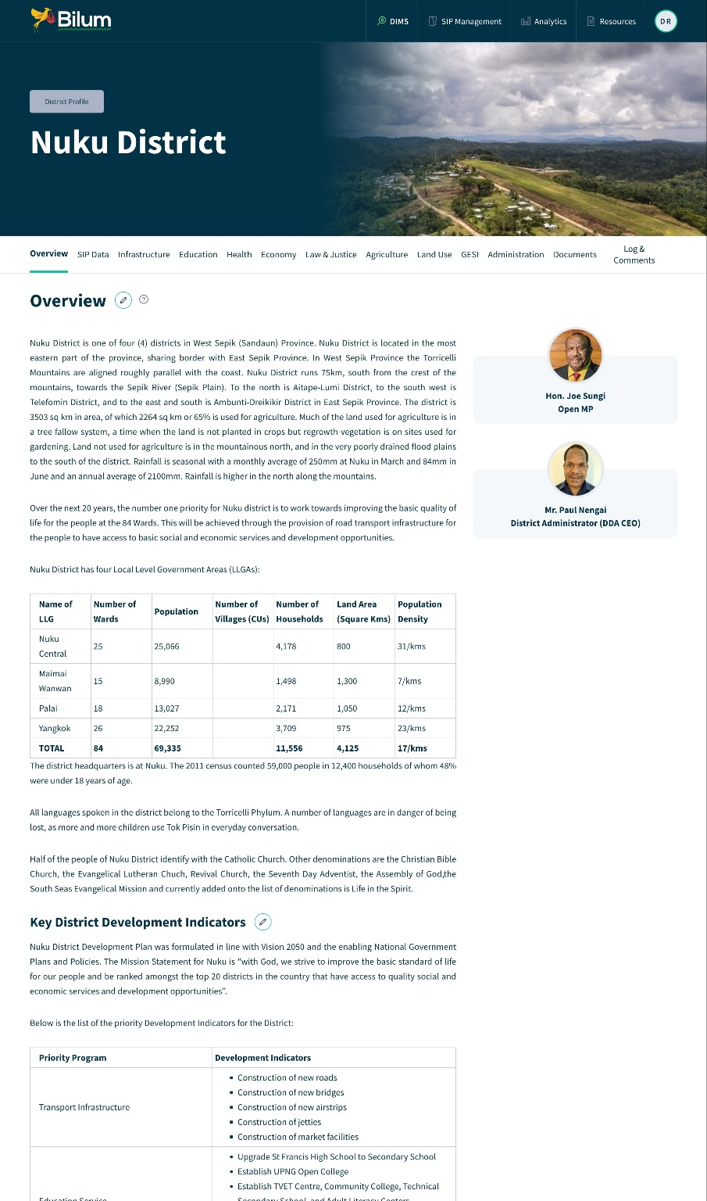
COMPONENT TWO: DIMS - District Information Management
DIMS - Enhancing Data Management and Decision-Making
Centralized Data Repository:
  A centralized platform for collecting, storing, and managing district-level data across various sectors.
  Ensures information is available for decision making, improving resource allocation and planning.
Support for Evidence-Based Planning:
  Integrates data from health, education, infrastructure, and other key areas to support district plans.
  Enhances the ability of local governments to make informed decisions and prioritize investments.
Interoperability with SIPMS:
  Seamlessly integrates with the SIP Management System, allowing for streamlined data flow between project management and broader district data.

Slide 13
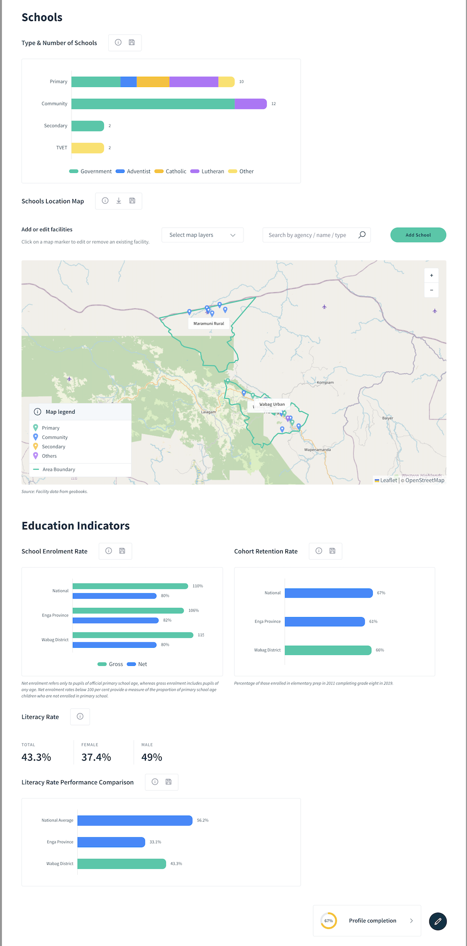
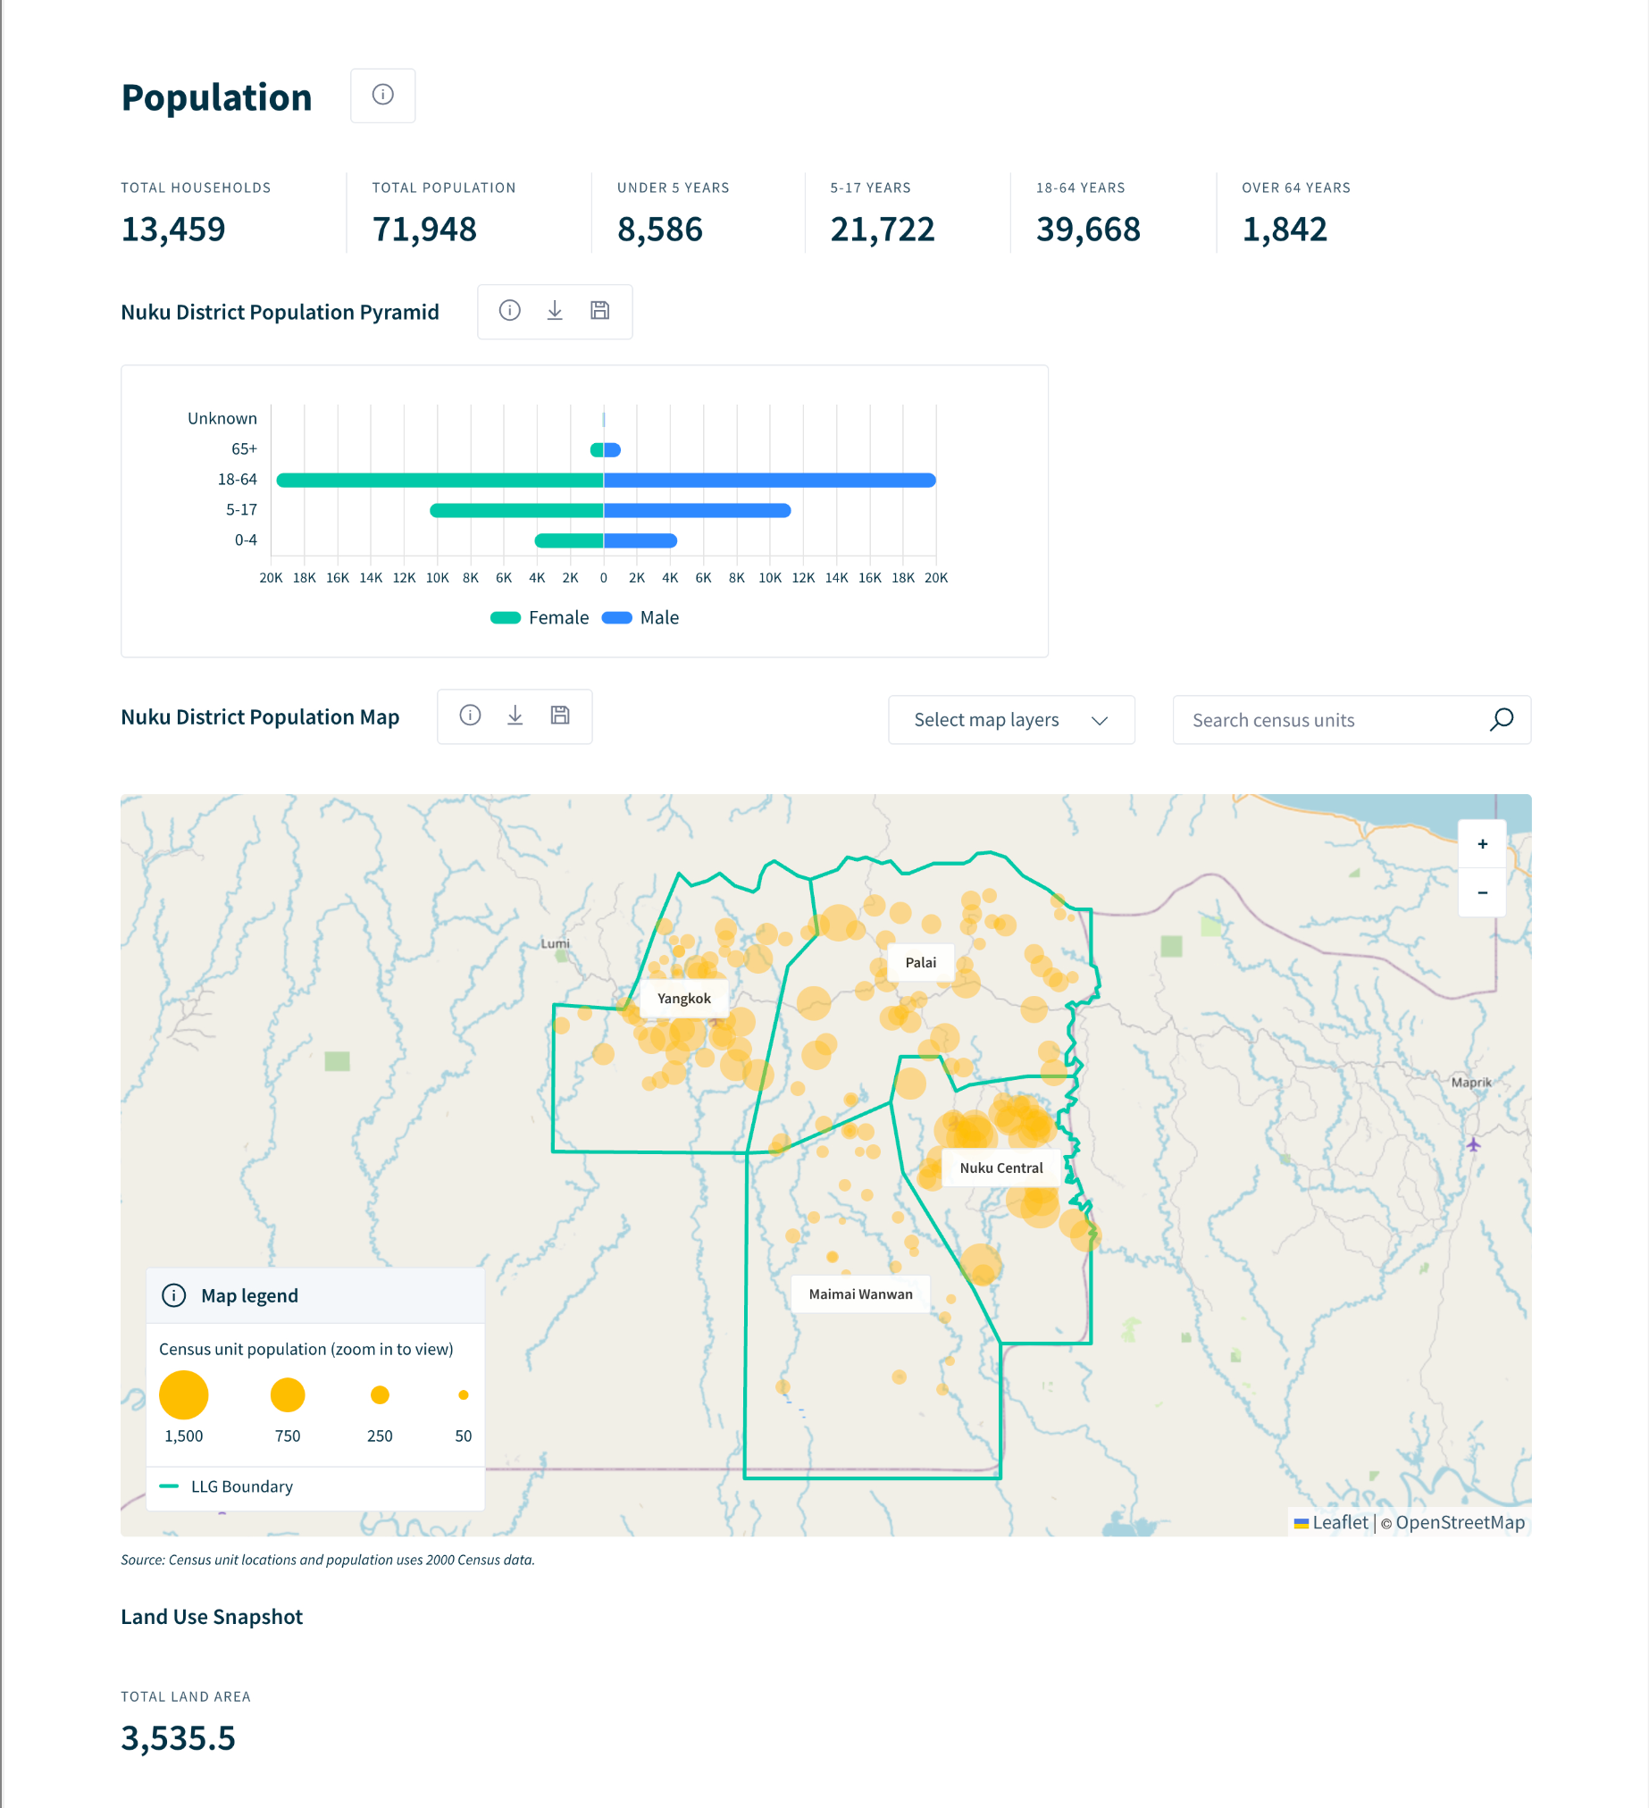

Slide 14
INNOVATION
Utilising AI: Bilum utilises AI to automatically map SIP projects to the objectives of the MTDP IV
Cloud based and works offline: Bilum is a cloud first service and also works offline - ensuring it can work in remote areas with patchy internet & power
Data sharing: Bilum integrates data from DoE, DoH, Census, Districts, Provinces. It serves as a coherent repository of different data sources
Future integration with IFMS: DIRD has initiated talks with DoF on the possibility of integration of IFMS data in Bilum. This would help to make the system more efficient and avoid duplication of reporting on some financial data
Key digital innovations
Notes:
Much of of the data from the Data sharing is publicly available, additionally we have arrangements some data sharing arrangements that is uploaded to Bilum

Slide 15
DIGITAL TRANSFORMATION
Bilum recently switched to a Government domain (S38).
Bilum supports electronic filing of paper records (S42)
Bilum prepares the way for data sharing through the Secure Data Exchange platform (S31).
DIRD as the implementer has appointed a DTO earlier this year (S9)
Bilum has been registered and given an account on the government cloud in first quarter of 2024 (S25(3))
DIRD has submitted Bilum’s application for the CoC last month and currently awaiting 30 day clearance before issuance of CoC by DICT (S15).
Data Governance - Development of Bilum’s Data Governance Framework is a priority and progressing well, after attending the recent Data Governance Workshop organised by DICT in June 2024 (S44).
Alignment with Government policies
Digital Government Act (2022)

Slide 16
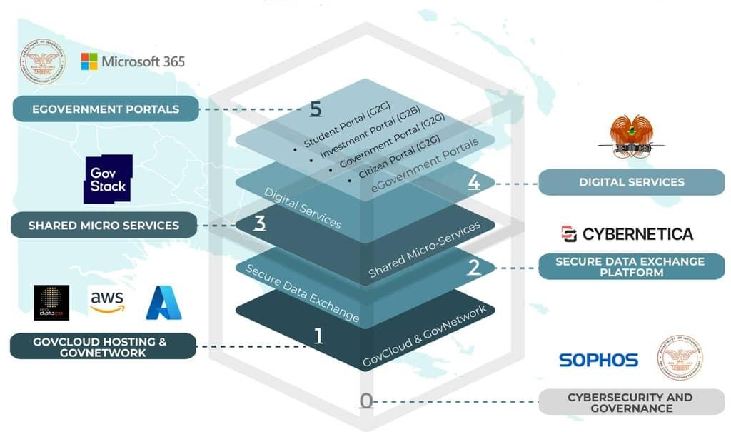
DIGITAL TRANSFORMATION
Bilum and the Government Technology Stack
Layer 1 Data Governance and Cyber Security
Layer 2 Hosting and Communication Infrastructure
Layer 3 Integrated National Information Technology
Notes:
Bilum aligns with 3 of the layers in the Government Technology stack
1) The first layer of the government technology stack is Data Governance and Cyber Security Layer, the Bilum platform alings with this stack as shown from the previous slide with its alignment with Government policy,
Our team attended the Data Governance and Protection workshop facilitated by DICT and we are currently preparing our own Data governance framework which will reflect the learnings and policy shared from that June workshop
importantly also DICT is advising us on how to facilitate a comprehensive Penetration test of the Bilum platform which we hope to conduct over the next few weeks, this is part of our process of application for the certificate of compliance which will go to show the security protections we have in place so that the sensitive data on Bilum is secure.
2) The second layer is the hosting and communications infrastructure and for the DIRD Bilum platform our technical team is working with DICT to migrate to the Gov cloud. And we hope to achieve this over the next few weeks.
3) The 3rd layer of the Government technology stack the Integrated National Information Technology, this is a very important layer for us as we are currently pursuing interoperability with the DoF IFMS system and also looking at interfacing with other government systems as they come online, we believe that DIRD has a unique access to especially sub national data that will have utility for other state agencies and departments.

Slide 17
Looking forward
National rollout
We have established a low cost rollout strategy
60 Sub-national locations have been inducted to Bilum
Target is to rollout in all electorates by 2027
SIP Reporting
All electorates to submit annual SIP Reports using Bilum by 2027.
GovCloud migration
Migration plan for migrating all infrastructure to GovCloud
Data sharing
Target of broad sharing of financial / sectoral data (DoF, DoH, DoE, etc)
Supporting DICT Secure Data Exchange
2024 - 2025

Slide 18
Thanks for your time

