Slide 1




Department of Information And Communications Technology
DIGITAL TRANSFORMATION SUMMIT 2024
Infrastructure and Shared Services Delivery
Government Cloud
1ST – 3RD OCTOBER 2024
Presenter – Lizarhmarie Warike Manager – Infrastructure & Shared Services Delivery (GovCloud)
www.ict.gov.pg
www.ict.gov.pg

Slide 2


OUTLINE
Government Cloud Overview (JOURNEY)
Government Technology Stack – 2024
Government Technology Stack Overview (Stack 1)
Current Onboarding Statistics (Government Body)
Shared Service Deployment Statistics
Current hosting of Solutions Update
Onboarding Process on Government Cloud
www.ict.gov.pg

Slide 3
GOVERNMENT CLOUD OVERVIEW
GOVERNMENT CLOUD JOURNEY
2020
NEC endoses Digital Transformation Policy
2021
Restructure and Rebranding of DICT
2022
Digital Government Act passed by Parliament
2023
2024
NEC endosed Government Cloud Policy DICT established and Build the Government Cloud Platfrom
Onboarding of Government Bodies to the Government Cloud Platform
www.ict.gov.pg

Slide 4
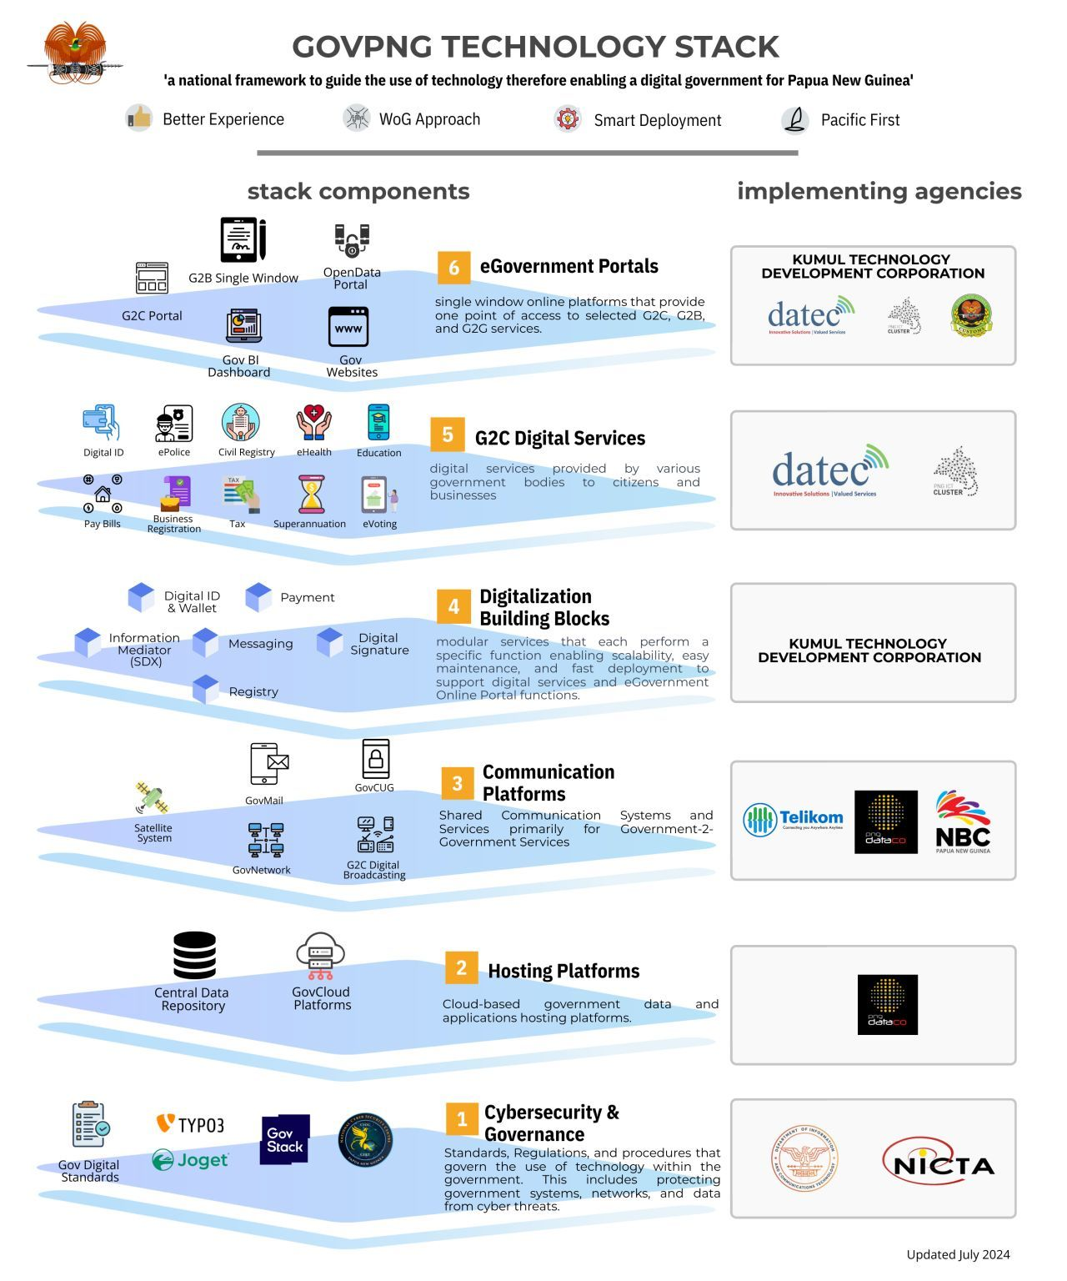
GOVERNMENT TECHNOLOGY STACK
The Government Technology Stack, emphasizes interoperability and efficiency, reducing duplicated investments, and enabling rapid scaling for enhanced government service delivery. The various layers of the Government Technology Stack will be an enabler in implementing digital services​.
​
www.ict.gov.pg

Slide 5

FOUNDATIONAL STACK
Government stack layer 1 Overview
GOVERNMENT CLOUD –- It provides computing resources, such as servers, storage, networking, and software applications, delivered as a service over the internet. It also support the unique needs of government operations, such as handling sensitive data, facilitating collaboration among agencies, and delivering citizen services securely and efficiently. They may also integrate with other government IT systems and services to enable interoperability and seamless data exchange.

Slide 6
CURRENT ONBOARDING STATISTICS
Government Bodies;
National => 46
2) Subnational => 22
3) Provincial Health Authority => 11
4) DDAs/LLGs => 6
Total Onboarded => 85 Government bodies
Notes:
To cut down on duplication of investment by public bodies

Slide 7
CURRRENT STATISTICS FOR SHARED SERVICES DEPLOYMENT
Total number of Licenses issued to Government Bodies for Microsoft 365 = 1700
These licenses were Piloted issued to six (6) Central Government Agencies.
Total number of email created for the whole of government through the aws workmail = 1714
These email users covered 12 national government agencies, 5 Provincial Health Authorities and 5 Provincial Government.
Total of 76 government domains are being redelegated or registered and hosted within the Government Cloud
Total of 93 government websites are hosted within the Government Cloud.
Challenges Faced in Rolling Managed Shared Services whole of Government:
Procurement of bulk M365 license for a government agency with maximum number of users
Support of the managed services when it is being rolled out.
Consolidated Billing on the Government Cloud for the whole of government hosting.
Process of off-setting the Billing of the Government Cloud.
www.ict.gov.pg

Slide 8
CURRENT HOSTING OF SOLUTION UPDATE
NATIONAL STATISTICS OFFICE
SOL: National Census Database,
Single window for Computer Assisted Personal Interviewing.
Application Fully build nationally from both teams from NSO and DICT work in collaboration.
Hosted within the National Statistics Cloud account within the GovCloud Platform.
UNIVERSITY OF TECHNOLOGY
SOL: Learning Management System, open Portal for all digital courses that are offered online for free, run and managed by Unitech.
System built by EU-Streit Program supported by the International Telecommunication Union (ITU)
The System is currently hosted within the Government Cloud and ensures no down time or interruption at all.
DEPARTMENT OF ICT
SOL: E-Government Portal Version 1, single window centric access point for all citizen facing digital services.
Built by internal DICT Devops & Cloud team in working collaboration with the AWS Professional team in Australia.
The Portal is Fully hosted within the Government Cloud and is supported without down time.

Slide 9
ONBOARDING GOVERNMENT CLOUD
Government Cloud – Get onboard !
DEPLOY.
CONTACT US
PLAN
Deploy Service in Production Environment.
Closure Report
Deployed services are transitioned into a Managed Service.
Email : info@ict.gov.pg
onboarding@digital.gov.pg
Website : www.digital.gov.pg.
Plan based on gathered requirements.
Establish Resources and schedules.
GET REQUIREMENTS
BUILD
Setup Initial meeting to gather all requirements.
Determine if request is a Project Support Request or an Operation Request.
Assigned Resources execute Plan.
Test & Verify Solution or Services.

Slide 10
Thank you !

